Slide 1


DISTRIBUTED INFORMATION SYSTEMS
The Pig Experience:
Building High-Level Data flows on top of Map-Reduce
VLDB paper
Source: Javeria Iqbal, Martin Theobald
Alan F. Gates, Olga Natkovich, Shubham Chopra, Pradeep Kamath, Shravan M. Narayanamurthy, Christopher Olston, Benjamin Reed,
Santhosh Srinivasan, Utkarsh Srivastava,
Building a High-Level Dataflow System on top of Map-Reduce: The Pig Experience, VLDB 2009.

Slide 2
Outline
Map-Reduce and the need for Pig Latin
Pig Latin
Compilation into Map-Reduce
Optimization
Future Work

Slide 3
Data Processing Renaissance
Internet companies swimming in data
TBs/day for Yahoo! Or Google!
PBs/day for FaceBook!
Data analysis is “inner loop” of product innovation

Slide 4
Data Warehousing …?
Scale
High level declarative approach
Little control over execution method
Price
Prohibitively expensive at web scale
Up to $200K/TB
SQL
Often not scalable enough

Slide 5
Map-Reduce
Map : Performs filtering
Reduce : Performs the aggregation
These are two high level declarative primitives to enable parallel processing
BUT no complex Database Operations
e.g. Joins

Slide 6
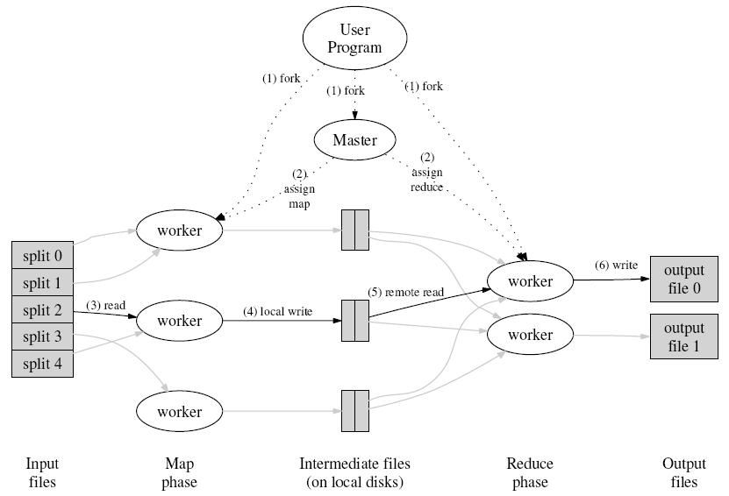
Execution Overview of Map-Reduce
Buffered pairs are written to local disk partitions,
Location of buffered pairs are sent to reduce workers
Worker reads, parses key/value pairs and
passes pairs to user-defined Map function
Split the Program
Master and Worker Threads

Slide 7
Execution Overview of Map-Reduce
Unique keys, values are passed to user’s Reduce function.
Output is appended to the output file for this reduce partition.
Reduce worker sorts data
by the intermediate keys.

Slide 8
The Map-Reduce Appeal
Scalable due to simpler design
Explicit programming model
Only parallelizable operations
Scale
Price
Runs on cheap commodity hardware
Less Administration
SQL
Procedural Control- a processing “pipe”

Slide 9
Disadvantages
1. Extremely rigid data flow
M
R
Other flows hacked in
M
M
R
M
Join, Union
Split
Chains
2. Common operations must be coded by hand
Join, filter, projection, aggregates, sorting, distinct
3. Semantics hidden inside map-reduce functions
Difficult to maintain, extend, and optimize
3. No combined processing of multiple Datasets
Joins and other data processing operations

Slide 10
Motivation
Need a high-level, general data flow language
Inflexible
Lots of hand coding
Scalable
Cheap
Control over execution
Semantics hidden

Slide 11
Enter Pig Latin
Need a high-level, general data flow language
Scalable
Cheap
Control over execution
Pig Latin

Slide 12
Outline
Map-Reduce and the need for Pig Latin
Pig Latin
Compilation into Map-Reduce
Optimization
Future Work

Slide 13
Introduction to Pig Latin
Pig Latin is a dataflow language through which users can write programs in Pig
Pig Latin consists of the following datatypes
Data Atom
Simple atomic data value eg. ‘alice’ or ‘1.0’
Tuple
Data record consisting of a sequence of “fields” (similar to record in SQL) e.g. (alice,lakers) or (alice,kings)
Data Bag
Set of Tuples equivalent to a “table” in SQL terminology e.g. {(alice,lakers), (alice,kings)}
Data Map
A set of key value pairs e.g. [likes#(lakers,kings),age#22]

Slide 14
Pig Latin: Data Types
Type
Example
1. Data Atom
an atomic value
‘alice’
2. Tuple
a record
(alice,lakers)
3. Data Bag
collection supporting scan
(alice,lakers)
(alice,kings)
[
(lakers),
(kings)
]
4. Data Map
collection with key lookup
‘likes’#
‘age’#22

Slide 15
Pig Types
Pig supports the following types in addition to map, bag and tuples
int: 32 bit integer, signed type
long: 64 bit for unsigned type
(alice,25,6L)
float: 32 bit floating point
(alice,25, 5.6f),(alice,25,1.92e2f)
double: 64 bit floating point
(alice,22,1.92),(alice,22,1.92e2)
chararray: set of characters stored in Unicode
(‘alice’, ‘bob’)
bytearray: array of bytes
default type if you do not specify the type of the field

Slide 16
Expressions
a = name of alias/relation which contains types int, tuple and map
note: bag, tuple keywords are optional
a ➔ (f1:int , f2:bag{t:tuple (n1:int, n2:int)}, f3: map[] )
(
)
(2,3),
(4,6)
Sample tuple of a
1,
, [‘yahoo’#‘mail’]
f1or $0
f2 or $1
f3 or $2
Field referred to by position
Field referred to by name
Projection of a data item
(2,3),
(4,6)
(2),
(4)
$1 =
(2,3),
(4,6)
f2 =
f2.$0 =
$0 = 1
Function Application
Map Lookup
SUM(f2.$0) = 6 (2+4)
COUNT(f2) = 2L
f3# ‘yahoo’ = ‘mail’
Notes:
Pig 2.0, result of any arithmetic operation is of the same type as the operand Division or multiplication

Slide 17
Conditions (Boolean Expressions)
a = name of alias which contains types int, tuple and map
a ➔ (f1:int , f2:bag{t:tuple (n1:int, n2:int)}, f3: map[] )
(
)
(2,3),
(4,6)
Sample tuple of a
1,
, [‘yahoo’#‘mail’]
f1or $0
f2 or $1
f3 or $2
==, !=, >, >=, <, <= for numerical comparison
Pig: only f1==1 works as f1 is type integer
eq, neq, gt, gte, lt, lte for string comparisons
f3#‘yahoo’ gt ‘ma’
deprecated, does not force operations to string
matches for regular expression matching
f3#‘yahoo’ matches ‘(?i)MAIL’

Slide 18
Pig Latin Operators and Conditional Expression
a = name of alias which contains types int, tuple and map
a ➔ (f1:int , f2:bag{t:tuple (n1:int, n2:int)}, f3: map[] )
(
)
(2,3),
(4,6)
Sample tuple of a
1,
, [‘yahoo’#‘mail’]
f1or $0
f2 or $1
f3 or $2
Logical Operators
AND, OR, NOT
f1==1 AND f3#‘yahoo’ eq ‘mail’
Conditional Expression (aka BinCond)
(Condition?exp1:exp2)
f3#‘yahoo’matches ‘(?i)MAIL’ ? ‘matched’: ‘notmatched’

Slide 19
Pig Latin: Input/Output Data
Input:
queries = LOAD `query_log.txt'
USING myLoad()
AS (userId, queryString, timestamp);
Output:
STORE query_revenues INTO `myoutput'
USING myStore();

Slide 20
Word count using Pig
wc.txt
program program
pig pig
program pig
hadoop pig latin latin latin latin
Count words in a text file separated by lines and spaces
Basic idea:
Load this file using a loader
Foreach record generate word token
Group by each word
Count number of words in a group
Store to file

Slide 21




Word Count using Pig
myinput = load '/user/viraj/wc.txt' USING TextLoader() as (myword:chararray);
words = FOREACH myinput GENERATE FLATTEN(TOKENIZE(*));
grouped = GROUP words BY $0;
counts = FOREACH grouped GENERATE group, COUNT(words);
store counts into ‘/user/viraj/pigoutput’ using PigStorage();
Write to HDFS /user/viraj/pigoutput/part-* file

Slide 22
Computing average number of page visits by user
user | url | time
Amy | www.cnn.com | 8:00
Amy | www.crap.com | 8:05
Amy | www.myblog.com | 10:00
Amy | www.flickr.com | 10:05
Fred Fred | cnn.com/index.htm cnn.com/index.htm | 12:00 1:00
Visits log
. . .
Logs of user visiting a webpage consists of (user,url,time)
Fields of the log are tab separated and in text format
Basic idea:
Load the log file
Group based on the user field
Count the group
Calculate average for all user

Slide 23


How to program this in Pig Latin
VISITS = load ‘/user/viraj/visits' as (user, url, time);
USER_VISITS = group VISITS by user;
USER_CNTS = foreach USER_VISITS generate group as user, COUNT(VISITS) as numvisits;
ALL_CNTS = group USER_COUNTS all;
AVG_CNT = foreach ALL_CNTS generate AVG(USER_COUNTS.numvisits);
dump visits;

Slide 24
Identify users who visit “Good Pages”
Visits log
Good page
Pages log
user | url | time
Amy | www.cnn.com | 8:00
Amy | www.crap.com | 8:05
Amy | www.myblog.com | 10:00
Amy | www.flickr.com | 10:05
Fred Fred | cnn.com/index.htm cnn.com/index.htm | 12:00 1:00
url | pagerank
www.cnn.com | 0.9
www.flickr.com | 0.9
www.myblog.com | 0.7
www.crap.com | 0.2
. . .
. . .
Good pages are those pages visited by users whose page rank is greater than 0.5
Basic idea
Join tables based on url
Group based on user
Calculate average pagerank of user visited pages
Filter user who has average pagerank greater than 0.5
Store the result

Slide 25
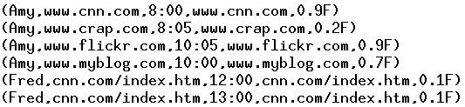
How to Program this in Pig
Load files for processing with appropriate types
VISITS = load ‘/user/viraj/visits.txt' as (user:chararray, url:chararray, time:chararray);
PAGES = load '/user/viraj/pagerank.txt' as (url:chararray, pagerank:float);
VISITS_PAGES = join VISITS by url, PAGES by url;
Join them on url fields of table

Slide 26

How to Program this in Pig
Group by user, in our case Amy, Fred
USER_VISITS = group VISITS_PAGES by user;
USER_AVGPR = foreach USER_VISITS generate group, AVG(VISITS_PAGES.pagerank) as avgpr;
GOOD_USERS = filter USER_AVGPR by avgpr > 0.5f;
store GOOD_USERS into '/user/viraj/goodusers';
Generate an average pagerank per user
Filter records based on pagerank
Store results in hdfs

Slide 27
Pig Latin: FOREACH with Flatten
expanded_queries = FOREACH queries GENERATE userId, expandQuery(queryString);
----------------- expanded_queries = FOREACH queries GENERATE userId, FLATTEN(expandQuery(queryString));

Slide 28
Pig Latin: COGROUP
Getting Related Data Together: COGROUP Suppose we have two data sets result: (queryString, url, position) revenue: (queryString, adSlot, amount) grouped_data = COGROUP result BY queryString, revenue BY queryString;

Slide 29
Pig Latin: COGROUP vs. JOIN

Slide 30
Pig Latin: Other Commands
UNION : Returns the union of two or more bags
CROSS: Returns the cross product
ORDER: Orders a bag by the specified field(s)
DISTINCT: Eliminates duplicate tuple in a bag

Slide 31
Pig Latin: Nested Operations
grouped_revenue = GROUP revenue BY queryString;
query_revenues = FOREACH grouped_revenue {
top_slot = FILTER revenue BY
adSlot eq `top';
GENERATE queryString,
SUM(top_slot.amount),
SUM(revenue.amount);
};

Slide 32
Pig Pen: Screen Shot

Slide 33
Pig Latin: Example 1
Suppose we have a table
urls: (url, category, pagerank)
Simple SQL query that finds,
For each sufficiently large category, the average pagerank of high-pagerank urls in that category
SELECT category, Avg(pagerank)
FROM urls WHERE pagerank > 0.2
GROUP BY category HAVING COUNT(*) > 10⁶

Slide 34

Data Flow
Filter good_urls by pagerank > 0.2
Group by category
Filter category by count > 10⁶
Foreach category
generate avg. pagerank

Slide 35
Equivalent Pig Latin
good_urls = FILTER urls BY pagerank > 0.2;
groups = GROUP good_urls BY category;
big_groups = FILTER groups BY COUNT(good_urls) > 10⁶ ;
output = FOREACH big_groups GENERATE category, AVG(good_urls.pagerank);

Slide 36
Example 2: Data Analysis Task
Find the top 10 most visited pages in each category
Visits
Url Info
User | Url | Time
Amy | cnn.com | 8:00
Amy | bbc.com | 10:00
Amy | flickr.com | 10:05
Fred | cnn.com | 12:00
Url | Category | PageRank
cnn.com | News | 0.9
bbc.com | News | 0.8
flickr.com | Photos | 0.7
espn.com | Sports | 0.9

Slide 37
Data Flow
Load Visits
Group by url
Foreach url
generate count
Load Url Info
Join on url
Group by category
Foreach category
generate top10 urls

Slide 38
Equivalent Pig Latin
visits = load ‘/data/visits’ as (user, url, time);
gVisits = group visits by url;
visitCounts = foreach gVisits generate url, count(visits);
urlInfo = load ‘/data/urlInfo’ as (url, category, pRank);
visitCounts = join visitCounts by url, urlInfo by url;
gCategories = group visitCounts by category;
topUrls = foreach gCategories generate top(visitCounts,10);
store topUrls into ‘/data/topUrls’;

Slide 39
Quick Start and Interoperability
visits = load ‘/data/visits’ as (user, url, time);
gVisits = group visits by url;
visitCounts = foreach gVisits generate url, count(urlVisits);
urlInfo = load ‘/data/urlInfo’ as (url, category, pRank);
visitCounts = join visitCounts by url, urlInfo by url;
gCategories = group visitCounts by category;
topUrls = foreach gCategories generate top(visitCounts,10);
store topUrls into ‘/data/topUrls’;
Operates directly over files

Slide 40
Quick Start and Interoperability
visits = load ‘/data/visits’ as (user, url, time);
gVisits = group visits by url;
visitCounts = foreach gVisits generate url, count(urlVisits);
urlInfo = load ‘/data/urlInfo’ as (url, category, pRank);
visitCounts = join visitCounts by url, urlInfo by url;
gCategories = group visitCounts by category;
topUrls = foreach gCategories generate top(visitCounts,10);
store topUrls into ‘/data/topUrls’;
Schemas optional;
Can be assigned dynamically

Slide 41
User-Code as a First-Class Citizen
visits = load ‘/data/visits’ as (user, url, time);
gVisits = group visits by url;
visitCounts = foreach gVisits generate url, count(urlVisits);
urlInfo = load ‘/data/urlInfo’ as (url, category, pRank);
visitCounts = join visitCounts by url, urlInfo by url;
gCategories = group visitCounts by category;
topUrls = foreach gCategories generate top(visitCounts,10);
store topUrls into ‘/data/topUrls’;
User-defined functions (UDFs) can be used in every construct
Load, Store
Group, Filter, Foreach

Slide 42
Nested Data Model
Pig Latin has a fully nested data model with:
Atomic values, tuples, bags (lists), and maps
Avoids expensive joins
finance
yahoo ,
email
news

Slide 43
Nested Data Model
Decouples grouping as an independent operation
User | Url | Time
Amy | cnn.com | 8:00
Amy | bbc.com | 10:00
Amy | bbc.com | 10:05
Fred | cnn.com | 12:00
group | Visits
cnn.com | Amy | cnn.com | 8:00
 | Fred | cnn.com | 12:00
bbc.com | Amy | bbc.com | 10:00
 | Amy | bbc.com | 10:05
group by url
Common case: aggregation on these nested sets
Power users: sophisticated UDFs, e.g., sequence analysis
Efficient Implementation (see paper)
I frankly like pig much better than SQL in some respects (group + optional ﬂatten), I love nested data structures).”
Ted Dunning
Chief Scientist, Veoh
43

Slide 44
CoGroup
results
revenue
query | url | rank
Lakers | nba.com | 1
Lakers | espn.com | 2
Kings | nhl.com | 1
Kings | nba.com | 2
query | adSlot | amount
Lakers | top | 50
Lakers | side | 20
Kings | top | 30
Kings | side | 10
group | results |  |  | revenue
Lakers | Lakers | nba.com | 1 | Lakers | top | 50
 | Lakers | espn.com | 2 | Lakers | side | 20
Kings | Kings | nhl.com | 1 | Kings | top | 30
 | Kings | nba.com | 2 | Kings | side | 10
Cross-product of the 2 bags would give natural join

Slide 45
Pig Features
Explicit Data Flow Language unlike SQL
Low Level Procedural Language unlike Map-Reduce
Quick Start & Interoperability
Mode (Interactive Mode, Batch, Embedded)
User Defined Functions
Nested Data Model

Slide 46
Outline
Map-Reduce and the need for Pig Latin
Pig Latin
Compilation into Map-Reduce
Optimization
Future Work

Slide 47
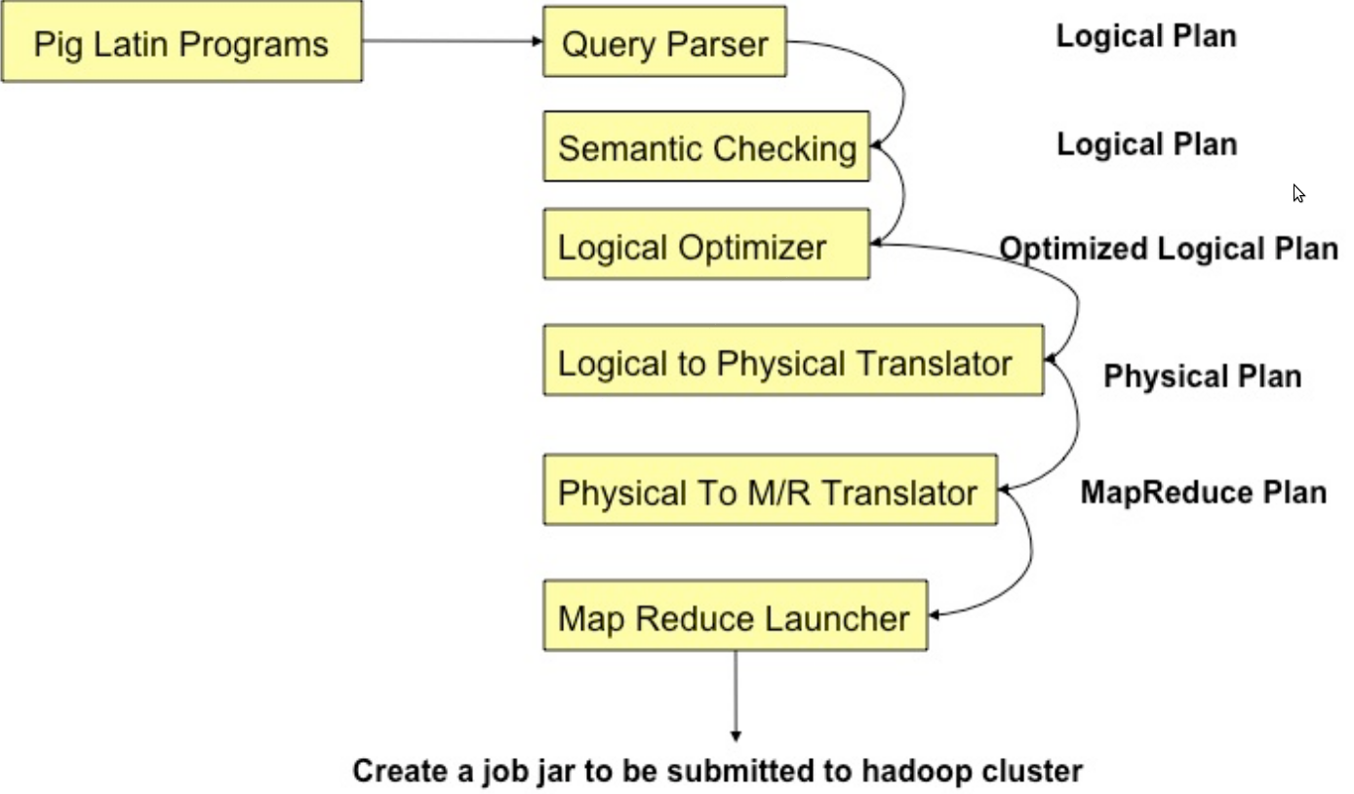
Compilation

Slide 48
Parsing
Type checking with schema
References verifying
Logic plan generating
One-to-one fashion
Independent of execution platform
Limited optimization

Slide 49
Logical Plan
Consists of DAG of Logical Operators as nodes and Data Flow represented as edges
Logical Operators contain list of i/p’s o/p’s and schema
Logical operators
Aid in post parse stage checking (type checking)
Optimization
Translation to Physical Plan
Load
Proj(0)
Filter
>
a = load ‘myfile’;
b = filter a by $0 > 5;
store b into ‘myfilteredfile’;
Store
Const(5)
Notes:
All logical operators extend LogicalOperator class, these include: LOLoad, LOStore, LOForEach, LOGenerate, LOFilter, LOCogroup, LOSort, ExpresssionOperator
ExpressionOperators: Binary, Unary, LOBinCond, LOUserFunc, LOParend, LOCast
BinayExpressionOperators: LOAnd, LOOr, LOSubtract etc..

Slide 50
Physical Plan
Layer to map Logical Plan to multiple back-ends, one such being M/R (Map Reduce)
Chance for code re-use if multiple back-ends share same operator
Consists of operators which pig will run on the backend
Currently most of the physical plan is placed as operators in the map reduce plan
Logical to Physical Translation
1:1 correspondence for most Logical operators
Except Cross, Distinct, Group, Co-group and Order

Slide 51
Logic Plan
LOAD
A=LOAD 'file1' AS (x, y, z);
B=LOAD 'file2' AS (t, u, v);
C=FILTER A by y > 0;
D=JOIN C BY x, B BY u;
E=GROUP D BY z;
F=FOREACH E GENERATE group, COUNT(D);
STORE F INTO 'output';
LOAD
FILTER
JOIN
GROUP
FOREACH
STORE

Slide 52
Physical Plan
1:1 correspondence with most logical operators
Except for:
DISTINCT
(CO)GROUP
JOIN
ORDER

Slide 53
Logical to Physical Plan for Group operator
Logical operator for co-group/group is converted to 3 Physical operators
Local Rearrange (LR)
Global Rearrange (GR)
Package (PKG)
Example:
Co-group A by Acol1, B by Bcol1
{1,{(1,R)¹}, {(1,B)²}}
{2,{(2,G)¹}, {(2,Y)²}}
PKG
{1,{(1,R)¹, (1,B)²}}
{2,{(2,Y)², (2,G)¹}}
GR
{Key,{ListofValues}}
{1,(1,R)}¹
{2,(2,G)}¹
{ 1,(1,B)}²
{2,(2,Y)}²
{Key,(Value)}^{(table no)}
LR
LR
A
B
Tuples
(1,R)
(2,G)
(1,B)
(2,Y)
Acol1
Bcol1

Slide 54
Map Reduce Plan
Physical to Map Reduce (M/R) Plan conversion happens through the MRCompiler
Converts a physical plan into a DAG of M/R operators
Boundaries for M/R include cogroup/group, distinct, cross, order by, limit (in some cases)
Push all subsequent operators between cogroup to next cogroup into reduce
order by is implemented as 2 M/R jobs
JobControlCompiler then uses the M/R plan to construct a JobControl object
map₁
reduce₁
map_{i}
reduce_{i}
load
filter
group
cogroup
cogroup
C₁
C_{i}
C_{i+1}

Slide 55
LOAD
LOAD
FILTER
LOAD
LOCAL REARRANGE
LOAD
GLOBAL REARRANGE
FILTER
PACKAGE
JOIN
FOREACH
LOCAL REARRANGE
GROUP
GLOBAL REARRANGE
FOREACH
PACKAGE
FOREACH
STORE
STORE

Slide 56
MapReduce Plan
Determine MapReduce boundaries
GLOBAL REARRANGE
Some operations are done by MapReduce framework
Coalesce other operators into Map & Reduce stages
Generate job jar file

Slide 57
LOAD
FILTER
LOAD
Map
FILTER
LOCAL REARRANGE
LOCAL REARRANGE
GLOBAL REARRANGE
Reduce
PACKAGE
PACKAGE
FOREACH
FOREACH
LOCAL REARRANGE
Map
LOCAL REARRANGE
GLOBAL REARRANGE
PACKAGE
FOREACH
Reduce
PACKAGE
STORE
FOREACH

Slide 58
Pig Latin to Physical Plan
A = LOAD ‘file1’ AS (x,y,z);
B = LOAD ‘file2’ AS (t,u,v);
C = FILTER A by y > 0;
D = JOIN C by x,B by u;
E = GROUP D by z;
F = FOREACH E generate group, COUNT(D);
STORE F into ‘output’;
LOAD
LOAD
FILTER
JOIN
x,y,z
x,y,z,t,u,v
GROUP
FOREACH
group , count
STORE

Slide 59
Logical Plan to Physical Plan
3
1
LOAD
1
LOAD
3
LOAD
LOAD
FILTER
2
2
4
FILTER
JOIN
LOCAL REARRANGE
GLOABL REARRANGE
4
PACKAGE
4
5
4
GROUP
4
FOREACH
6
FOREACH
LOCAL REARRANGE
GLOBAL REARRANGE
5
PACKAGE
5
7
5
STORE
FOREACH
6
STORE
7

Slide 60
Physical Plan to Map-Reduce Plan
1
LOAD
LOAD
3
Filter
2
FILTER
Local Rearrange
LOCAL REARRANGE
GLOABL REARRANGE
Package
4
PACKAGE
4
4
Foreach
4
FOREACH
LOCAL REARRANGE
GLOBAL REARRANGE
Local Rearrange
5
PACKAGE
5
5
Package
FOREACH
6
STORE
Foreach
7

Slide 61
Compilation into Map-Reduce
Map₁
Every group or join operation forms a map-reduce boundary
Load Visits
Group by url
Reduce₁
Map₂
Foreach url
generate count
Load Url Info
Join on url
Reduce₂
Map₃
Other operations pipelined into map and reduce phases
Group by category
Reduce₃
Foreach category
generate top10(urls)

Slide 62
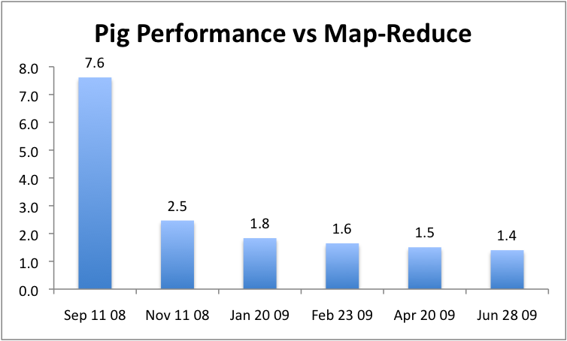
Performance

Slide 63


Strong & Weak Points
+++
The step-by-step method of creating a program in Pig is much cleaner and simpler to use than the single block method of SQL. It is easier to keep track of what your variables are, and where you are in the process of analyzing your data.
Explicit Dataflow
Retains Properties of Map-Reduce
Scalability
Fault Tolerance
Multi Way Processing
Open Source
Column wise Storage structures are missing
Memory Management
No facilitation for Non Java Users
Limited Optimization
No GUI for Flow Graphs
Jasmine Novak
Engineer, Yahoo!
With the various interleaved clauses in SQL
It is difficult to know what is actually happening sequentially.
David Ciemiewicz
Search Excellence, Yahoo!

