Slide 1
Machine Learning with OpenCV
VIDEO ANALYTICS
CS 6327
Spring 2018
Instructor: B. Prabhakaran
TA: Kevin Desai (Kevin.Desai@utdallas.edu)

Slide 2
What is machine learning?
UTD
 How do ‘we’ learn?
 Machine learning is the way to teach computer the ability to ‘learn from experience’
 Machine learning algorithm uses computational methods to ‘learn’ information directly from the data
 It finds natural pattern in data providing the insight and help to make better
decisions
 The performance increases as the number of samples for learning increases

Slide 3
 Machine Learning Techniques
UTD
Unsupervised
Learning
Interpret and analyze data solely based on the data
Finds hidden patterns or structure in the input data
Clustering
Machine Learning
Predicts discrete labels. For example, if the email is spam or not
Supervised Learning
Develop predictive model based on both input and output data
Classification
Predicts continuous labels. For example, changes in stock market, temperature
Regression

Slide 4
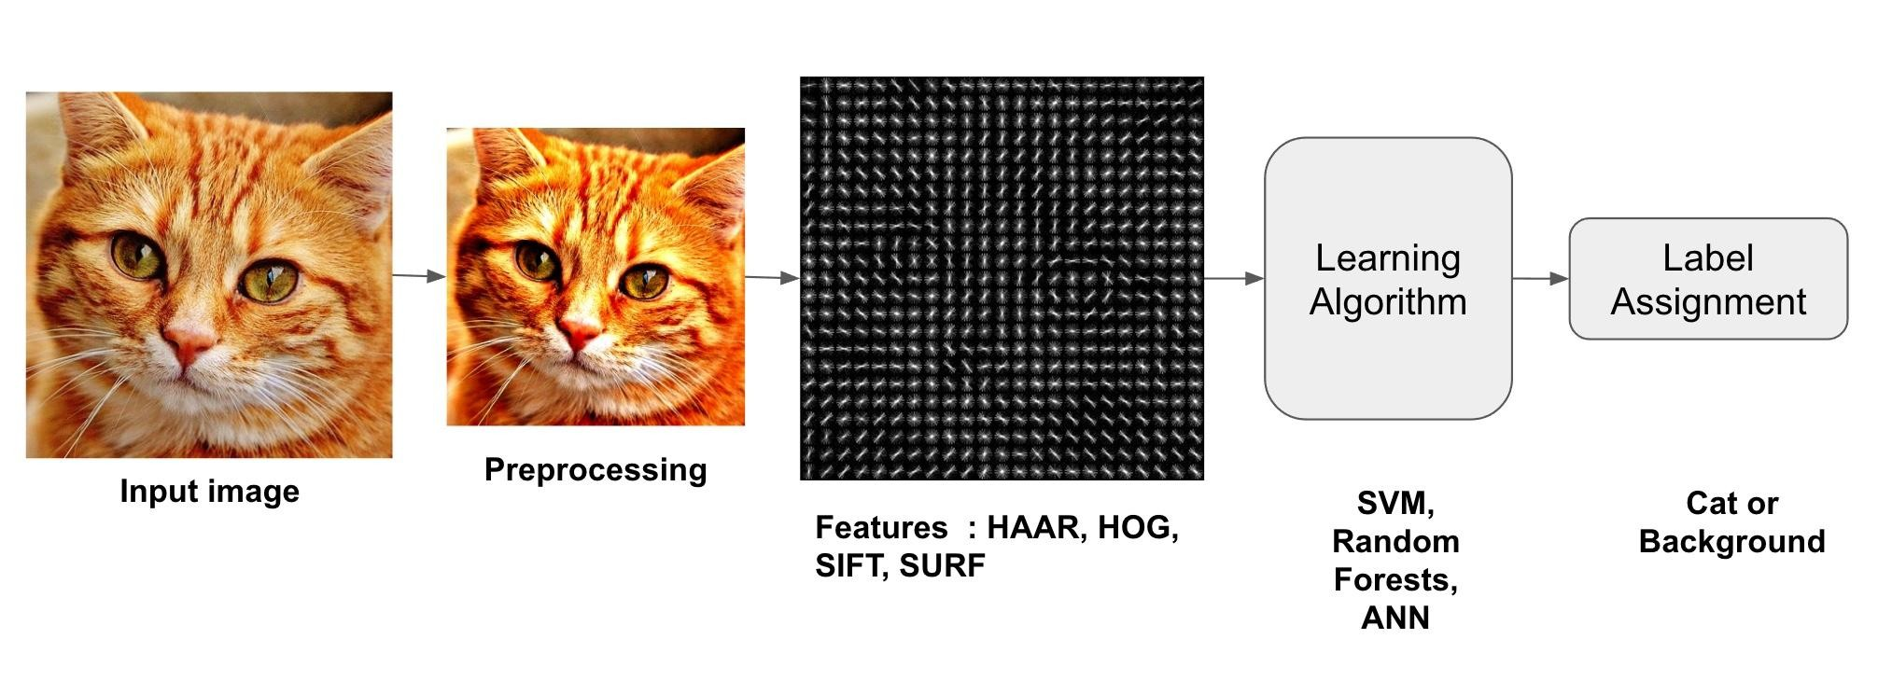
Image Classification
UTD
 Input: Image
 Output: Label describing what is in the image
To normalize brightness effect and contrast
Simplify the data by extracting important information
Train the algorithm using various positive and negative examples
Credit: http://www.learnopencv.com/image-recognition-and-object-detection-part1/

Slide 5
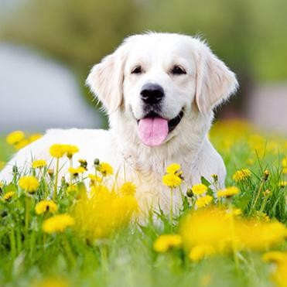
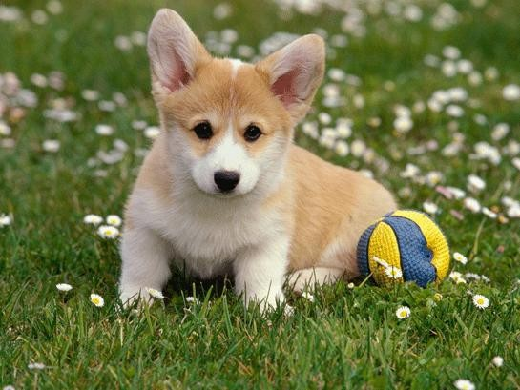
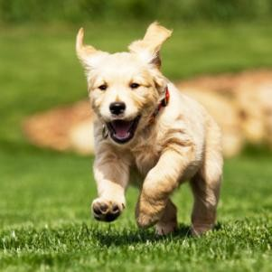
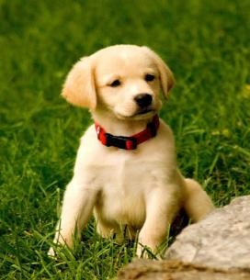
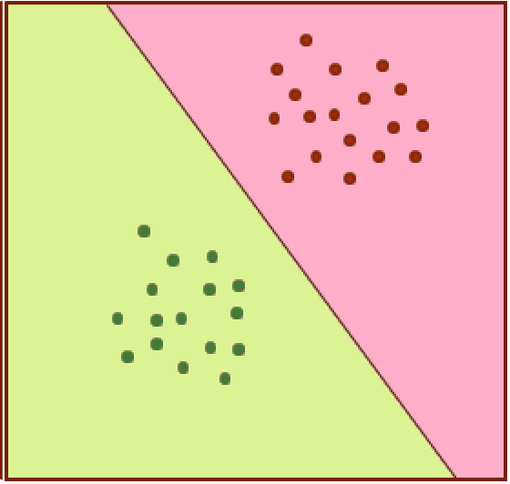




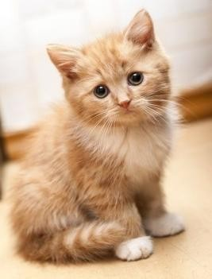







Image Classification
UTD

Slide 6
UTD
 Links for Machine Learning in OpenCV
 http://docs.opencv.org/3.1.0/dc/dd6/ml_intro.html
 http://docs.opencv.org/2.4/doc/tutorials/ml/introduction_to_svm/introducti on_to_svm.html#introductiontosvms
 http://www.learnopencv.com/image-recognition-and-object-detection- part1/

Slide 7
Demo
UTD

