Slide 1
Image Formation and Filters
B. (Prabha) Prabhakaran
Department of Computer Science
bprabhakaran@utdallas.edu
www.utdallas.edu/~praba

Slide 2
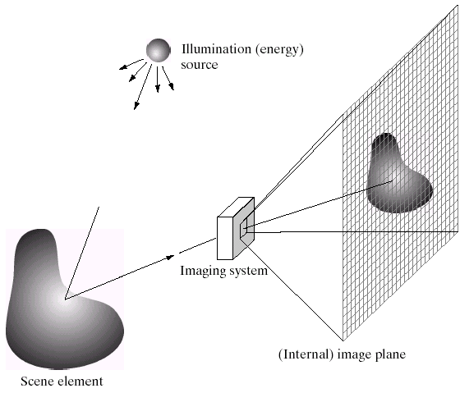
Image Formation
Slide credit: Derek Hoiem

Slide 3
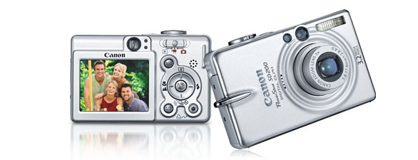
Digital camera
A digital camera replaces film with a sensor array
Each cell in the array is light-sensitive diode that converts photons to electrons
http://electronics.howstuffworks.com/digital-camera.htm
Slide by Steve Seitz

Slide 4
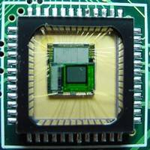
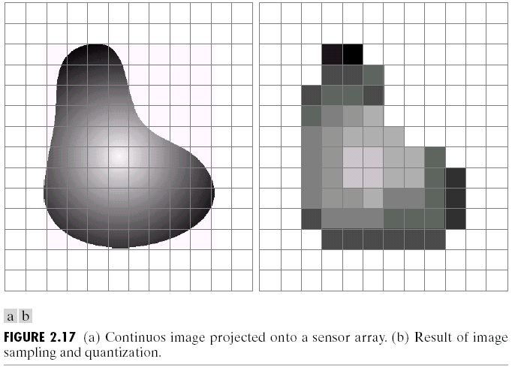
Digital images
Slide credit: Derek Hoiem

Slide 5

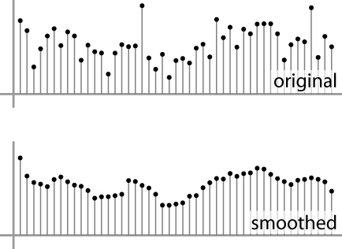
Digital images
Sample the 2D space on a regular grid
Quantize each sample (round to nearest integer)
Image thus represented as a matrix of integer values.
2D
1D
Adapted from S. Seitz

Slide 6
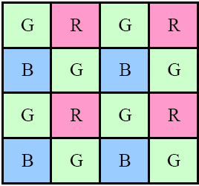
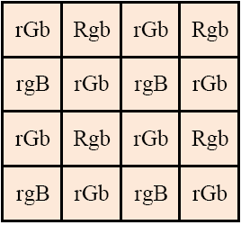
Color Filter Arrays
Separate sensors for three primary colors
Bayer RGB pattern: (a) color filter array layout; (b) interpolated pixel values
Notes:
The luminance signal is mostly determined by green values and the visual system is much more sensitive to high frequency detail in luminance than in chrominance

Slide 7
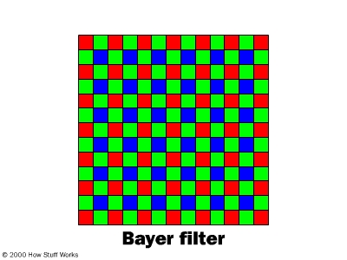
Digital color images

Slide 8
Bayer Pattern, 1976
Green filters are twice as many as red and blue filters
Human visual system is much more sensitive to high frequency detail in luminance than chrominance
Luminance is mostly determined by green value

Slide 9
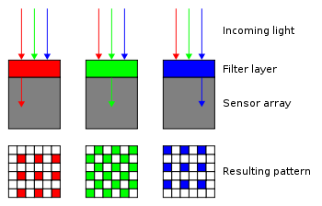
Bayer Filter

Slide 10
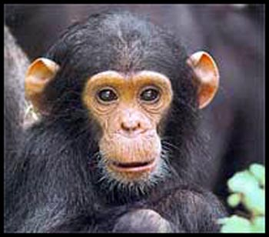
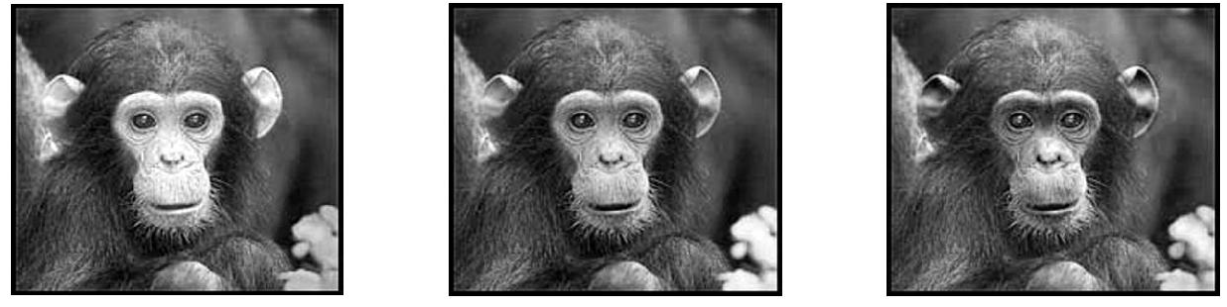
Digital color images
Color images, RGB color space
R
G
B

Slide 11
Images as Matrices
column
row
R
0.92 | 0.93 | 0.94 | 0.97 | 0.62 | 0.37 | 0.85 | 0.97 | 0.93 | 0.92 | 0.99
0.95 | 0.89 | 0.82 | 0.89 | 0.56 | 0.31 | 0.75 | 0.92 | 0.81 | 0.95 | 0.91
0.89 | 0.72 | 0.51 | 0.55 | 0.51 | 0.42 | 0.57 | 0.41 | 0.49 | 0.91 | 0.92
0.96 | 0.95 | 0.88 | 0.94 | 0.56 | 0.46 | 0.91 | 0.87 | 0.90 | 0.97 | 0.95
0.71 | 0.81 | 0.81 | 0.87 | 0.57 | 0.37 | 0.80 | 0.88 | 0.89 | 0.79 | 0.85
0.49 | 0.62 | 0.60 | 0.58 | 0.50 | 0.60 | 0.58 | 0.50 | 0.61 | 0.45 | 0.33
0.86 | 0.84 | 0.74 | 0.58 | 0.51 | 0.39 | 0.73 | 0.92 | 0.91 | 0.49 | 0.74
0.96 | 0.67 | 0.54 | 0.85 | 0.48 | 0.37 | 0.88 | 0.90 | 0.94 | 0.82 | 0.93
0.69 | 0.49 | 0.56 | 0.66 | 0.43 | 0.42 | 0.77 | 0.73 | 0.71 | 0.90 | 0.99
0.79 | 0.73 | 0.90 | 0.67 | 0.33 | 0.61 | 0.69 | 0.79 | 0.73 | 0.93 | 0.97
0.91 | 0.94 | 0.89 | 0.49 | 0.41 | 0.78 | 0.78 | 0.77 | 0.89 | 0.99 | 0.93
G
0.92 | 0.93 | 0.94 | 0.97 | 0.62 | 0.37 | 0.85 | 0.97 | 0.93 | 0.92 | 0.99
0.95 | 0.89 | 0.82 | 0.89 | 0.56 | 0.31 | 0.75 | 0.92 | 0.81 | 0.95 | 0.91
0.89 | 0.72 | 0.51 | 0.55 | 0.51 | 0.42 | 0.57 | 0.41 | 0.49 | 0.91 | 0.92
0.96 | 0.95 | 0.88 | 0.94 | 0.56 | 0.46 | 0.91 | 0.87 | 0.90 | 0.97 | 0.95
0.71 | 0.81 | 0.81 | 0.87 | 0.57 | 0.37 | 0.80 | 0.88 | 0.89 | 0.79 | 0.85
0.49 | 0.62 | 0.60 | 0.58 | 0.50 | 0.60 | 0.58 | 0.50 | 0.61 | 0.45 | 0.33
0.86 | 0.84 | 0.74 | 0.58 | 0.51 | 0.39 | 0.73 | 0.92 | 0.91 | 0.49 | 0.74
0.96 | 0.67 | 0.54 | 0.85 | 0.48 | 0.37 | 0.88 | 0.90 | 0.94 | 0.82 | 0.93
0.69 | 0.49 | 0.56 | 0.66 | 0.43 | 0.42 | 0.77 | 0.73 | 0.71 | 0.90 | 0.99
0.79 | 0.73 | 0.90 | 0.67 | 0.33 | 0.61 | 0.69 | 0.79 | 0.73 | 0.93 | 0.97
0.91 | 0.94 | 0.89 | 0.49 | 0.41 | 0.78 | 0.78 | 0.77 | 0.89 | 0.99 | 0.93
B
0.92 | 0.93 | 0.94 | 0.97 | 0.62 | 0.37 | 0.85 | 0.97 | 0.93 | 0.92 | 0.99
0.95 | 0.89 | 0.82 | 0.89 | 0.56 | 0.31 | 0.75 | 0.92 | 0.81 | 0.95 | 0.91
0.89 | 0.72 | 0.51 | 0.55 | 0.51 | 0.42 | 0.57 | 0.41 | 0.49 | 0.91 | 0.92
0.96 | 0.95 | 0.88 | 0.94 | 0.56 | 0.46 | 0.91 | 0.87 | 0.90 | 0.97 | 0.95
0.71 | 0.81 | 0.81 | 0.87 | 0.57 | 0.37 | 0.80 | 0.88 | 0.89 | 0.79 | 0.85
0.49 | 0.62 | 0.60 | 0.58 | 0.50 | 0.60 | 0.58 | 0.50 | 0.61 | 0.45 | 0.33
0.86 | 0.84 | 0.74 | 0.58 | 0.51 | 0.39 | 0.73 | 0.92 | 0.91 | 0.49 | 0.74
0.96 | 0.67 | 0.54 | 0.85 | 0.48 | 0.37 | 0.88 | 0.90 | 0.94 | 0.82 | 0.93
0.69 | 0.49 | 0.56 | 0.66 | 0.43 | 0.42 | 0.77 | 0.73 | 0.71 | 0.90 | 0.99
0.79 | 0.73 | 0.90 | 0.67 | 0.33 | 0.61 | 0.69 | 0.79 | 0.73 | 0.93 | 0.97
0.91 | 0.94 | 0.89 | 0.49 | 0.41 | 0.78 | 0.78 | 0.77 | 0.89 | 0.99 | 0.93
Slide credit: Derek Hoiem

Slide 12
Image filtering
Compute a function of the local neighborhood at each pixel in the image
Function specified by a “filter” or mask saying how to combine values from neighbors.
Uses of filtering:
Enhance an image (denoise, resize, etc)
Extract information (texture, edges, etc)
Detect patterns (template matching)
Adapted from Derek Hoiem

Slide 13
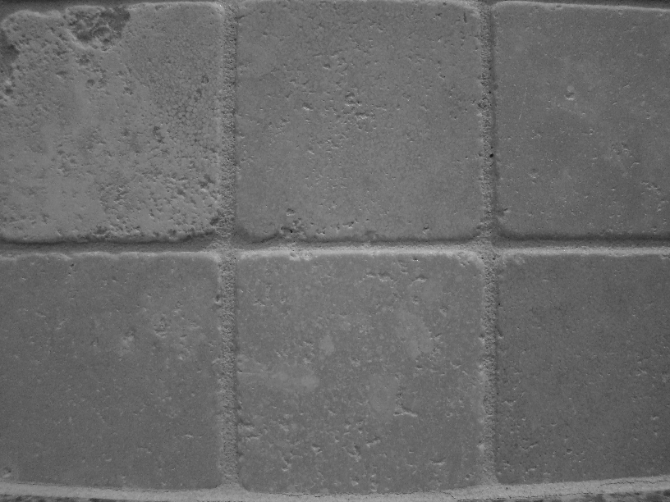
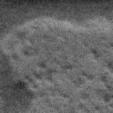
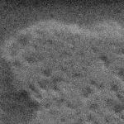

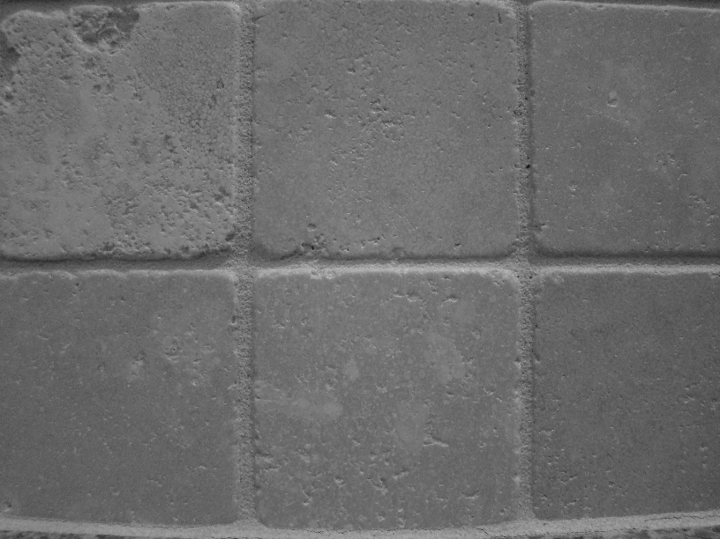
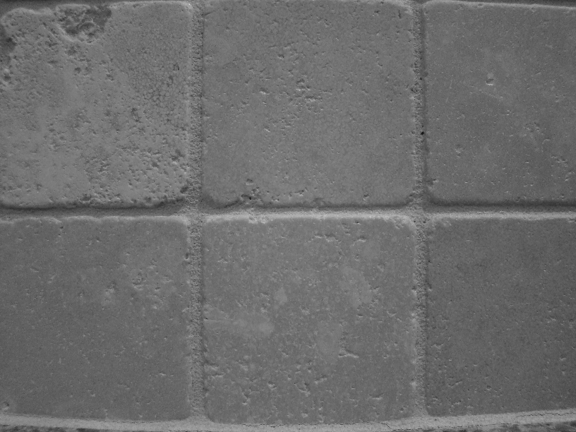


Motivation: noise reduction
Even multiple images of the same static scene will not be identical.

Slide 14
Common types of noise
Salt and pepper noise: random occurrences of black and white pixels
Impulse noise: random occurrences of white pixels
Gaussian noise: variations in intensity drawn from a Gaussian normal distribution
Source: S. Seitz

Slide 15
Motivation: noise reduction
Even multiple images of the same static scene will not be identical.
How could we reduce the noise, i.e., give an estimate of the true intensities?
What if there’s only one image?

Slide 16
First attempt at a solution
Let’s replace each pixel with an average of all the values in its neighborhood
Assumptions:
Expect pixels to be like their neighbors
Expect noise processes to be independent from pixel to pixel

Slide 17
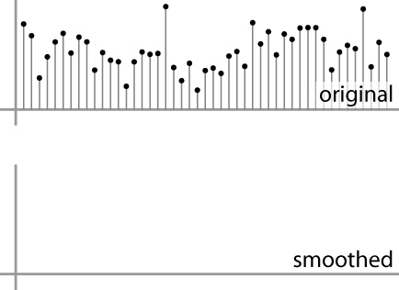
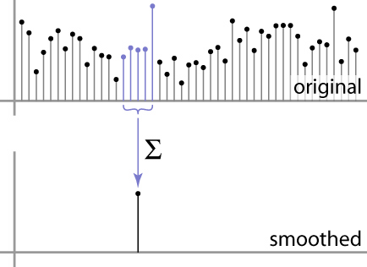
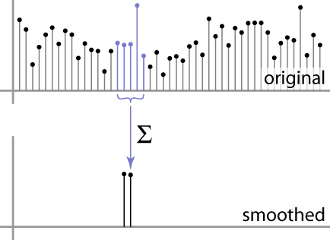
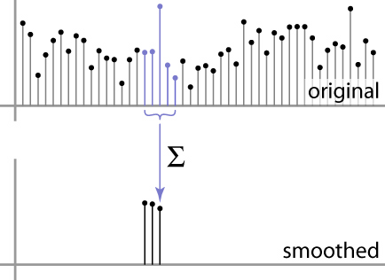
First attempt at a solution
Let’s replace each pixel with an average of all the values in its neighborhood
Moving average in 1D:
Source: S. Marschner

Slide 18
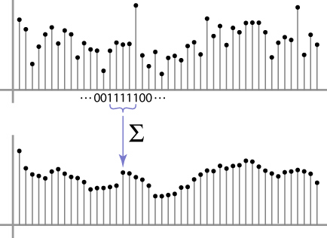
Weighted Moving Average
Can add weights to our moving average
Weights [1, 1, 1, 1, 1] / 5
Source: S. Marschner

Slide 19

Weighted Moving Average
Non-uniform weights [1, 4, 6, 4, 1] / 16
Source: S. Marschner

