Slide 1
Edges - 2
Slides Acknowledgements
Steve Seitz
Kirsten Grauman, Vassilis Athitsos
Other Vision Researchers
Ebook: R. Szeliski

Slide 2
Contours
A contour is a curve/line (typically not straight) that delineates the boundary of a region, or between regions.

Slide 3




Shapes Without Texture
Letters/numbers.
Contours.
Edge templates.

Slide 4



Detecting Shapes Without Texture
Normalized correlation does not work well.
Slight misalignments have a great impact on the correlation score.
star1
star3
combined

Slide 5

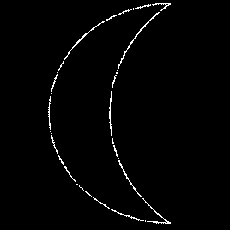
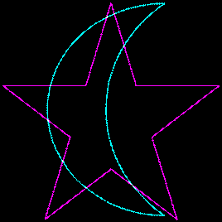
Chamfer Distance
On two stars:
31 pixels are nonzero in both images.
On star and crescent:
33 pixels are nonzero in both images.
Correlation scores can be misleading.

Slide 6
Chamfer Distance
Chamfer distance is much smaller between the two stars than between the star and the crescent.

Slide 7
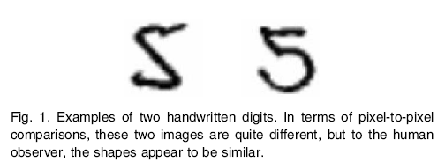
Comparing Contours
Figure from Belongie et al.

Slide 8
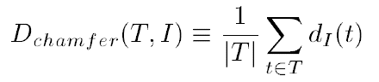
Chamfer distance
Average distance to nearest feature
Set of points in image
Set of points on (shifted) template
Minimum distance between point t and some point in I
Kristen Grauman, UT-Austin

Slide 9
Chamfer distance
Kristen Grauman, UT-Austin

Slide 10
Chamfer Distance
For each edge pixel in star1:
How far is it from the nearest edge pixel in star3?
The average of all those answers is the directed chamfer distance from star1 to star3.

Slide 11
Chamfer Distance
For each edge pixel in star1:
How far is it from the nearest edge pixel in star3?
The average of all those answers is the directed chamfer distance from star1 to star3.

Slide 12
Chamfer Distance
For each edge pixel in star1:
How far is it from the nearest edge pixel in star3?
The average of all those answers is the directed chamfer distance from star1 to star3.

Slide 13
Chamfer Distance
For each edge pixel in star1:
How far is it from the nearest edge pixel in star3?
The average of all those answers is the directed chamfer distance from star1 to star3.

Slide 14
Chamfer Distance
For each edge pixel in star3:
How far is it from the nearest edge pixel in star1?
The average of all those answers is the directed chamfer distance from star3 to star1.

Slide 15
Directed Chamfer Distance
Input: two sets of points.
red, green.
c(red, green):
Average distance from each red point to nearest green point.

Slide 16
Directed Chamfer Distance
Input: two sets of points.
red, green.
c(red, green):
Average distance from each red point to nearest green point.
c(green, red):
Average distance from each green point to nearest red point.

Slide 17
Chamfer Distance
Input: two sets of points.
red, green.
c(red, green):
Average distance from each red point to nearest green point.
c(green, red):
Average distance from each red point to nearest green point.
Chamfer distance:
C(red, green) = (c(red, green) + c(green, red))/2

Slide 18
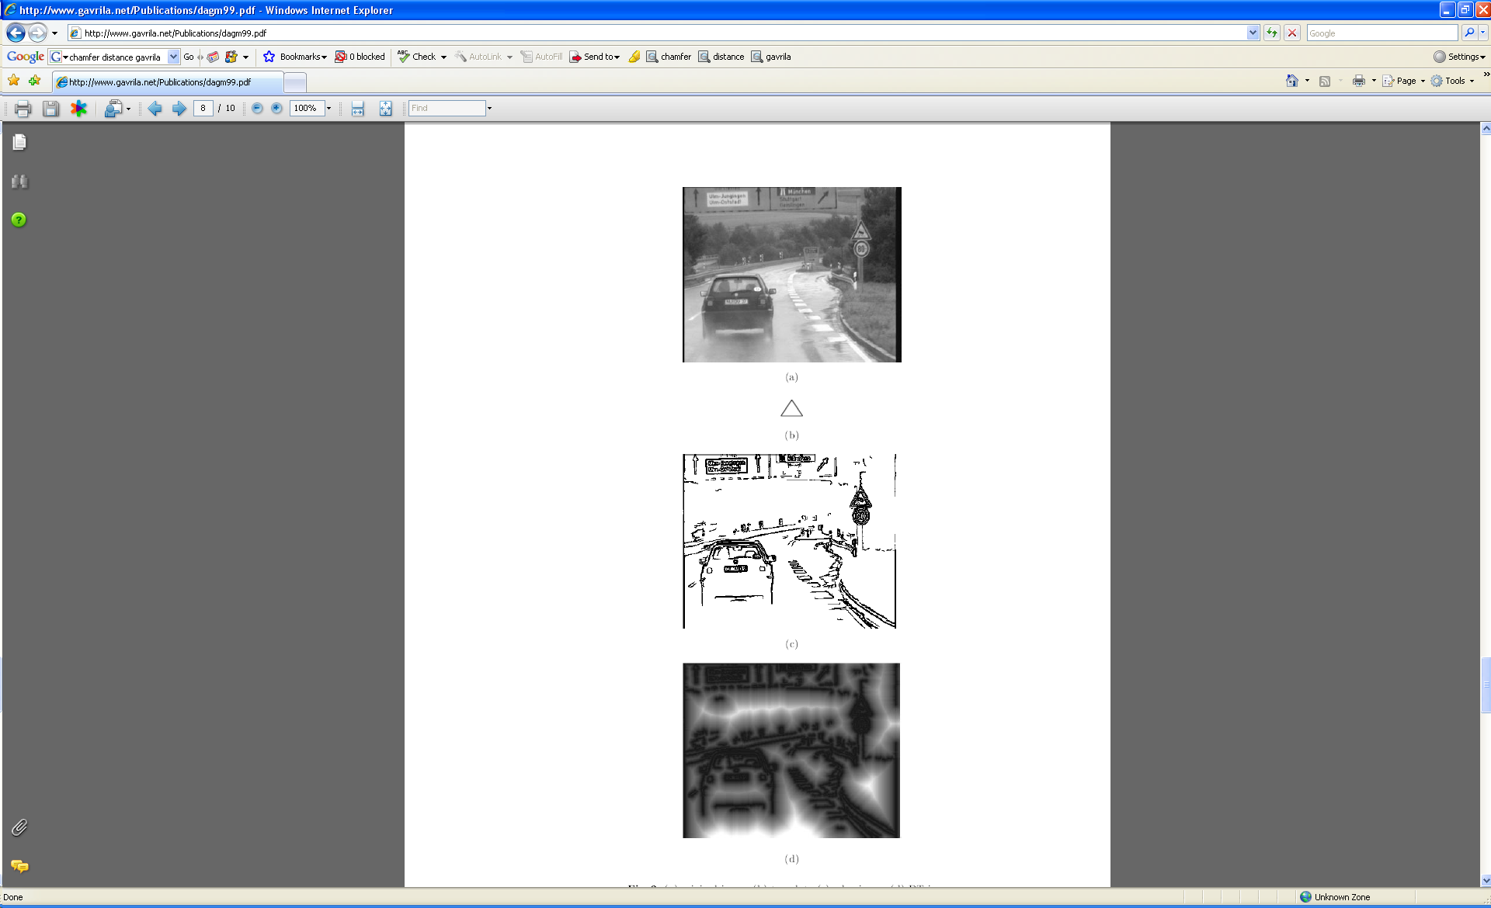
Chamfer distance
Average distance to nearest feature
How is the measure different than just filtering with a mask having the shape points?
How expensive is a naïve implementation?
Edge image
Kristen Grauman, UT-Austin

Slide 19
Chamfer distance
Average distance to nearest feature
Edge image
Distance transform image
Kristen Grauman, UT-Austin

Slide 20
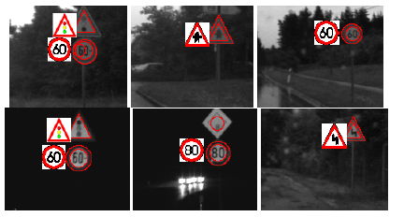
Chamfer distance
Edge image
Distance transform image
Fig from D. Gavrila, DAGM 1999
Kristen Grauman, UT-Austin

Slide 21
Chamfer Distance: Properties
Sensitive to scale and rotation
Tolerant of small shape changes, clutter
Need large number of template shapes
Inexpensive way to match shapes

Slide 22
Distance Transform
Image features (2D)
Distance Transform
1
0
1
2
3
4
3
2
1
0
1
2
3
3
2
1
1
0
1
2
3
2
1
0
1
0
0
1
2
1
0
1
2
1
1
2
1
0
1
2
3
2
2
2
1
0
1
2
4
3
3
2
1
0
1
2
5
4
4
3
2
1
0
1
Distance Transform is a function that for each image pixel p assigns a non-negative number corresponding to distance from p to the nearest feature in the image I
Features could be edge points, foreground points,…

Slide 23

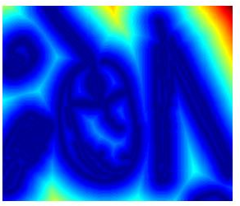

Distance Transform
original
edges
distance transform
Value at (x,y) tells how far that position is from the nearest edge point (or other binary mage structure)
Kristen Grauman, UT-Austin

Slide 24
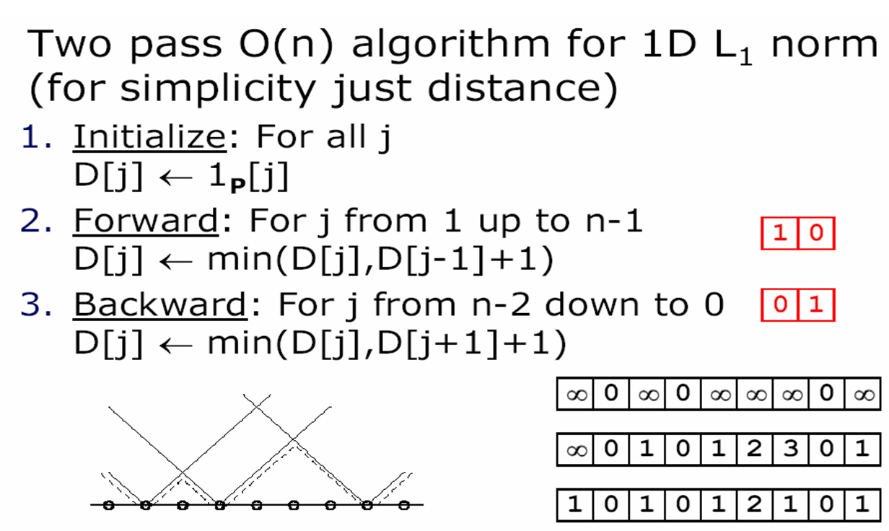
Distance Transform (1D)
// 0 if j is in P, infinity otherwise
Adapted from D. Huttenlocher

Slide 25
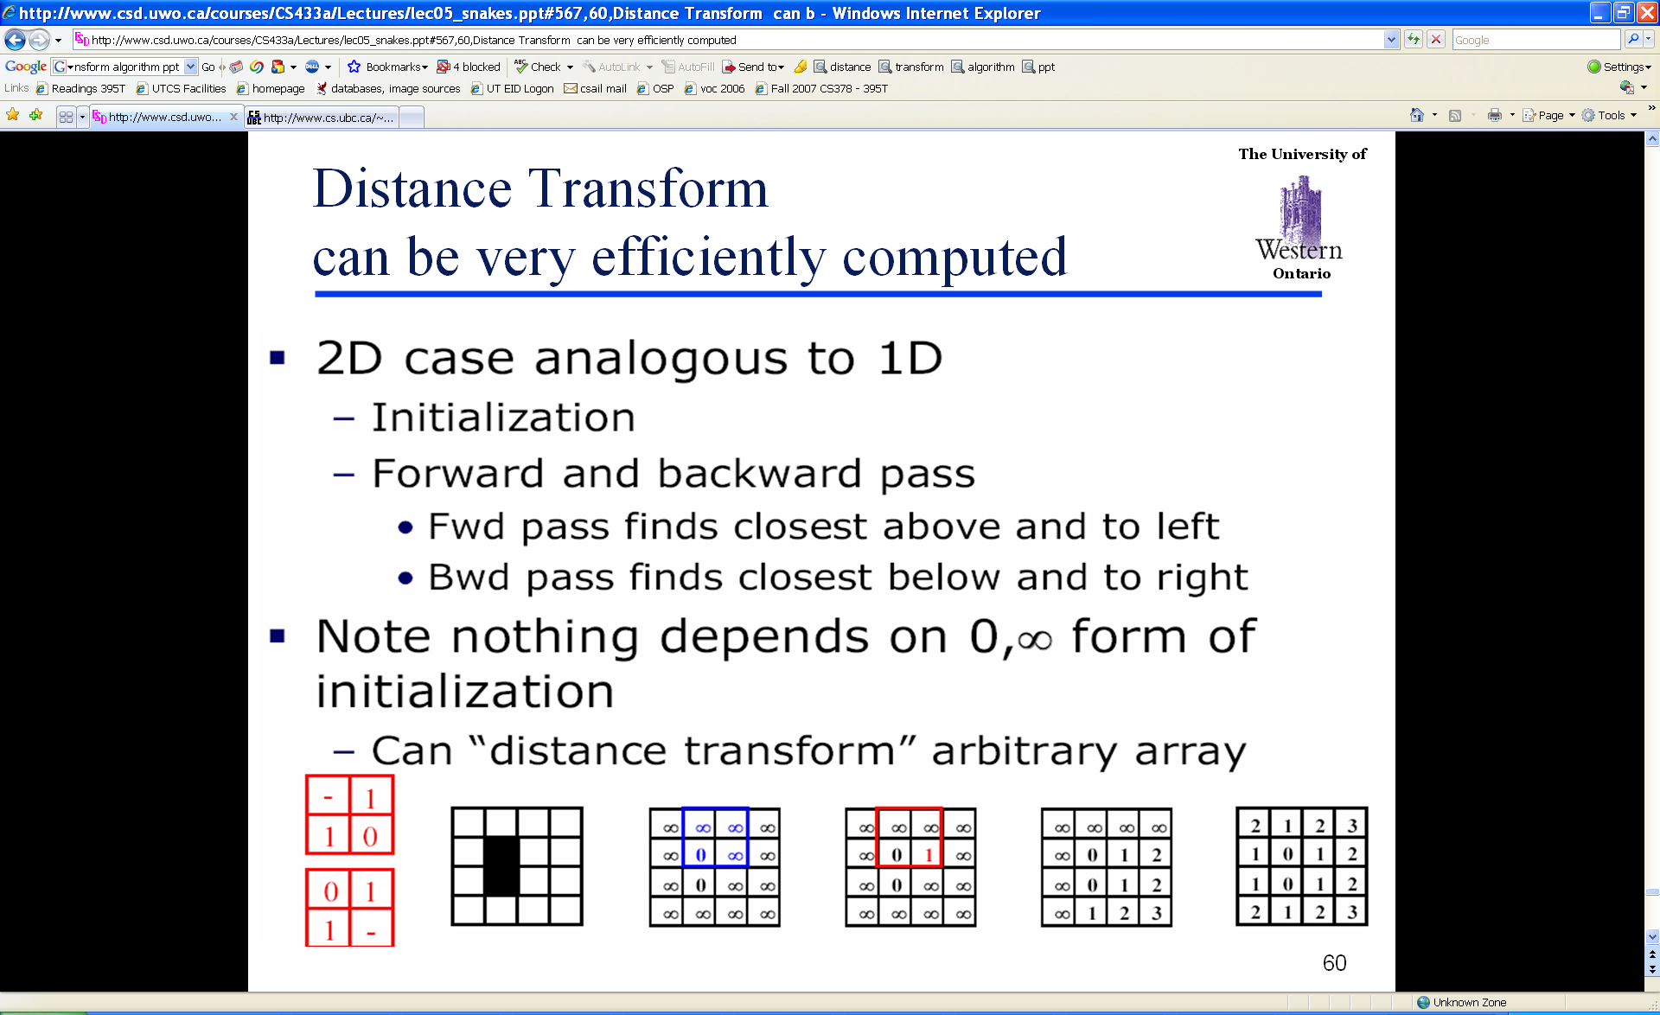
Distance Transform (2D)
Adapted from D. Huttenlocher

Slide 26

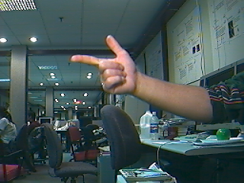
Detecting Hands
Template.
Input image
Problem: hands are highly deformable.
Normalized correlation does not work as well.
Alternative: use edges.

Slide 27
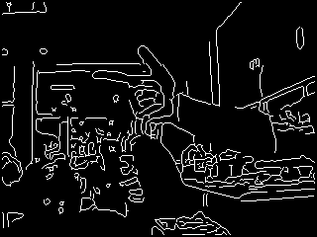

Detecting Hands
window
template
Compute chamfer distance, at all windows, all scales, with template.
Which version? Directed or undirected?
We want small distance with correct window, large distance with incorrect windows.

Slide 28
Direction Matters
window
template
Chamfer distance from window to template: problems?

Slide 29
Direction Matters
window
template
Chamfer distance from window to template: problems?
Clutter (edges not belonging to the hand) cause the distance to be high.

Slide 30
Direction Matters
window
template
Chamfer distance from template to window: problems?

Slide 31
Direction Matters
window
template
Chamfer distance from template to window: problems?
What happens when comparing to a window with lots of edges?

Slide 32
Direction Matters
window
template
Chamfer distance from template to window: problems?
What happens when comparing to a window with lots of edges? Score is low.

Slide 33
Choice of Direction
window
template
For detection, we compute chamfer distance from template to window.
Being robust to clutter is a big plus, ensures the correct results will be included.
Incorrect detections can be discarded with additional checks.

Slide 34
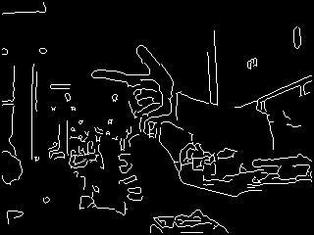
Computing the Chamfer Distance
Compute chamfer distance, at all windows, all scales, with template.
Can be very time consuming.

Slide 35
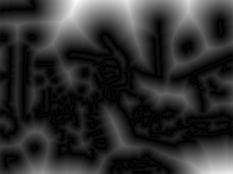
Distance Transform
Edge image e1
Distance transform d1
For every pixel, compute distance to nearest edge pixel.

Slide 36
Distance Transform
t1
Edge image e1
Distance transform d1
If template t1 is of size (r, c):
Chamfer distance with a window (i:(i+r-1), (j:(j+c-1)) of e1 can be written as:

Slide 37
Distance Transform
t1
Edge image e1
Distance transform d1
If template t1 is of size (r, c):
Chamfer distance with a window (i:(i+r-1), (j:(j+c-1)) of e1 can be written as:
Computing image of chamfer scores for one scale
window = d1(i:(i+r-1), j:(j+c-1));
sum(sum(t1 .* window))

Slide 38
Distance Transform
t1
Edge image e1
Distance transform d1
Computing image of chamfer scores for one scale s
How long does that take? Can it be more efficient?
resized = imresize(image, s, 'bilinear');
resized_edges = canny(resized, 7);
resized_dt = bwdist(resized_edges);
chamfer_scores = imfilter(resized_dt, t1, 'symmetric');
figure(3); imshow(chamfer_scores, []);

Slide 39
Improving Efficiency
t1
Edge image e1
Distance transform d1
Which parts of the template contribute to the score of each window?

Slide 40
Improving Efficiency
t1
Edge image e1
Distance transform d1
Which parts of the template contribute to the score of each window?
Just the nonzero parts.
How can we use that?

Slide 41
Improving Efficiency
t1
Edge image e1
Distance transform d1
Which parts of the template contribute to the score of each window? Just the nonzero parts.
How can we use that?
Compute a list of non-zero pixels in the template.
Consider only those pixels when computing the sum for each window.

Slide 42
Results for Single Scale Search
What is causing the false result?

Slide 43
Results for Single Scale Search
What is causing the false result?
Window with lots of edges.
How can we refine these results?

Slide 44
Results for Single Scale Search
What is causing the false result?
Window with lots of edges.
How can we refine these results?
Skin color, or background subtraction

Slide 45
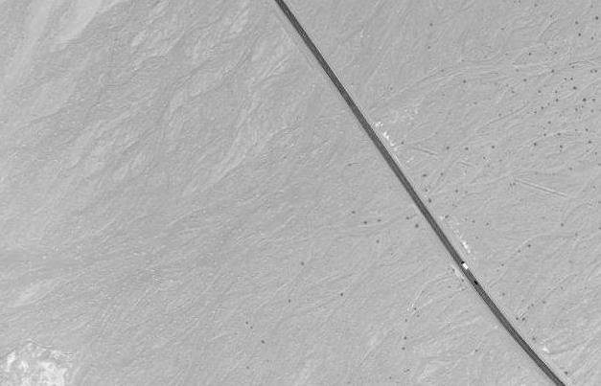
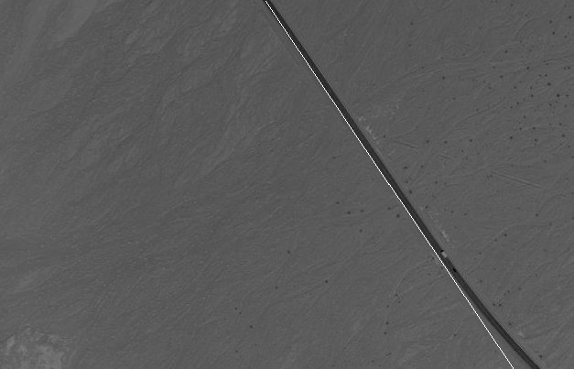
Hough Transforms
Goal: identify simple geometric shapes in images, such as lines and circles.
Example: find the most prominent line in an image.

Slide 46
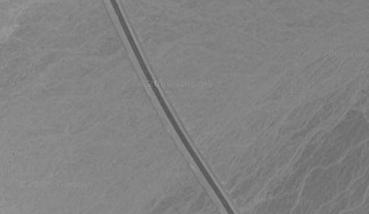
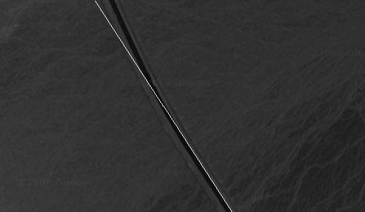
Hough Transforms
Goal: identify simple geometric shapes in images, such as lines and circles.
Example: find the most prominent line in an image.

Slide 47
What is a Straight Line?

Slide 48
What is a Straight Line?
It is infinite.
It is defined in multiple ways:

Slide 49
Defining Straight Lines
How many parameters do we need to define a line?

Slide 50
Defining Straight Lines
How many parameters define a line?
One option:
a point (x0, y0) and a theta.
Another option:
two points (x0, y0) and (x1, y1).
NOTE: for representing 2D points, two conventions are common:
(x, y), where x is horizontal coord., y is vertical coord.
(i, j), where i is vertical coord, j is horizontal coord.
In any piece of code, ALWAYS VERIFY THE CONVENTION.

Slide 51
Defining Straight Lines
How many parameters define a line?
One option:
a point (x0, y0) and a theta.
Another option:
two points (x0, y0) and (x1, y1).
Any problem with the above two parameterizations?

Slide 52
Defining Straight Lines
How many parameters define a line?
One option:
a point (x0, y0) and a theta.
Another option:
two points (x0, y0) and (x1, y1).
Any problem with the above two parametrizations?
It is redundant.
A line has infinite parametrizations/representations.

Slide 53
Defining Straight Lines
y = c1 * x + c2
Problems?

Slide 54
Defining Straight Lines
y = c1 * x + c2
The above parametrization cannot represent vertical lines.

Slide 55
Defining Straight Lines
Can we define a line in a non-redundant way?

Slide 56
Defining Straight Lines
Defining a line using rho and theta:
rho = x*cos(theta) + y*sin(theta)
rho: distance of line from origin.
theta: direction PERPENDICULAR to line.
The line is the set of (x, y) values satisfying the equation.

Slide 57
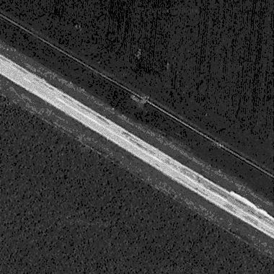
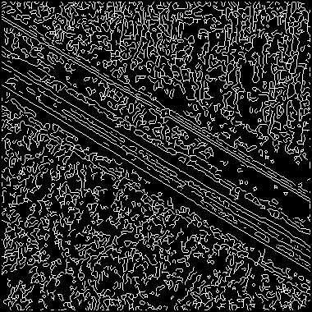
Voting for Lines
Every edge pixel votes for all the lines it is a part of.
Vote array: # of rhos x # of thetas.
We choose how much we want to discretize.
Votes collected in a single for loop.

Slide 58
Voting for Lines - Pseudocode
counters = zeros (# of rhos, # of thetas)
For every pixel (i, j):
if (i, j) not an edge pixel, then continue
for every theta in thetas:
rho = find_rho(i, j, theta)
counters(rho, theta)++;

Slide 59
Voting for Lines - Pseudocode
counters = zeros(# of rhos, # of thetas)
For every pixel (i, j):
if (i, j) not an edge pixel, then continue
for every theta in thetas:
rho = find_rho(i, j, theta)
counters(rho, theta)++;
How long does it take?

Slide 60
Voting for Lines - Pseudocode
counters = zeros(# of rhos, # of thetas)
For every pixel (i, j):
if (i, j) not an edge pixel, then continue
for every theta in thetas:
rho = find_rho(i, j, theta)
counters(rho, theta)++;
How long does it take?
# pixels * # thetas.
# edge pixels * # thetas.

Slide 61
Hough Transform for Lines
The Hough transform for lines simply computes the votes for all lines.

Slide 62
Possible Line Fittings

Slide 63
Voting for Lines
Using edge orientations to make it faster:

Slide 64
Voting for Lines
Using edge orientations to make it faster:
Use the orientation of an edge pixel to limit the thetas that it votes for.

Slide 65
Voting for Lines – Pseudocode 2
counters = zeros(# of rhos, # of thetas)
For every pixel (i, j):
if (i, j) not an edge pixel, then continue
o = gradient_orientation(i, j)
pixel_thetas = thetas such that abs(angle(o, theta)) <= thr.
for every theta in pixel_thetas:
rho = find_rho(i, j, theta)
counters(rho, theta)++;

Slide 66
Defining Circles

Slide 67
Defining Circles
Parameters: center_x, center_y, radius.
(x - center_x)² + (y - center_y)² = radius²
The circle is the set of all (x, y) values satisfying the above equation.

Slide 68
Hough Transform on Circles
What is the voting space?
Who votes?
What does each voter vote for?

Slide 69
Hough Transform on Circles
What is the voting space?
the set of all circles that can be defined.
size of array:
Who votes?
What does each voter vote for?

Slide 70
Hough Transform on Circles
What is the voting space?
the set of all circles that can be defined.
size of array: # centers * # radii.
Who votes?
What does each voter vote for?

Slide 71
Hough Transform on Circles
What is the voting space?
the set of all circles that can be defined.
size of array: # centers * # radii.
Coarser discretizations can be used.
combine 3x3 neighborhoods for center locations.
choose step at which radii are sampled.
Who votes?
What does each voter vote for?

Slide 72
Hough Transform on Circles
What is the voting space?
the set of all circles that can be defined.
Who votes?
What does each voter vote for?

Slide 73
Hough Transform on Circles
What is the voting space?
the set of all circles that can be defined.
Who votes?
Every edge pixel.
What does each voter vote for?

Slide 74
Hough Transform on Circles
What is the voting space?
the set of all circles that can be defined.
Who votes?
Every edge pixel.
What does each voter vote for?
Every edge pixel votes for all the circles that it belongs to.

Slide 75
Hough Transform on Circles
What is the voting space?
the set of all circles that can be defined.
Who votes?
Every edge pixel.
What does each voter vote for?
Every edge pixel votes for all the circles that it can belong to.
Faster version:

Slide 76
Hough Transform on Circles
What is the voting space?
the set of all circles that can be defined.
Who votes?
Every edge pixel.
What does each voter vote for?
Every edge pixel votes for all the circles that it can belong to.
Faster version: every edge pixel (i, j) votes for all the circles that it can belong to, such that the line from (i, j) to the circle center makes a relatively small angle with the gradient orientation at (i, j).

Slide 77
Hough Transform on Circles
What does each voter vote for?
Every edge pixel votes for all the circles that it can belong to.
Faster version: every edge pixel (i, j) votes for all the circles that it can belong to, such that the line from (i, j) to the circle center makes a relatively small angle with the gradient orientation at (i, j).
How long does it take?

Slide 78
Hough Transform on Circles
What does each voter vote for?
Every edge pixel votes for all the circles that it can belong to.
Faster version: every edge pixel (i, j) votes for all the circles that it can belong to, such that the line from (i, j) to the circle center makes a relatively small angle with the gradient orientation at (i, j).
How long does it take?
# edge pixels * # pixels * # radii.

Slide 79
General Hough Transforms
In theory, we can use Hough transforms to detect more complicated shapes.
In practice, this requires memory and time exponential to the number of parameters, and is usually not practical.

