Slide 1
more Features
Slides Acknowledgements
Steve Seitz
Kirsten Grauman, Vassilis Athitsos
Other Vision Researchers
Ebook: R. Szeliski

Slide 2
The Wavelet Transform
Use narrower windows at high frequencies for better time resolution.
Use wider windows at low frequencies for better frequency resolution.

Slide 3
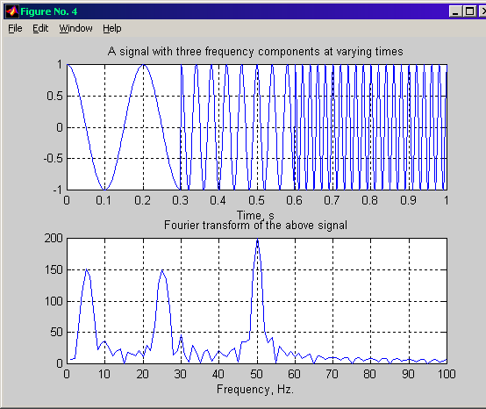
Wavelet Transform (cont’d)
Wide windows do not provide good localization
at high frequencies.

Slide 4
Wavelet Transform (cont’d)
Use narrower windows at high frequencies.

Slide 5
Wavelet Transform (cont’d)
Narrow windows do not provide good localization
at low frequencies.

Slide 6
Wavelet Transform (cont’d)
Use wider windows at low frequencies.

Slide 7
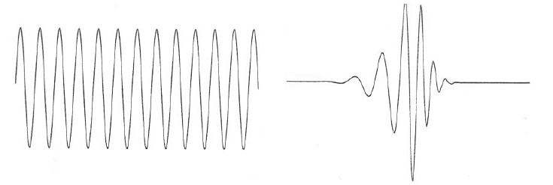
What are Wavelets?
Wavelets are functions that “wave” above and below the x-axis, have (1) varying frequency, (2) limited duration, and (3) an average value of zero.
This is in contrast to sinusoids, used by FT, which have infinite energy.
Sinusoid Wavelet

Slide 8
Wavelets? (cont’d)
Like sines and cosines in FT, wavelets are used as basis functions ψ_{k}(t) in representing other functions f(t):
Span of ψ_{k}(t): vector space S containing all functions f(t) that can be represented by ψ_{k}(t).

Slide 9

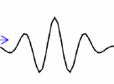
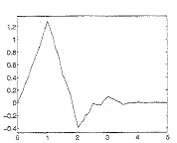
Wavelets? (cont’d)
There are many different wavelets:
Haar
Morlet
Daubechies

Slide 10
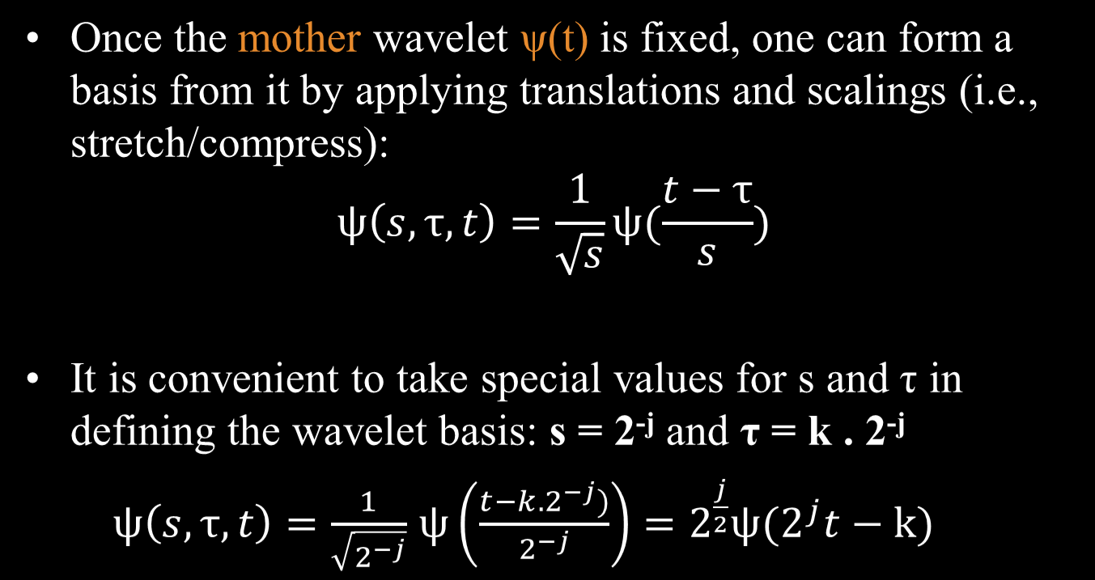
Wavelets? (cont’d)
(dyadic/octave grid)

Slide 11
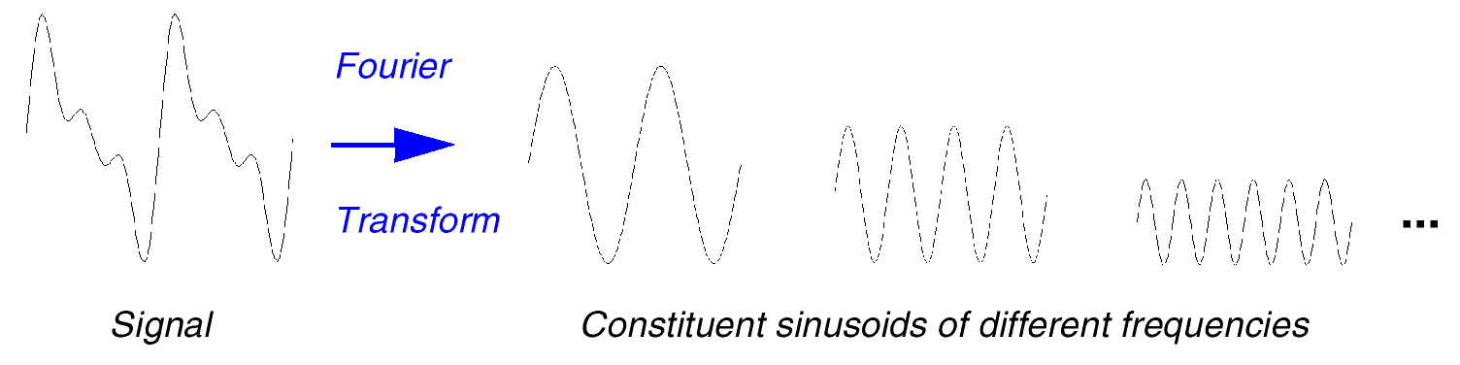
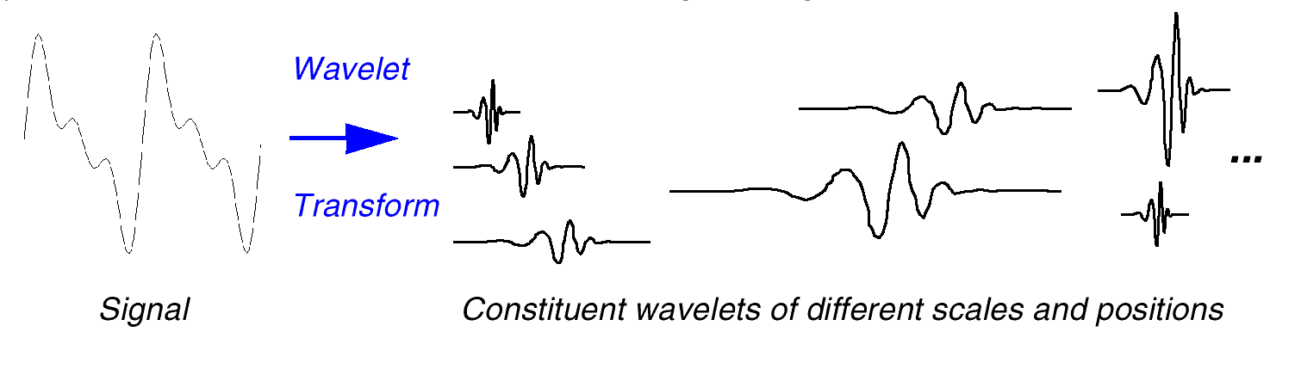
FT vs WT
weighted by F(u)
weighted by C(τ,s)

Slide 12
Properties of Wavelets
Sparsity: for functions typically found in practice, many of the coefficients in a wavelet representation are either zero or very small.
Linear-time complexity: many wavelet transformations can be accomplished in O(N) time.

Slide 13
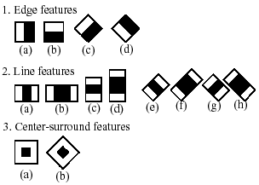

Haar-Like Features
Each Haar-like feature consists of two or three jointed “black” and “white” rectangles:
The value of a Haar-like feature is the difference between the sum of the pixel gray level values within the black and white rectangular regions:
f(x)=Sum_{black rectangle} (pixel gray level) – Sum_{white rectangle} (pixel gray level)
Compared with raw pixel values, Haar-like features can reduce/increase the in-class/out-of-class variability, and thus making classification easier.
Figure 1: A set of basic Haar-like features.
Figure 2: A set of extended Haar-like features.

Slide 14
Haar-Like Features (cont’d)
The rectangle Haar-like features can be computed rapidly using “integral image”.
Integral image at location of x, y contains the sum of the pixel values above and left of x, y, inclusive:
The sum of pixel values within “D”:
P (x, y)
A
P₁
B
P₂
C
D
P₃
P₄

Slide 15
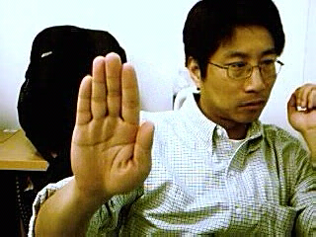
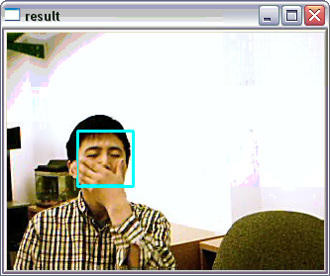

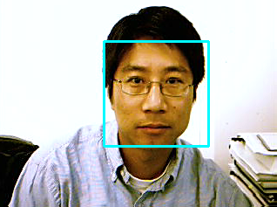
Haar-Like Features (cont’d)
To detect the hand, the image is scanned by a sub-window containing a Haar-like feature.
Based on each Haar-like feature f_{j} , a weak classifier h_{j}(x) is defined as: where x is a sub-window, and θ is a threshold. p_{j} indicating the direction of the inequality sign.

Slide 16
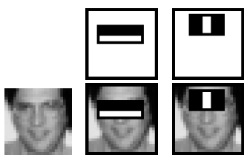
Example
Feature’s value is calculated as the difference between the sum of the pixels within white and black rectangle regions.

Slide 17
Adaboost Learning
The more distinctive the feature, the larger the weight.

Slide 18
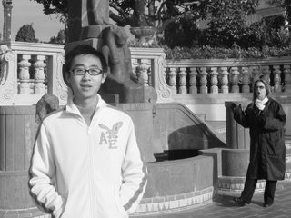

Haar-Feature based object detection algorithm
X axis
320
Original image
0
Scaled images
Y axis
Face found
20x20
sub- window
…
240
Faces detected on different scales
Movement of sub-window
(320 – 20) * (240 – 20) = 66,000 sub-windows

Slide 19


Face detection in sub-window
Original image
Integral Image
Facial Haar features
1 1 1
1 2 3
1 1 1
2 4 6
1 1 1
3 6 9
Pass
Stores Pixel sum of Rect(from top-left corner to this point)
Need 4 corner values
20 x 20 sub-window
p1
p2
P1
P2
R1
p3
p4
P3
P4
Fail
Pixel_Sum(R1) =
P4 - P2 - P3 + P1 = 4
Calculate Haar-feature value:
Pixel_Sum(Rect_W) – Pixel_Sum(Rect_B)
Constant time Pixel_Sum calculation

Slide 20
Cascade decision process
Frontal-face has 2000 features
Divided into multiple stages
S1
2 features
pass
S2
5 features
pass
S3
16 features
pass
S22
212 features
pass
……
Face detected
Fail
Reject
Fail any stage will reject current sub-window

Slide 21
Detector in Intel OpenCV
Collect a database of positive samples and a database of negative samples.
Mark object by objectmarker.exe
Build a vec file out of positive samples using createsamples.exe
Run haartraining.exe to build the classifier.
Run performance.exe to evaluate the classifier.
Run haarconv.exe to convert classifier to .xml file

Slide 22
Links
Original paper: http://research.microsoft.com/~viola/Pubs/Detect/violaJones_CVPR2001.pdf
How-to build a cascade of boosted classifiers based on Haar-like features: http://lab.cntl.kyutech.ac.jp/~kobalab/nishida/opencv/OpenCV_ObjectDetection_HowTo.pdf
Objectmarker.exe and haarconv.exe, *.dll:
http://www.iem.pw.edu.pl/~domanskj/haarkit.rar

Slide 23
SIFT Again
Local invariant Interest point detector-descriptor
For finding correspondences between two images of the same scene or object
Many applications, including 3D reconstruction, image retrieval and object recognition
SIFT is one of the best but slow
Image of size 1000 x 700 described in around 6 seconds (actual cost depends on the # features generated, 4000 in this case)
128-D feature vectors

Slide 24
SURF - Motivation
Fast interest point detection
Distinctive interest point description
Speeded-up descriptor matching
Invariant to common image transformations:
Image rotation
Scale changes
Illumination change
Small change in Viewpoint

Slide 25

Methodology
Using integral images for major speed up
Integral Image (summed area tables) is an intermediate representation for the image and contains the sum of gray scale pixel values of image
Second order derivative and Haar-wavelet response
Cost four additions operation only

Slide 26
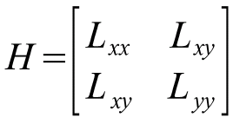
Detection
Hessian-based interest point localization
L_{xx}(x,y,σ) is the Laplacian of Gaussian of the image
It is the convolution of the Gaussian second order derivative with the image
Lindeberg showed Gaussian function is optimal for scale-space analysis
This paper argues that Gaussian is overrated since the property that no new structures can appear while going to lower resolution is not proven in 2D case

Slide 27
Detection
Approximated second order derivatives with box filters (mean/average filter)

Slide 28
Detection
Scale analysis with constant image size
9 x 9, 15 x 15, 21 x 21, 27 x 27 → 39 x 39, 51 x 51 …
1st octave 2nd octave
Notes:
Scale spaces are usually implemented as image pyramids. The images are repeatedly smoothed with a Gaussian and subsequently sub-sampled in order to achieve a higher level of the pyramid. Due to the use of box filters and integral images, we do not have to iteratively apply the same filter to the output of a previously filtered layer, but instead can apply such filters of any size at exactly the same speed directly on the original image.

Slide 29
Detection
Non-maximum suppression and interpolation
Blob-like feature detector

Slide 30
Description
Orientation Assignment
Circular neighborhood of
radius 6s around the interest point
(s = the scale at which the point was detected)
x response y response
Side length = 4s
Cost 6 operation to
compute the response

Slide 31
Description
Dominant orientation
The Haar wavelet responses are represented as vectors
Sum all responses within a sliding orientation window covering an angle of 60 degree
The two summed response yield a new vector
The longest vector is the dominant orientation
Second longest is … ignored

Slide 32
Description
Split the interest region up into 4 x 4 square sub-regions with 5 x 5 regularly spaced sample points inside
Calculate Haar wavelet response d_{x} and d_{y}
Weight the response with a Gaussian kernel centered at the interest point
Sum the response over each sub-region for d_{x} and d_{y} separately → feature vector of length 32
In order to bring in information about the polarity of the intensity changes, extract the sum of absolute value of the responses → feature vector of length 64
Normalize the vector into unit length

Slide 33
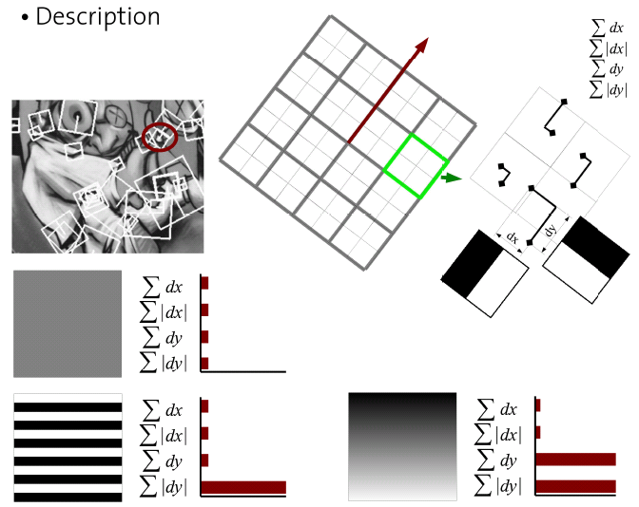
Description

Slide 34
Description
SURF-128
The sum of d_{x} and |d_{x}| are computed separately for d_{y} < 0 and d_{y} >0
Similarly for the sum of d_{y} and |d_{y}|
This doubles the length of a feature vector

Slide 35
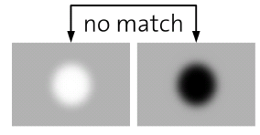
Matching
Fast indexing through the sign of the Laplacian for the underlying interest point
The sign of trace of the Hessian matrix
Trace = L_{xx} + L_{yy}
Either 0 or 1 (Hard thresholding, may have boundary effect …)
In the matching stage, compare features if they have the same type of contrast (sign)

Slide 36
Experimental Results

Slide 37
Experimental Results
Viewpoint change of 30 degrees

Slide 38
Experimental Results

Slide 39
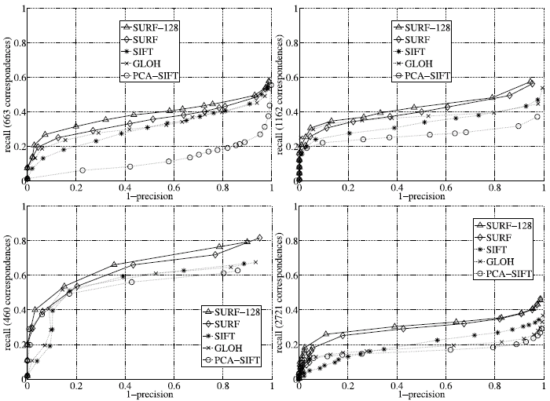
Experimental Results
1. Wall 2. Boat 3. Bikes 4. Trees

Slide 40
Analysis
Benchmark on SURF and SIFT using the Visual Geometry Group Dataset
SURF: Fast-Hessian detector + SURF descriptor
SIFT: DOG detector + SIFT descriptor
 | SURF | SIFT
Memory Cost | SURF: 64 floats SURF-128: 128 floats | 128 bytes
Speed (Time to detect and describe 4000 features) | SURF: 2.4 seconds | 6 seconds
# Features detected in 1024x768 image (Default threshold) | ~ 1000 | > 3000

Slide 41
Analysis
img# | bikes | boat | graf | leuven | wall
2 | o | ++ | -- | - | ---
3 | o | o | - | -- | ----
4 | + | +++ | - | -- | ---
5 | ++ | +++ | o | -- | o
6 | +++ | +++ | o | --- | o
Legend
+ | SURF better by 0.1 recall rate
- | SIFT better by 0.1 recall rate
o | Draw

Slide 42
Analysis
SURF is good at
handling serious blurring
handling image rotation
SURF is poor at
handling viewpoint change
handling illumination change
SURF is always better than the SIFT implemented by VGG but not the original SIFT
img# | Bikes | Boat | graf | leuven | wall
2 | o | ++ | -- | - | ---
3 | o | o | - | -- | ----
4 | + | +++ | - | -- | ---
5 | ++ | +++ | o | -- | o
6 | +++ | +++ | o | --- | o

Slide 43
Indexing and Retrieval

Slide 44
Overview
Visual Words
Indexing
Results
Query

Slide 45
Input format
Pre-processing
Video Id | Frame Id | pos_x | pos_y | Visual word Id
Query
Set of visual words in the query rectangle

Slide 46
Output format
Retrieved Results
Rank | Video Id | Frame Id

Slide 47
Objectives
Efficient Indexing
Fast Retrieval Time
Good Recall

Slide 48
Approach …
Removing the common words
Reverse Indexing
Ranking of results

Slide 49
Indexing and Retrieval in Document Retrieval
Stop list
Used to remove the common words.
Inverted File Structure
An entry for each word in the corpus followed by a list of all the documents in which it appears.
Spatial Consistency Ranking
Use the ordering and separation of words to calculate the relevance of a document.

Slide 50
Stop list
In textual context
Words are extracted from text.
Words are filtered based on the level of usefulness.
For instance words which are independent of subject or event being described are filtered out.
Removing such words will have no effect on the results.
E.g.: The way the school is long and hard when walking in the rain.
Removing `the` will have no effect on the result.

Slide 51
Stop list (contd.)
In the current context
Stop list - list of visual words.
Occur very often or very less.
Determine stop list boundaries empirically.
Advantages
Reduce number of mismatches
Reduce size of inverted file
Meaningful visual vocabulary

Slide 52
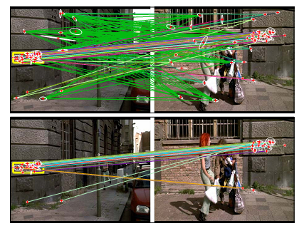
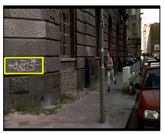
Stop list (contd…)

Slide 53
Stop list (contd…)
In the figure, we notice the matches after using stop list.
The top 5% and bottom 10% are stopped.
Notice the clear benefit of imposing stop list.
Reduce the number of mis-matches

Slide 54
Inverted File Structure
Inverted File structure for Indexing
Popular DS in Document Retrieval
Mapping from words to Document
Less query time compared to Forward indexing
Forward Indexing – Sequential
Inverted Indexing – Random

Slide 55
Words
Movie
D₃
D₂₃
D₂₅
D₁₀₅₁
D₁
Spain
D₁
D₃
D₈
…….
Table
D₂
D₈
D₁₀₀
D₂₀₂₉
…….
…….
…….
…….
…….
Song
D₁₂
D₁₀₇₈
D₁₀₂
D₂₅

Slide 56
Visual Analogy
Words ~ Visual Words
Documents ~ Frames
Query vector ~ visual words in Sub-Part of frame

Slide 57
Visual words
V₁
D₃
D₂₃
D₂₅
D₁₀₅₁
D₁
V₂
D₁
D₃
D₈
…….
V₃
D₂
D₈
D₁₀₀
D₂₀₂₉
…….
…….
…….
…….
…….
V_{n}
D₁₂
D₁₀₇₈
D₁₀₂
D₂₅

Slide 58
Ranking the results - tf-idf
Document – vector of word frequencies
Each component of the vector is given some weight
Standard Weighting Method
TF-IDF

Slide 59
Ranking the results - tf-idf
Each document is represented as a vector < t₁, t₂, t₃, … t_{i},…, t_{k-1}, t_{k} >
n_{id} - number of occurrences of i^{th} word in document d.
n_{d} - total number of words in document d.
n_{i} - number of occurrences of i^{th} visual word in whole database.
N - number of documents in the whole database
IDF – down weights most frequent words
Ranked by cosine of angle between query vector and all document vectors.

Slide 60
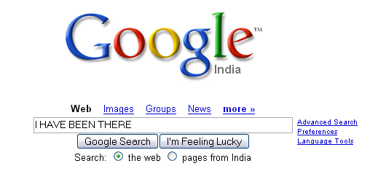
Ranking the results – Spatial Consistency
There it is. That’s what I ….. been .... have ….
I have been there once , while ……..
“Google increases the probability of documents having
all the search words close to one another"

Slide 61
Spatial Consistency Ranking
Spatial arrangement of objects in images.
Spatial consistency measure - Re-rank the results
Neighboring matches in the query region lie in a surrounding area in the retrieved image.

Slide 62
Spatial Consistency Ranking
Search area is defined by 15 nearest neighbors.
A neighbor in the surrounding area in the retrieved image counts as a vote.
Match with no support / hits is rejected.
Repeat this for every match.
Total number of votes decides the rank.

Slide 63
V
V
Number of votes = 3

Slide 64
Visual words
Frame 1
Frame 2
Frame 3
Frame N
V₁
10
7
0
4
V₂
4
3
0
8
…….
V₃
9
0
2
14
…….
…….
…….
…….
…….
V_{n}
0
2
0
8
36
23
4
57

Slide 65
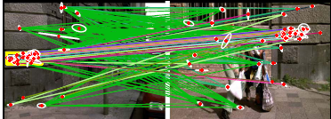
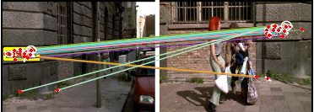
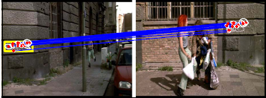
Initial Match
After Stoplist
After Spatial Consistency

Slide 66
Histogram of Gradients

Slide 67
Tested with
RGB
LAB
Grayscale
Gamma Normalization and Compression
Square root
Log

Slide 68
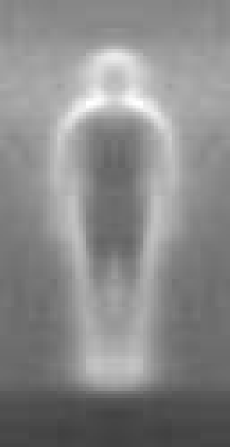

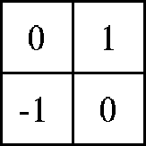

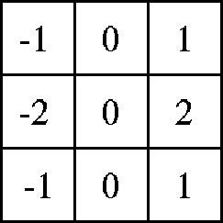

centered
diagonal
uncentered
cubic-corrected
Sobel

Slide 69
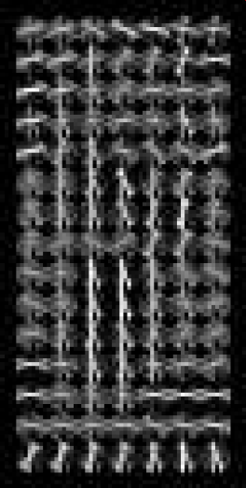
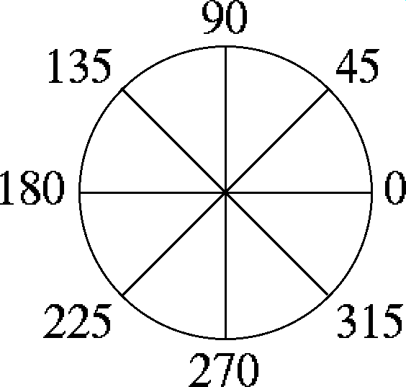
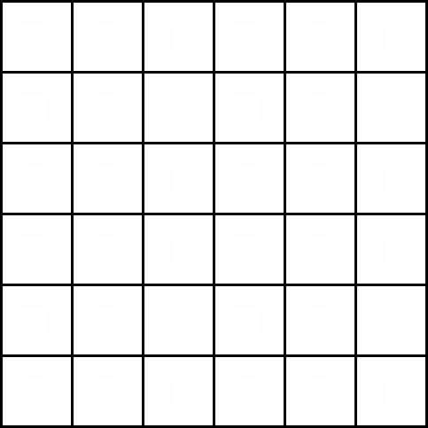
Histogram of gradient orientations
-Orientation -Position
Weighted by magnitude

Slide 70
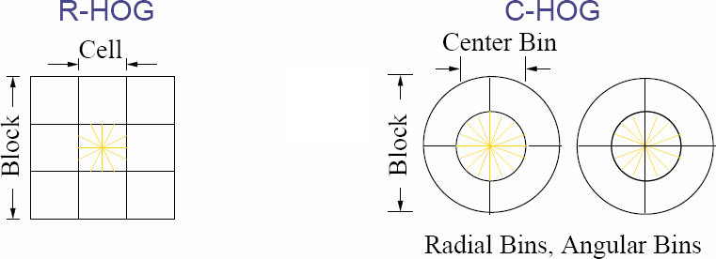

Slide 72


Slide 73
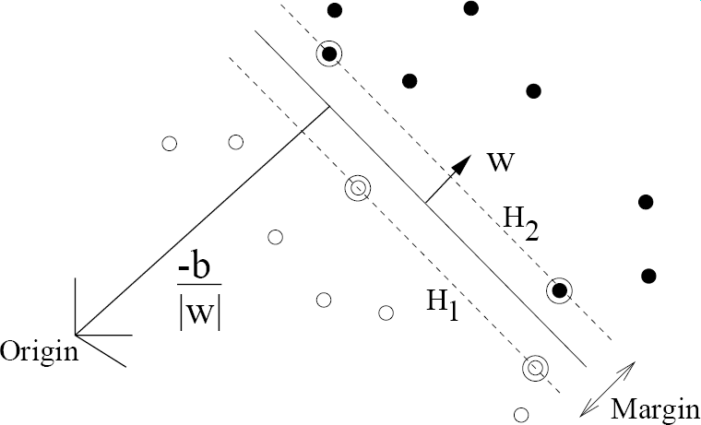

Slide 74
