Slide 1
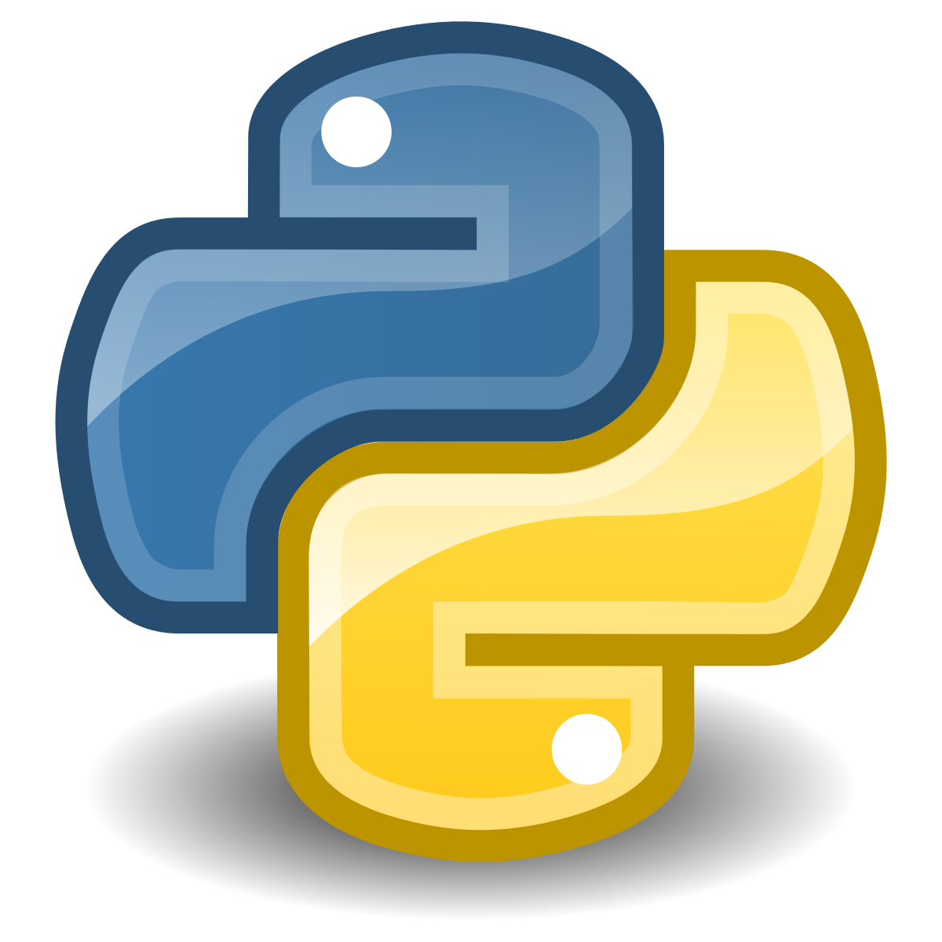
Welcome to Python!
Master in Big Data Solutions 2020-2021
Sergio Gago – Guillermo Alonso
sergiogh@gmail.com

Slide 2
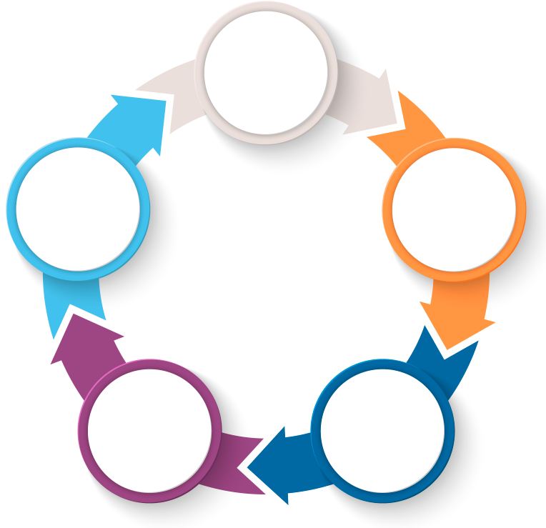
Project Lifecycle
DEFINE data-driven opportunities based on business value creation
UnderstandBusiness
IMPLEMENT & OPTIMIZE data-driven business models
Data collection
IDENTIFY, transform and validate data
Exploit
To lead and manage Big Data projects
Smart
Data
Analysis & Visualization
DEVELOP & TRAIN intelligent data algorithms
DEVELOP analytical and data visualization techniques

Slide 3
Project Lifecycle
Data-Driven Business
Creative Technology
Entrepreneurship
Big Data legal & Security
Agile
UnderstandBusiness
Data-Driven Business
Data Science Foundations
Big Data Infrastructure
Real-time Data Analysis
Big Data legal & Security
Agile
Data-Driven Business
Advanced Data Analysis
Big Data Infrastructure
Real-time Data Analysis
Big Data legal & Security
Agile
Data collection
Exploit
To lead and manage Big Data projects
Data-Driven Business
Data Visualization
Advanced Data Analysis
Artificial Intelligence
Big Data Infrastructure
Big Data legal & Security
Real-time Data Analysis
Agile
Smart
Data
Analysis & Visualization
Data-Driven Business
Data Science Foundations
Classical Data Analysis
Big Data Infrastructure
Real-time Data Analysis
Big Data legal & Security
Agile

Slide 4
Pre-Course
What we will learn
This course is designed to prepare students in the basics of programming to be able to follow the Master in Big Data Solutions.
We will learn:
Understand basic Computers, Networks and Unit Base Operative System concepts and tools.
Understand basic programming principle and code programs using python language
Use control version tools like Git to do collaborative development of python programs.
Use basic Python syntax to create simple programs
Learn programming best practices for their projects

Slide 5
Student Experience
Industry congresses
Meetups
Keynotes
Visits to companies
BTS DEMO
DAY
DIGITAL ECOSYSTEM
EXPERIENCE
A
ACADEMIC EXPERIENCE
B
Z
20%
100%
OF THE STUDENT EXPERIENCE
OF THE STUDENT EXPERIENCE
WORK ON YOUR PURPOSE - RESEARCH – DISCOVER –
BUILD NETWORKING – JOIN COMMUNITIES –
PARTICIPATE – GENERATE PUBLIC CONTENT

Slide 6
Session 1 - Objective
Meet each other
Identify what we don’t know and see how we will get it
Set the working basis for the course

Slide 7
Contents
Welcome! To BTS, to the Masters, and to BTS and to Barcelona
Who are we?
Why this pre-course and what you will learn
Introductions

Slide 8
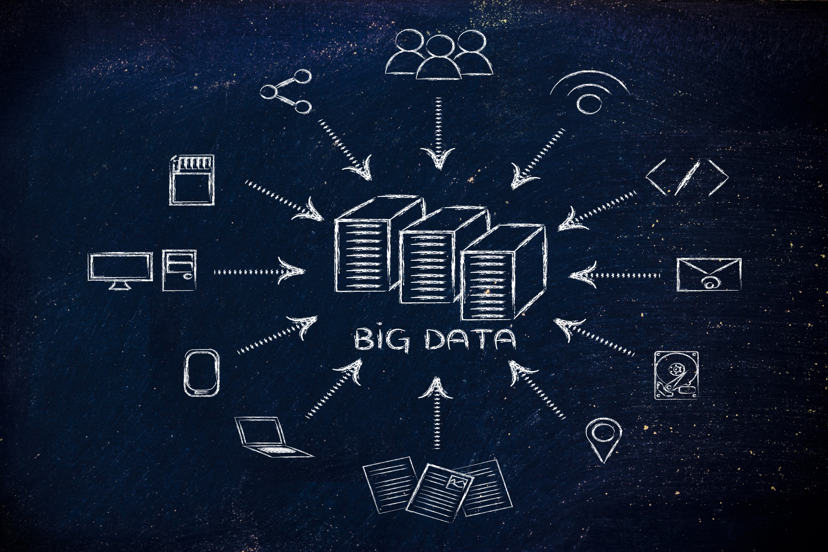
Welcome!

Slide 9
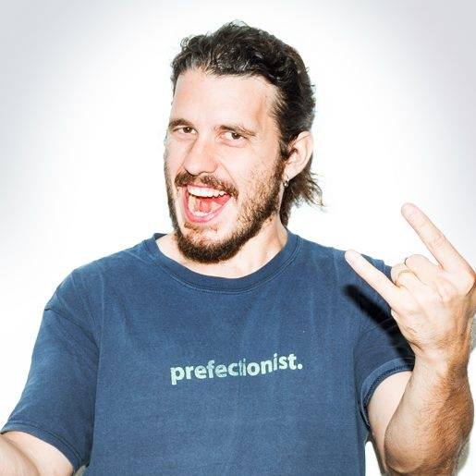
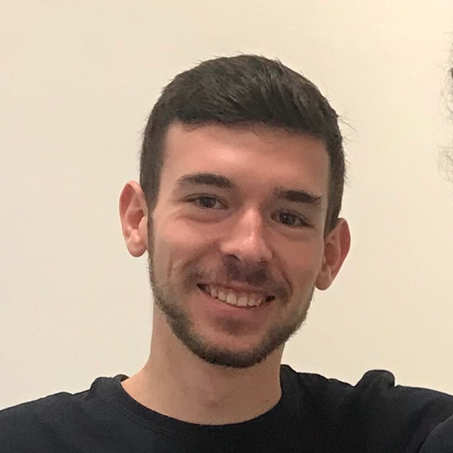
The Teachers
Sergio Gago Lead Instructor
20 years experience coding or managing developers
CTO at Naviga, Zinio, Rakuten
Entrepreneur and investor
Sometimes I hate Python (and Javascript).
Guillermo Alonso Course Instructor
Computer Scientist and Mathematician
Expert in Big Data and Machine Learning
He does love Python
Expert in Quantum Computing

Slide 10
Why Python

Slide 11
What we will learn? (in detail)
Use Unix based OS
Understand the “software engineering” mindset. Coding good practices, clean code. etc.
Have an overview of the software development landscape. Programming language types, most common frameworks, infrastructure providers.
Set up a working environment in Python, including setting up terminal, IDEs, version control, debugging, testing and deployment.
Use basic Python syntax to create simple programs
Do basic clean up and ordering operations on data files
Learn the basics of Object-Oriented Programming
Learn programming best practices for their projects
Integrate all these elements in a personal project

Slide 12
Course Structure
(More or less)
9 – 9:30 | Recap
9:30 - 11 | Lesson 1
11 – 11:30 | Morning Break
11:30 – 13:30 | Lesson 2
13:30 – 14:30 | Lunch Break
14:30 – 16:30 | Individual programming / Project Development
SEPTEMBER
M | T | W | T | F | S | S
 | 1 | 2 | 3 | 4 | 5 | 6
7 | 8 | 9 | 10 | 11 | 12 | 13
14 | 15 | 16 | 17 | 18 | 19 | 20
21 | 22 | 23 | 24 | 25 | 26 | 27
28 | 29 | 30 | 1 | 2 | 3 | 4

Slide 13
Contents
Fasten your seatbelts!
Computing basics
Brief history of where we are
Binary
Encoding
Operating Systems: Filesystems, Processes & threads, Networking
Introduction to programming
Learning to learn
How programmers approach problems
Programming languages, methodologies, frameworks and architectures
Infrastructure / Hosting basics
Coding good practices (introduction)
Development lifecycle
IDEs and tooling
Dependencies, libraries, components
Version Control: Git & Gitflow
Testing & CICD
Introduction to Python
Language history
Different implementations
Python Interpreter
Jupyter notebooks
Variables and Types
Keyboard input
Basic Operators
Flow Control
Lists and Dictionaries
Data structures
Strings operations and formatting
Functions
Classes
Key libraries: Numpy, Matplotlib
Regular Expressions
Exceptions
Working with Files
JSON workshop
Coding good practices applied
Design patterns
Clean Code
SOLID principles
TDD

Slide 14
Yes, but how
That’s a lot of stuff, how are we going to tackle it?
First, we will do a little bit of theory. Just to start from the same point
Then we will do some coding
Then we will continue coding
... More coding...
... And a bit more coding ...
... We will code until your eyes bleed ...
... And then we will code a final project in Python in pairs*...
* To be decided

Slide 15
Pre-Course Project
Choose one, or make your own
Traveller salesman problem
Super simple weather predictor
Marvel superhero explorer
Task List Manager
Snake game
Mastermind Game
Battleships!

Slide 16
Evaluation
Participation: 30%
Active participation in class is expected during the subject.
Individual Project and Assignments: 60%
Continuous assessment by delivery of individual exercises and group exercises.
Test: 10%
Result of tests done in class.
85% of attendance to each subject is required to pass the Master.

Slide 17
Let’s get to know each other!
Who are you, what do you do, where do you come from, what you expect from the course
What do you know about programming (and about Python)
Why do you want to work in Data?

Slide 18
