Slide 1
NN and AI applications in ISALab projects

Slide 2
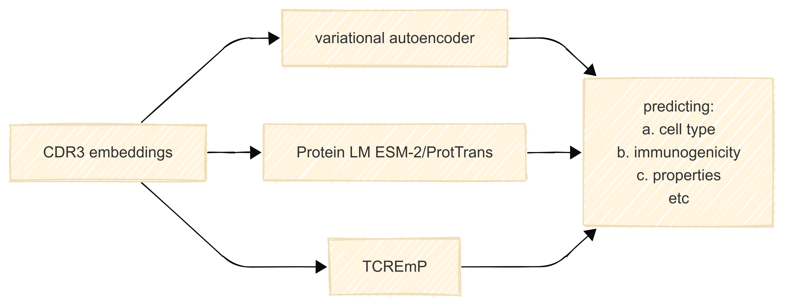
Embedding based approaches
Adopting various embeddings to be used in predicting CDR3 features
Biology associated TCREmP embeddings lack speed
Fine-tuning of autoencoder protein models for T/B cells

Slide 3
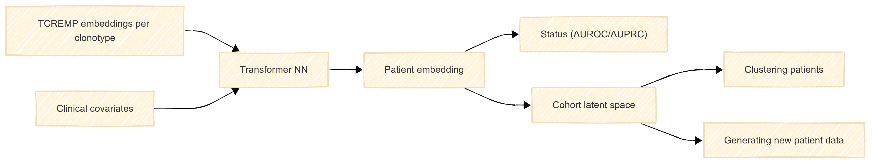
Embedding based approaches
Cluster donors in embedding space and surface rare/atypical immune portraits
Patient-level embeddings
Utilize CDR3 embeddings via creating a joint vector and dimensionality reduction
Predicting donor status and generating new donor data

Slide 4
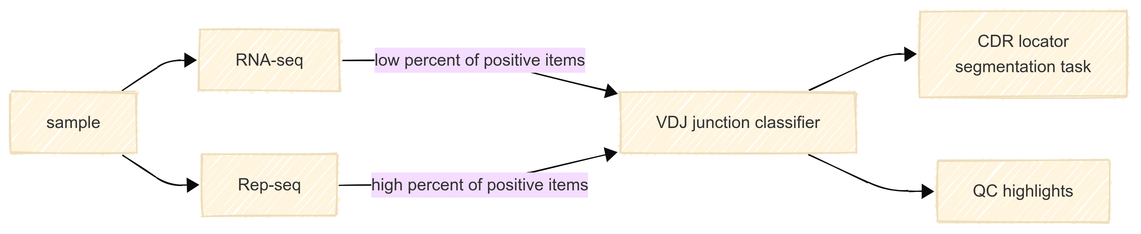
AI-driven extracting and summarizing antigen receptor gene rearrangements
Robustly locate CDR3 regions and flag VDJ junctions in noisy reads
Speed-up Rep/RNA- sequencing raw data alignment via GPU
Creating a VDJ junction presence classifier
Further, a task of read segmentation is planned to be solved

Slide 5
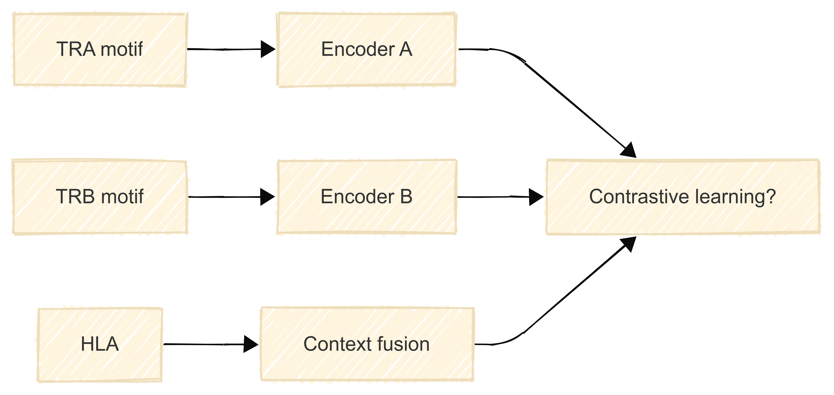
HLA‑aware TRA+TRB motif pairing
Imprinting the HLA context into TRA+TRB embeddings to create a contrastive learning model
Learn pairing preferences between TRA/TRB motifs conditioned on HLA

Slide 6
Conditional generative model for TCR landscape analysis
Learn joint embeddings for CDR3 and epitopes
Predict compatible MHCs;
Generate TCR candidates for specific MHC context and epitope

Slide 7
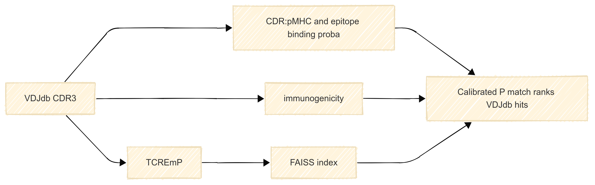
AI-based VDJdb hits ranking
Combine alignment scores, embedding similarities, immunogenicity, single‑cell phenotypes
Create ranked hits with calibrated P(match).

