Slide 1
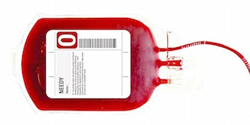
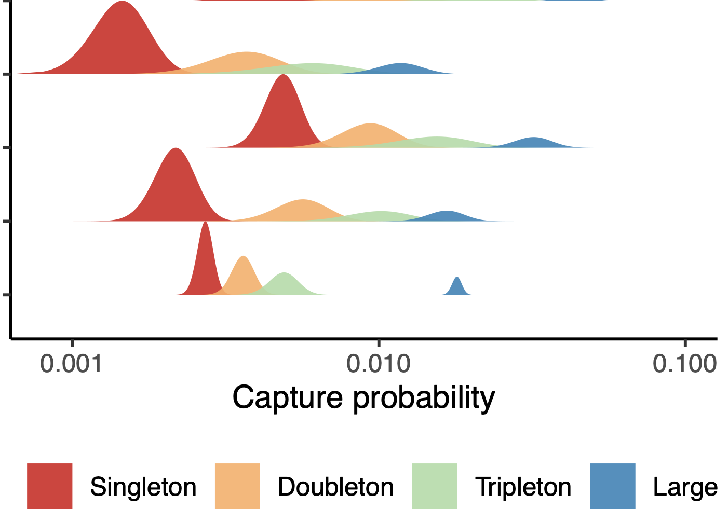

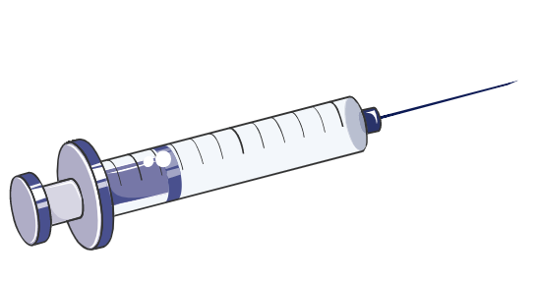

A
R
N(A)
B_{A}
n₁ n₂ …
by clones
B
A_{B}
c₁ c₂ …
by cells
N(B)
A
s = 1, 2,3, 3+
Problem: Estimate expected overlaps A_{B} and/or B_{A} if we only know summary statistics of both samples, such as diversity N: {N(A), n_{i}(A), c_{i}(A), N(B), n_{i}(B), c_{i}(B)}
rare
public /
expanded
Observation: Clones of size s have a well-defined probabilities to be captured in the following sample that increase exponentially with s:
Solution: Group clones by size s and build a linear model (using common R-style syntax)
log P ~ s + N
where P is the fraction of clones from A captured in B.
Condition/clone grouping effects are tested by introducing factor G
log P ~ s + N + G
Applications: Allows quantifying
- chimerism/subset survival in HSCT
- clonal dynamics in time courses
- emerging antigen-specific T-cells

