Slide 1

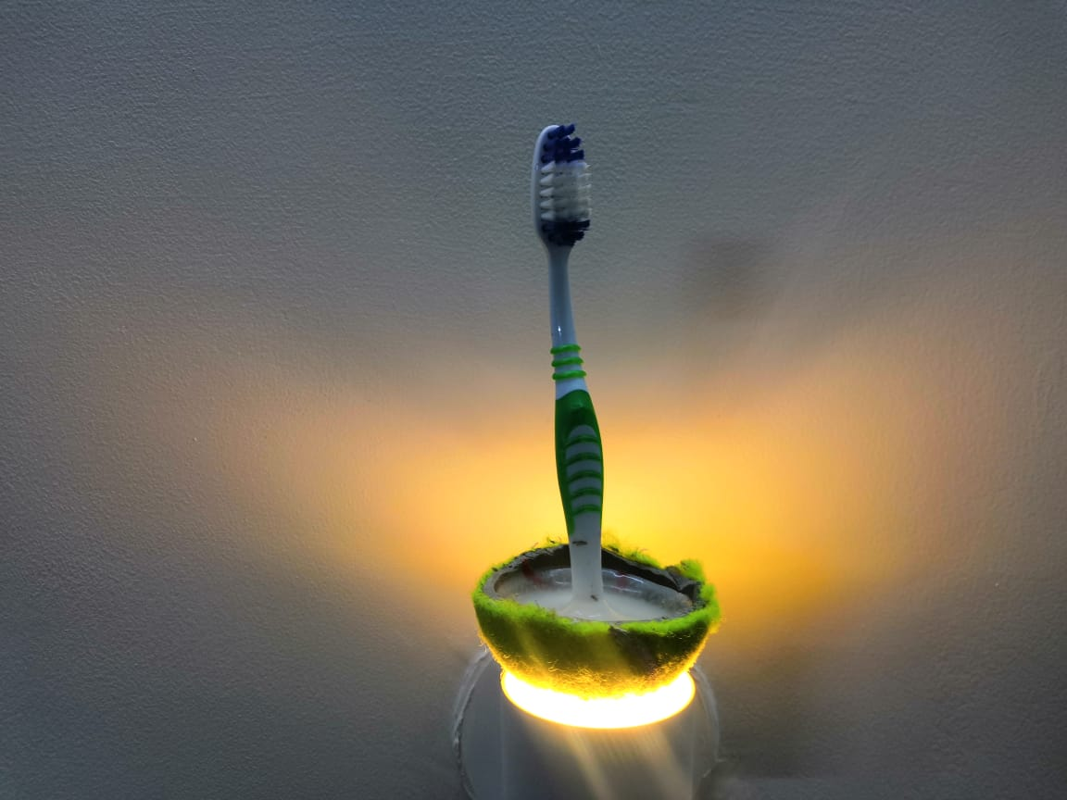
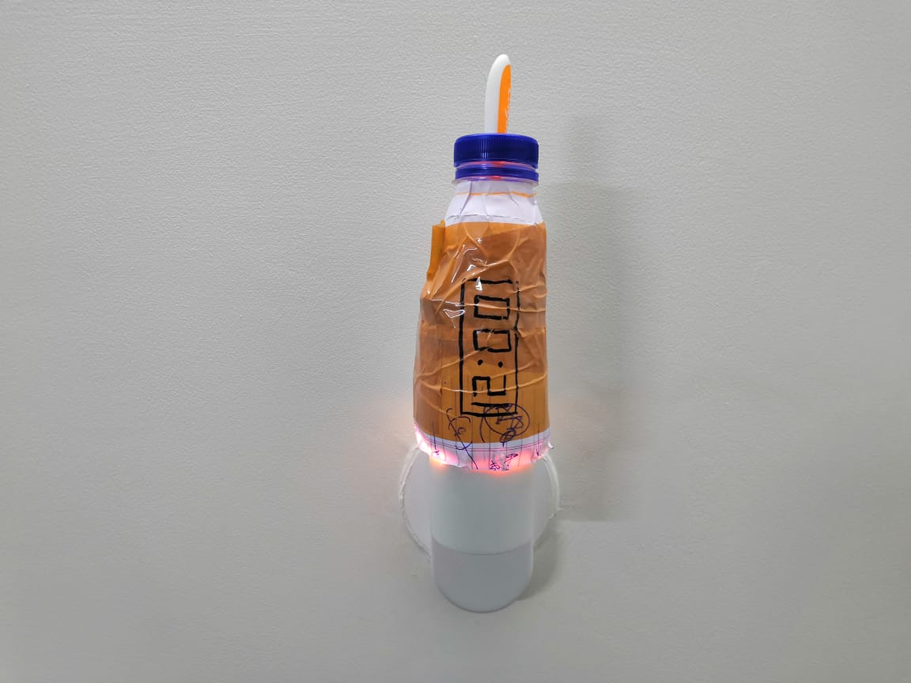
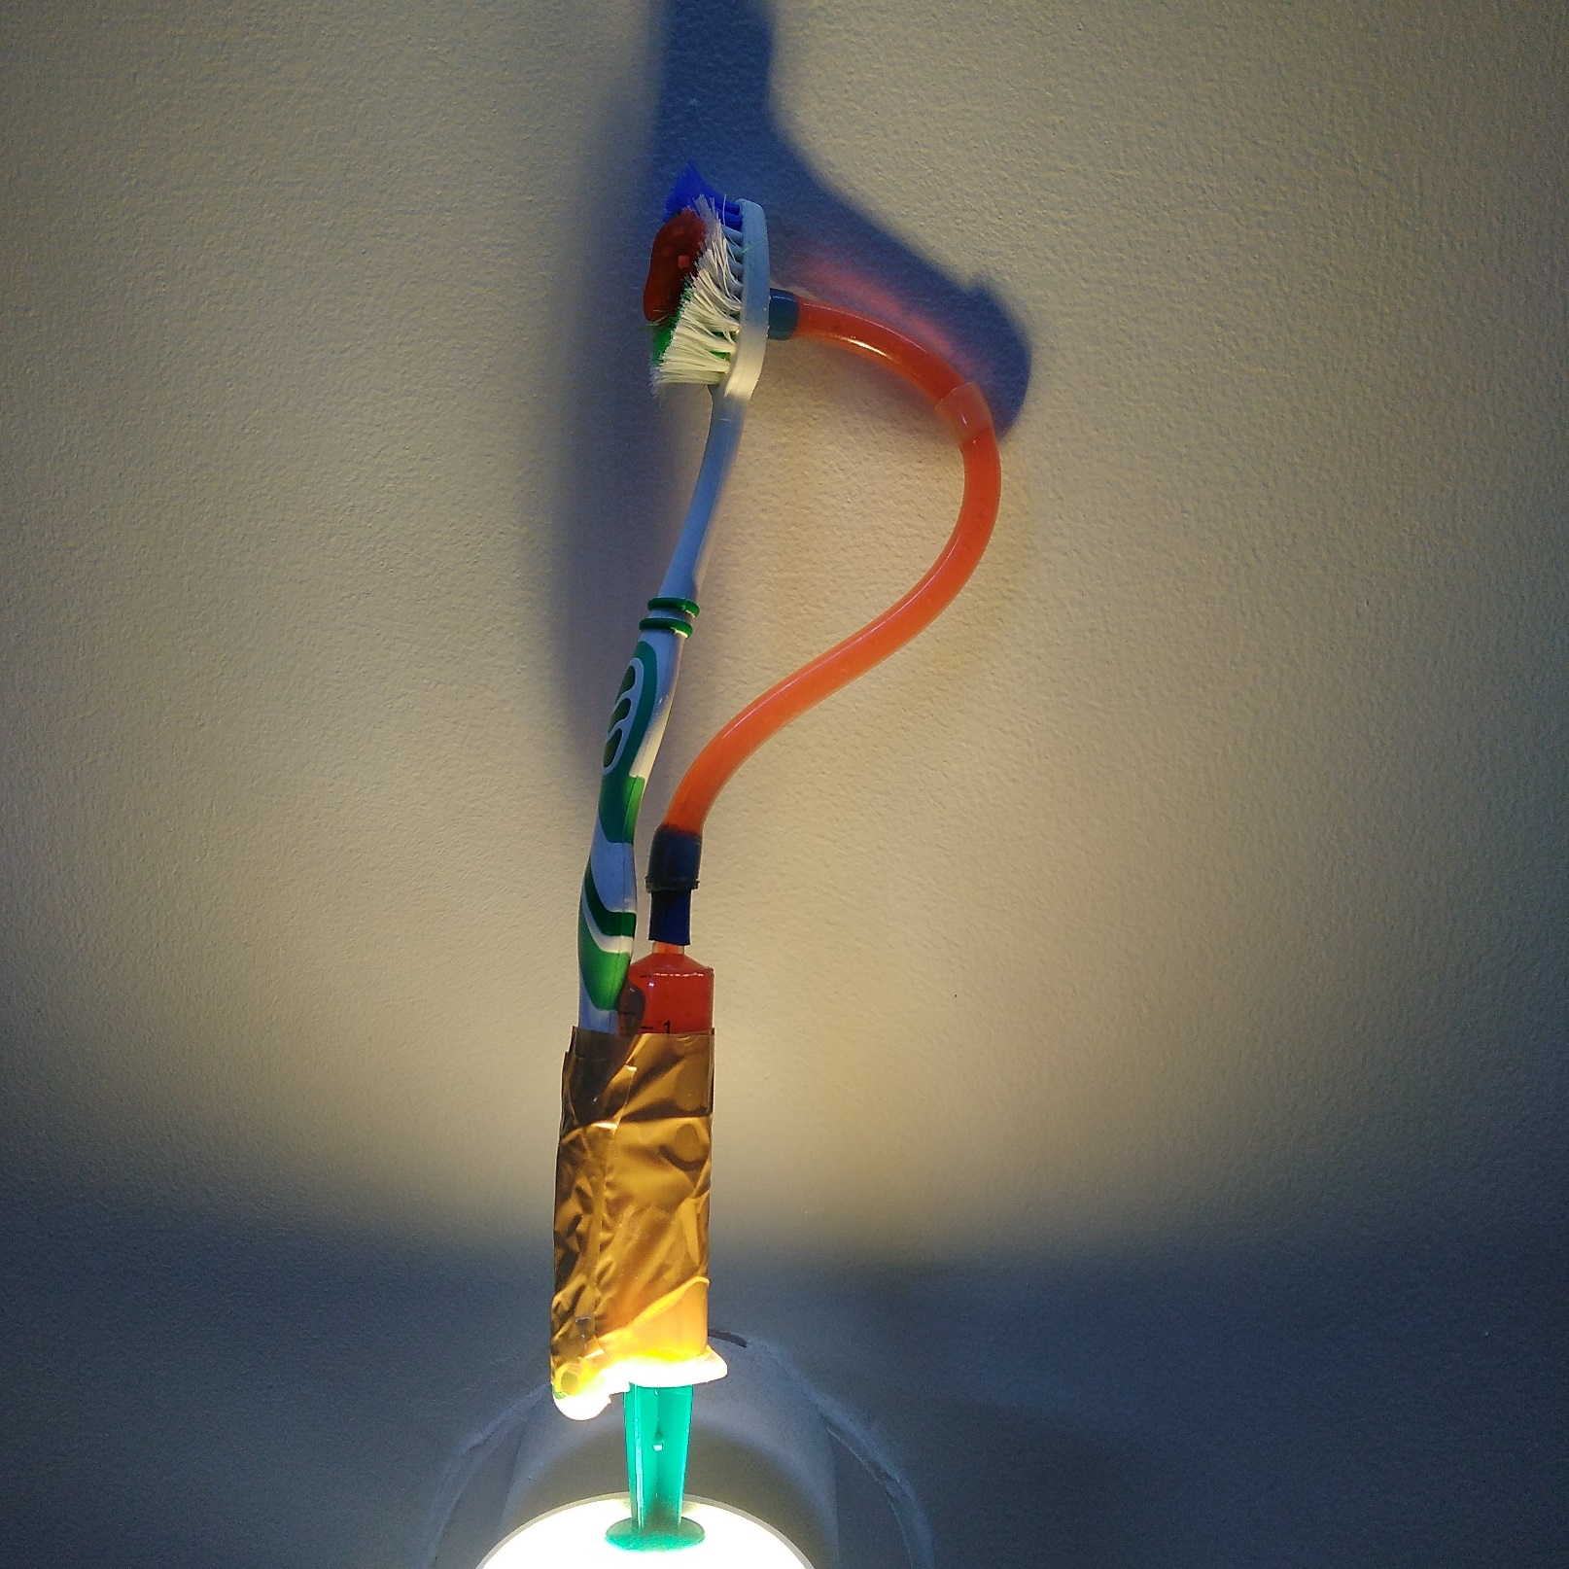
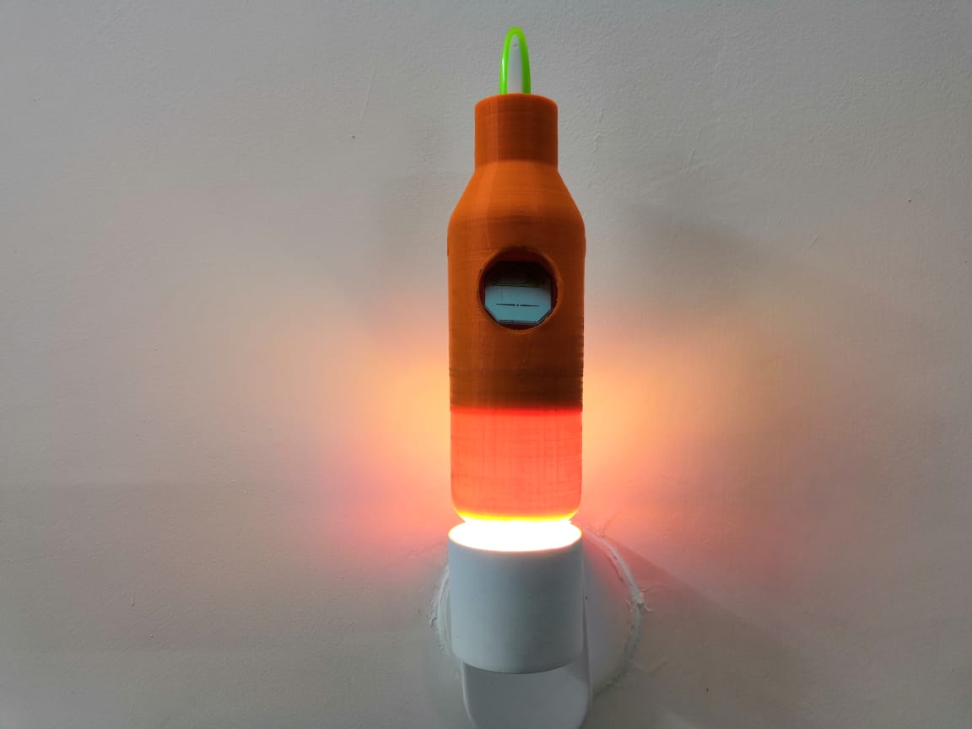
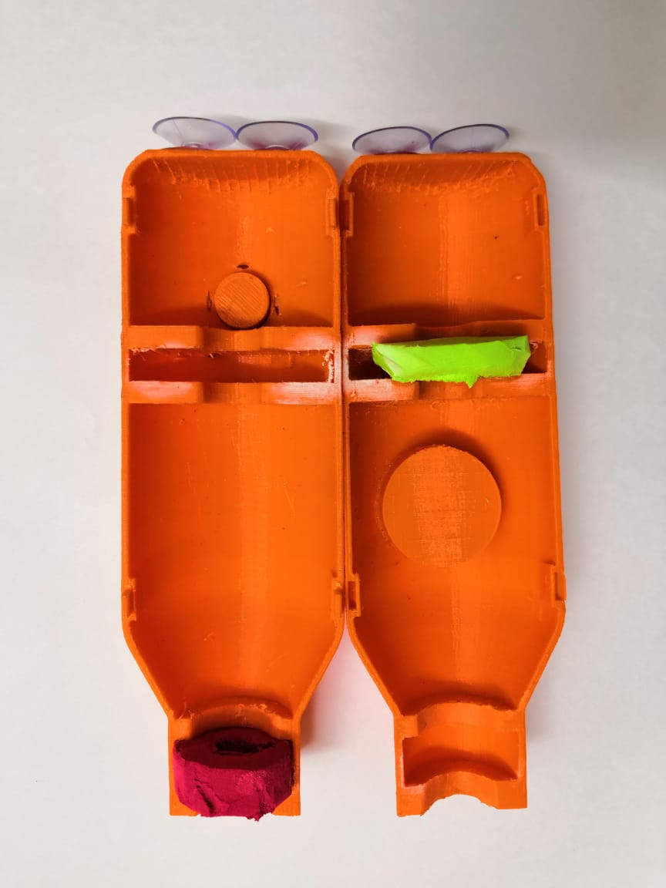
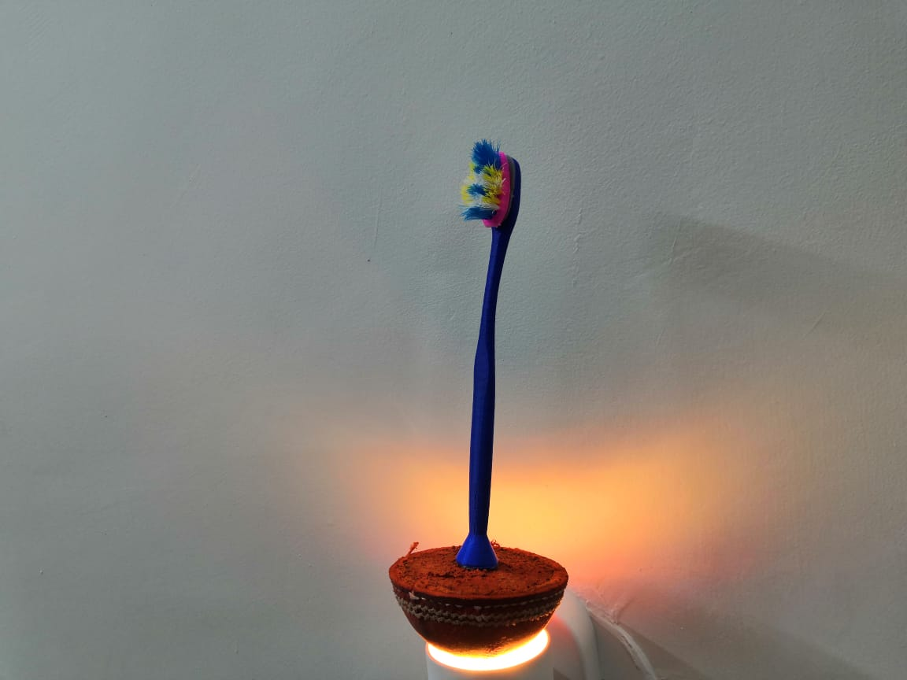
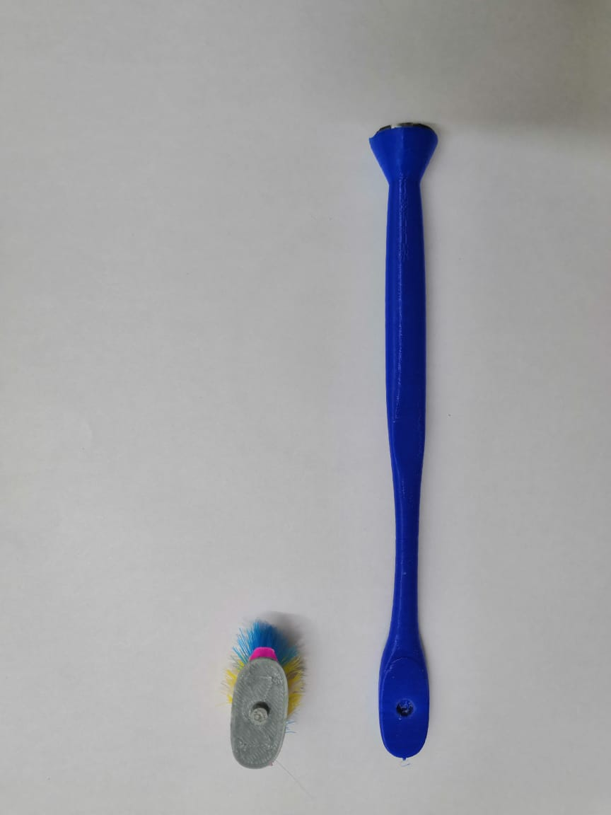


IIT Gandhinagar
ES 201 Introduction to design and Innovation
Title of the Project : ‘ Hassle-Free Brushing Tool’
Project brief: To design a solution for increasing usability and enhancing the user experience of a toothbrush. It is difficult to keep track of time while brushing. Bristles being exposed to the surrounding environment makes the toothbrush unhygienic to use. Falling of the toothbrush on ground from time to time makes it even more unhygienic. Increasing the life of a toothbrush.
Concept 1 : Balancing by Centre of Mass
Concept 2 : Holder with medicating agent
Concept 3 : Toothpaste Dispenser
Hygiene- The toothbrush balances by adjusting the center of mass of the whole device. It will protect it from falling.
Track of time- The toothbrush holder has an integrated clock.
Medicating agent- The bristles will be dipped inside a medicating agent for keeping the bristles bacteria-free. The medicating agent can be replaced from time to time.
Easy dispensing of toothpaste – Integrated toothpaste barrel to prevent carrying toothpaste explicitly. Toothpaste is dispensed by piston mechanism.​
“VIBRISTLY”
The toothbrush helps in maintaining track of time and provides a hygienic storage solution.
Track of Time: The holder contains a digital clock to keep track of time while brushing. This will aid the user to do brushing for a sufficient amount of time, without worrying about getting late. The user may speed up or slow down the brushing speed depending upon the time available.
Prevention of Toppling: Suction cups are attached at the bottom of the holder. This ensures that the holder remains firmly attached to the platform, thus preventing the toothbrush (inserted inside the holder) from tumbling or toppling.
Maintenance of Hygiene: While not in use, the toothbrush bristles remain immersed in a disinfectant present inside the holder. Thus, the bristles are protected from harmful particles present in external surroundings and are kept germ free by the disinfectant. The user remains protected from dental diseases. There is a designated place to replace the disinfectant.
Suction cups to prevent toppling of container
The toothbrush helps in maintain hygiene and is economical in the long run.
Replaceable Head: The toothbrush has a replaceable head. When the toothbrush bristles are worn out, a new head can be installed. The user doesn’t have to purchase a new brush altogether. This saves money and reduces the waste generated due to disposal of the toothbrush body.
Prevention of Toppling: There is a magnet attached to the bottom of the toothbrush and in the round container. This enables us to easily attach and detach the toothbrush from the container. The heavy container balances itself when given a jerk, thus protecting the toothbrush from falling on the surface and encountering germs.
Replaceable head to change the bristles when worn out
Explore Vibristly!
Aditya Tripathi
18110010
Sakshi Baheti
18110032
Hardik Khichi
18110059
Kushagra Sharma
18110091
Raghav Goyal
18110135
Siddharth Soni
18110165

