Slide 1

Engagement Report
April 2016

Slide 2
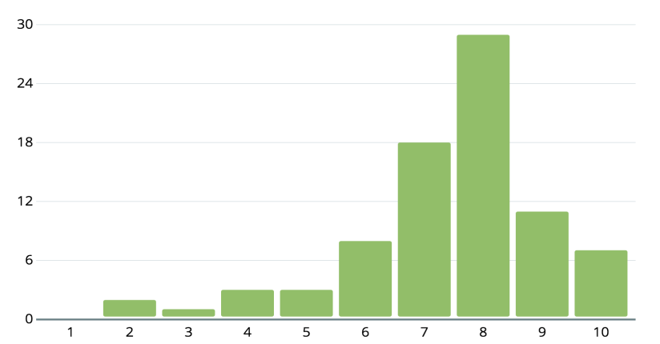
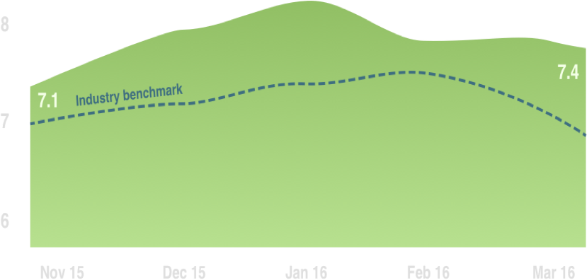
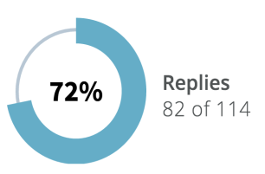
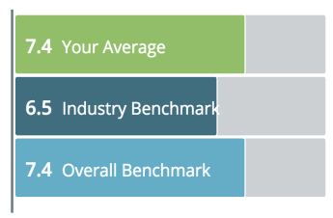
Mar 27th, 2016
On a scale from 1 to 10, how happy are you at work?
99
123
12

Slide 3
Mar 27th, 2016
38 responses | 2 Virtual Suggestions
36 responses | 10 Virtual Suggestions
"Love the new onboarding programs. I feel my new team members have a better sense about our customer base"
"I think it’s awesome the way the company has been focused on wellness and balance. I’ve been enjoying my classes at the Pro Club"
10
10
"I think it’s great management has committed to the annual education fund. I can’t wait to attend the upcoming MLDS Conference"
"I’m so appreciative of my team’s support during my eight weeks of maternity leave."
9
9
"It’s awesome that our management team is investing in Precision Questioning training. This will definitely help us get honest feedback as we evaluate Product."
"The new John Howie restaurant on the Redmond campus is a phenomenal deal at $15."
9
9
23 responses
36 responses
"Our management team is very open & respectful. I feel like recent changes have made it very easy for me to voice my opinion "
"We were recently purchased by Microsoft. I feel so blessed that the 365 team has made us feel at home from day one"
9
10
"Brenna has been a huge help in my onboarding. Lucky to have such a generous manager!"
"The new additions have really lightened the load. Good coworkers makes work so much better"
8
9
"It’s not often you find a manager who is truly self-critical. Because of Jim, our team is constantly learning and improving."
"I’m grateful for the flexibility to switch teams here. Variety is the spice of life, and I feel more inclined to stay with the company now that I have expos..."
8
9

