Slide 5
Happiness Highlight
Mar 27th, 2016
“Training Programs” 38 responses | 2 Virtual Suggestions
10
“Love the new onboarding programs. I feel my new team members have a better sense about our customer base”
9
“I think it’s great management has committed to the annual education fund. I can’t wait to attend the upcoming MLDS Conference”
9
“It’s awesome that our management team is investing in Precision Questioning training. This will definitely help us get honest feedback as we evaluate Product.

Slide 6
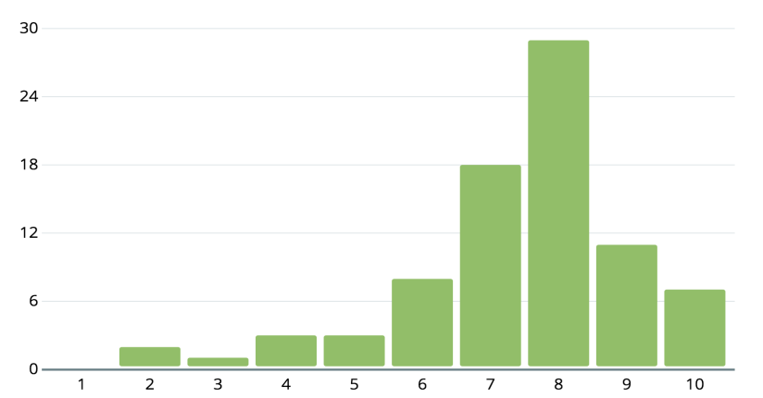
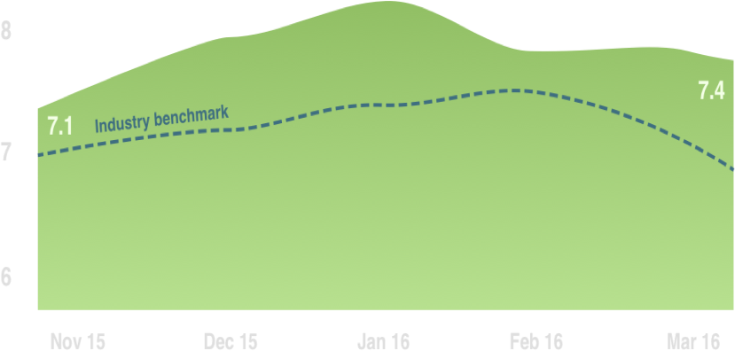
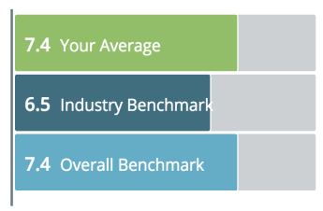
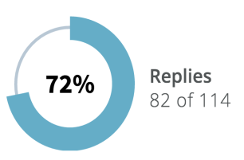

`
Shareback Report
Mar 27th, 2016
#question
Happiness Trend
#res
#che
#vss
Responses
Cheers
Virtual Suggestions

Slide 7

ENGAGEMENT REPORTS
Mar 9 - 16

Slide 8
On a scale from 1 to 10, how happy are you at work?

Slide 10
Shareback Report
Mar 27th, 2016
#r
#c
#vs
Replies
Responses
Cheers
Virtual Suggestions
82 of 114

