Slide 1
P&O Attribution
Stage Two Results – 15th December 2017

Slide 2
Agenda
Project Scope & Timings
MTA Methodology
Executive Summary
Conversion Journeys
Results and Results Deep Dive
‘Optimum’ Demo
Next Steps
Appendix

Slide 3
Project Scope & Timings

Slide 4
Project Overview
This is an update from the last presentation (‘Stage One’) of the project where we have re-run the Multi-Touch Attribution (MTA) model for P&O Bookings across the 5 core markets
The conversion window has been extended: July 14th – December 5th 2017
The conversion tags used in this project are P&O online bookings
All data is sourced from DoubleClick log files (DTV2 files) and Impact Radius
Media Channels Tracked:
  Display
  PPC Search
  Natural Search
  Affiliate
  Social (Facebook)
  Email
Note: Stage Two analysis includes All Conversions , not only First Conversions

Slide 5
Scope
Scope is the same as it was in Stage One of the analysis:
Carry out MTA for P&O Ferries Online Bookings across 5 markets by route:
    UK (Short Sea, North Sea I (Hull-Rotterdam), North Sea II (Hull-Zeebrugge), Irish Sea)
    France (Short Sea, North Sea I, North Sea II, Irish Sea)
    Germany (Short Sea, North Sea I, North Sea II, Irish Sea)
    Belgium (Short Sea, North Sea I, North Sea II, Irish Sea)
    Holland (Short Sea, North Sea I, North Sea II, Irish Sea)
We also have included mini-cruise routes for UK, Netherlands and Belgium

Slide 6
Project Timings
We are here!
Stage 1
Stage 2
Test
Integration
Completed Nov 17'
Full MTA to be completed before the end of Dec 17'
Test will begin in January alongside normal planning
Once the test has been proved successful we will move to full integration of MTA and 'Optimum' into digital spend
Recommendation to proceed to Stage 2
MTA will inlcude extra channels from stage 1 (Natural Search, email and affiliate site split)
Build 'Optimum' , the web application optimisation tool
Test will show the results (CPA) of what could have been achieved if the MTA recommendations had been implemented
Q2 2018 auto integration for DoubleClick search and ongoing development will be implemented
Begin integration of MTA results
November 17’ December 17’ January 18’ February 18’

Slide 7
Definitions Used in This Presentation
MTA : Multi-Touch Attribution
  The approach used in this project to more accurately reflect contribution from digital touchpoints toward conversions e.g. sales
LTA : Last-Touch Attribution
  Simple attribution approach where 100% of contribution credit is awarded to the last touchpoint prior to the conversion goal; the industry default view

Slide 8
Quick Reminder of Our Methodology

Slide 9
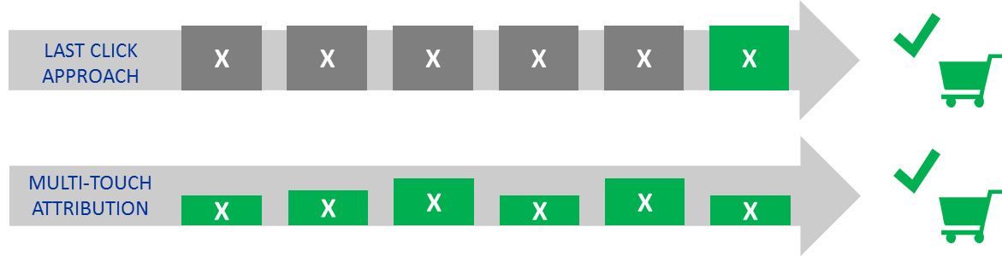




Last Click vs MTA
Which interaction is responsible for the conversion?
Email
Search
Display
Search
Affiliates
The industry default
LAST CLICK APPROACH
X
X
X
X
Email
Search
Display
Search
Affiliates
A better way…
MULTI-TOUCH ATTRIBUTION
Email
Search
Display
Search
Affiliates

Slide 10
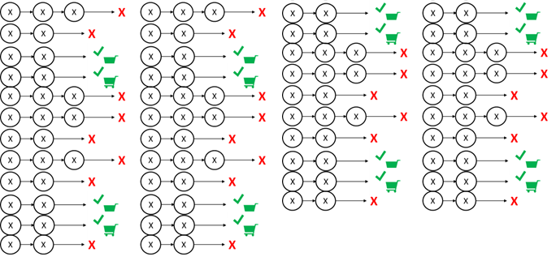
All Journey's Considered
All customer digital journeys are stitched together by user (cookie) IDs including those which convert and those which don’t
Database
(Cloud Storage)
TP1
TP2
TP3

Slide 11


Brief Outline Of Our Approach
Two questions to answer:
  Given a user journey, what is the conversion probability
  What is the contribution/effect of each touch point on the conversion probability
?
Search
Display
Affiliate
Search
Display
Affiliate
Search
Display
Affiliate

Slide 12
Executive Summary

Slide 13
Executive Summary – Top Line MTA Results
12% Efficiency Gain* for UK
14% Efficiency Gain* for Europe
Potential £600K Annual Saving
Across 5 Markets
Display is Undervalued by 79%
PPC is Overvalued by 8%
The Opportunity to Optimise within Channel is Even Greater
*Based on reallocating spend across digital channels PPC, Display, Affiliates and Social. Does not include intra channel optimisation which would be a further boost to increasing ROI

Slide 14
Executive Summary - Whole Period (July 14th – December 5th 2017)
-Display is undervalued, PPC and Affiliates are overvalued
 | LTA | MTA | % Change
Affiliate | 19,301 | 14,958 | -23%
Display | 11,848 | 22,558 | 90%
PPC | 57,137 | 52,492 | -8%
Social | 5 | 10 | 100%
Email | 2,477 | 1,895 | -23%
Natural Search | 9,643 | 7,660 | -21%
 | LTA | MTA | % Change
Affiliate | 1,666 | 1,203 | -28%
Display | 5,256 | 8,087 | 54%
PPC | 13,492 | 12,814 | -5%
Social | 13 | 26 | 100%
Email | 115 | 97 | -16%
Natural Search | 2,792 | 1,894 | -32%

Slide 15
Executive Summary – Part Period* (October 13th – December 5th 2017 )
-Cutting the period to capture full effect of Email and Natural Search does not change the overall story
 | LTA | MTA | % Change
Affiliate | 5,491 | 3,846 | -30%
Display | 1,572 | 2,858 | 82%
PPC | 13,600 | 12,161 | -11%
Social | 1 | 3 | 145%
Email | 2,477 | 1,895 | -23%
Natural Search | 9,643 | 7,660 | -21%
 | LTA | MTA | % Change
Affiliate | 473 | 325 | -31%
Display | 850 | 1,249 | 47%
PPC | 3,270 | 3,219 | -2%
Social | 2 | 3 | 42%
Email | 115 | 97 | -15%
Natural Search | 2,792 | 1,894 | -32%
*This period is cut to reflect the start of Natural Search and Email Tracking and will be used to calculate efficiency gains

Slide 16
Potential Savings from MTA Efficiency Gains
12% Increase
Largest potential saving comes from the UK
*For October – November 2017

Slide 17
Conversion Journeys

Slide 18
Most Common Multi-Touchpoint Pathways - July 14th – December 5th 2017
Conversions
Paid Search
Paid Search
8,020
Paid Search
Paid Search
Paid Search
2,714
61.5% of pathways (digital consumer journeys) have at least two Touchpoints
The top 15 pathways here represent almost 34.4% of all Multi-Touchpoint journeys
Affiliate
Affiliate
1,722
Paid Search
Affiliate
1,256
Display
Paid Search
1,156
Paid Search
Paid Search
Paid Search
Paid Search
1,035
Natural Search
Natural Search
899
Display
Display
774
Affiliate
Affiliate
Affiliate
749
Paid Search
Natural Search
719
Paid Search
Affiliate
Affiliate
658
Display
Display
Display
554
Display
Display
Paid Search
551
Paid Search
Paid Search
Paid Search
Paid Search
Paid Search
522
Display
Display
Display
Display
433

Slide 19
Most Common Multi-Touchpoint Pathways - October 13th – December 5th 2017
Conversions
Paid Search
Paid Search
1,824
Natural Search
Natural Search
941
Paid Search
Natural Search
872
59.8% of pathways (digital consumer journeys) have at least two Touchpoints
The top 15 pathways here represent almost 35.2% of all Multi-Touchpoint journeys
Paid Search
Paid Search
Paid Search
567
Affiliate
Affiliate
415
Email
Email
361
Paid Search
Affiliate
350
Natural Search
Paid Search
308
Natural Search
Natural Search
Natural Search
298
Paid Search
Paid Search
Natural Search
203
Natural Search
Affiliate
198
Display
Paid Search
193
Paid Search
Paid Search
Paid Search
189
Affiliate
Affiliate
Affiliate
180
Email
Email
Email
166

Slide 20
Results

Slide 21
Total Attribution Results
Channel | LTA Conversions | MTA Conversions | %MTA Difference
Total
Affiliate | 20,966 | 16,162 | -22.9%
Display | 17,104 | 30,646 | 79.2%
PPC | 70,628 | 65,305 | -7.5%
Social | 18 | 35 | 96.6%
Email | 2,592 | 1,992 | -23.1%
Natural Search | 12,436 | 9,554 | -23.2%
Total | 123,744 | 123,694
UK
Affiliate | 19,301 | 14,958 | -22.5%
Display | 11,848 | 22,558 | 90.4%
PPC | 57,137 | 52,492 | -8.1%
Social | 5 | 10 | 99.6%
Email | 2,477 | 1,895 | -23.5%
Natural Search | 9,643 | 7,660 | -20.6%
Total | 100,410 | 99,573
Euro
Affiliate | 1,666 | 1,203 | -27.7%
Display | 5,256 | 8,087 | 53.9%
PPC | 13,492 | 12,814 | -5.0%
Social | 13 | 26 | 95.5%
Email | 115 | 97 | -15.5%
Natural Search | 2,792 | 1,894 | -32.2%
Total | 23,334 | 24,121
Note: Affiliate, Display, PPC, Social numbers cover 14th Jul 2017 – 5th Dec 2017; Email, Natural Search, 13th Oct 2017 – 5th Dec 2017

Slide 22
Total Attribution Results – Desktop vs Mobile
Desktop
Mobile
Channel | LTA Conversions | MTA Conversions | %MTA Difference
Total
Affiliate | 15,394 | 11,088 | -28.0%
Display | 14,856 | 26,846 | 80.7%
PPC | 47,983 | 43,068 | -10.2%
Social | 11 | 25 | 132.0%
Email | 1,880 | 1,360 | -27.7%
Natural Search | 9,180 | 6,910 | -24.7%
Total | 89,304 | 89,297
UK
Affiliate | 13,938 | 10,063 | -27.8%
Display | 10,667 | 20,296 | 90.3%
PPC | 37,008 | 32,740 | -11.5%
Social | 1 | 4 | 249.4%
Email | 1,775 | 1,271 | -28.4%
Natural Search | 6,839 | 5,319 | -22.2%
Total | 70,228 | 69,692
Euro
Affiliate | 1,456 | 1,025 | -29.6%
Display | 4,189 | 6,551 | 56.4%
PPC | 10,975 | 10,329 | -5.9%
Social | 10 | 21 | 117.3%
Email | 106 | 89 | -15.7%
Natural Search | 2,341 | 1,591 | -32.1%
Total | 19,076 | 19,605
Channel | LTA Conversions | MTA Conversions | %MTA Difference
Total
Affiliate | 5,573 | 5,076 | -8.9%
Display | 2,263 | 3,809 | 68.3%
PPC | 22,430 | 22,077 | -1.6%
Social | 7 | 10 | 43.6%
Email | 749 | 657 | -12.3%
Natural Search | 3,257 | 2,645 | -18.8%
Total | 34,279 | 34,274
UK
Affiliate | 5,363 | 4,897 | -8.7%
Display | 1,192 | 2,276 | 91.0%
PPC | 19,912 | 19,590 | -1.6%
Social | 4 | 5 | 49.7%
Email | 738 | 647 | -12.3%
Natural Search | 2,806 | 2,342 | -16.5%
Total | 30,013 | 29,758
Euro
Affiliate | 210 | 178 | -15.2%
Display | 1,072 | 1,533 | 43.1%
PPC | 2,519 | 2,487 | -1.3%
Social | 4 | 5 | 37.6%
Email | 11 | 10 | -11.3%
Natural Search | 451 | 303 | -32.8%
Total | 4,266 | 4,516
Note: Affiliate, Display, PPC, Social numbers cover 14th Jul 2017 – 5th Dec 2017; Email, Natural Search, 13th Oct 2017 – 5th Dec 2017

Slide 23
MTA vs LTA by Channel and Sub-Channel UK
Channel/Sub-Channel | LTA Conversions | MTA Conversions | % MTA Difference
Affiliate | 19,301 | 14,958 | -22.5%
KWB | 4,604 | 3,413 | -25.9%
Cashback / Loyalty | 2,812 | 1,979 | -29.6%
Sub-Network | 394 | 290 | -26.4%
Voucher | 9,589 | 6,258 | -34.7%
Content | 186 | 168 | -9.4%
Long-Tail | 47 | 44 | -7.0%
Other | 1,669 | 2,806 | 68.1%
Display | 11,848 | 22,558 | 90.4%
Awareness | 272 | 781 | 186.7%
Prospecting | 6,575 | 13,213 | 101.0%
Retargeting | 2,596 | 3,927 | 51.3%
Targeting | 19 | 73 | 281.4%
Other | 2,386 | 4,564 | 91.3%
PPC | 57,137 | 52,492 | -8.1%
Generic | 12,589 | 12,654 | 0.5%
Brand | 43,178 | 38,636 | -10.5%
Competitor | 23 | 24 | 6.1%
Other | 1,346 | 1,178 | -12.5%
Social | 5 | 10 | 99.6%
Email | 2,477 | 1,895 | -23.5%
Adhoc | 1,978 | 1,516 | -23.3%
Triggered | 499 | 379 | -24.0%
Natural Search | 9,643 | 7,660 | -20.6%
Total | 100,410 | 99,573 | -0.8%
Note: Affiliate, Display, PPC, Social numbers cover 14th Jul 2017 – 5th Dec 2017; Email, Natural Search, 13th Oct 2017 – 5th Dec 2017

Slide 24
MTA vs LTA by Channel and Sub-Channel France
Channel/Sub-Channel | LTA Conversions | MTA Conversions | % MTA Difference
Affiliate | 811 | 472 | -41.9%
KWB | 1 | 1 | -24.8%
Cashback / Loyalty | - | 0 | 0.0%
Voucher | 8 | 5 | -42.3%
Other | 802 | 465 | -41.9%
Display | 1,722 | 2,873 | 66.8%
Awareness | 2 | 22 | 833.5%
Prospecting | 335 | 671 | 100.3%
Retargeting | 1,322 | 1,948 | 47.3%
Other | 62 | 232 | 271.6%
PPC | 4,825 | 4,962 | 2.8%
Generic | 1,164 | 1,215 | 4.4%
Brand | 2,948 | 3,064 | 3.9%
Competitor | 20 | 25 | 23.6%
Other | 692 | 657 | -5.2%
Social | 11 | 20 | 84.9%
Email | 83 | 69 | -16.8%
Adhoc | 55 | 48 | -12.2%
Triggered | 28 | 20 | -25.9%
Natural Search | 1,414 | 879 | -37.8%
Total | 8,866 | 9,274 | 4.6%
Note: Affiliate, Display, PPC, Social numbers cover 14th Jul 2017 – 5th Dec 2017; Email, Natural Search, 13th Oct 2017 – 5th Dec 2017

Slide 25
MTA vs LTA by Channel and Sub-Channel Germany
Channel/Sub-Channel | LTA Conversions | MTA Conversions | % MTA Difference
Affiliate | 199 | 162 | -18.9%
KWB | - | 0 | 0.0%
Voucher | 4 | 6 | 0.0%
Other | 196 | 155 | -20.7%
Display | 1,278 | 1,796 | 40.5%
Awareness | 1 | 1 | 0.0%
Prospecting | 158 | 318 | 100.6%
Retargeting | 1,118 | 1,477 | 32.1%
PPC | 2,718 | 2,515 | -7.5%
Generic | 910 | 881 | -3.1%
Brand | 1,698 | 1,546 | -8.9%
Competitor | 16 | 14 | -8.9%
Other | 95 | 74 | -22.3%
Email | 1 | 2 | 79.4%
Triggered | 1 | 2 | 79.4%
Natural Search | 362 | 269 | -25.7%
Total | 4,559 | 4,744 | 4.1%
Note: Affiliate, Display, PPC, Social numbers cover 14th Jul 2017 – 5th Dec 2017; Email, Natural Search, 13th Oct 2017 – 5th Dec 2017

Slide 26
MTA vs LTA by Channel and Sub-Channel Netherlands
Channel/Sub-Channel | LTA Conversions | MTA Conversions | % MTA Difference
Affiliate | 556 | 484 | -12.9%
KWB | - | 1 | 0.0%
Cashback / Loyalty | - | 0 | 0.0%
Voucher | 7 | 5 | -31.7%
Other | 548 | 478 | -12.8%
Display | 1,121 | 1,656 | 47.8%
Awareness | - | 3 | 0.0%
Prospecting | 202 | 416 | 106.5%
Retargeting | 917 | 1,231 | 34.2%
Other | 2 | 6 | 166.0%
PPC | 3,059 | 2,808 | -8.2%
Generic | 713 | 721 | 1.2%
Brand | 2,093 | 1,816 | -13.2%
Competitor | 12 | 17 | 42.0%
Other | 241 | 254 | 5.2%
Social | 1 | 2 | 60.5%
Email | 28 | 22 | -18.6%
Triggered | 28 | 22 | -18.6%
Natural Search | 577 | 468 | -19.0%
Total | 5,341 | 5,441 | 1.9%
Note: Affiliate, Display, PPC, Social numbers cover 14th Jul 2017 – 5th Dec 2017; Email, Natural Search, 13th Oct 2017 – 5th Dec 2017

Slide 27
MTA vs LTA by Channel and Sub-Channel Belgium
Channel/Sub-Channel | LTA Conversions | MTA Conversions | % MTA Difference
Affiliate | 100 | 86 | -13.6%
KWB | - | 1 | 0.0%
Voucher | 7 | 2 | 0.0%
Other | 92 | 84 | -9.5%
Display | 1,135 | 1,762 | 55.2%
Awareness | - | 1 | 0.0%
Prospecting | 263 | 634 | 0.0%
Retargeting | 872 | 1,127 | 29.2%
PPC | 2,888 | 2,529 | -12.5%
Generic | 671 | 647 | -3.5%
Brand | 1,988 | 1,642 | -17.4%
Competitor | 12 | 14 | 14.8%
Other | 217 | 226 | 3.9%
Social | 1 | 4 | 226.4%
Email | 4 | 4 | 7.6%
Triggered | 2 | 3 | 11.0%
Other | 1 | 1 | 0.9%
Natural Search | 439 | 277 | -36.8%
Total | 4,567 | 4,661 | 2.1%
Note: Affiliate, Display, PPC, Social numbers cover 14th Jul 2017 – 5th Dec 2017; Email, Natural Search, 13th Oct 2017 – 5th Dec 2017

Slide 28
Results Deep Dive

Slide 29
LTA vs MTA by Route and Channel UK
Route/Channel | LTA Conversions | MTA Conversions | %MTA Difference
irish sea-ferry | 11,044 | 11,027 | -0.2%
Affiliate | 1,910 | 1,499 | -21.5%
Display | 1,049 | 2,160 | 105.9%
Email | 97 | 75 | -23.2%
Natural Search | 1,129 | 860 | -23.8%
PPC | 6,858 | 6,433 | -6.2%
Social | - | 0 | 0.0%
north sea-ferry-1 | 5,460 | 5,383 | -1.4%
Affiliate | 1,242 | 947 | -23.8%
Display | 632 | 1,346 | 112.8%
Email | 114 | 83 | -27.6%
Natural Search | 623 | 468 | -24.9%
PPC | 2,849 | 2,540 | -10.8%
Social | - | 0 | 0.0%
north sea-ferry-2 | 3,932 | 3,862 | -1.8%
Affiliate | 1,092 | 837 | -23.3%
Display | 410 | 956 | 132.9%
Email | 148 | 109 | -25.9%
Natural Search | 427 | 316 | -26.1%
PPC | 1,855 | 1,644 | -11.4%
Social | - | 0 | 0.0%
short sea-ferry | 69,660 | 69,002 | -0.9%
Affiliate | 12,092 | 9,239 | -23.6%
Display | 8,305 | 15,548 | 87.2%
Email | 2,000 | 1,544 | -22.8%
Natural Search | 6,516 | 5,333 | -18.2%
PPC | 40,742 | 37,332 | -8.4%
Social | 4 | 5 | 35.9%
minicruise | 9,408 | 9,393 | -0.2%
Affiliate | 2,938 | 2,409 | -18.0%
Display | 809 | 1,907 | 135.7%
Email | 116 | 83 | -28.8%
Natural Search | 948 | 683 | -27.9%
PPC | 4,597 | 4,309 | -6.3%
Social | - | 3 | 0.0%
Note: Affiliate, Display, PPC, Social numbers cover 14th Jul 2017 – 5th Dec 2017; Email, Natural Search, 13th Oct 2017 – 5th Dec 2017

Slide 30
Display– TOP 20 Placements
Top 20 placements show large differences between LTA and MTA
Campaign | LTA Conversions | MTA Conversions | %MTA Difference
DISP_UK_Q2_P&O Short Sea 2017 | 5,032 | 9,014 | 79.1%
DISP_UK_Q2_P&O North Sea 2017 | 1,895 | 3,682 | 94.3%
DISP_FR_Q2_P&O 2017 | 1,657 | 2,622 | 58.2%
P&O Visit Passchendaele | 1,297 | 2,408 | 85.6%
DISP_UK_Q3_P&O North Sea 2017 | 728 | 1,966 | 169.9%
DISP_DE_Q2_P&O 2017 | 1,246 | 1,759 | 41.2%
DISP_NL_Q2_P&O 2017 | 1,121 | 1,656 | 47.8%
DISP_BN_Q2_P&O 2017 | 1,009 | 1,432 | 41.9%
DISP_UK_Q2_P&O Irish Sea 2017 | 678 | 1,363 | 101.1%
P&O - DISP - Visit Holland - AugOct 2017 | 660 | 1,205 | 82.5%
P&O - DISP - Tourism Ireland - Sep 2017 | 584 | 1,091 | 86.7%
P&O - DISP - Half Term Minicruise - Sep 2017 | 325 | 554 | 70.4%
DISP_BF_Q2_P&O 2017 | 126 | 330 | 161.7%
P&O - DISP - NS/SS - NOV 2017 | 256 | 325 | 27.0%
P&O - Q4 - Visit Bruges - 2017 | 103 | 271 | 162.4%
DISP_P&O_France Summer Education 2017 | 62 | 232 | 271.6%
P&O - Free Fuel - UK - October 2017 | 136 | 232 | 71.0%
P&O - DISP - Awareness - SS - 2017 | 31 | 116 | 271.0%
DISP_UK_Q4_P&O_Mobile Test_2017 | 34 | 113 | 234.9%
P&O - DISP - Awareness - NS - 2017 | 23 | 85 | 271.8%
P&O Ferries_Partnership Adserving_201718 | 25 | 64 | 152.4%
P&O - DISP - IS - NOV 2017 | 35 | 52 | 48.8%
P&O Visit Britain Oct 2017 | 32 | 37 | 14.8%
P&O - DISP - Awareness - IS - 2017 | 6 | 20 | 230.4%
P&O - Free Fuel - EU - Q4 2017 | 1 | 10 | 745.5%
Note: Affiliate, Display, PPC, Social numbers cover 14th Jul 2017 – 5th Dec 2017; Email, Natural Search, 13th Oct 2017 – 5th Dec 2017

Slide 31
Paid Search – Generic Level TOP 20 Keywords UK
Top 20 generic keywords show large differences between LTA and MTA
Paid Search Keyword | LTA Conversions | MTA Conversions | %MTA Difference
ferry to france | 950 | 882 | -7.2%
dover to calais | 773 | 837 | 8.3%
ferries to france | 421 | 415 | -1.5%
dover calais ferry | 323 | 333 | 3.2%
dover to calais ferry | 353 | 329 | -6.7%
+ferry | 320 | 319 | -0.4%
+calais +dover | 246 | 245 | -0.4%
calais dover | 253 | 243 | -3.9%
ferry dover to calais | 223 | 223 | 0.1%
ferry dover calais | 214 | 202 | -5.2%
ferry to calais | 179 | 180 | 0.8%
ferry from dover to calais | 169 | 175 | 3.6%
dover calais | 178 | 171 | -3.9%
calais to dover | 175 | 169 | -3.4%
cairnryan to larne | 188 | 163 | -13.3%
ferry | 144 | 146 | 1.5%
ferry calais dover | 134 | 133 | -1.0%
+calais +ferry | 119 | 127 | 7.1%
calais dover ferry | 124 | 117 | -5.2%
north sea ferries | 139 | 113 | -19.0%
Note: Affiliate, Display, PPC, Social numbers cover 14th Jul 2017 – 5th Dec 2017; Email, Natural Search, 13th Oct 2017 – 5th Dec 2017

Slide 32
Paid Search – Brand Level TOP 20 Keywords UK
Top 20 branded keywords show large differences between LTA and MTA
Paid Search Keyword | LTA Conversions | MTA Conversions | % MTA Difference
p&o ferries | 8,051 | 7,304 | -9.3%
p and o ferries | 5,476 | 4,972 | -9.2%
p&o | 4,058 | 3,536 | -12.9%
p&o ferry | 2,880 | 2,504 | -13.0%
p and o | 2,240 | 2,120 | -5.4%
p & o ferries | 2,387 | 1,995 | -16.4%
p & o ferry | 1,706 | 1,613 | -5.5%
ferry p&o | 1,066 | 1,050 | -1.5%
po ferries | 1,057 | 914 | -13.6%
+p&o | 1,033 | 890 | -13.9%
p o ferries | 882 | 794 | -10.0%
p and o ferry | 708 | 686 | -3.1%
po ferry | 550 | 574 | 4.4%
poferries | 593 | 513 | -13.5%
pando ferries | 545 | 465 | -14.7%
p&o ferries dover | 511 | 415 | -18.8%
pando | 350 | 322 | -8.1%
p&0 ferries | 294 | 251 | -14.5%
p&o ferries dover to calais | 246 | 205 | -16.8%
pando ferry | 216 | 198 | -8.3%
p&o mini cruise | 163 | 152 | -6.7%
Note: Affiliate, Display, PPC, Social numbers cover 14th Jul 2017 – 5th Dec 2017; Email, Natural Search, 13th Oct 2017 – 5th Dec 2017

Slide 33
Affiliate– TOP 20 Sites UK
Top 20 sites show large differences between LTA and MTA
Site | Category | LTA Conversions | MTA Conversions | %MTA Difference
UK Web Media LTD | KWB | 2,605 | 1,927 | -26.0%
RetailMeNot UK Ltd. | Voucher | 2,936 | 1,878 | -36.0%
Net Media Planet | KWB | 2,000 | 1,489 | -25.6%
Quidco | Voucher | 2,032 | 1,414 | -30.4%
TopCashback Ltd | Cashback / Loyalty | 1,924 | 1,352 | -29.7%
Webgears GmbH | Voucher | 1,726 | 1,117 | -35.3%
Invitation Digital Ltd | Voucher | 954 | 610 | -36.1%
Groupon International Limited | Voucher | 775 | 506 | -34.7%
The Global Voucher Group Ltd, | Voucher | 806 | 505 | -37.4%
Reward Gateway (UK) Ltd | Cashback / Loyalty | 404 | 305 | -24.5%
The Support Group | Cashback / Loyalty | 277 | 181 | -34.8%
digidip GmbH | Sub-Network | 188 | 165 | -12.6%
Skimbit, Ltd. | Sub-Network | 205 | 125 | -39.1%
Holidaypirates Ltd | Content | 110 | 103 | -6.4%
bor350 | Other | 120 | 95 | -20.8%
MSH LTD | Voucher | 136 | 85 | -37.4%
PPC Insight Ltd (Ferry To) | Other | 100 | 77 | -22.6%
Savoo.co.uk | Voucher | 125 | 74 | -40.5%
ICLP. | Cashback / Loyalty | 98 | 73 | -25.7%
FutureproofDigital Media Ltd | Other | 104 | 70 | -32.8%
Note: Affiliate, Display, PPC, Social numbers cover 14th Jul 2017 – 5th Dec 2017; Email, Natural Search, 13th Oct 2017 – 5th Dec 2017

Slide 34
‘Optimum’ Demo

Slide 35

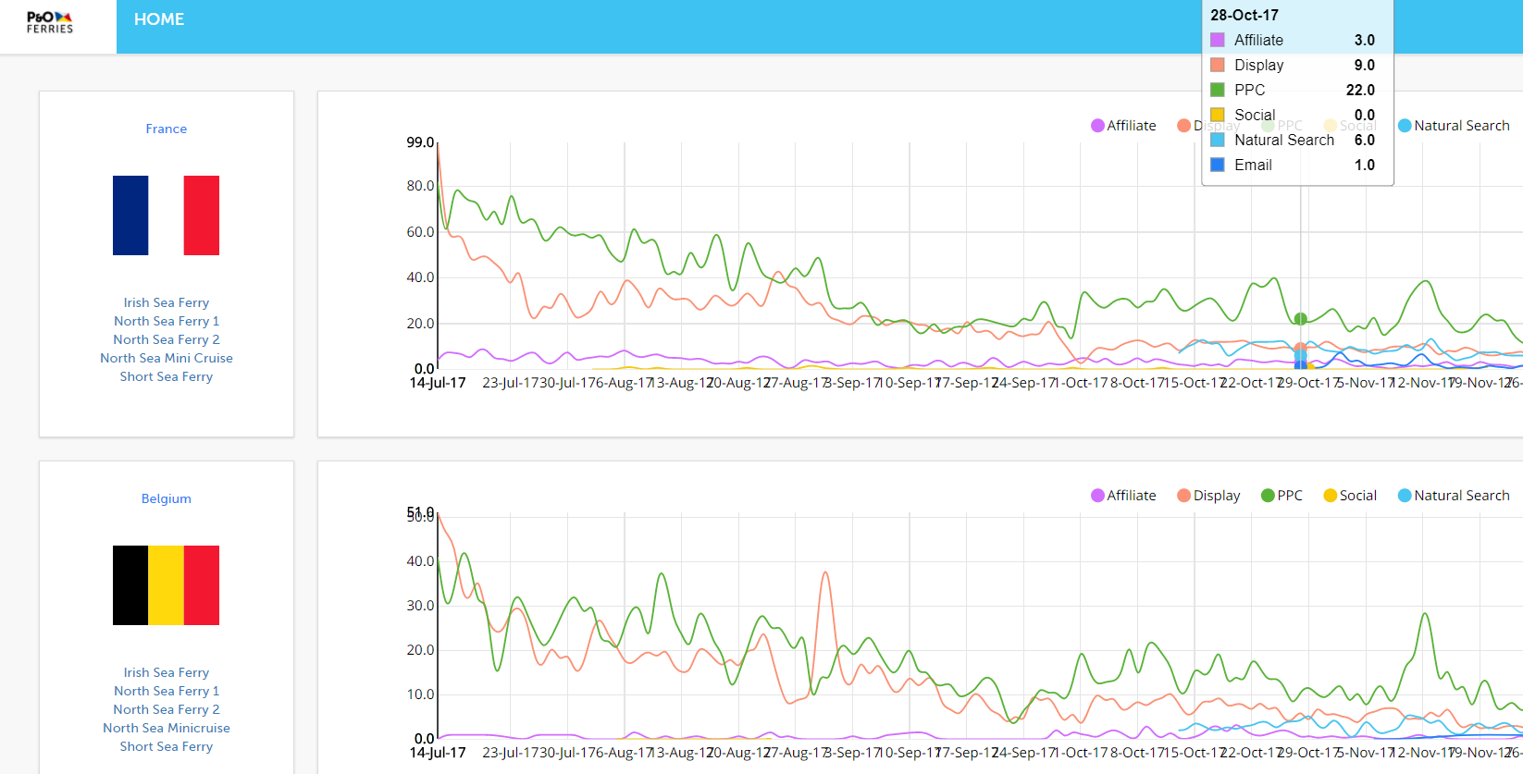
Optimum Dashboard

Slide 36
Next Steps

Slide 37
Next Steps
Complete the ‘Optimum’ Dashboard and make it fully operational for Jan 2018 integration
Training with the relevant Starcom channel teams to integrate the MTA optimisation recommendations into their digital media planning
Mid-Late Jan 2018 complete the digital results test: MTA recommendations vs normal planning
Brief results presentation on the test and plan full roll out for Feb 2018
Set up the viewability display test to compare with MTA display results
Begin work on search auto integration Q2 2018

Slide 38
Thank You

Slide 39
Appendix

Slide 40
Views on Apple’s Intelligent Tracking Prevention (ITP)
In September 2017 Apple has rolled out iOS 11 and macOS High Sierra which both have a new cookie anti-tracking feature
In summary, if a user does not convert within 24 hrs after visiting a website their cookie will be deleted
This will apply for third party tracking platforms such as DoubleClick, however first party tracking will not delete cookies for up to 30 days
Despite opposition form the American Association of Advertising Agencies Apple has said they have no plans to drop ITP from Safari
One way around the deletion is the new GA cookie, which can be considered first party

Slide 41
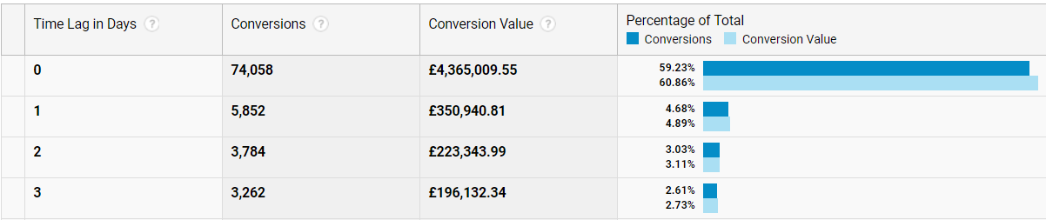
Impact of Apple’s ITP on P&O Ferries
iOS users make up 52% percent of mobile users and 39% of total users (desktop, mobile and tablet)
However, in terms of transactions, 37% are mobile and 23% are at a total level (including desktop)
Then if 59% of those transactions take place within 24 hrs we estimate* that 9% of conversions will be impacted by ITP
59% Conversions take place within 24hours
Source: Google Analytics
* Estimation based on 0.23 x (1-0.59) = 0.09 of transactions are likely to be impacted by ITP

Slide 42
How Facebook is Measured in DoubleClick
DoubleClick can track Facebook activity outside of app
For P&O Ferries we track impressions in browser on desktop and mobile
This means that for 2.9M impressions we only are able to model the effect of 400K impressions (15%)
Currently there is no way in DCM to track in-app activity, however we are in discussions with Facebook to obtain a better understanding of this activity within DoubleClick

Slide 43
Clicks and Impressions Display - July 14th – December 5th 2017
DISP_P&O_France Summer Education 2017 does look high. Research showed that the following two placements with a significantly high click through rate: Lonely Planet LExpress_Data Travelers_RON_1x1 and Lonely Planet LExpress_ROS_1x1 could be the reason why – Further investigation is needed
 | Impressions | Clicks | Impressions/Clicks
BE | 11,260,198 | 5,877 | 1916
NL | 14,164,298 | 12,913 | 1097
DE | 14,653546 | 8,453 | 1734
FR | 22,109,057 | 14,9075 | 148
UK | 95,238,462 | 56,337 | 1691

