Slide 1

CSE 420: Image Processing Final Report Presentation
A comprehensive analysis of different transfer learning techniques for skin cancer classification
Presented by:
MD Rayhan Hossain¹, MD Rahat Al Mamun², Saif Nasim Bosunia¹, Jotirmoy Mollick¹, Muaaz Mohammad¹
¹Department of Computer Science & Engineering
²Department of Electrical & Electronic Engineering
INDEPENDENT UNIVERSITY, BANGLADESH
Presented To: Md. Rashedur Rahman, D.Eng
Image Processing Cse 420 Page 1

Slide 2
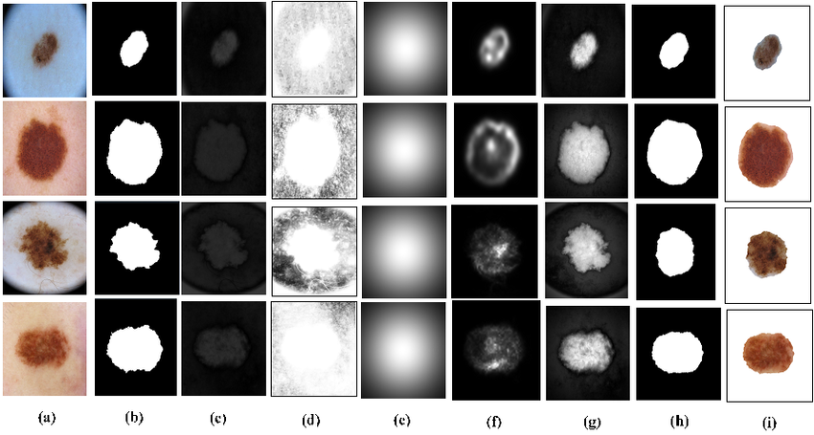
Background and Objective
ISIC 2016 Dataset
International Skin Imaging Collaboration (ISIC) widely used benchmarking dataset used for research in automated skin lesion analysis.
It contains 900 dermoscopic image. Each image labeled for binary classification into one of two categories: benign or malignant.
Background: Identifying skin cancer using traditional method is time consuming and financially burdening. Computer based diagnosis produce faster and more accurate results | Objective: To apply transfer learning with multiple CNN architectures, including MobileNetV2, InceptionV3, EfficientNetB0, ResNet50, and VGG16. To determine the most effective model architecture and training strategy for reliable automated skin cancer detection.
Image Processing Cse 420 Page 2
Notes:
Background:
Skin cancer is a general term for the abnormal growth of skin cells, and melanoma is the most serious form among them.
Early detection of melanoma is critical because it can spread (metastasize) to other organs if untreated.
Diagnosing skin cancer manually through dermoscopic images is time-consuming, costly, and prone to errors.
Computer-based diagnosis using deep learning can produce faster, more accurate, and scalable results.
Earlier approaches relied on hand-crafted features with classical machine learning, but modern research has shifted to end-to-end convolutional neural networks (CNNs) and transfer learning.
Limited and imbalanced datasets, such as the ISIC 2016 dataset, make achieving robust and generalizable performance challenging.

Slide 3
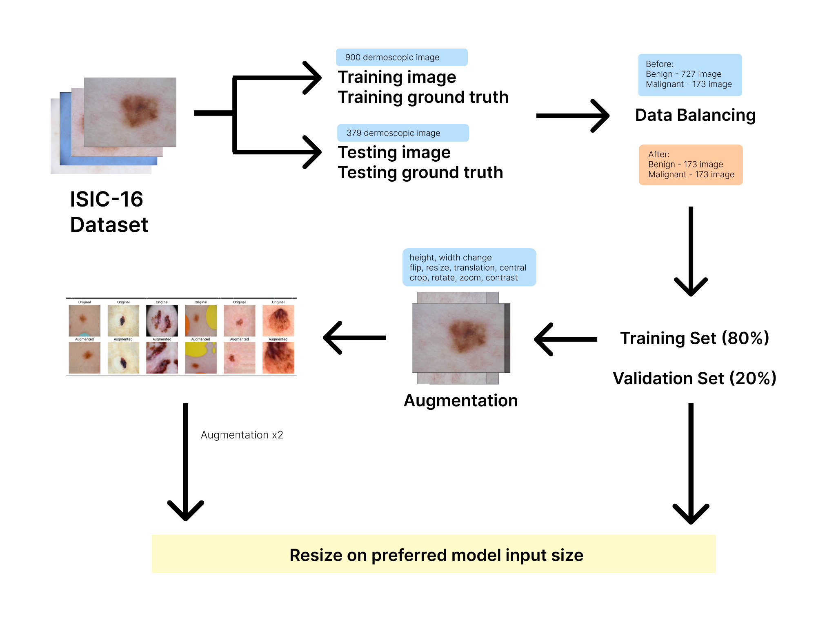
Data Preprocessing
Dataset | Train: 900 Dermoscopic image and groundtruth Test: 379 image with groundtruth
Class Imbalance | Benign: 727 images Malignant: 173 images
Data Balancing | Benign: 173 images Malignant: 173 images
Augmentation (on training set) | Geometric transformation, color based augmentation, gaussian noise.
Later, images were resized into preferred model input size
Image Processing Cse 420 Page 3
Notes:
Dataset & Initial Split
The process begins with the ISIC-16 dataset, which contains 900 dermoscopic images for training.
This data is first separated into a training set and a testing set, each with its corresponding ground truth labels.
Addressing Class Imbalance
The original training set was highly imbalanced, with only 177 benign images compared to 723 malignant images.
To correct this, data balancing was performed by oversampling the minority (benign) class, resulting in an equal distribution of 723 benign and 723 malignant images.
Training & Validation Split
The balanced dataset was then partitioned, with 80% allocated for the training set and the remaining 20% for the validation set.

Slide 4
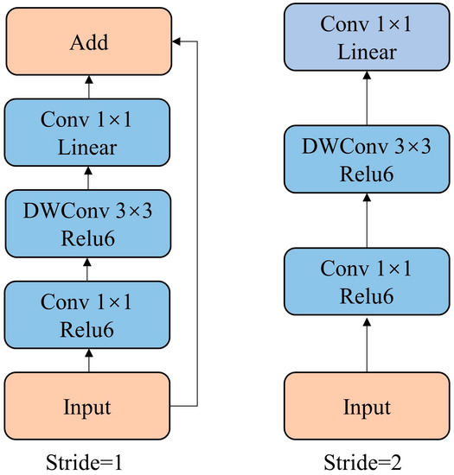
MobileNetV2
Features | Description
Input Size | 224×224×3 (RGB images)
Total Parameters | Approximately 3.49 million parameters
Trainable Parameters (before freezing) | Approximately 3.49 million parameters (since the base model is frozen)
Model Size (disk) | Approximately 13.3 MB (floating-point precision)
Top-1 accuracy on imagenet | Approximately 71.8%
BASE MODEL
Figure title: Visualization of MobileNetV2
What is MobileNetV2
Lightweight CNN by Google for mobile and edge devices.
Efficient: significantly less computation than traditional CNNs (~350 GFLOPs).
Input: 224×224×3 images (ImageNet-pretrained).
Architecture: 53 convolution layers + 1 average pooling layer.
Core Components
Residual Blocks
Inverted Residual Bottleneck Blocks
Image Processing Cse 420 Page 4

Slide 5
MobileNetV2 (continued)
Transfer Learning on Raw Dataset
Used MobileNetV2 (ImageNet pretrained, no top layer).
kept the base of mobileNetV2 frozen, added custom layers (GAP, Dropout, Dense-256, Sigmoid).
Compiled with Adam (1e-5), binary crossentropy, metrics (Acc, Precision, Recall).
Handled class imbalance with weights + EarlyStopping.
Trained on raw dataset (no augmentation).
Evaluated Acc, Precision, Recall, training curves + confusion matrix.
Transfer Learning on Augmented Dataset
Applied On Augmented Dataset.
Used same MobileNetV2 (frozen base + custom layers).
Compiled with Adam (1e-4), metrics (Acc, Precision, Recall, AUC).
Added callbacks: ModelCheckpoint, EarlyStopping, ReduceLROnPlateau.
Trained on augmented dataset (50 epochs).
Evaluated Loss, Acc, Precision, Recall, AUC, training/validation curves + confusion matrix.
Fine-Tuning on Augmented Model
Unfroze deeper layers (from block_13), kept BatchNorm frozen.
Recompiled with Adam (1e-6) for careful fine-tuning.
Continued training on augmented data (25 epochs).
Same callbacks (Checkpoint, EarlyStopping, ReduceLROnPlateau).
Evaluated final Loss, Acc, Precision, Recall, AUC.
Plotted full training curves + final confusion matrix.
Image Processing Cse 420 Page 5

Slide 6
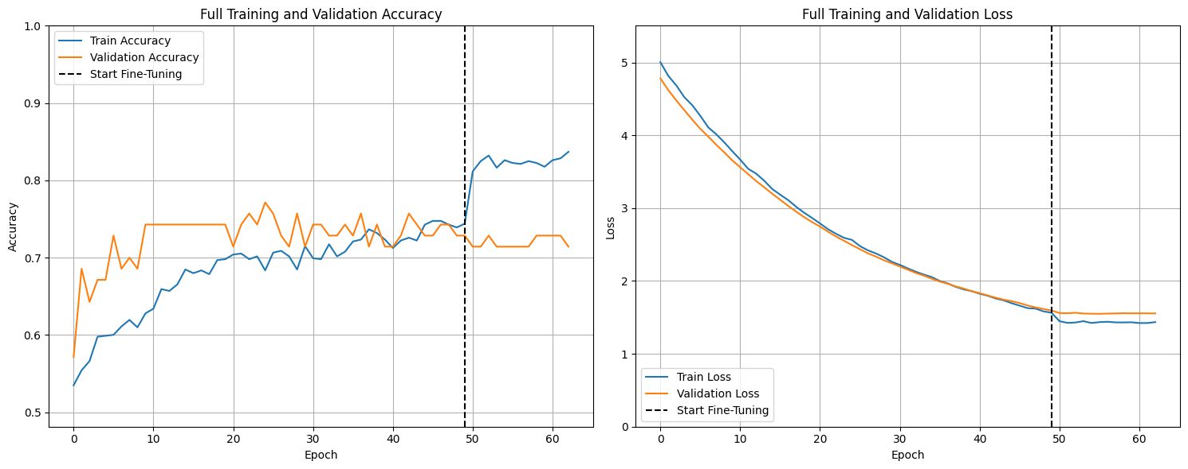
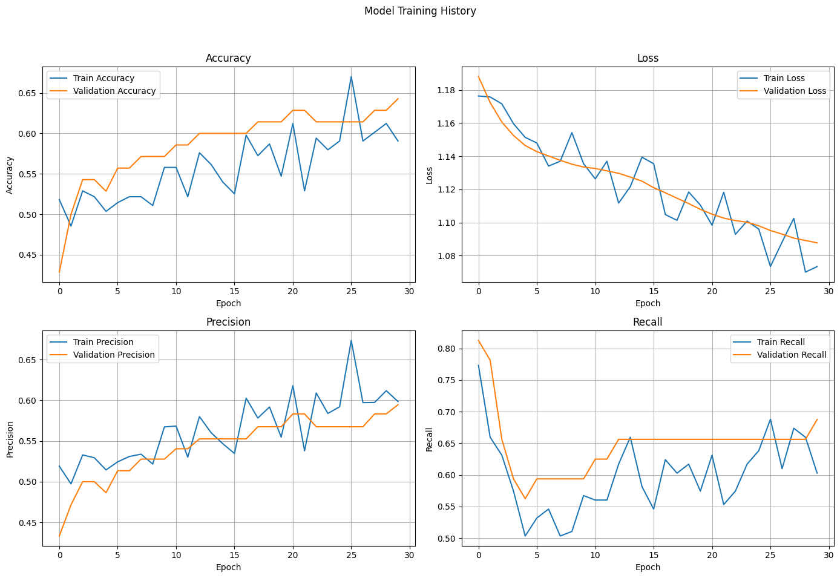
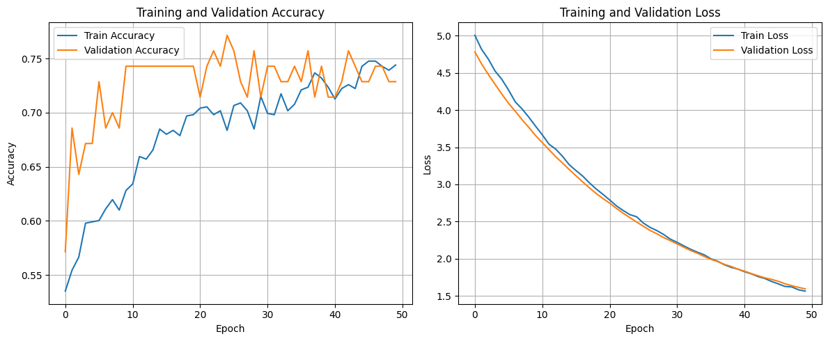
MobileNetV2 (continued)
Performance of MobileNetV2 Across Training Strategies
When I trained on the raw dataset, the model reached 54% accuracy with a recall of 72%, meaning it caught most positives. Precision was only 26%, showing it produced too many false alarms and its positive predictions were unreliable.
After live augmentation, performance improved to 65% accuracy with an AUC of 0.74. Recall stayed decent at 69%, and precision rose slightly to 32.5%, but the model still struggled with many false positives, making its positive predictions weak.
Finally, after fine-tuning on the augmented model, the model gave the best results: 67.5% accuracy, AUC 0.75, and precision improved to 34%. While accuracy and reliability improved slightly, the false positive issue still limits its effectiveness for medical diagnosis.
Figure title: Training with fine tuning on augmented transfer learning model
Figure title: Training with on raw data
Figure title : Training with on augmented data
Image Processing Cse 420 Page 6

Slide 7
MobileNetV2 (continued)
Why Good for Transfer Learning:
MobileNetV2 is pre-trained on ImageNet, so it already knows how to recognize a wide variety of features from images.
Its base layers can be kept frozen while adding new layers specific to your task, which allow the model to quickly adapt to new problems.
This approach works well even with small datasets and helps reduce overall training time.
Benefits for Medical Sector:
MobileNetV2 delivers high accuracy while keeping computational costs low.
It has been successfully used in medical imaging tasks, such as skin lesion classification.
The model can help with early disease detection, supporting faster and more efficient diagnoses.
Image Processing Cse 420 Page 7

Slide 8
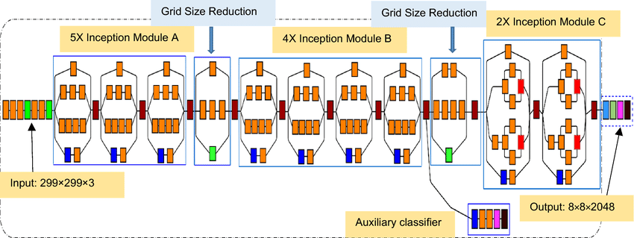
Inception V3
Features | Description
Input Size | 299 x 299 x 3
Total Parameters | ~ 23 million
Trainable Parameters (before freezing) | ~0.5 million (can be reduced if layers are frozen)
Model Size (disk) | ~90.9 MB (TensorFlow/Keras implementation)
Top-1 accuracy on imagenet | ~77% (baseline performance)
BASE MODEL
Fig Title: Inception V3 Baseline Architecture
Freeze up to mixed8
Preserves general features (edges, textures, shapes)
Faster training, fewer trainable parameters
Less flexibility if your dataset differs a lot from ImageNet
Unfreeze mixed9 & mixed10
Lets high-level abstract features adapt to your dataset
Usually improves classification accuracy
Risk of overfitting on small datasets, training a bit slower
FINE TUNE
Features | Description
Frozen layers | mixed8
Unfrozen layers | mixed9 & mixed10
Trainable Parameters | ~6.5 million
Keep BatchNorm frozen
Prevents instability and exploding gradients
BN stats may not perfectly match your new dataset
Image Processing Cse 420 Page 8

Slide 9
Inception V3 (continued)
Transfer Learning on Raw Dataset
Base Model: InceptionV3 (ImageNet pretrained, no top layer, input 299×299×3)
Base Frozen: Yes
Custom Layers: GAP → Dropout(0.2) → Dense-256 (ReLU) → Dropout(0.3) → Dense-1 (Sigmoid)
Optimizer & Loss: Adam (1e-4), Binary Crossentropy
Metrics: Accuracy, Precision, Recall, AUC
Imbalance Handling: Class Weights + EarlyStopping
Training Data: Raw dataset (no augmentation)
Evaluation: Test Loss, Accuracy, Precision, Recall, AUC, Training Curves, Confusion Matrix
Transfer Learning on Augmented Dataset
Augmentation: Rotations, Flips, Shifts
Base Model: InceptionV3 (frozen base + custom layers)
Custom Layers: GAP → Dropout(0.3) → Dense-256 (ReLU, L2=0.01) → Dropout(0.5) → Dense-1 (Sigmoid)
Optimizer & Loss: Adam (1e-4), Binary Crossentropy
Metrics: Accuracy, Precision, Recall, AUC
Callbacks: ModelCheckpoint, EarlyStopping, ReduceLROnPlateau
Training: Augmented dataset, up to 100 epochs
Evaluation: Test Loss, Accuracy, Precision, Recall, AUC, Training/Validation Curves, Confusion Matrix
Fine-Tuning on Augmented Model
Unfreezing: Deeper layers from mixed9/mixed10 (BatchNorm kept frozen)
Recompiled Optimizer: Adam (5e-6), Binary Crossentropy
Metrics: Accuracy, Precision, Recall, AUC
Callbacks: ModelCheckpoint, EarlyStopping, ReduceLROnPlateau
Training: Augmented dataset, up to 50 epochs (fine-tuning phase)
Evaluation: Final Test Loss, Accuracy, Precision, Recall, AUC
Outputs: Training/Validation Curves + Final Confusion Matrix
Image Processing Cse 420 Page 9

Slide 10
Inception V3 (continued)
Why Good for Transfer Learning:
MobileNetV2 is pre-trained on ImageNet, so it already knows how to recognize a wide variety of features from images.
Its base layers can be kept frozen while adding new layers specific to your task, allowing the model to quickly adapt to new problems.
This approach works well even with small datasets and helps reduce overall training time.
Benefits for Medical Sector:
MobileNetV2 delivers high accuracy while keeping computational costs low, making it ideal for real-time analysis.
It has been successfully used in medical imaging tasks, such as skin lesion classification.
The model can help with early disease detection, supporting faster and more efficient diagnoses.
Image Processing Cse 420 Page 10

Slide 11
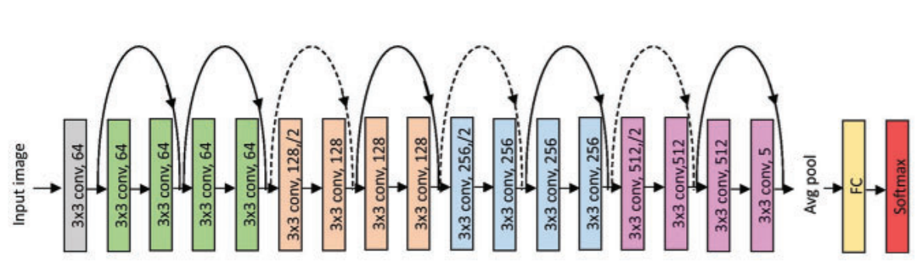
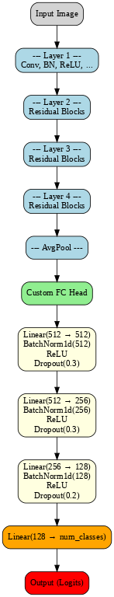
ResNet18
Features | Description
Model & Input Size | ResNet-18 with 224 × 224 × 3 input
Trainable Layers | Early layers frozen (layer1, layer2, layer3) depending on configuration
FC Head | 1–3 hidden layers (512, 256, 128) with BatchNorm, ReLU, Dropout (0.2–0.5)
Training | 30 epochs; learning rates 1e-5 (frozen layers), 1e-4 (FC head)
Performance Tracking | Train/val loss & accuracy, learning curves, confusion matrices
Fig title: ResNet18 baseline architecture
Model: ResNet-18 (11.7M params, 512-dim output)
Task: 2-class classification on custom dataset
Layer Freezing: Up to layer1, layer2, or layer3
FC Head: 1–3 hidden layers (512 → 256 → 128) with BN, ReLU, Dropout (0.2–0.5)
Training: 30 epochs; LR = 1e-5 (frozen layers), 1e-4 (FC head)
Monitoring: Training/validation loss & accuracy per epoch; learning curves
Evaluation: Confusion matrices on validation & test sets
Focus: Impact of layer freezing and FC head design on transfer learning
Fig title: ResNet18 Custom Architecture with logits
Image Processing Cse 420 Page 11

Slide 12
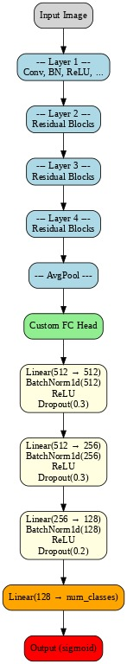
ResNet18 with sigmoid Activation
Model: Fine-tuned ResNet-18 for binary classification
Training: 12 epochs per configuration, loss = BCEWithLogitsLoss
Strategy: Freeze different parts of ResNet-18 backbone to leverage ImageNet features
Configurations:
Freeze up to layer2 → train layer3, layer4, FC head
Freeze up to layer1 → train layers 2–4, FC head
Freeze up to layer3 → train layer4, FC head
Evaluation: Tested thresholds 0.3, 0.5, 0.7 on validation set
Final Metrics: Chosen threshold applied to validation & test accuracies
Focus: Effect of layer freezing + threshold tuning on transfer learning performance
Fig title: ResNet18 baseline architecture
Fig title: ResNet18 Custom Architecture with sigmoid
Image Processing Cse 420 Page 12

Slide 13
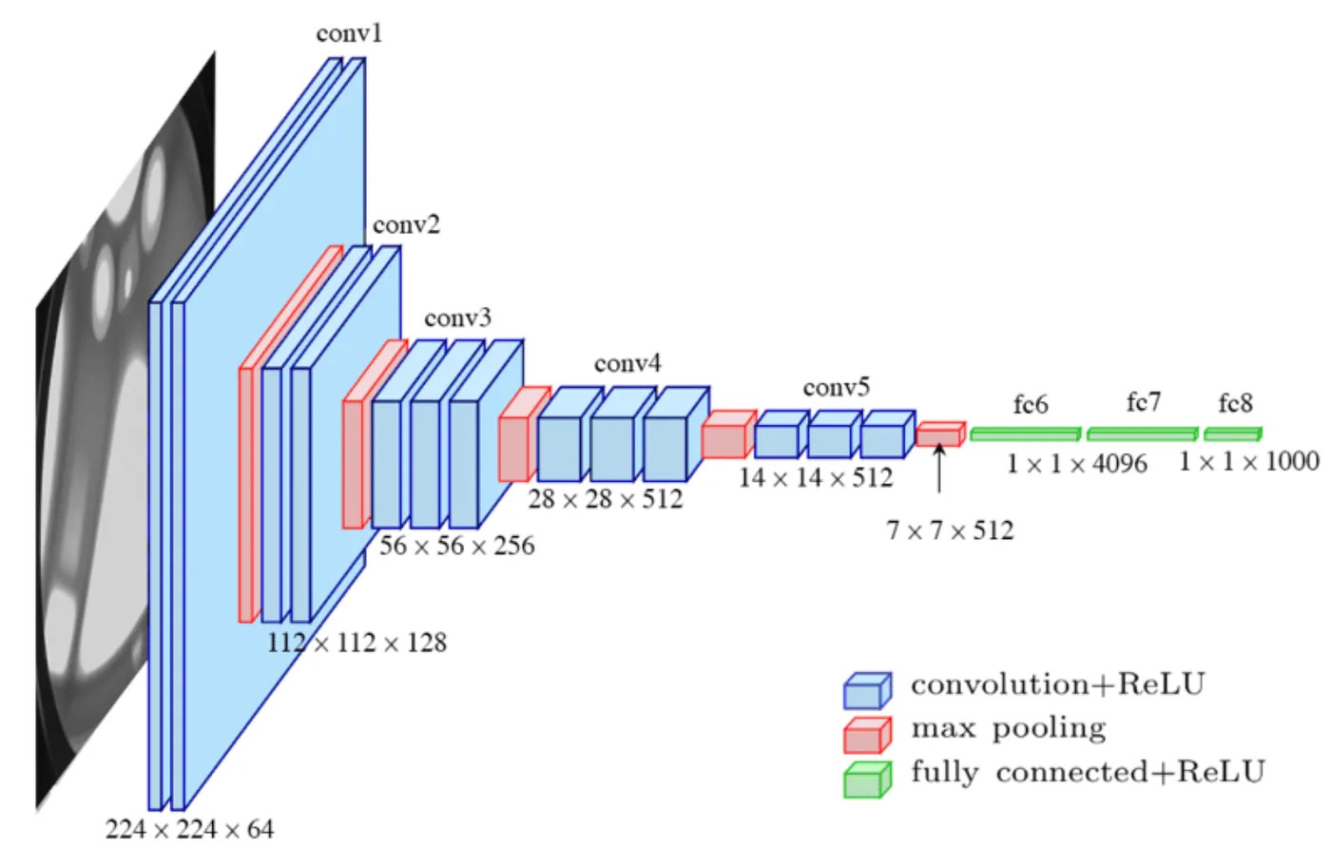
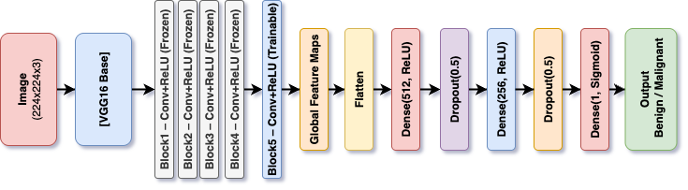
VGG Architecture
Features | Description
Input Size | 299 × 299 × 3 RGB (adapted from 224×224)
Total Parameters | ~138 million
Trainable Parameters (before freezing) | ~120 million (after freezing first 15 layers ~18M frozen)
Model Size (disk) | ~528 MB (full VGG16 weights)
Top-1 accuracy on imagenet | 71.5%
MODEL SUMMARY
VGG (Visual Geometry Group) developed at Oxford University (2014)
Known for deep convolutional neural networks with simple architecture
Two main versions: VGG16 (16 layers) and VGG19 (19 layers)
Key idea: Use small 3×3 convolution filters stacked to increase depth
Fig Title: Diagram VGG16 architecture
Fig Title: Fine-Tuned Model Block Diagram VGG16
Image Processing Cse 420 Page 13

Slide 14
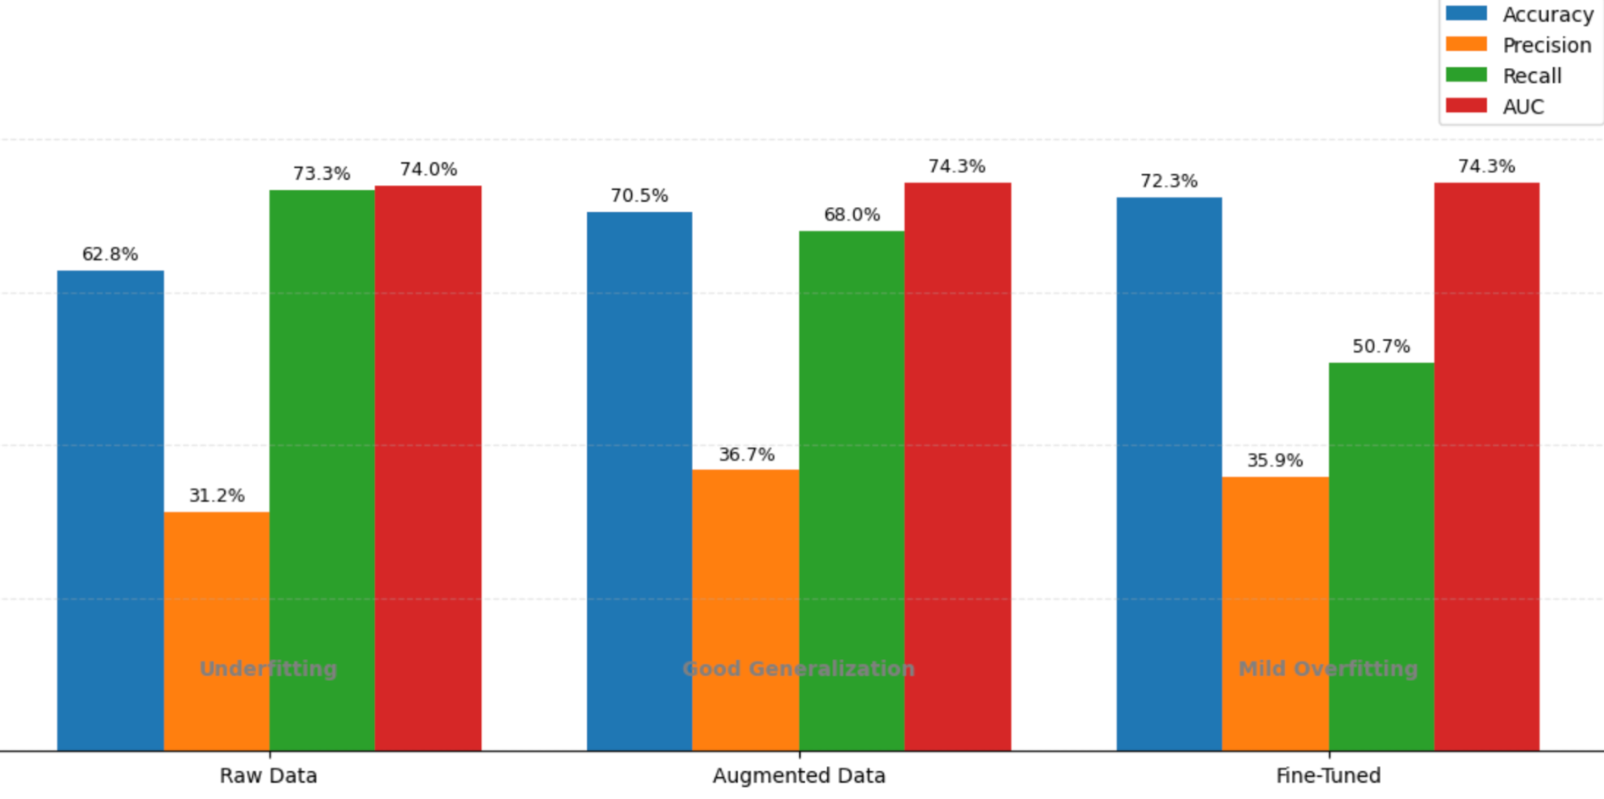
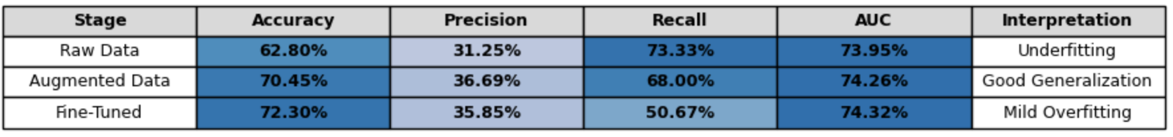
VGG Architecture(continued)
Case | Accuracy | Precision | Recall | AUC
Raw Data | 0.6280 | 0.3125 | 0.7333 | 0.7395
Augmented Data | 0.7045 | 0.3669 | 0.6800 | 0.7426
Fine-Tuned Model | 0.7230 | 0.3585 | 0.5067 | 0.7432
Result
Raw Data – baseline performance, high recall but low precision.
Augmented Data – improved accuracy and balance between recall & precision.
Fine-Tuned Model – best accuracy and AUC after unfreezing deeper layers.
Data augmentation significantly improved generalization.
Fine-tuning increased accuracy (72.3%) and AUC (0.7432).
Trade-off observed between precision vs recall across settings.
Image Processing Cse 420 Page 14

Slide 15
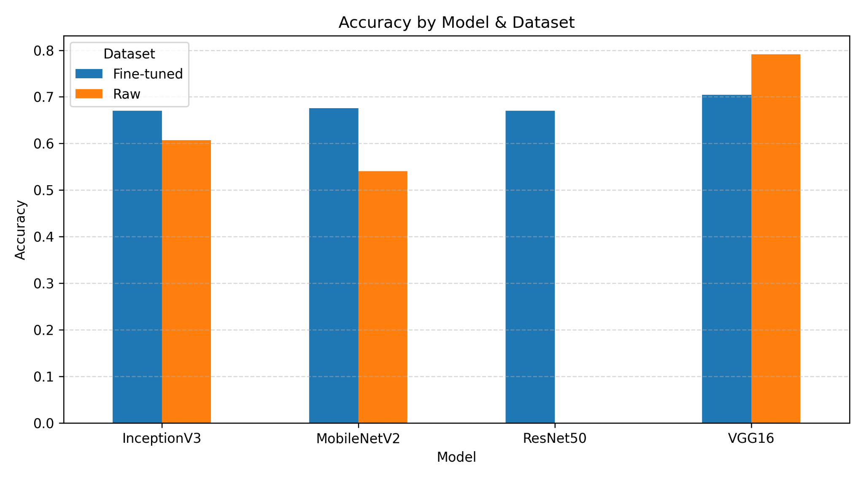
Result & Discussion
Model | Accuracy | Precision | Recall | AUC
InceptionV3 (Raw) | 0.6069 | 0.2989 | 0.7333 | 0.7157
InceptionV3 (Aug) | 0.6702 | 0.3288 | 0.64 | 0.7084
InceptionV3 (Fine-tuned) | 0.6702 | 0.3355 | 0.68 | 0.7368
ResNet18 | 0.6702 | 0.3355 | 0.68 | 0.7368
MobileNetV2 (Raw) | 0.5409 | 0.2609 | 0.72 | 0.7402
MobileNetV2 (Aug) | 0.6544 | 0.325 | 0.6933 | 0.7402
MobileNetV2 (Fine-tuned) | 0.6755 | 0.3421 | 0.6933 | 0.7527
VGG16 (Raw) | 0.7916 | 0.4773 | 0.56 | 0.7828
VGG16 (Aug) | 0.6544 | 0.325 | 0.6933 | 0.7402
VGG16 (Fine-tuned) | 0.7045 | 0.3669 | 0.68 | 0.7426
Image Processing Cse 420 Page 15

Slide 16

Any questions, comments or suggestions?
Image Processing Cse 420 Page 16

