Slide 1
Designing California’s clean and resilient grid for vulnerable communities
Overview and status

Slide 2
Research Thrusts and collaborations
1. Motivation:
Extreme weather events (wildfires, precipitation, etc.) have increased the complexity to get to zero emissions while maintaining reliability
Resiliency especially in disadvantaged communities (DACs):
- technical redesign of our grid’s infrastructure and operation
- new modeling framework to incorporate social and environmental justice
Role of DERs and inequitable adoption/access for DACs
2. Goal:
Develop tools that enable public and private planners to identify equitable approaches for DACS that are resilient to climate impacts.

Slide 3
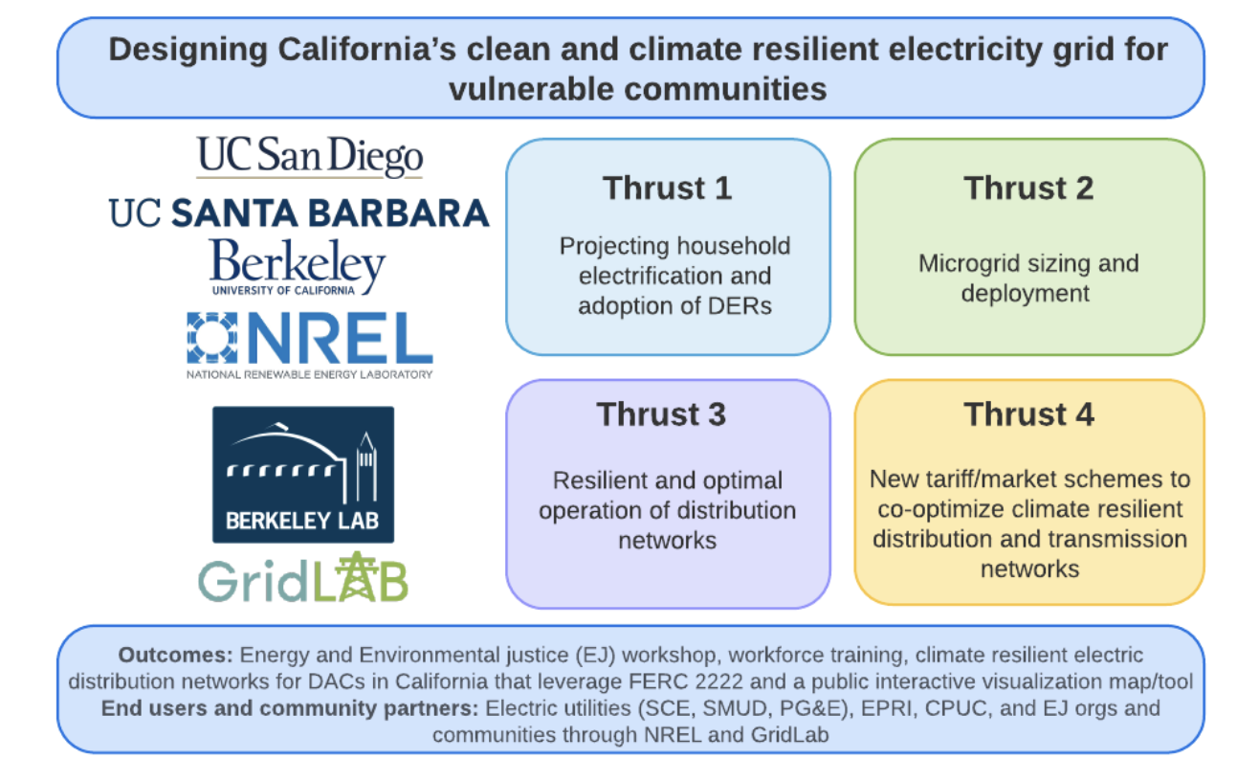
Research Thrusts and collaborations

Slide 4
Th1&2: Survey and microgrids
Census track survey
Oversampling DACs
Themes:
Electrification, rooftop PV adoption, subsidies for DERs, DR, etc.
Models to represent likelihood of adoption of DERs/electrification/DR
Outputs used as inputs for grid modeling
Microgrids sizing and deployment
Improve climate resiliency for DACs
Configurations: household to community-level
Considering technical and spatial constraints
Using survey outputs: estimating new load profiles from electrification/DERs/DR by census track.
Notes:
There have been significant prior works of designing and optimizing linear controllers for frequency control, mainly in the major transmission grid.
However, with the high renewable penetration, there is calling for designing better controller to handle the time-varying inertia, and complex networks in microgrid.
In essence, we need a more intelligent, adaptive solution for a greener, more complex world. That's where our research journey begins.

Slide 5
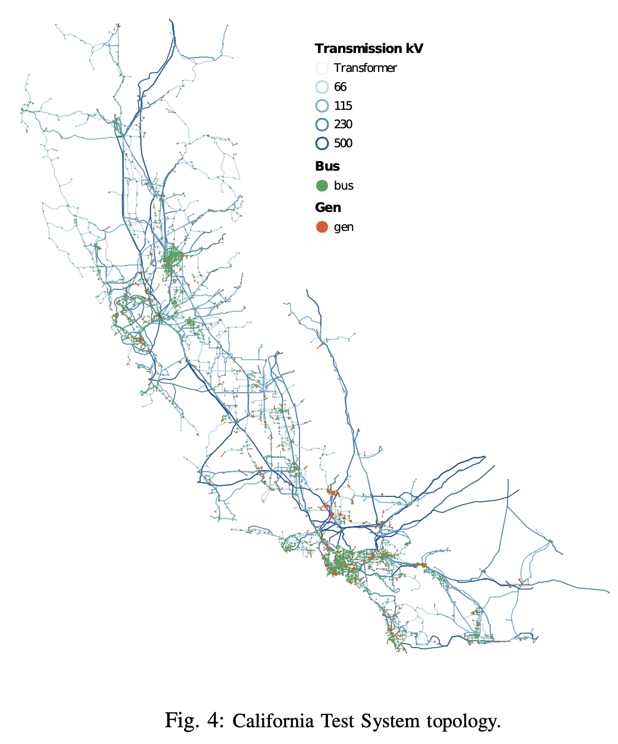
Th3&4: Transmission network modeling
Asses statewide impacts of DERs/microgrids deployment
Resiliency to extreme weather events (e.g., wildfires, flooding)
Metrics: EJ (bill savings, pollutants?), operational and investment costs
Tariff/market designs: Income from participating in FERC 2222
Demonstration of microgrids operations in DERconnect (19 MW, 96 feeders)
Geographical aspects: Leverage CATS model (L. Roalds’ group)
8,700 buses (substations)
Uses CEC’s transmission lines/substations GIS layers
Generators’ locations from EIA
Temporal aspects:
Hourly resolution of loads for each substation
Hourly capacity factors for solar and wind
Notes:
There have been significant prior works of designing and optimizing linear controllers for frequency control, mainly in the major transmission grid.
However, with the high renewable penetration, there is calling for designing better controller to handle the time-varying inertia, and complex networks in microgrid.
In essence, we need a more intelligent, adaptive solution for a greener, more complex world. That's where our research journey begins.

Slide 6
Th3&4: Transmission/distribution network modeling
Geographical aspects:
8,700 buses (substations)/census tracks (8,057)
Map communities to substations using ICA maps
Aggregated representative info per substation
Ideal info from the Survey and Thrust 2:
Hourly load scenarios by census track
Characterization of demand flexibility for each load scenario (e.g., EVs, heating/cooling loads, DR)
Characterization of distributed generation by census track for each scenario (e.g., taking into account the physical and social potential for rooftop PV)
Battery and storage social potential by census track for each scenario
Target years: 2030 and 2035
Notes:
There have been significant prior works of designing and optimizing linear controllers for frequency control, mainly in the major transmission grid.
However, with the high renewable penetration, there is calling for designing better controller to handle the time-varying inertia, and complex networks in microgrid.
In essence, we need a more intelligent, adaptive solution for a greener, more complex world. That's where our research journey begins.

Slide 7
Actionable Project Outcomes
Opportunities for reshaping distribution network markets as enabled by FERC 2222. It will support California's electric utilities in their business models that interface communities, with an emphasis on low income and minority (LIM) communities and resilience to climate change.
Design of climate resilient electric distribution networks for LIM communities in California. The team will consider leveraging microgrids deployment as a method to self generate electricity during critical events, as well as the deployment (and needed subsidies) for distributed energy resources deployment (DERs). There will also be a testing task using the UCSD microgrid NSF facility, which was recently awarded $39M.
Workforce training of undergraduate students, graduate students and postdoctoral fellows. Graduate students from this project will have the option to pursue internships at the Lawrence Berkeley National Lab, the National Renewable Energy Lab and interested electric utilities.
Virtual Environmental Justice workshop where the leading California’s researchers in this field will present their work. This activity will include networking events to promote collaborations and further extend the work performed by the team and others.
Public interactive visualization/map tool. The team will condense the main findings (set of scores by community associated to environmental justice, resilience, bill savings/earnings, benefits to the transmission network, land use, etc.)
Additional deliverables to be determined with utility and community partners

Slide 8
Your feedback
Aspects we should be focusing on?
That are important from your perspective or
Complementary to READi’s efforts
Collaboration opportunities between you and us?
How can we leverage your prior and ongoing efforts?
Modeling efforts?
Climate data for power systems? (READi’s deliverable in Y2)
In the future, can we join one of your internal events?
Recommendations for policy engagement?
How to attract utilities’ interest? (How to serve them)

Slide 9
Thank you

Slide 10
Th2: Overview
Electricity Cost Calculator:
Built to answer the question: “How much will an end user spend on electricity given various factors”
Mapping Interface:
Primarily a visual tool built for policymakers and the broader public audience to engage with findings

Slide 11
Th2: End-user electricity cost modeling
Electricity Cost Calculator:
Estimating the cost of electricity to residential users given:
Hourly load profiles
Initially assumed based off of approximate kWh consumption
This can be modified for any given calculation
Time of use rates
These will be adjusted to be specific to the utility
Major sources of electrical load (heat pumps, EV charging, solar, potentially battery)
Can also specify COP, VMT, sunlight hours for any given calculation
Incorporating NEM 3.0 offsets for solar usage
Plan to expand calculator to incorporate available capacity on distribution lines, and potential utility costs (eg. upgrading distribution lines)

Slide 12
Th2: Visualizing capacity, cost, climate, equity factors
Mapping
An exploratory tool to engage with this study’s findings
Will leverage PG&E’s ICA data to surface areas of limited distribution capacity to take on new DER load
May incorporate the Electricity Cost Calculator to identify differences in electricity costs in across California regions
May also overlay other attributes (socioeconomic status, zoning, or potentially various climate risk factors), and leverage CalEnviroScreen’s data on disadvantaged communities
Depending on survey results, may be an avenue to highlight some interesting geographic variance in survey findings

Slide 13
Th3&4: Transmission/distribution network modeling
Geographical aspects:
8,700 buses (substations)/census tracks (8,057)
Map communities to substations using ICA maps
Aggregated representative info per substation
Ideal info from the Survey and Thrust 2:
Hourly load scenarios by census track:
- Electrification and energy efficiency scenarios:
- Extremely optimistic
- …
- Very conservative
Notes:
There have been significant prior works of designing and optimizing linear controllers for frequency control, mainly in the major transmission grid.
However, with the high renewable penetration, there is calling for designing better controller to handle the time-varying inertia, and complex networks in microgrid.
In essence, we need a more intelligent, adaptive solution for a greener, more complex world. That's where our research journey begins.

Slide 14
Th3&4: Transmission/distribution network modeling
Strategy:
8,700 buses (substations)/census tracks (8,057)
We will optimize DERs/DR for the set of scenarios from the Survey and Thrust 2
We will optimize DERs/DR for more optimistic and conservative academic scenarios
All of them for BAU and extreme weather conditions
Thrust 4 uses the same set up, but focuses on the tariff design and market layer
Notes:
There have been significant prior works of designing and optimizing linear controllers for frequency control, mainly in the major transmission grid.
However, with the high renewable penetration, there is calling for designing better controller to handle the time-varying inertia, and complex networks in microgrid.
In essence, we need a more intelligent, adaptive solution for a greener, more complex world. That's where our research journey begins.

