Slide 1
openFAST-Inputfiles
5MW-Windkraftanlage

Slide 2
Verzeichnisstruktur
5MW-Turbine-Inputfiles
5MW_Land_DLL_Wturb.fst
Sub-Inputfiles
NRELOffshrBsline5MW_AeroDyn_blade.dat
NRELOffshrBsline5MW_BeamDyn.dat
NRELOffshrBsline5MW_BeamDyn_Blade.dat
NRELOffshrBsline5MW_Blade.dat
NRELOffshrBsline5MW_InflowWind_12mps.dat
NRELOffshrBsline5MW_Onshore_AeroDyn15.dat
NRELOffshrBsline5MW_Onshore_ElastoDyn.dat
NRELOffshrBsline5MW_Onshore_ElastoDyn_Tower.dat
NRELOffshrBsline5MW_Onshore_ServoDyn.dat
Wind
90m_12mps_twr.bts
90m_12mps_twr.inp
90m_12mps_twr.sum
NoShr_12.wnd
Airfoils
Cylinder1.dat
Cylinder1_coords.txt
Cylinder2.dat
Cylinder2_coords.txt
DU21_A17.dat
DU21_A17_coords.txt
DU25_A17.dat
DU25_A17_coords.txt
DU30_A17.dat
DU30_A17_coords.txt
DU35_A17.dat
DU35_A17_coords.txt
DU40_A17.dat
DU40_A17_coords.txt
NACA64_A17.dat
NACA64_A17_coords.txt

Slide 3
Abhängigkeiten
5MW_Land_DLL_Wturb.fst
NRELOffshrBsline5MW_Onshore_ElastoDyn.dat
NRELOffshrBsline5MW_Onshore_ElastoDyn_Tower.dat
RELOffshrBsline5MW_Blade.dat
NRELOffshrBsline5MW_BeamDyn.dat
NRELOffshrBsline5MW_BeamDyn_Blade.dat
NRELOffshrBsline5MW_InflowWind_12mps.dat
Wind / 90m_12mps_twr.bts
NRELOffshrBsline5MW_Onshore_AeroDyn15.dat
Airfoils / …
NRELOffshrBsline5MW_AeroDyn_blade.dat
NRELOffshrBsline5MW_Onshore_ServoDyn.dat

Slide 4
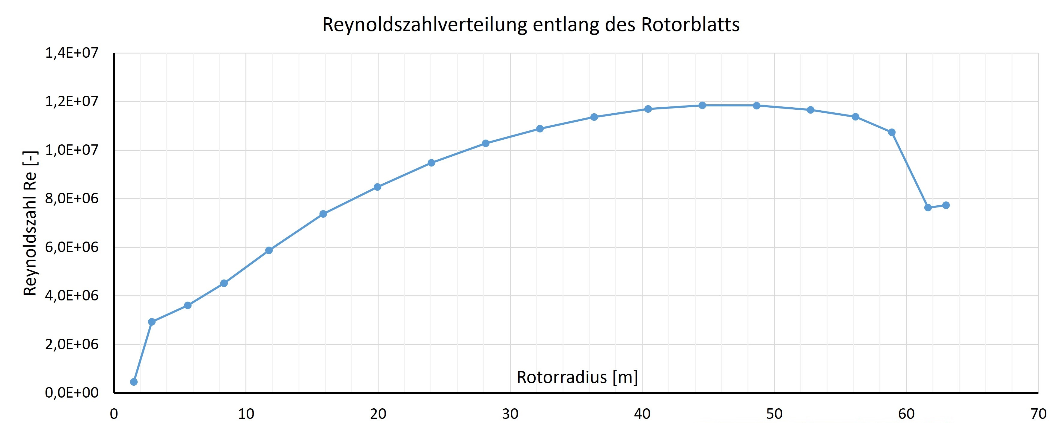

Slide 5
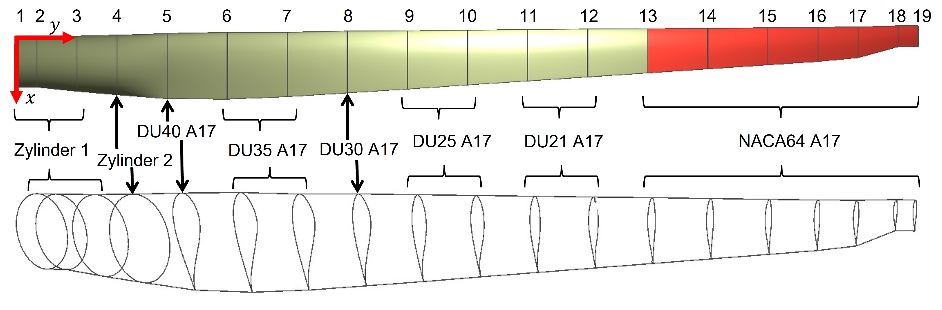
Cylinder 1
Cylinder 2

Slide 6
