Slide 1
ANTLR Down Under
Terence Parr @ Sydney JUG
Hosted by Atlassian & Cenqua
Beer/Pizza: I.T. Matters Recruitment Services
June 20, 2007

Slide 2
Topics
ANTLRWorks intro/credits
Information flow and syntax
LL(*)
Autobacktracking
Error recovery_x0010__x000f_
Attributes
Tree rewrite rules
Template rewrite rules
Retargetable code generator
DEMO: A config file interpreter

Slide 3
ANTLRWorks
Domain-specific development environment for ANTLR v3 grammars written by Jean Bovet
Main components:
  grammar-aware editor
  grammar interpreter
  parser debugger
Open-source, BSD license

Slide 4
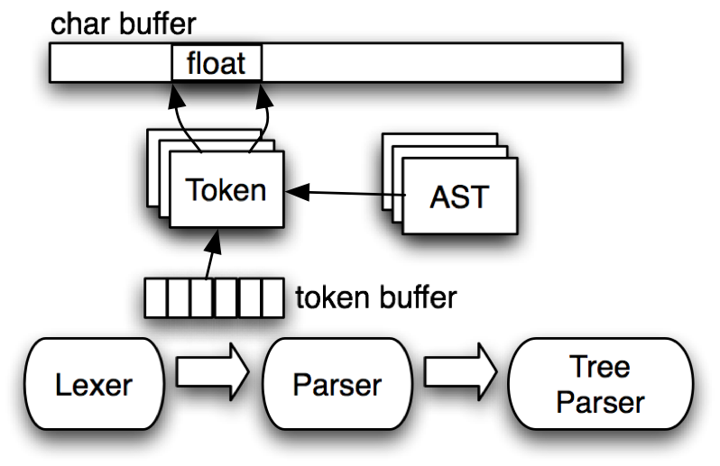
Block Info Flow Diagram
“Humuhumunukunukuapua'a have a diamond-shaped body with armor-like scales.”

Slide 5
Example: Parse CSV
Input:
3,10,32,48
993,2,23,5,8,954
Grammar:
grammar CSV;
file : record+ ;
record : INT (',' INT)* '\n' ;
INT : '0'..'9'+ ;
Stream of INT and ‘\n’ tokens sent from lexer to parser

Slide 6
Overall Grammar Syntax
/** doc comment */
kind grammar name;
options {…}
tokens {…}
scopes…
@header {…}
@members {…}
rules…
/** doc comment */
rule[String s, int z]
returns [int x, int y]
throws E
options {…}
scopes
@init {…}
@after {…}
: α
| β
;
catch [Exception e] {…}
finally {…}
Trees
^(root child1 … childN)

Slide 7
Building LL parsers
Building a parser generator is easy except for the lookahead analysis:
  rule ref → “rule()”
  token ref → “match(token)”
  rule def →
  void rule() {
  if ( lookahead-expr-alt 1 ) { match alt 1; }
  else if ( lookahead-expr-alt 2 ) { match alt 2; }
  else error;
  }
The nature of the lookahead expressions dictates the strength of your parser generator

Slide 8
What is LL(*)?
Natural extension to LL(k) lookahead DFA: Allow cyclic DFA that can skip ahead past common prefixes to see what follows
Analogy: like trying to decide which line to get in at the movies: long line, can’t see sign ahead from the back; run ahead to see sign
Predict and proceed normally with LL parse
No need to specify k a priori
Weakness: can’t deal with recursive left-prefixes
ticket_line : PEOPLE+ BORAT
| PEOPLE+ THE_BODY_GUARD
;

Slide 9
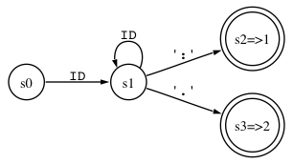
LL(*) Example
s : ID+ ':' ‘x’
| ID+ '.' ‘y’
;
void s() {
int alt=0;
while (LA(1)==ID) consume();
if ( LA(1)==‘:’ ) alt=1;
if ( LA(1)==‘.’ ) alt=2;
switch (alt) {
case 1 : …
case 2 : …
default : error;
}
}
Note: ‘x’, ‘y’ not in prediction DFA

Slide 10
Auto-Backtracking
Idea: when LL(*) analysis fails, simply backtrack at runtime to figure it out
  “newbie” or rapid prototyping mode
  people dump the craziest stuff into ANTLR
  impl: add syntactic predicate to each alt left edge
  LL(*) alg. uses preds only in nondeterministic decisions
Use fixed k lookahead+backtracking to get grammar working; then optimize with LL(*)
ANTLR v3 can memoize partial parsing results to guarantee linear parsing time (packrat parsing ala Bryan Ford)

Slide 11
Error Recovery
ANTLR v3 does what Josef Grosch does in Cocktail
Does single token insertion or deletion if necessary to keep going
Computes context-sensitive FOLLOW to do insert/delete
  proper context is passed to each rule invocation
  knows precisely what can follow reference to r rather than what could follow any reference to r (per Wirth circa 1970)

Slide 12
Error Recovery Example
missing ‘)’
class T {
void foo( { duh(34); }
void bar() { x = 3 }
}
missing ‘;’
line 2:12 mismatched input '{' expecting ')'
line 3:21 mismatched input '}' expecting ';'

Slide 13
Errors during development
Instead of the default:
line 1:2 no viable alternative at ‘;’
You can alter runtime to emit:
line 1:2 [prog, stat, expr, multExpr, atom] no viable alternative,
token=[@2,2:2=';',<7>,1:2] (decision=5 state 0)
decision=<<35:1: atom : ( INT | '(' expr ')' );>>

Slide 14
Scoped Attributes
A rule may define a scope of attributes visible to any invoked rule; operates like a stacked global variable
Avoids having to pass a value down
method
scope { String name; }
: "method" ID '(' ')' {$name=$ID.text;} body
;
body: '{' stat* '}’ ;
…
atom : ID {… $method::name …}
| INT
;

Slide 15
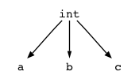
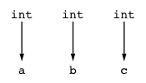
Tree Rewrite Rules
Maps an input grammar fragment to an output tree grammar fragment
grammar T;
options {output=AST;}
stat : 'return' expr ';' -> ^('return' expr) ;
decl : 'int' ID (',' ID)* -> ^('int' ID+) ;
decl : 'int' ID (',' ID)* -> ^('int' ID)+ ;

Slide 16
Template Rewrite Rules
Reference template name with attribute assigments as args:
Template assign defined like this:
grammar T;
options {output=template;}
s : ID '=' INT ';' -> assign(x={$ID.text},y={$INT.text}) ;
group T;
assign(x,y) ::= "<x> := <y>;"

Slide 17
ANTLR Code Generator
ANTLR v2: undignified, entangled blobs of code generation logic and print statements
  code generation: 39% of total v2 code
  4000 lines of Java code per generator
v3: Each language target is purely group of StringTemplate templates
  Not a single output literal in code
  code generation: 8% of total v3 code
  2000 lines of templates per generator
Currently: Java, C#, C, Python
Coming soon: Ruby, C++, Objective-C, …

Slide 18
DEMO
_x000e_Coders use XML for config files because it’s easy; Fig is easy too, but has a Human friendly interface
Fig: A general but simple config file interpreter
Parse a fig file and return a list of initialized objects; Just include fig.jar and ``she’ll be right’’
Uses reflection to create instances and call setters or set fields directly
Refers to user-defined classes
Expressions are: strings, ints, lists, and references to other configuration objects

Slide 19
Fig Input Syntax
Creates 3 object instances: 2 Site objects and 1 Server object:
Site jguru {
port = 80;
answers = "www.jguru.com";
aliases = ["jguru.com", "www.magelang.com"];
menus = ["FAQ", "Forum", "Search"];
}
Site bea {
answers = "bea.jguru.com";
menus = ["FAQ", "Forum"];
}
Server {
sites = [$jguru, $bea];
}

Slide 20
Supporting Java Code
Application specific objects to init
Using Fig:
public class Site {
public int port;
private String answers;
public List aliases;
public List menus;
…
}
public class Server {
public List sites;
}
FigLexer lexer = new FigLexer(new ANTLRFileStream(fileName));
CommonTokenStream tokens = new CommonTokenStream(lexer);
FigParser fig = new FigParser(tokens);
// begin parsing and get list of config'd objects
List config_objects = fig.file();

Slide 21
Spring IOC XML
<?xml version="1.0" encoding="UTF-8"?>
<!DOCTYPE beans
PUBLIC "-//SPRING//DTD BEAN//EN"
"http://www.springframework.org/dtd/spring-beans.dtd">
<beans>
<!-- This demonstrates setter injection. -->
<bean id="config1" class="com.ociweb.springdemo.Config">
<!-- can specify value with a child element -->
<property name="color">
<value>yellow</value>
</property>
<!-- can specify value with an attribute -->
<property name="number" value="19"/>
</bean>
<!-- This demonstrates setter injection of another bean. -->
<bean id="myService1" class="com.ociweb.springdemo.MyServiceImpl">
<property name="config" ref="config1"/>
</bean>
<!-- This bean doesn't need an id because it will be
associated with another bean via autowire by type. -->
<bean class="com.ociweb.springdemo.Car">
<property name="make" value="Honda"/>
<property name="model" value="Prelude"/>
<property name="year" value="1997"/>
</bean>
</beans>

Slide 22
Equivalent Fig
/* This demonstrates setter injection. */
com.ociweb.springdemo.Config config1 {
color = yellow;
number = 19;
}
/* This demonstrates setter injection of another bean. */
com.ociweb.springdemo.MyServiceImpl myService1 {
config = $config1;
}
com.ociweb.springdemo.Car {
make = "Honda";
model = "Prelude";
year = 1997;
}

