Slide 1
Functions of Several Variables
Functions of Several Variables
A function of two variables is a rule which assigns for each ( ​$x,y$ ) in a domain ​$D⊂R^{2}$ a real number ​$z=f(x,y)$.
A function of two variables can be given by a formula, a graph or a table. Formula: ​$f(x,y)=x^{2}+y^{2}$ Graph: ​$\{(x,y,z)∣(x,y)∈D$ and ​$z=f(x,y)\}$

Slide 2
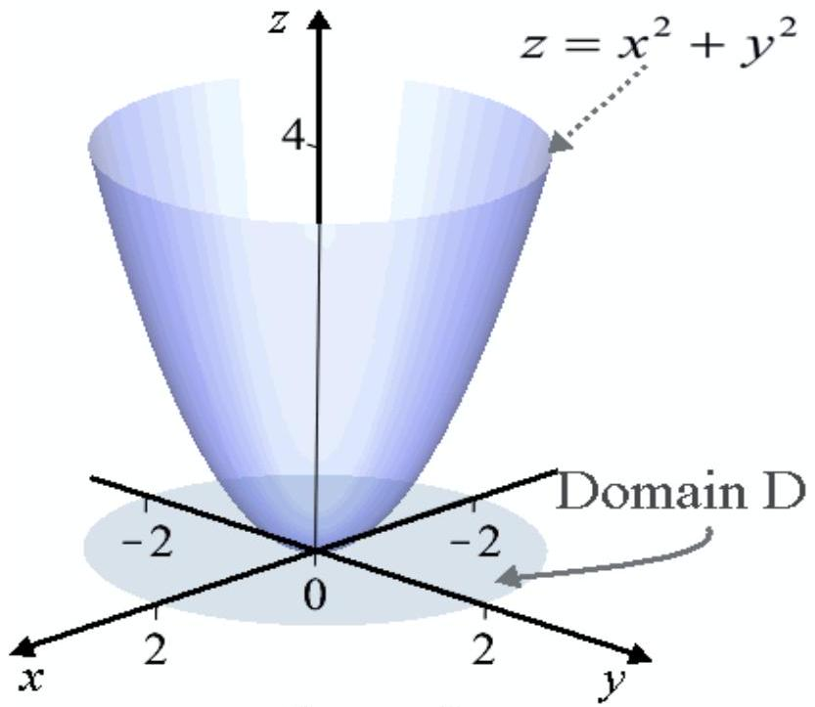

Slide 3
Graph of ​$z=x^{2}+y^{2}$ in the domain
$$D=\left\{(x,y)∣x^{2}+y^{2}≤4\right\}$$

Slide 4
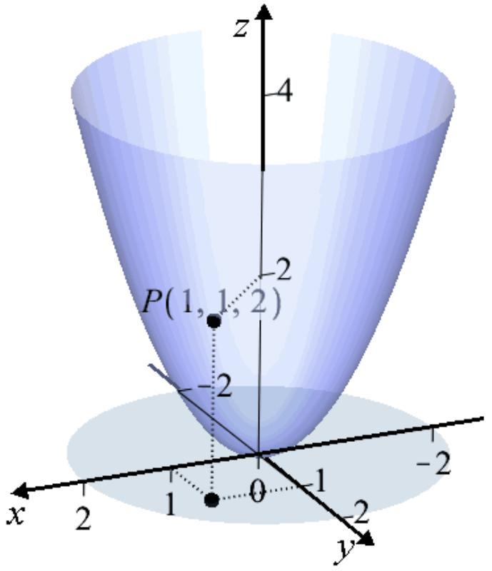

Slide 5
Since ​$f(1,1)=2$, the point ​$P(1,1,2)$ is on the graph of ​$f$.
Functions of Several Variables
Table: ​$f(x,y)=x^{2}+y^{2}$
​$$yx$$ | ​$$1$$ | ​$$2$$ | ​$$3$$ | ​$$4$$
​$$−2$$ | 5 | 8 | 13 | 20
​$$1$$ | 2 | 5 | 10 | 17
​$$4$$ | 17 | 20 | 25 | 32
$$\begin{matrix}f(1,−2)=1^{2}+(−2)^{2}=5 \\ f(2,4)=2^{2}+4^{2}=20\end{matrix}$$
Functions of Several Variables
The Level Curves of the function are the curves with equation ​$f(x,y)=k$ projected down on the ​$xy$-plane. The graph of the level curves is called the contour plot

Slide 7
View from the top Contour plot of the function ​$$f(x,y)=x^{2}+y^{2}$$
View from the top Contour plot of the function ​$$f(x,y)=x^{2}+y^{2}$$

Slide 9
The level curves are the traces of the graph of ​$f$ in the horizontal planes ​$z=k$ projected in the ​$xy$-plane
$$f(x,y)=k− \begin{matrix}k=1: & circle \\ k=2: & x^{2}+y^{2}=1 \\ k=3: & circle \\ k=2 & x^{2}+y^{2}=2 \\ x^{2}+y^{2}=3 & \end{matrix}$$
Functions of Several Variables
Example of surface ​$z=f(x,y)$ with traces on the planes ​$z=k$ projected down in the ​$xy$-plane.

Slide 10
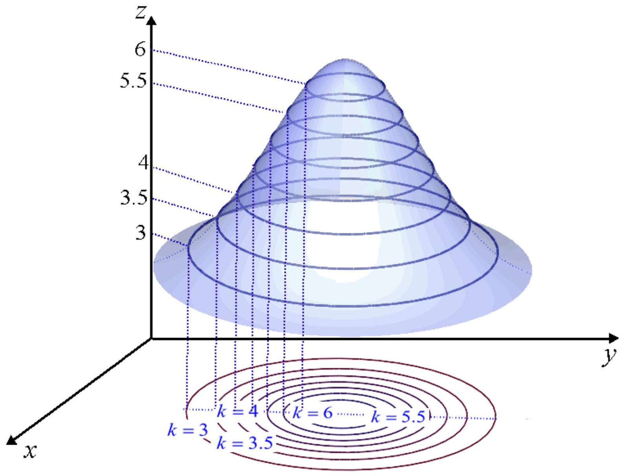

Slide 11
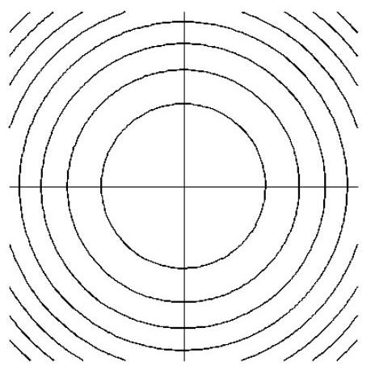
Functions of Several Variables
More Examples of contour plots:

Slide 12
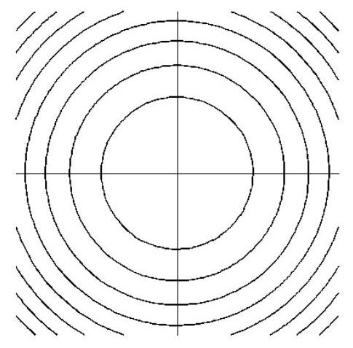

Slide 13
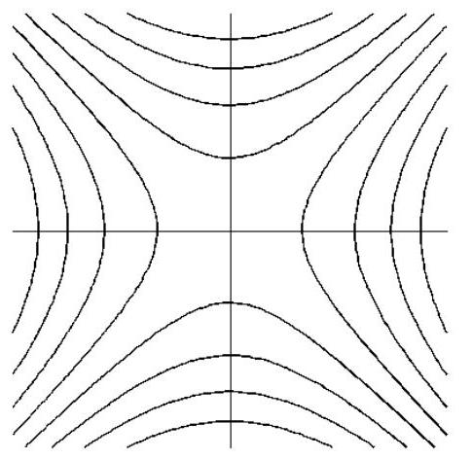

Slide 14
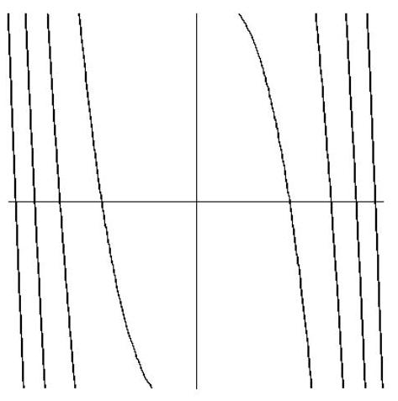

Slide 15
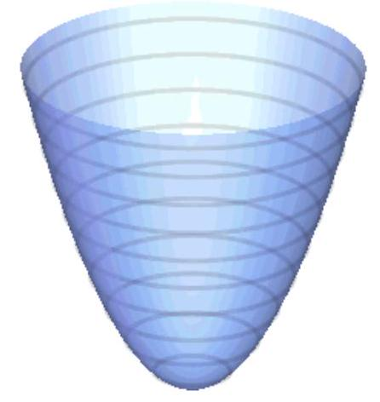
Concentric circles (ellipses): minimum

Slide 16
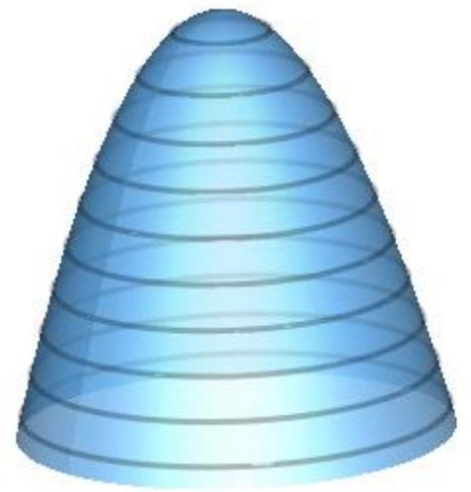
Concentric circles (ellipses): maximum

Slide 17
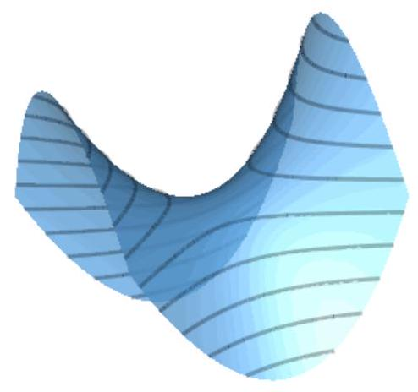
Hyperbolas: saddle point
Closely spaced contours: steep slope in 3D. Widely spaced contours: flat 3D surface.
Functions of Several Variables

Slide 18
Hyperbolic paraboloid (Saddle) ​$z=x^{2}−y^{2}$

Slide 19
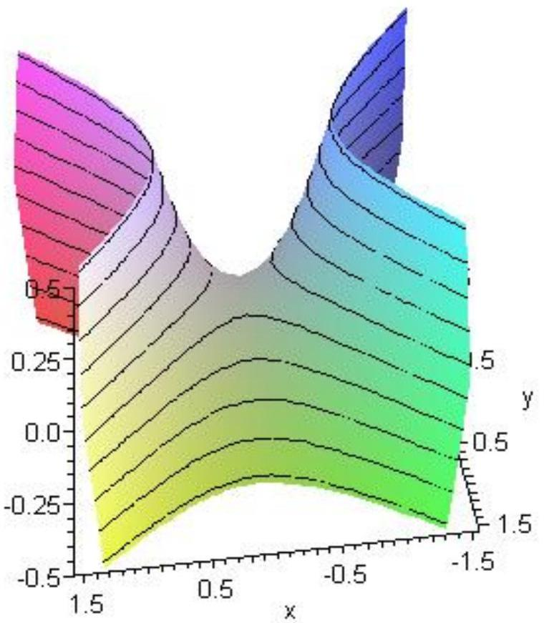

Slide 20
Level curves: ​$x^{2}−y^{2}=k$

Slide 21
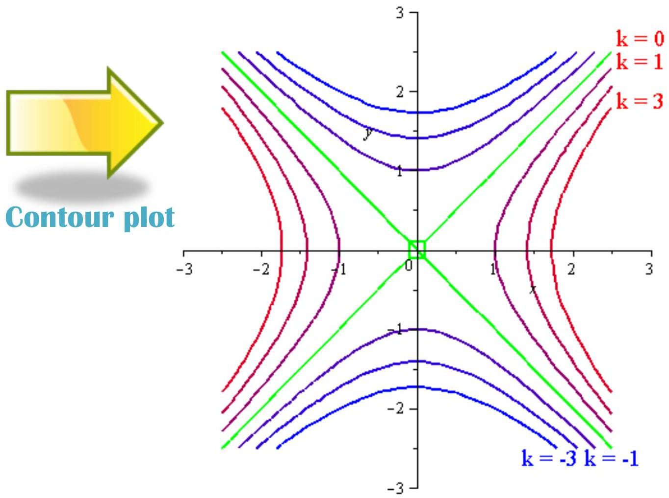

Slide 22
​$k=0$ gives the asymptotes: ​$y=x$ and ​$y=−x$. For all the other values of ​$k$ we get hyperbolas. Note that the values of ​$k$ decrease as we approach the origin from the ​$x$-axis and they increase as we approach the origin from the ​$y$-axis.
Functions of Several Variables
Use the contour plot to identify maximum, minimum and saddle points of of the function ​$$z=3(1−x)^{2}e^{−x^{2}−(y+1)^{2}}−10\left(\frac{x}{5}−x^{3}−y^{5}\right)e^{−x^{2}−y^{2}}−\frac{1}{3}e^{−(x+1)^{2}−y^{2}}+10$$

Slide 23
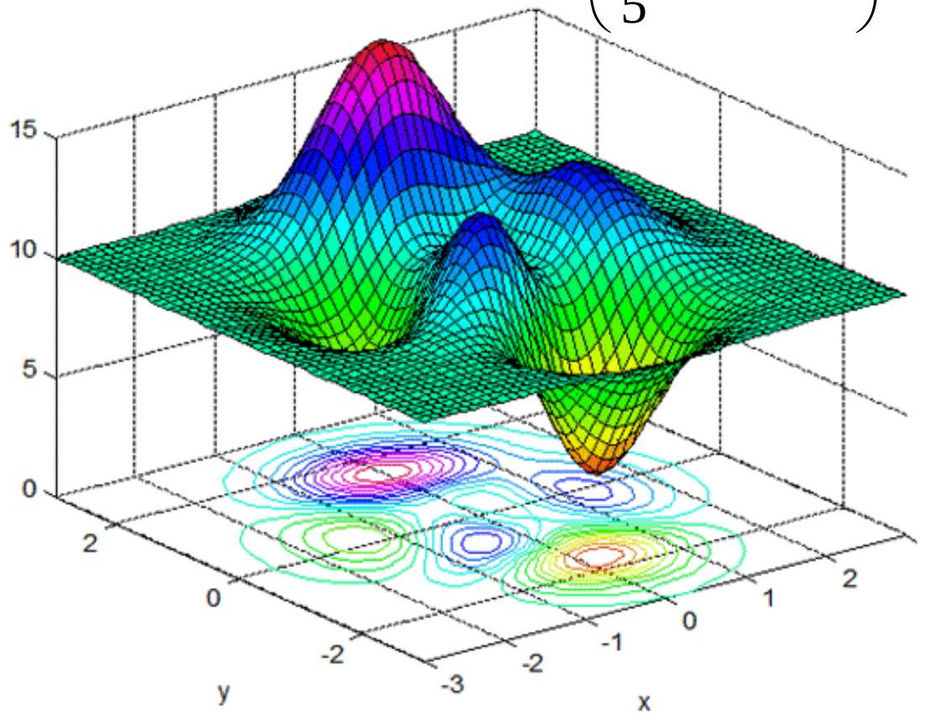

Slide 24
Local maxima:
$$(1.3,−0.005),(−.46,−.63),(−0.01,1.6)$$
Local minima:

Slide 25
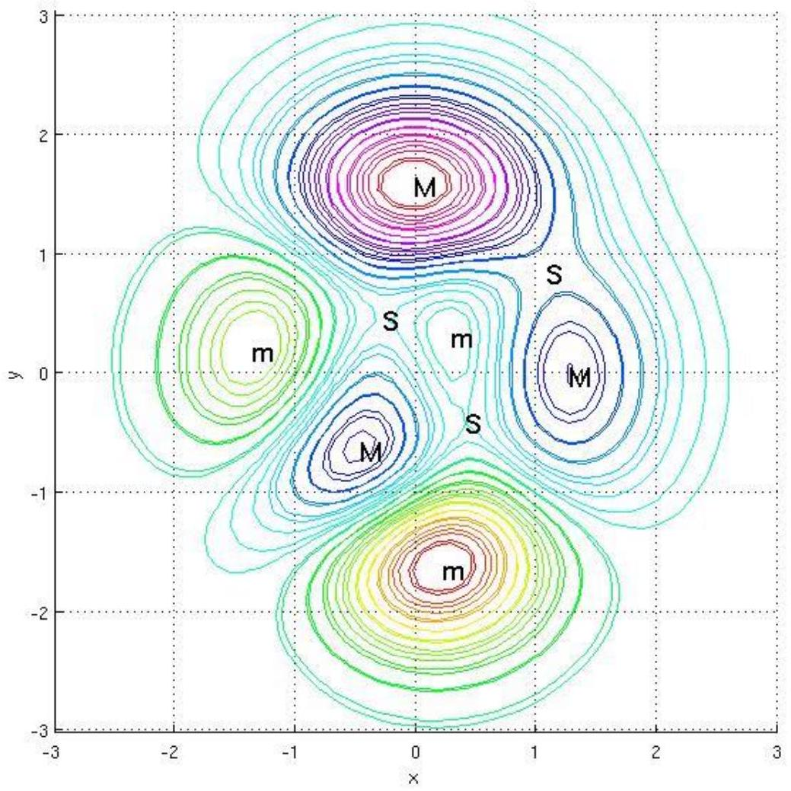

Slide 26
(.23,-1.6), (-1.3,.20), (.3,.3)
Saddle points: (-.27,.47), (.42,-.39), (1.1,.85)
Functions of Several Variables
Unless otherwise specified, the Domain of the function ​$f(x,y)$ is the set of all points ​$(x,y)$ for which ​$f(x,y)$ is a well defined real number.
The Range of the function ​$f(x,y)$ is the set ​$\{z∣z=f(x,y)$ with ​$(x,y)∈$ Domain ​$\}$ Example: Find the domain: ​f(x,y)= x−y+3x+2 The function is defined when ​$x−y+3≥0$ and ​$x+2≠0$

Slide 27
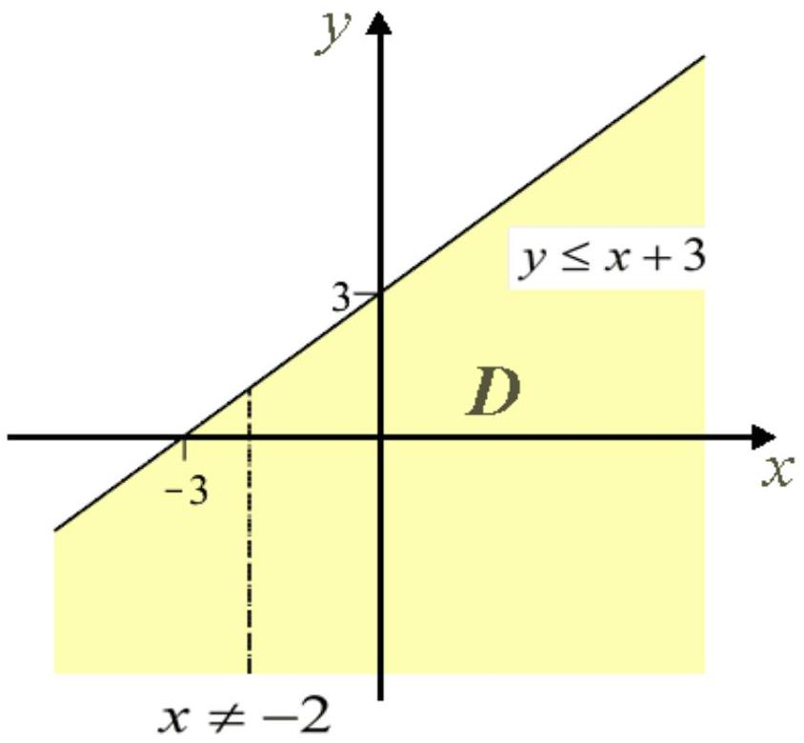

Slide 28
Functions of Several Variables
Example: Find domain and range: ​f(x,y)= 4−x2−y2
Domain:
​$$4−x^{2}−y^{2}≥0⇒x^{2}+y^{2}≤4$$

Slide 29
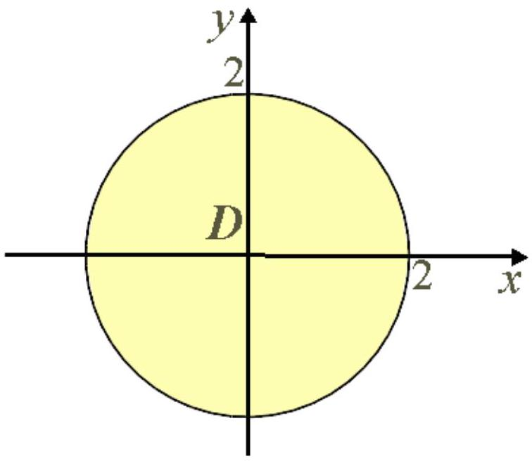

Slide 30
The surface is the top half of the sphere of radius 2 :
$$x^{2}+y^{2}+z^{2}=4$$
Range:
The largest value of ​$z$ is ​ 4=2, obtained when ​$x=0$ and ​$y=0$. On the other hand, the square root is always non negative, thus ​$z≥0$ and the range is the interval ​$[0,2]$

Slide 31
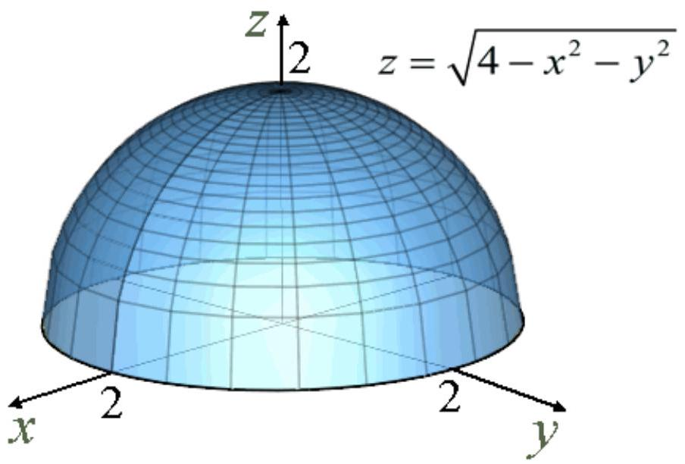

Slide 32
Function of Several Variables
A function of ​$n$ variables assigns a number ​$z=f\left(x_{1},x_{2},…,x_{n}\right)$ to an ​$n$-tuple ​$\left(x_{1},x_{2},…,x_{n}\right)$
Example: Consider the function of three variable ​$f(x,y,z)=x^{2}ln⁡(x−y+z)$ a) Evaluate ​$f(3,6,4)$
$$f(3,6,4)=3^{2}ln⁡(3−6+4)=9ln⁡(1)=0$$
b) Find the domain of ​$f$
$$D=\{(x,y,z)∣x−y+z>0\}$$
The plane ​$x−y+z=0$ divides the space in two parts. The part of space above the plane constitutes the domain of the function. c) Find the range of ​$f$

Slide 33
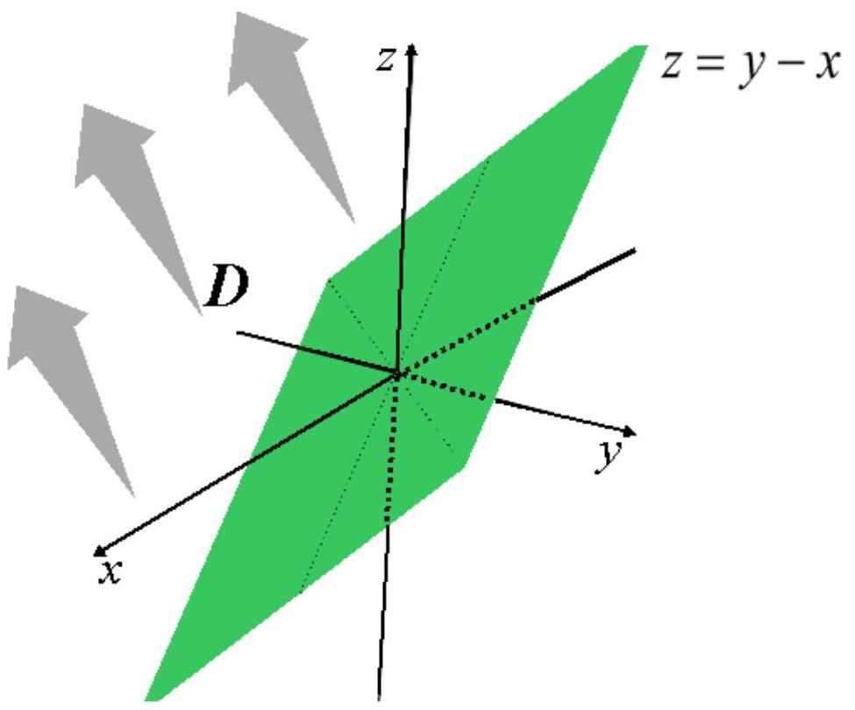

Slide 34
Since the natural logarithmic function takes on all possible real values, the domain of the function is ​$(−∞,∞)$
Function of Several Variables
Example: The temperature in a region where there is a heat source at the origin is given by
$$T=\frac{1000}{x^{2}+y^{2}+z^{2}} for x^{2}+y^{2}+z^{2}≥1$$
We cannot graph this "surface" because we would need four dimensions, but if we set ​$T(x,y,z)=k$ with ​$k$ constant, we obtain level surfaces which in this context are isotherms.

Slide 35
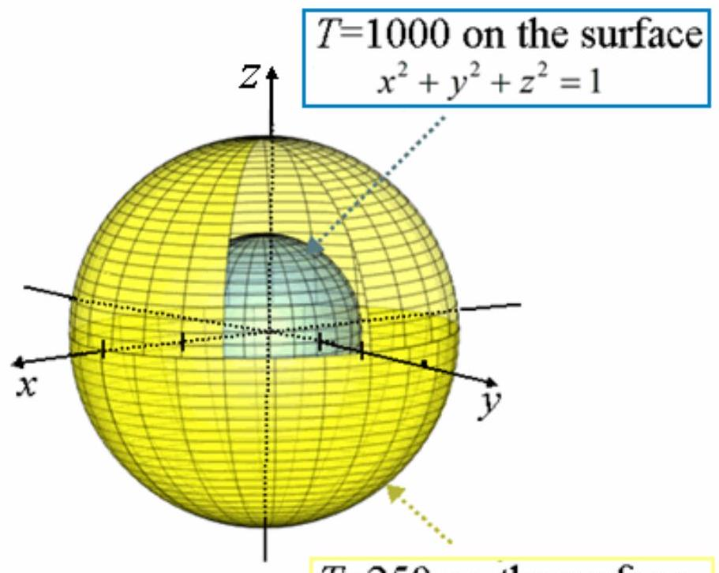

Slide 36
​$T=250$ on the surface ​$$x^{2}+y^{2}+z^{2}=4$$
$$\frac{1000}{x^{2}+y^{2}+z^{2}}=k$$
We can pick arbitrary values for ​$k$. Let's pick ​$k=1000$ and ​$k=250$
$$\begin{matrix} & k=1000⇒\frac{1000}{x^{2}+y^{2}+z^{2}}=1000⇒x^{2}+y^{2}+z^{2}=1 \\ & k=250⇒\frac{1000}{x^{2}+y^{2}+z^{2}}=250⇒x^{2}+y^{2}+z^{2}=4\end{matrix}$$

