Slide 1
Driftwatch
The cloud-audit agent that shows its work
Evidence lineage · adversarial critique · a live sponsor data plane
Open Agent Hackathon 2026 · Wildcard [Tinkerer] · solo build
Notes:
One-liner: an agent that audits an OCI tenancy for cost waste and shadow infrastructure — and can prove, line by line, how every verdict was reached. Everything in this deck is backed by committed artifacts in the repo.

Slide 2
The problem: confident verdicts, no receipts
Cloud tenancies quietly accumulate waste and unattributed “shadow” resources
LLM audit demos produce confident findings with no way to check how they were derived
Trust needs three things — evidence for every claim, a critic that can reject findings, and a reproducible record of the reasoning
And the auditor should consume governed data where governance lives — not a scraped summary
Notes:
Set up the stakes. Cost waste is a money problem; unattributed infra is a security problem; unprovable reasoning is a trust problem. Driftwatch attacks all three in one loop.

Slide 3
Four named agents, one bounded loop
Planner → Scout → Skeptic → Writer — handoffs traced to JSONL, every event
The Skeptic can reject a finding and force a re-investigation — rejection is as visible as acceptance
A figures guard refuses any number in the report that no evidence item supports
Hard caps: rounds, per-source deadlines, total budget — no unbounded debate, runs finish in minutes
Hand-rolled, no orchestration framework — 456 tests instead of a dependency tree
Notes:
Why hand-rolled: the loop is the thesis, not plumbing. The bounds are load-bearing: capped agent loops are the #1 defence against a hung run in front of a judge.

Slide 4
Zetaris: the data plane, live and least-privileged
Policy snapshots published as immutable filestore tables on the live Zetaris gateway (synthetic data, real engine)
The agent fetches policy via two pinned SELECTs — then re-verifies row count, content digest and scope hash after transport, before any agent touches a rule
Runtime identity is a SELECT-only user; the refusal of CREATE/GRANT is recorded evidence, not a promise
Full operations runbook: staged checksums, ephemeral capability probe first, one statement per request, scripted rollback
Sample mode never reads sponsor env at all — credentials-free and network-free by test
Notes:
This is the required integration, and it is load-bearing: the rules that drive findings come FROM Zetaris, verified through transport. The runbook is in docs/zetaris-policy-operations.md with a full execution record.

Slide 5
Meterless: the engine is load-bearing, the provider is honest
World Model engine in app/world_model/ — immutable observation store, validated ingestion, context pinned to one exact run
Scout and Skeptic both read through it; every finding carries the provenance of the observation behind it
Acceptance is generated, not written: verify_world_model.py rebuilds the proof offline, with no credentials
Nightshift is wired to the documented contract — bearer auth, /v1/models discovery, 60s budget, redirects refused — and contract-tested
Not yet live: the vendor's Mac build fails Gatekeeper and we did not bypass it, so the report says not_used

Slide 6
The causal experiment — not a demo branch
Notes:
The strongest one-slide proof of the sponsor integration.

Slide 7
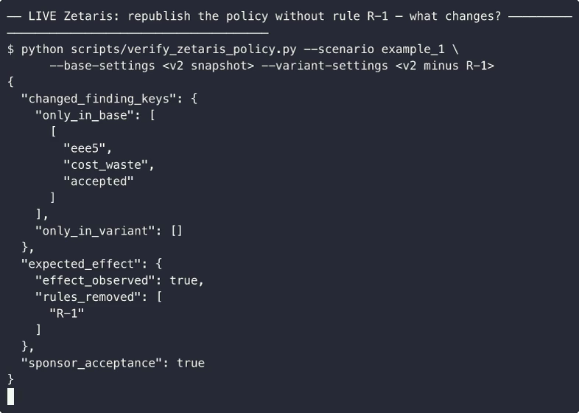
Same scenario, same code, one rule unpublished
live run | policy snapshot | rules | finding from R-1
base | example1_base_v2 | 5 | eee5 · cost_waste · ACCEPTED
variant | example1_no_volume_v2 | 4 | GONE
 |  |  | all other findings identical
guard | what it proved
dead endpoint | degrades honestly — sponsor_acceptance: FALSE
tampered digest pin | rejected before use — zero fabricated output
Notes:
We republished the policy WITHOUT rule R-1 as a new immutable snapshot and ran the identical audit. Exactly one finding disappeared — the one R-1 produces — and nothing else moved, computed through the full loop with provider=zetaris lineage in the trace. The right half is the real terminal frame from the committed acceptance run.

Slide 8
Our guard caught a supplier bug in production
The live engine’s CSV parser silently truncates cells at embedded quotes — row counts and headers looked fine
Our content-digest check rejected every fetch; the run degraded to fixture data honestly — no corrupted rule ever reached an agent
Response: quote-safe re-export (digests unchanged), new immutable snapshots, v1 revoked and dropped, supplier defect report written up
“A connector’s happy path is not its contract — validate the payload after the wire, not just the status code.”
Notes:
Judges should note the sequence: capability probe first (ephemeral session table), permanent registration only after, validation after transport, degradation labeled in the report. Found on day one of the live run; notes/zetaris-engine-defects-2026-10-22.md.

Slide 9
Measured, not promised
3 curated scenarios: precision 1.0 · recall 1.0 · verdict accuracy 1.0 · deterministic
10 held-out generated tenancies: same scores — and the generator exposed two real defects the curated set missed; both fixed, both now guarded by tests
456 tests; sample-mode isolation enforced by blocking sockets and subprocess creation with sponsor vars present and absent
Packaging verified from fresh clone, in containers on x86 and arm64, via POST /run — JSON in, JSON out, no UI needed
Every external call has a timeout; every loop has a cap; a run finishes in minutes
Notes:
The held-out generator matters most: hand-written tests only measure how well you predicted yourself. Seeded generation samples the space — and earned its keep immediately.

Slide 10
How it was built — attributed honestly
Cursor agent CLI drove Tasks 1–2 (session logs retained); free-tier quota exhausted mid-window — blocker posted to HackOS, the announced rule change captured
Hermes agent drove Tasks 3–6 with TDD throughout; per-task attribution lives in the committed build log
Every mutating step on the live Zetaris instance went through a dry-run approval package first — recorded in decisions.md
NVIDIA: model path is provider-agnostic (OpenAI-compatible, Nemotron-capable endpoints unconfirmed) — stated as-is
Meterless: World Model engine implemented in app/world_model/ and consumed by Scout and Skeptic, with generated offline acceptance; Nightshift provider implemented and contract-tested, never served a live request (vendor Mac build fails Gatekeeper) — stated as-is
Notes:
A hackathon with mandatory tooling and a dead quota is still an honesty test. The build log says exactly who did what — that transparency is itself an AI-usage-policy answer.

Slide 11
Run it yourself — no keys required
git clone https://github.com/antnoumous/antynomoushackathon26
python3.11 -m venv .venv && .venv/bin/pip install -r requirements.txt
python run.py # full agent on cached data, credential-free
python -m evals.run_eval # precision / recall / determinism, in seconds
Driftwatch: every claim traces to evidence — every failure degrades honestly.
Notes:
Closing beat: the judges' own reproducibility is part of the product. Point to output_examples/zetaris_acceptance_2026-10-22/ if asked 'did the sponsor integration actually do anything?' — acceptance.json answers with computed diffs.

