Slide 1
LiveScore Marketing Data Analyst Technical Test
An Nguyen

Slide 2
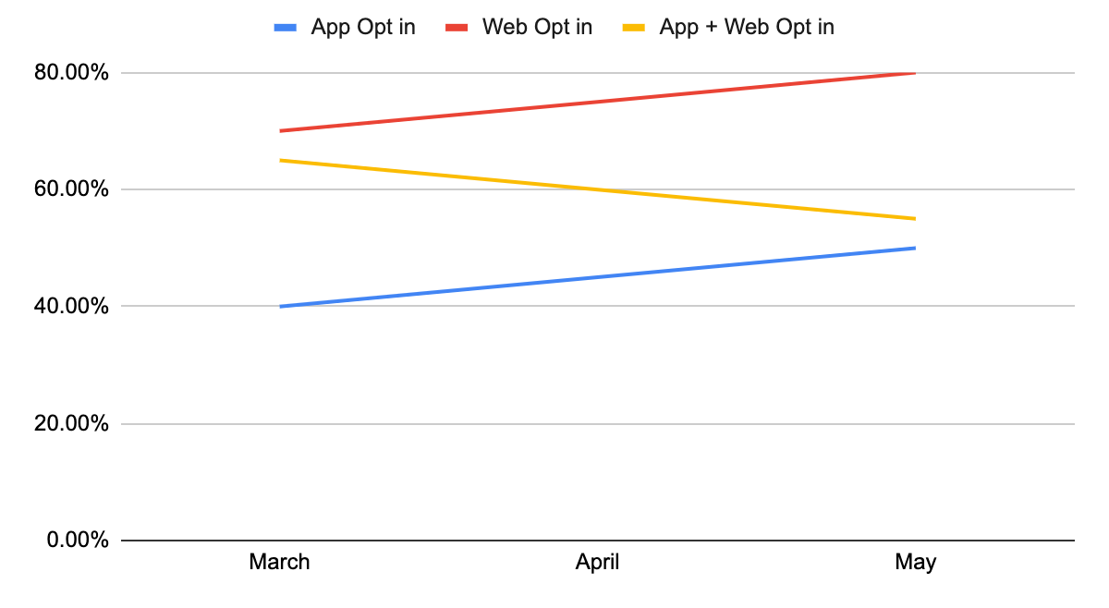
Question 1
From March to May, Web Opt-In is the most preferred method for marketing communication, followed by App + Web Opt-In and App Opp-In.
In the three months from March to May, App + Web Opt-In experiences the most reduction, going from approximately 65% to roughly 55%.
Both App Opt-In and Web Opt-In show upward trend, from 40% to 50% for App Opt-In and from 70% to 80% for Web Opt-In. Despite the upward trend, as mentioned above, overall App Opt-In still has lower performance than App + Web Opt-In and Web Opt-In is the best performance.

Slide 3
Question 2
WITH football_bets AS (
SELECT bettorID, COUNT(DISTINCT betID) AS football_bets_count
FROM BETS
WHERE betSport = 'Football' AND betDate BETWEEN '2022-12-01' AND '2022-12-31'
GROUP BY bettorID),
basketball_bets AS (
SELECT bettorID,
CASE WHEN betSport = 'Basketball' THEN 1 ELSE 0 END AS previously_bet_on_basketball
FROM BETS),
campaign_counts AS (
SELECT userID, channel, COUNT(DISTINCT campaignID) AS campaignsSent
FROM CAMPAIGNS
GROUP BY userID, channel),
average_stakes AS (
SELECT bettorID, AVG(betAmount) AS average_stake
FROM BETS
GROUP BY bettorID)
SELECT u.userID, f.football_bets_count, c.channel, c.campaignsSent, b. previously_bet_on_basketball, a.average_stake
FROM USER u
LEFT JOIN football_bets f ON u.userID = f.bettorID
LEFT JOIN campaign_counts c ON u.userID = c.userID
LEFT JOIN basketball_bets b ON u.userID = b.bettorID
LEFT JOIN average_stakes a ON u.userID = a.bettorID
WHERE u.brand = 'LiveScore' AND a.average_stake >= 10;
Changes I have made to the original query:
Replace multiple Left Join with CTEs to improve readability and reusability
Replaced double quotes ("") with single quotes ('') for string literals.
Reference the time condition (December) only once at the beginning of the query
Correct misspelling of “Basketball”
Join BETS and USER table to identify the users who previously bet on Basketball instead of joining BETS and CAMPAIGNS like the original query

Slide 4
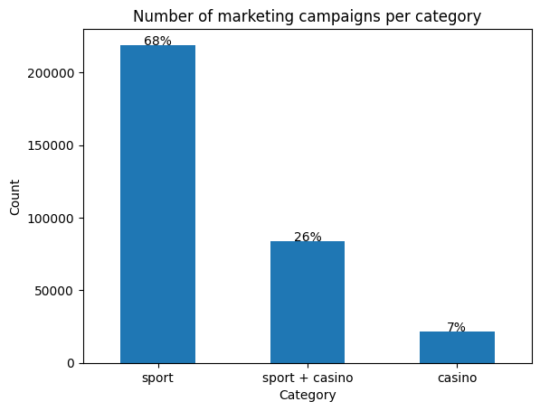
Question 3
This chart shows the number of marketing campaigns for each category.
Majority of campaigns are for sport (68%), followed by sport+casino (26%), and finally casino (7%).

Slide 5
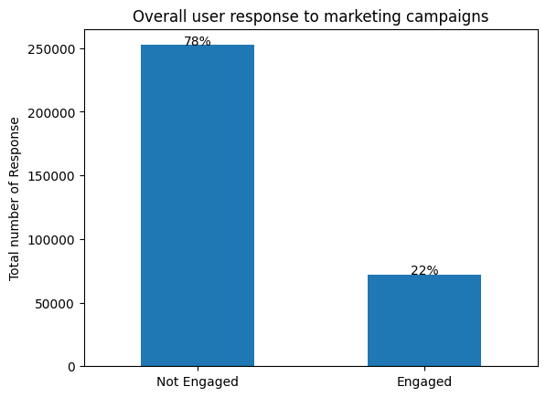
Question 3 (cont)
This graph shows the overall user response to marketing campaigns. A response is classified as “Engaged” if the user opens or clicks on the ad at least 1 time.
This analysis assumes that the values in “open” and “click” columns represent the number of times a user opens or clicks a campaign.
Majority of users do not engage with the campaigns, 78% of no engagement vs 22% of engagement.

Slide 6
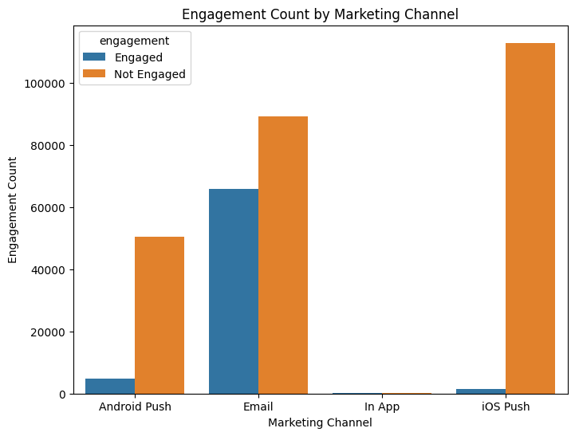
Question 3 (cont)
This chart shows which marketing channel has the highest engagement rate.
“Email” has the highest engagement count, followed by phone push notifications (Android phones have better engagement than Apple phones) and at the bottom is in-app notifications.

Slide 7
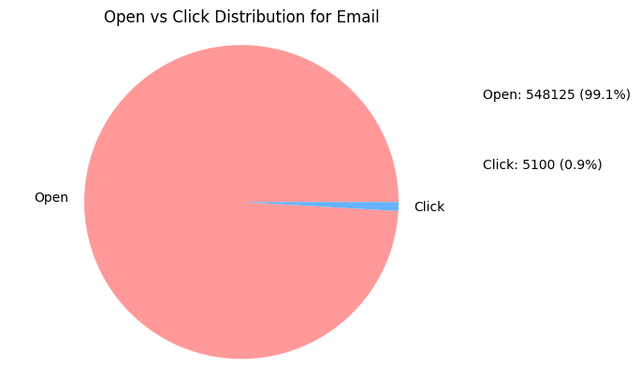
Question 3 (cont)
This analysis assumes that each unique “profile_id” is a unique user and the value in “open” and “click” columns represent the number of times a user opens or clicks the email.
99.1% of users open the emails, but only 0.9% click on email links.

