Slide 1
Sample Store
In depth analysis

Slide 2
Basic analysis

Slide 3
Sample Store
9994 data points
Only available in US
4 Regions of US covered
49 states of US covered
Available in 531 cities
631 Postal codes
4 types of ship modes
3 segments
3 categories and 17 sub categories

Slide 4
Sample Store
Attributes | Mean | Median
Sales | 229.86 | 54.49
Quantity | 3.79 | 3
Discount | 15.62% | 20%
Profit | 28.65 | 8.66

Slide 5
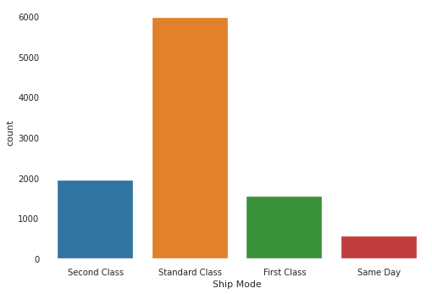
Ship Mode Analysis
We mostly use Standard Class (5968).
Followed by Second Class(1945).
Followed by First Class(1538)
We use Same day(543) shipping mode least

Slide 6
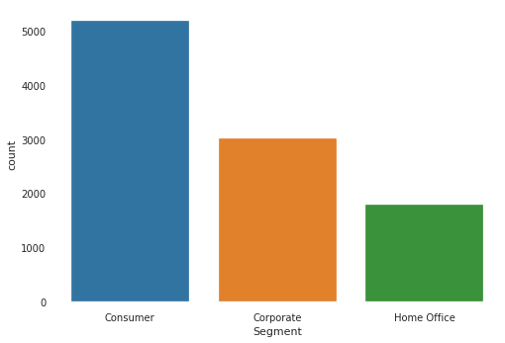
Segment Analysis
We mostly deal in consumer segment (5191)
Followed by Corporate Segment(3020).
Least in Home Office(1783).

Slide 7
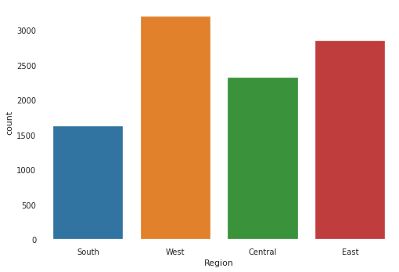
Region Analysis
Our consumer base is strongest in Western region (3203)
Eastern region(2848)
Central region(2323)
Southern region(1620)

Slide 8
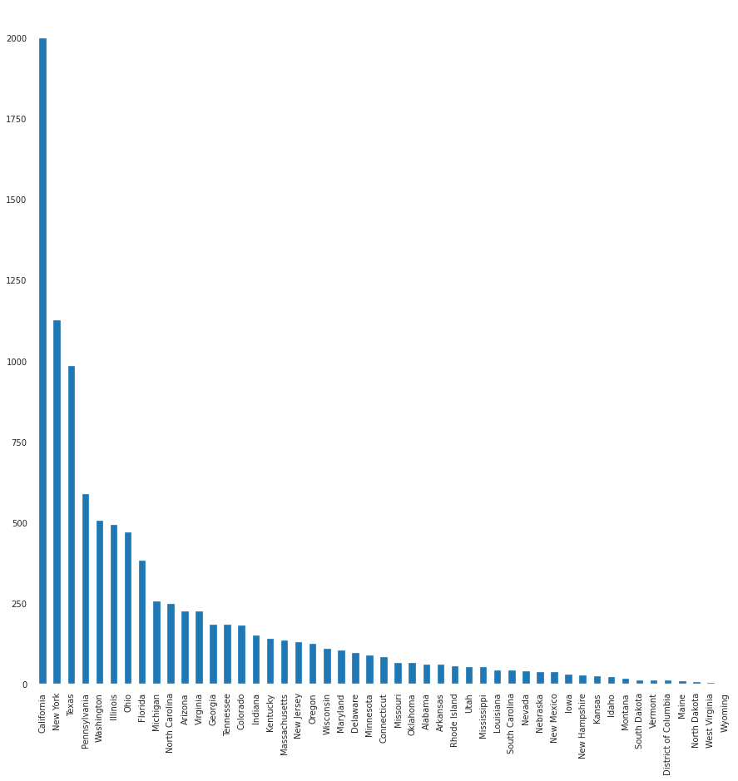
State Analysis
Most transactions happen in California state (2001)
Followed by New York state(1128) ,Texas state(985)

Slide 9
City Analysis
We have our presence is 531 cities.
Our top 5 cities which has most transactions
City | Number of transactions
New York City | 915
Los Angeles | 747
Philadelphia | 537
San Francisco | 510
Seattle | 428

Slide 10
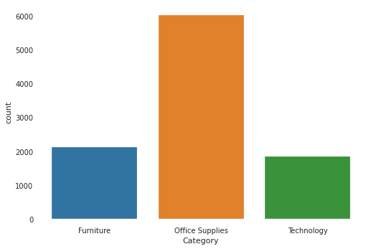
Category Analysis
Most transactions happen in Office Supplies(6026)
Furniture(2121)
Technology(1847)

Slide 11
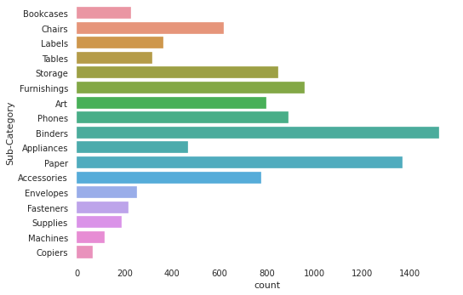
Sub Category Analysis
Most transactions happen in Binders sub category(1523)
Paper(1370)
Furnishings(957)

Slide 12
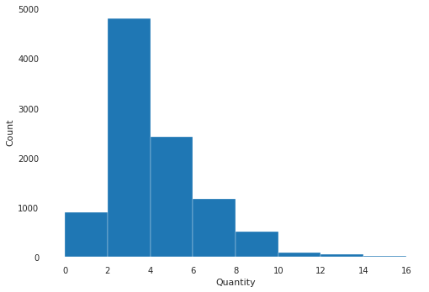
Quantity Analysis
Most of the transactions have quantity 2-4(4811)
Quantity 4-6 (2421)
Quantity 6-8 (1178)

Slide 13
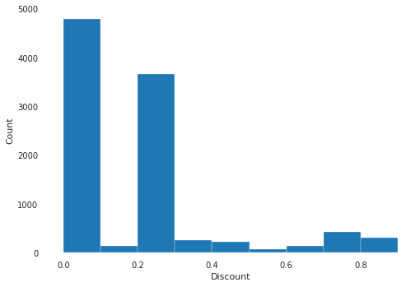
Discount Analysis
Most of the transactions that happened had discount between 0-10% (4798)
Followed by 20-30% (3657)

Slide 14
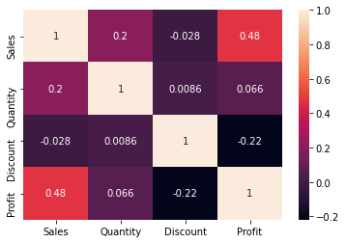
Relation between Attributes
Sales and Profit have correlation of 0.48
Sales has negative correlation with discount which is counterintuitive.

Slide 15
Level 1
In depth analysis

Slide 16
Ship Mode wise
In depth analysis

Slide 17
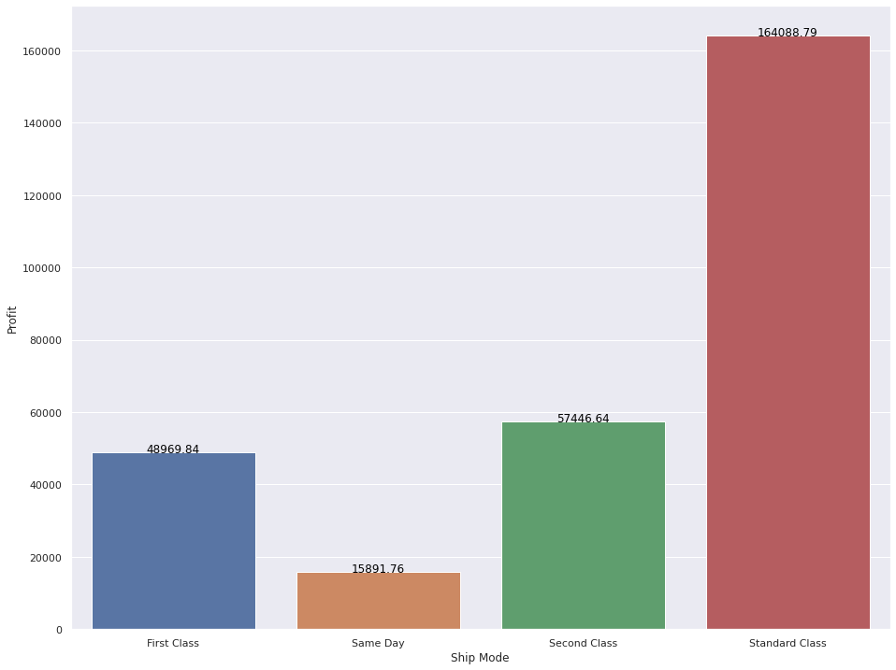
Profit distribution between different Ship modes
We have most profit delivering through standard mode.
Least profit in same day ship mode

Slide 18
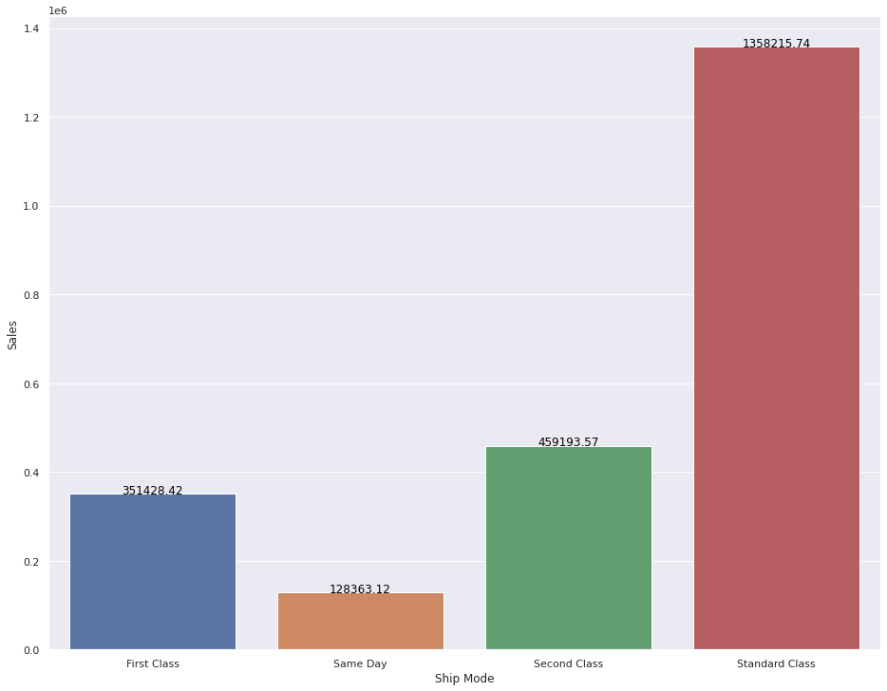
Sales distribution between different Ship modes
We have most sales delivering through standard mode.
Least profit in same day ship mode
Similar trend as we have in profit wise distribution

Slide 19
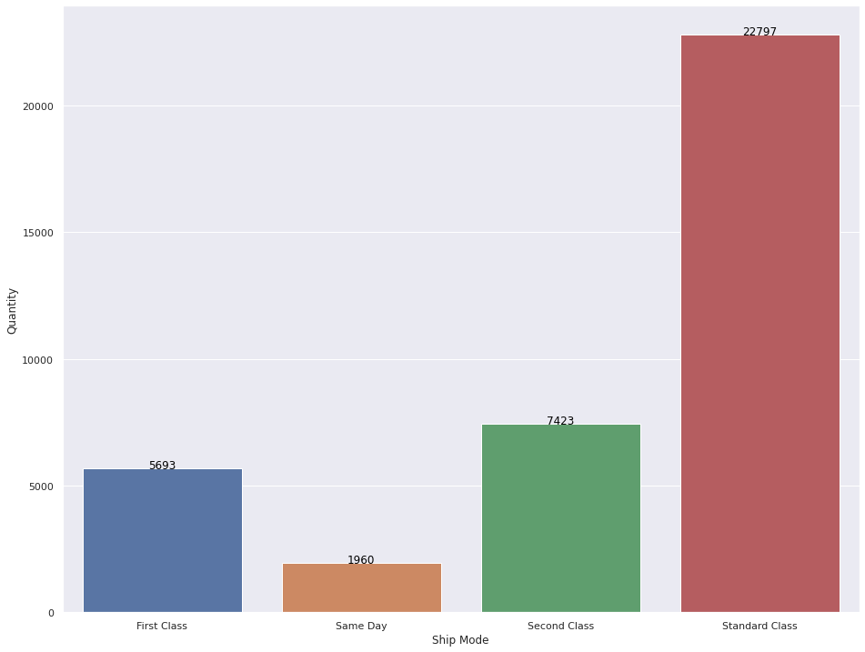
Quantity distribution between different Ship modes
We have most quantity delivered through standard mode.
Least quantity delivered through same day ship mode

Slide 20
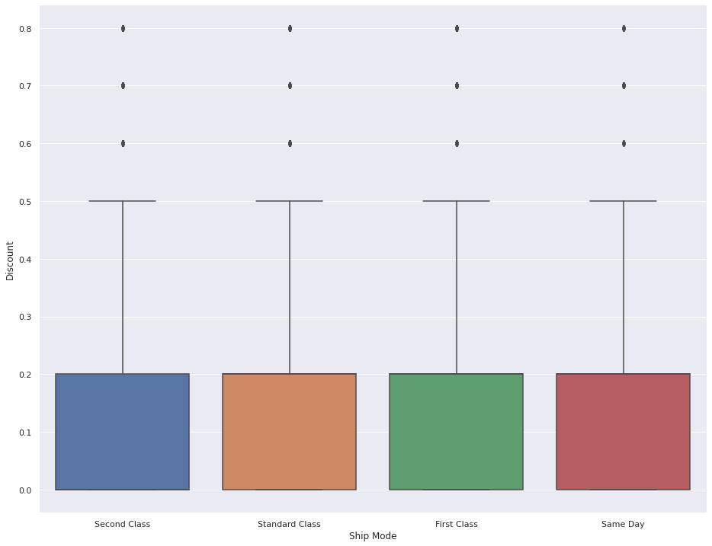
Discount distribution between different Ship Modes
There seems to be no difference in distribution of discount on the basis of ship mode

Slide 21
Segment wise
In depth analysis

Slide 22
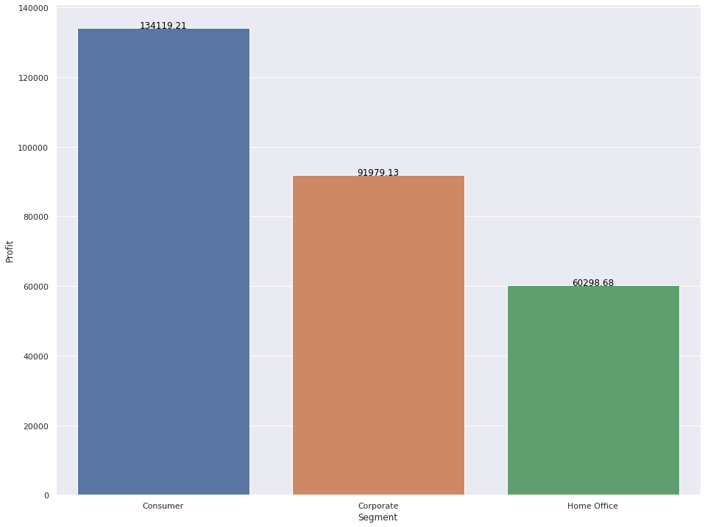
Profit distribution between different Segments
We have most profit in consumer segment
Least profit in Home office segment

Slide 23
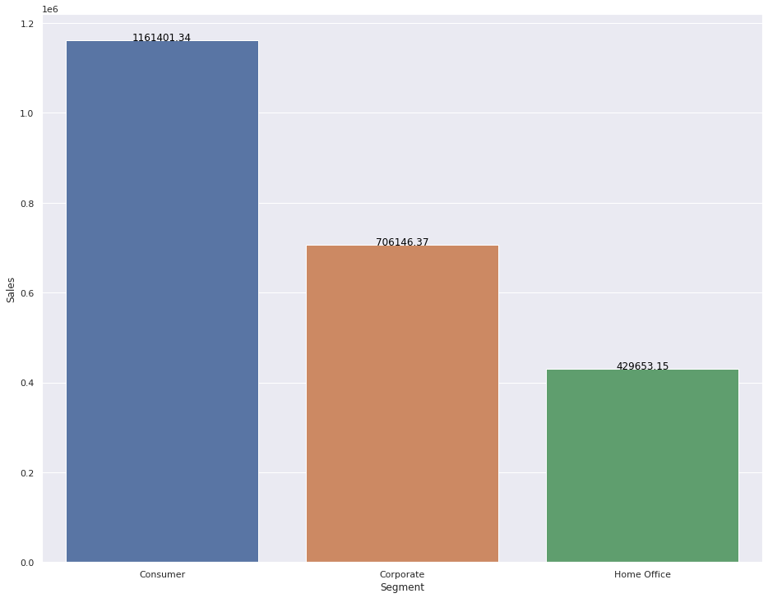
Sales distribution between different Segments
We have most sales in consumer segment
Least sales in Home office segment
Similar trend as that of profits distribution

Slide 24
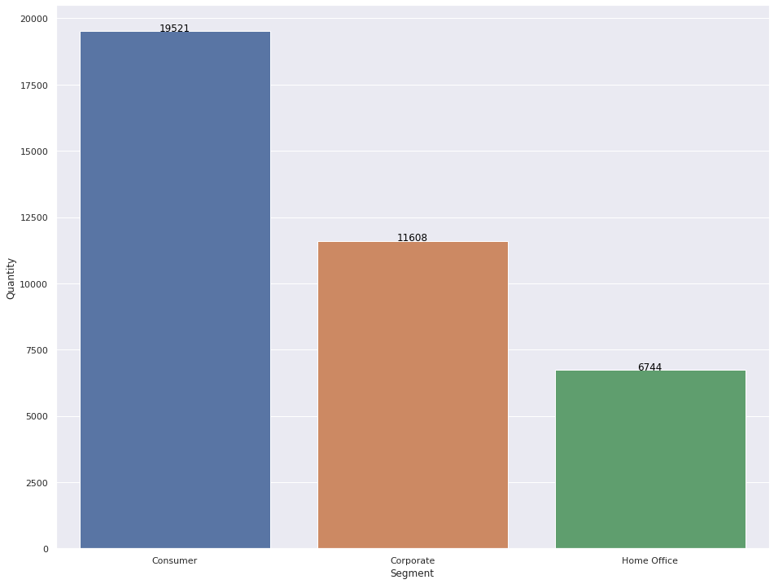
Quantity distribution between different Segments
Quantity is most delivered in consumer segment
Quantity is least delivered in Home office segment
Similar trend observed in profit distribution

Slide 25
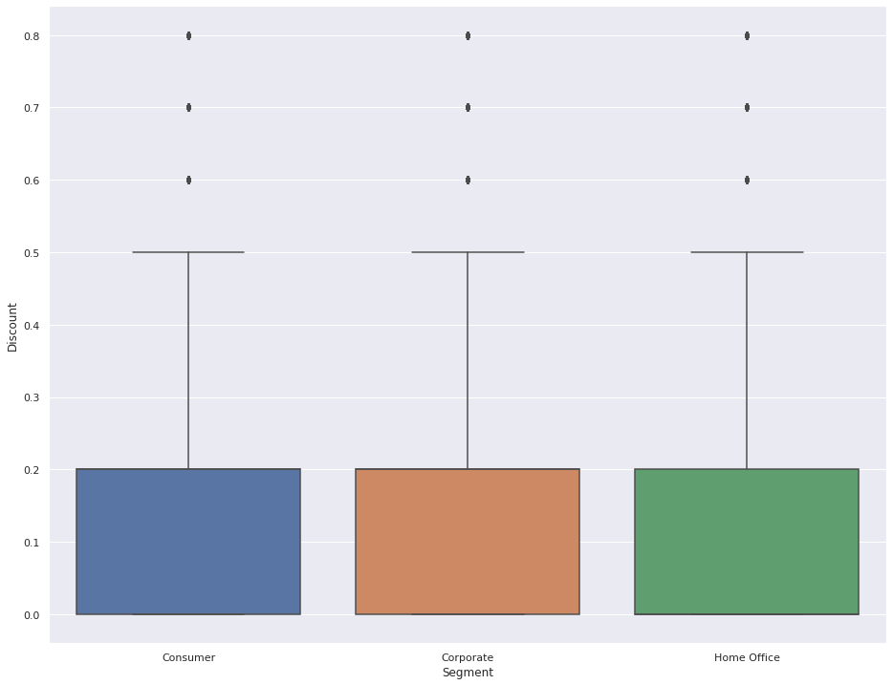
Discount distribution of different Segments
No difference in distribution of discount among various segments

Slide 26
Region wise
In depth analysis

Slide 27
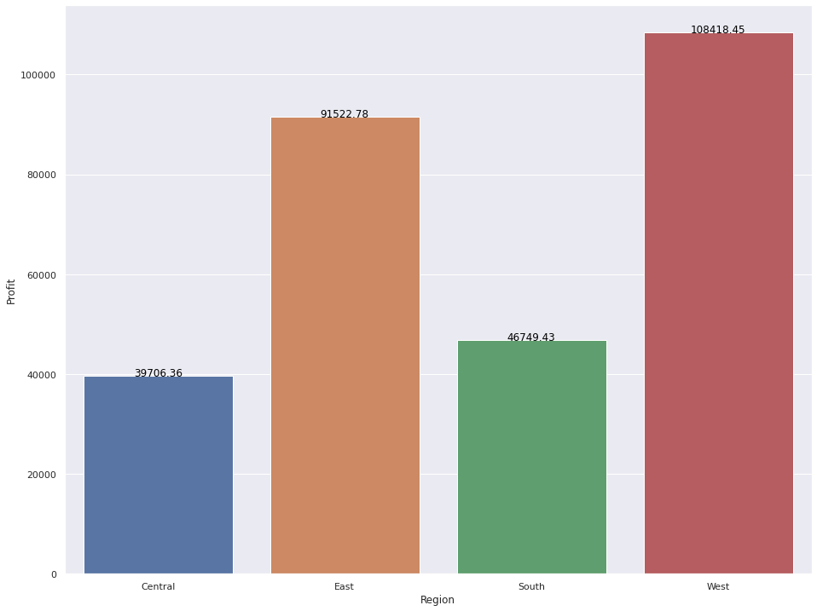
Profit distribution between different Regions
Western region is the most profitable region
Central region is least profitable region

Slide 28
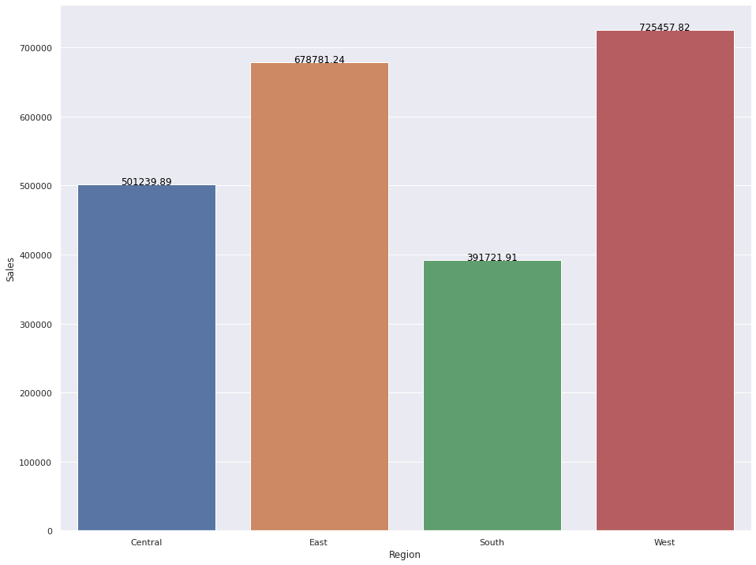
Sales distribution between different Regions
Most sales in western region
Least sales in south
Central region has more sales than southern region but Central has less profit than southern region

Slide 29
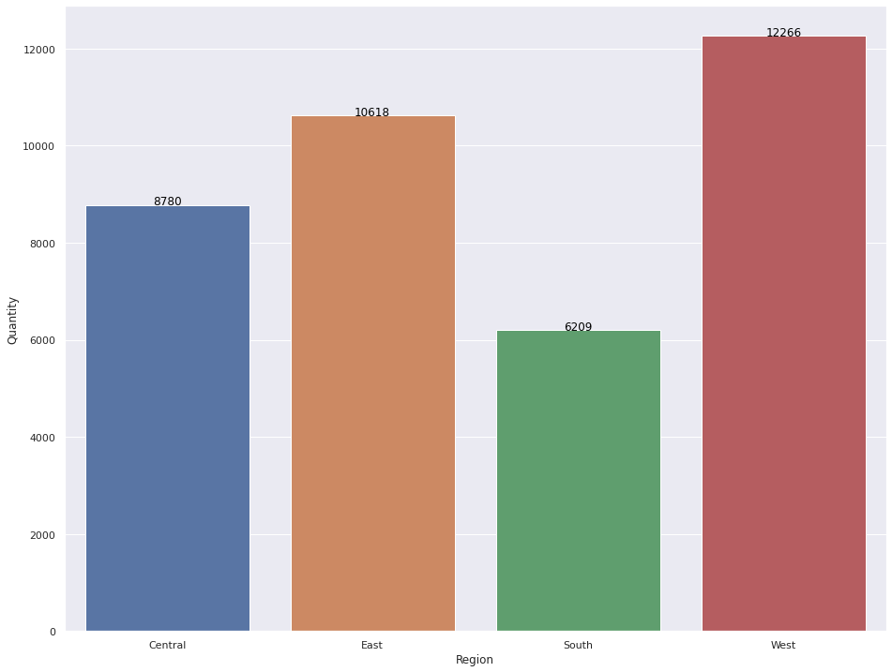
Quantity distribution between different Regions
Quantity is most delivered in western region
Quantity is least delivered in southern region
Similar trend to sales

Slide 30
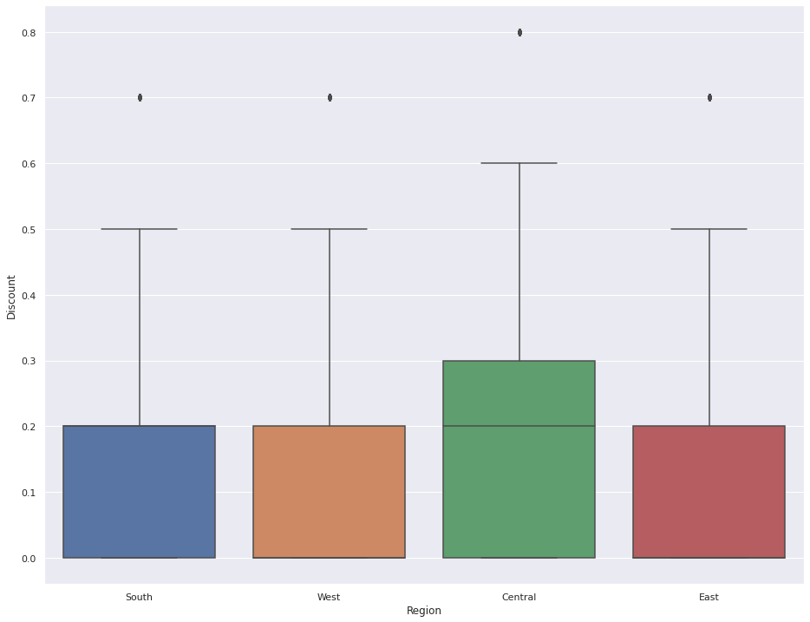
Discount distribution between different Regions
Discount is more offered in central region

Slide 31
Sub-Category wise
In depth analysis

Slide 32
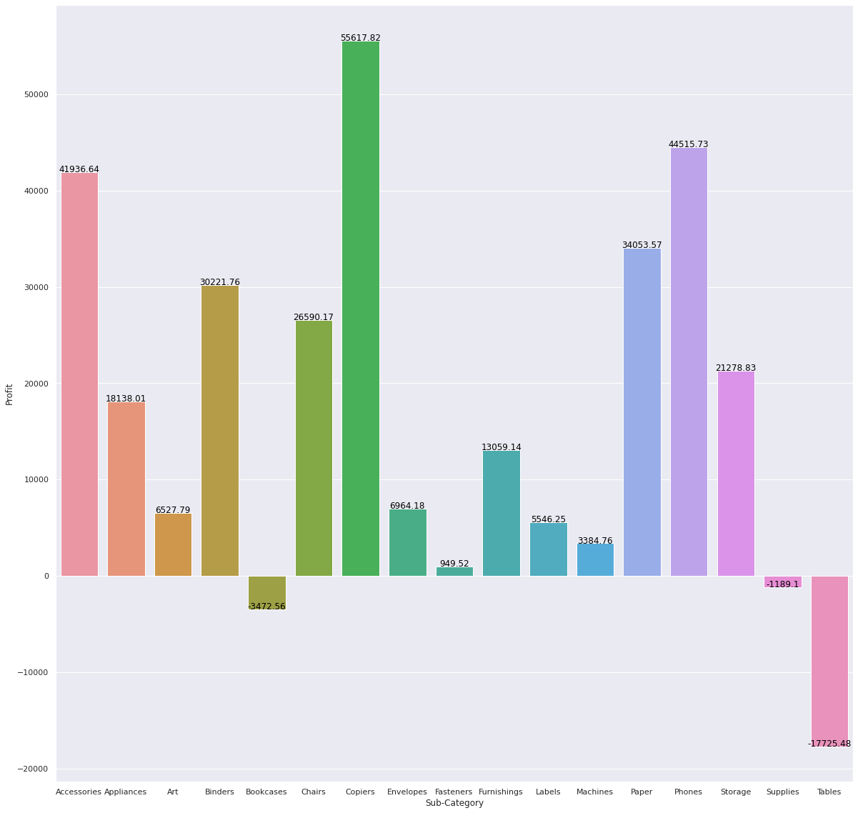
Profit distribution between different Sub Category
Copiers and Phones are the most profitable sub categories
Tables, Bookcases and supplies are loss making sub categories
Rest of the sub categories are positive

Slide 33
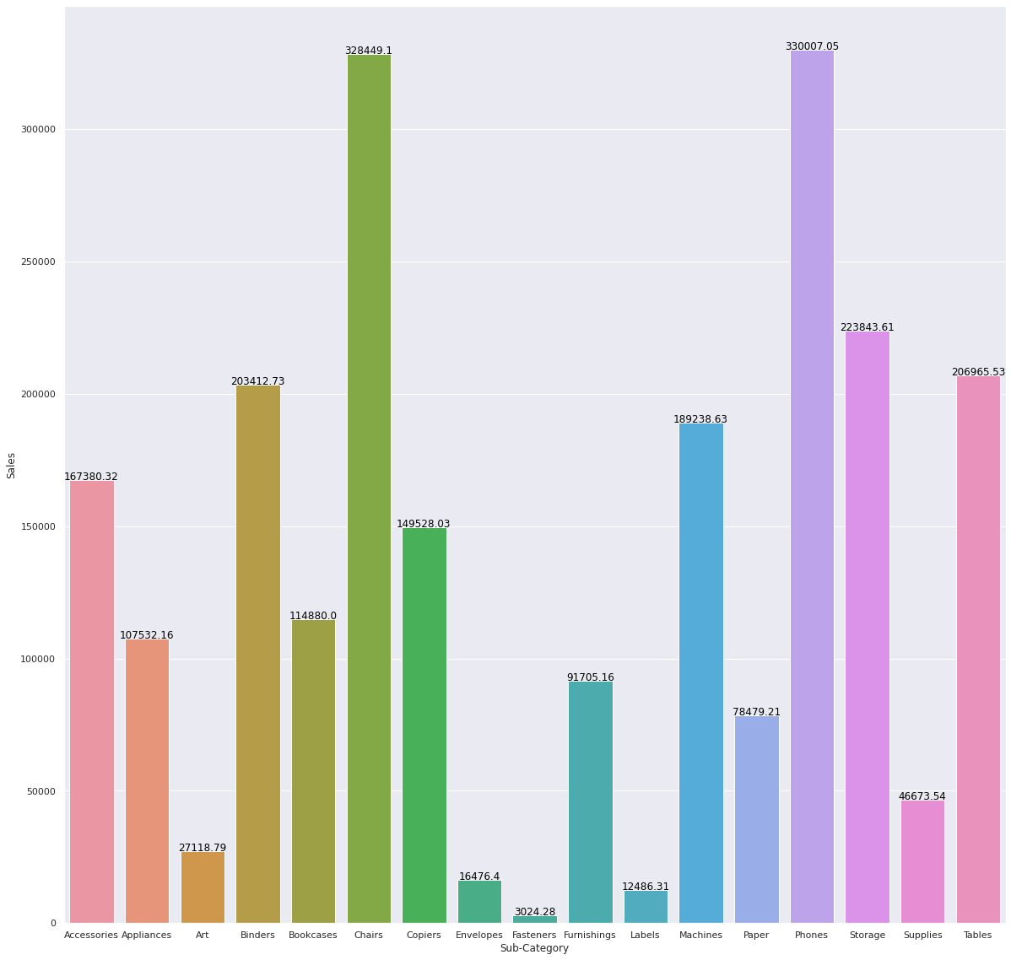
Sales distribution between different Sub Category
Phones, chairs have the most sales
Tables which is loss making sub category has more sales than copier which is the most profitable sub category
Bookcase which is also loss making sector has sales of 114880.
Supplies has sales of 46673.54

Slide 34
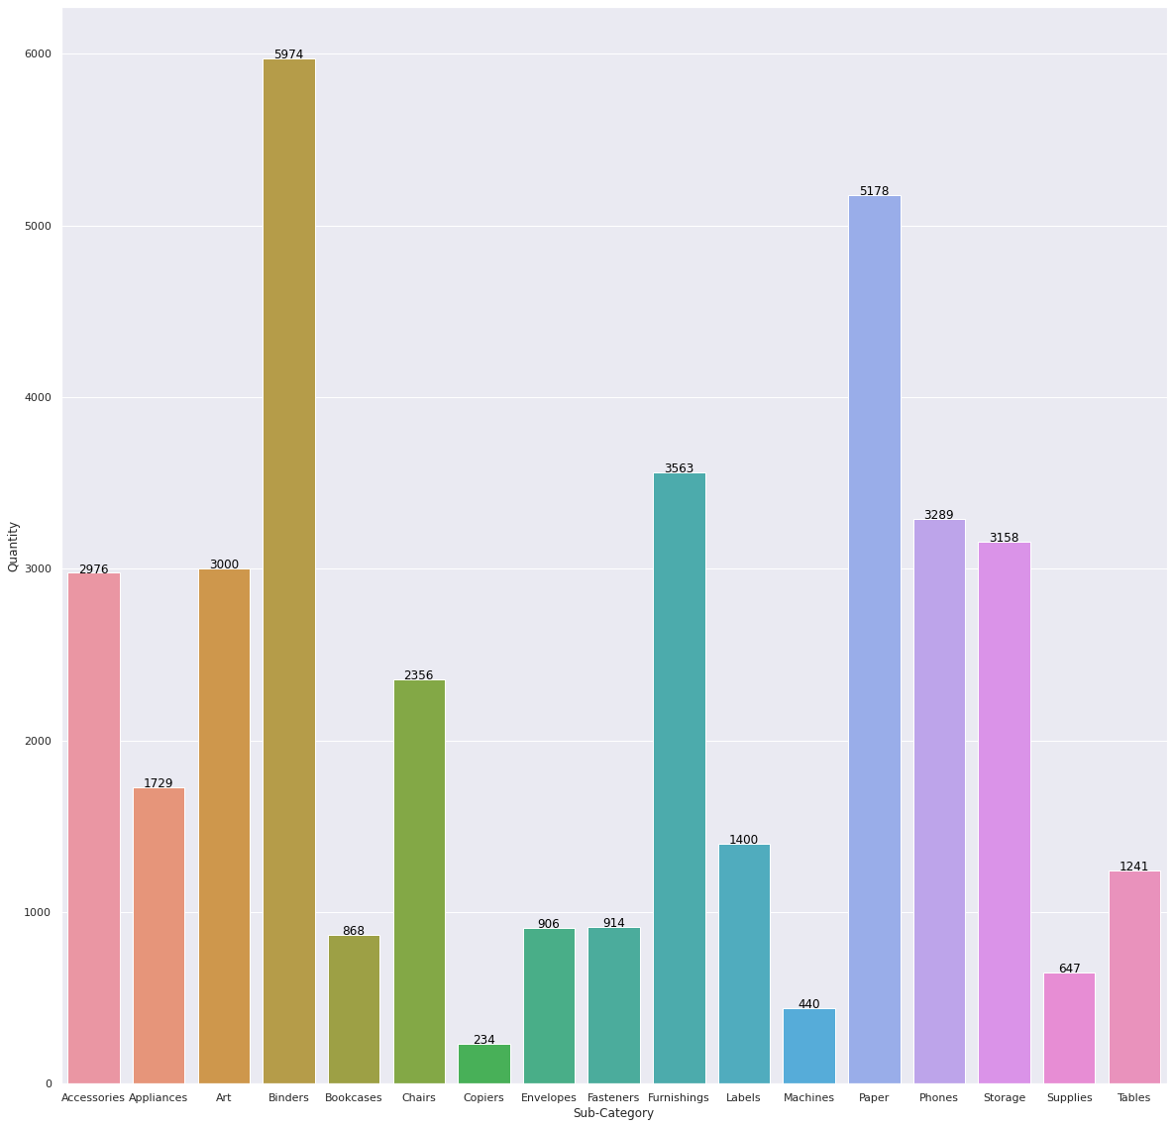
Quantity distribution between different Sub Category
Binders is the most sold item.
Followed by Paper
Tables is more sold than copiers

Slide 35
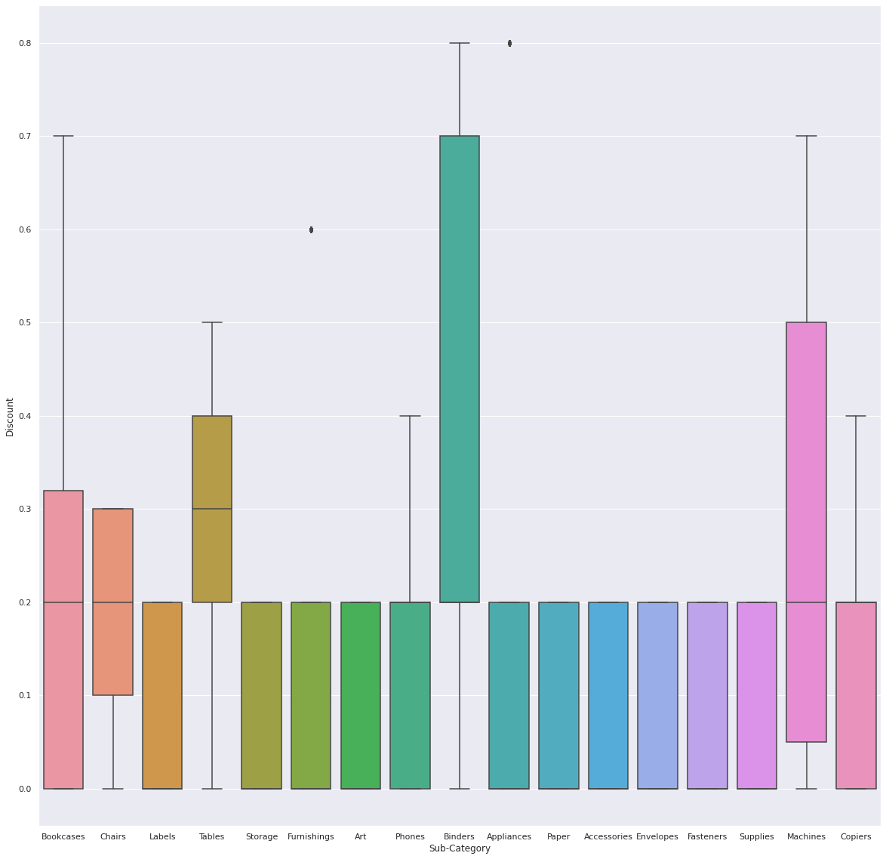
Discount distribution between different Sub Category
Higher discount is offered on Tables than copiers
High discounts are offered in bookcases subcategory
Storage, art, paper, accessories, envelopes, fasteners, supplies (which is loss making sub category) has same distribution of discount
Binders which is most sold item also has high discounts
Machines also has higher discounts as compared to rest

Slide 36
State wise
In depth analysis

Slide 37
Loss making States
State | Loss
Texas | 25729.35
Ohio | 16971.37
Pennsylvania | 15559.96
Illinois | 12607.88
North Carolina | 7490.91
Colorado | 6527.85
Tennessee | 5341.69
Arizona | 3427.92
Florida | 3399.30
Oregon | 1190.47

Slide 38
Critical States
These are states which lie in bottom 10% which needs to be taken care of else they might turn into loss making states
State | Profit
Wyoming | 100.19
West Virginia | 185.92
North Dakota | 230.15
South Dakota | 394.83

Slide 39
City wise
In depth analysis

Slide 40
Loss making Cities
These are the top 5 loss making cities
City | Loss
Philadelphia | 13837.76
Houston | 10153.54
San Antonio | 7299.0502
Lancaster | 7239.0684
Chicago | 6654.5688

Slide 41
Critical Cities
These are 5 cities which make close to break even so if proper measures are taken care they could turn profit.
City | Loss
Ormond Beach | 1.96
Pensacola | 1.47
Elyria | 1.39
Altoona | 1.18
Hickory | 1.09

Slide 42
Critical Cities
These are 5 cities which make close to break so they require some preventive steps so they don’t turn into loss making cities
City | Profit
Jupiter | 0.15
San Luis Obispo | 1.19
Arlington Heights | 1.23
Springdale | 1.42
Hillsboro | 1.54

Slide 43
Postal Code wise
In depth analysis

Slide 44
Loss making Areas
These are 5 postal code which face most loss
Postal Code | Loss
78207 | 7299.05
43130 | 7149.61
27217 | 5894.52
60653 | 5678.79
19140 | 5168.39

Slide 45
Critical areas
These are 5 postal codes which make close to break even so if proper measures are taken care they could turn profit.
Postal code | Loss
32174 | 1.96
32503 | 1.47
44035 | 1.39
16602 | 1.18
28601 | 1.09

Slide 46
Critical areas
These are 5 postal codes which make close to break so they require some preventive steps so they don’t turn into loss making cities
Postal code | Profit
33458 | 0.15
60302 | 1.02
93405 | 1.19
60004 | 1.23
94568 | 1.37

Slide 47
Problems
Found during Level 1 analysis

Slide 48
Problems in Superstore
We have overall decrease in sales with increase in discount
Less profit in same day shipping mode
Home office segment is least profitable
Problem in central region(More discount offered in central region)
Tables, bookcases and supplies are loss making sub category
High discounts are offered for tables, bookcases, binders, machines.
10 loss making states and 4 critical states
116 loss making cities
148 loss making areas( postal code)
For more in depth analysis proceed to Level 2 analysis

Slide 49
Level 2
In depth analysis

Slide 50
Region and Segment analysis
In depth analysis

Slide 51
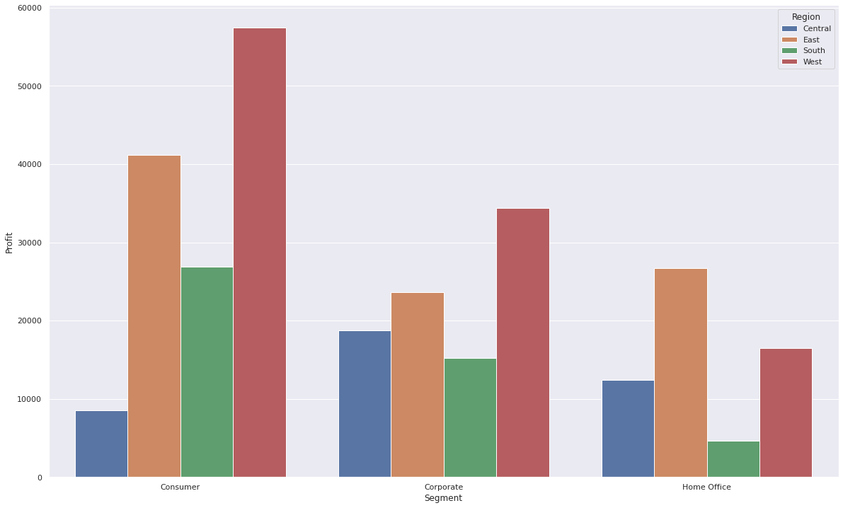
Profit distribution between Region and Segment
Consumer segment is weak in central region
Home office segment is weakest in southern region as compared to other regions

Slide 52
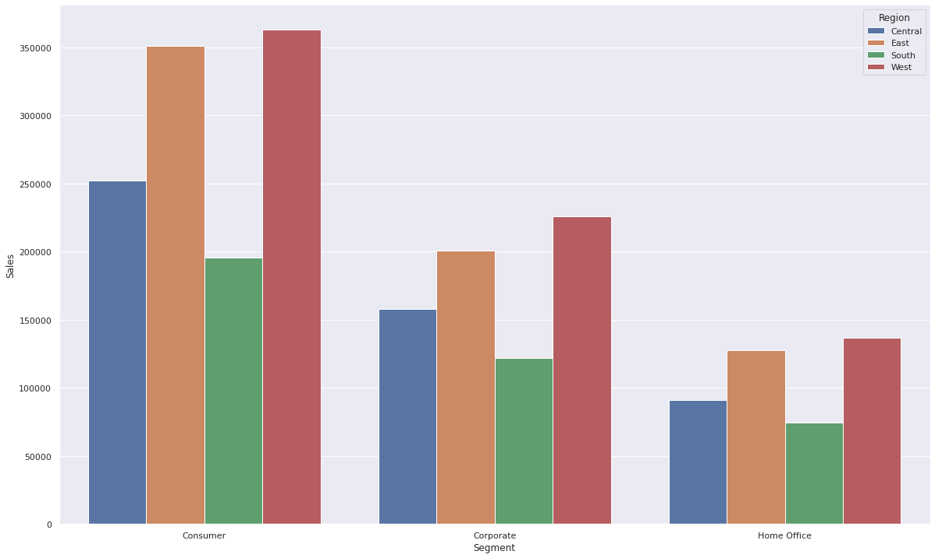
Sales distribution between Region and Segment
There are huge sales in consumer segment in central region although profits are less
Sales are weak in home office segment in all regions as compared to other segments

Slide 53
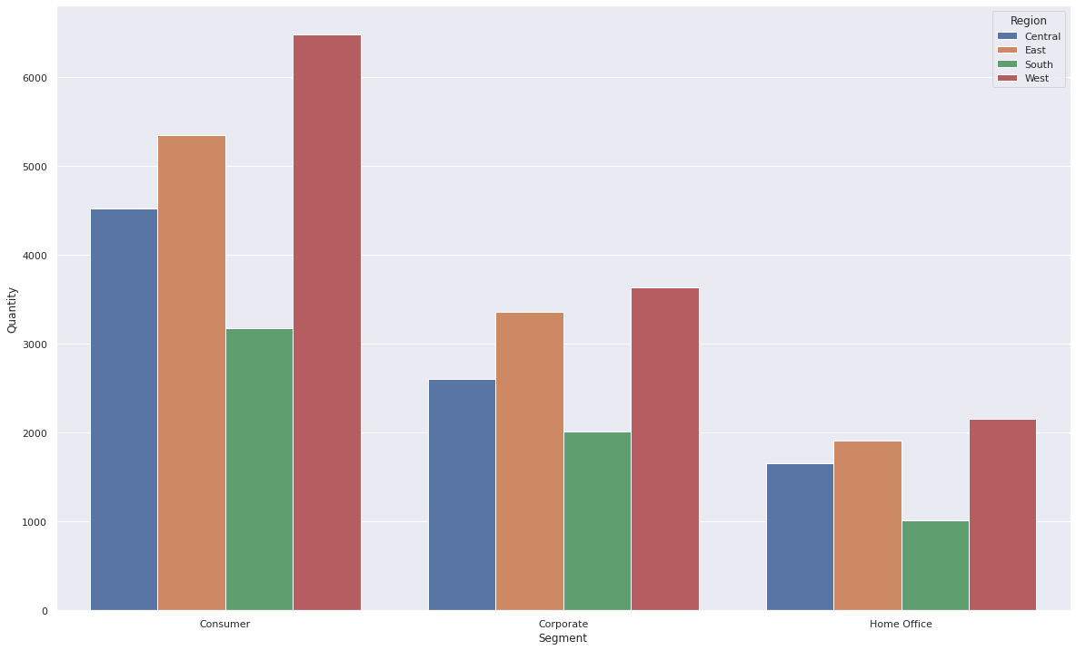
Quantity distribution between Region and Segment
Similar trend as followed in sales.

Slide 54
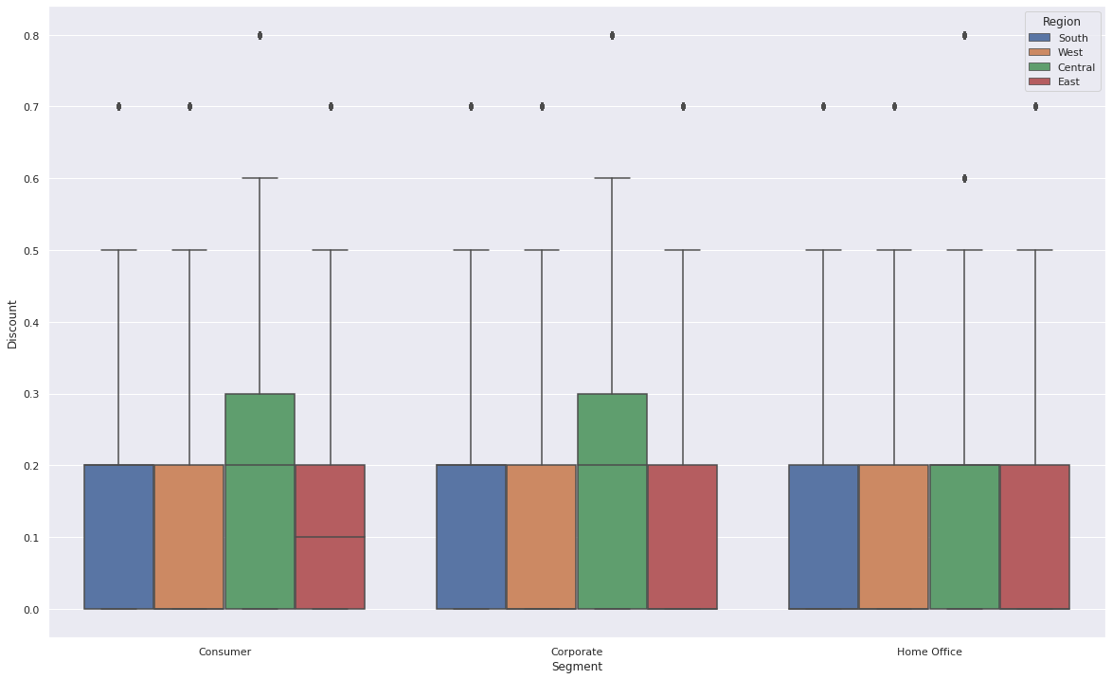
Discount distribution between Region and Segment
Less discount is offered for home office as compared to other regions

Slide 55
Region and Ship Mode
In depth analysis

Slide 56
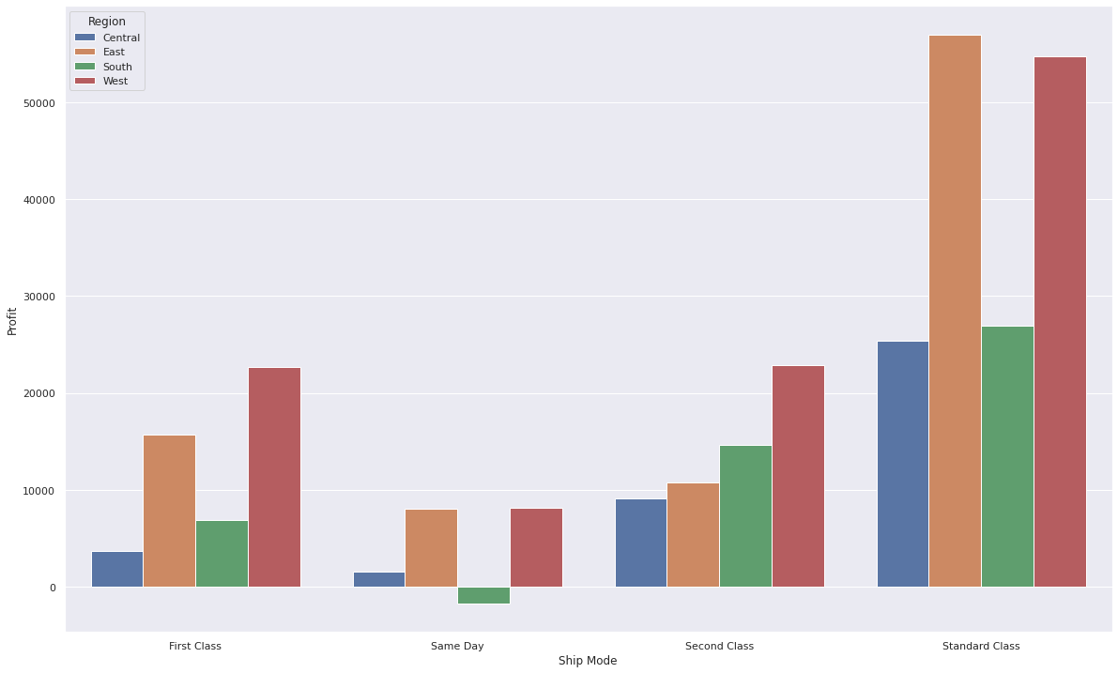
Profit distribution between Region and Ship Mode
Same day is loss making in southern region
Profit is very less for central region for same day mode
Standard class is highly profitable in eastern and western region

Slide 57
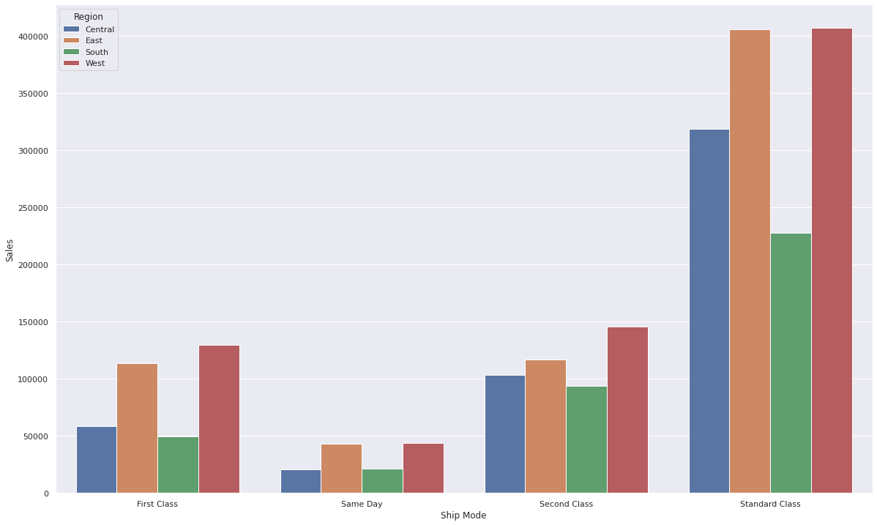
Sales distribution between Region and Ship Mode
Sales is also very less in southern and central region for same day shipping mode.
Standard class has high sales in all modes especially in eastern region and western region

Slide 58
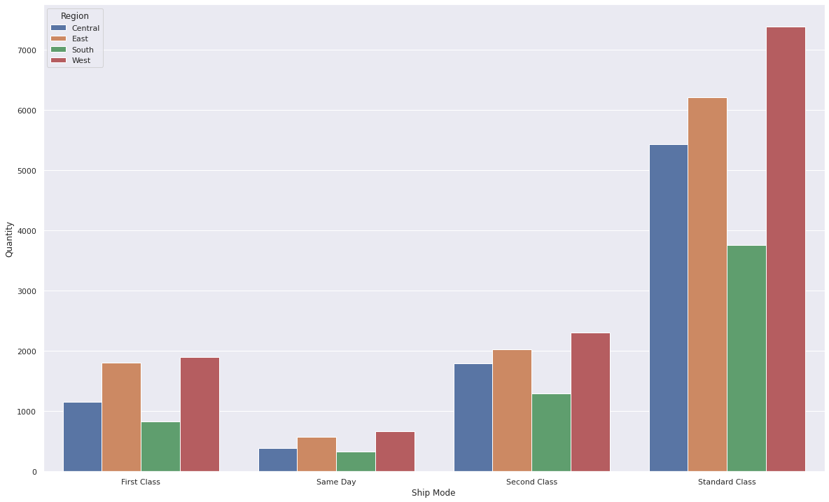
Quantity distribution between Region and Ship Mode
Fewer number of items are shipped through same day in central and southern region

Slide 59
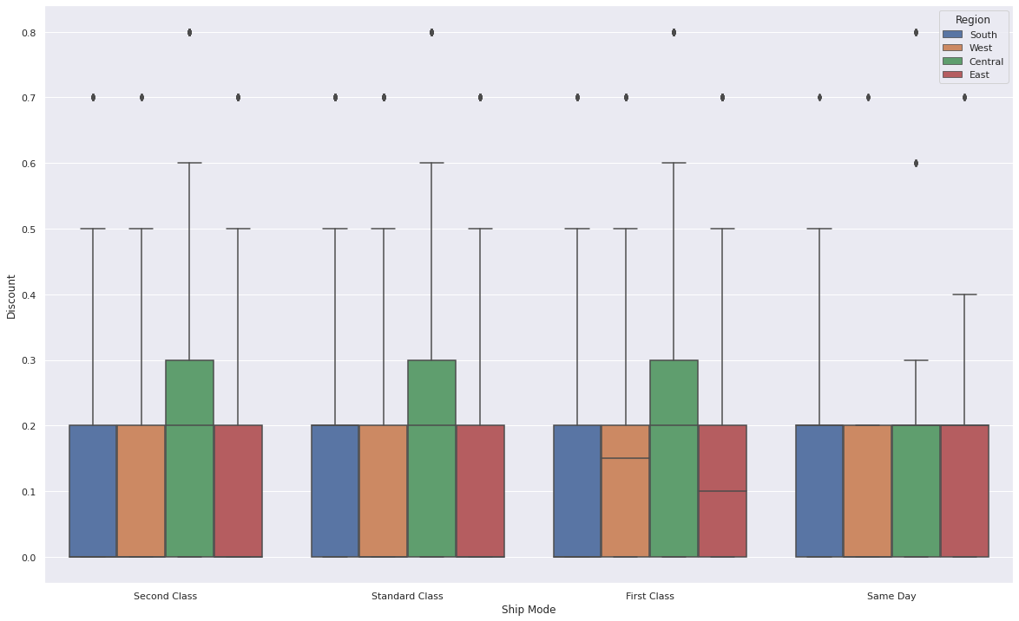
Discount distribution between Region and Ship Mode
Less discount is offered in same day in all regions as compared to all shipping modes.

Slide 60
Region and Sub Category wise
In depth analysis

Slide 61
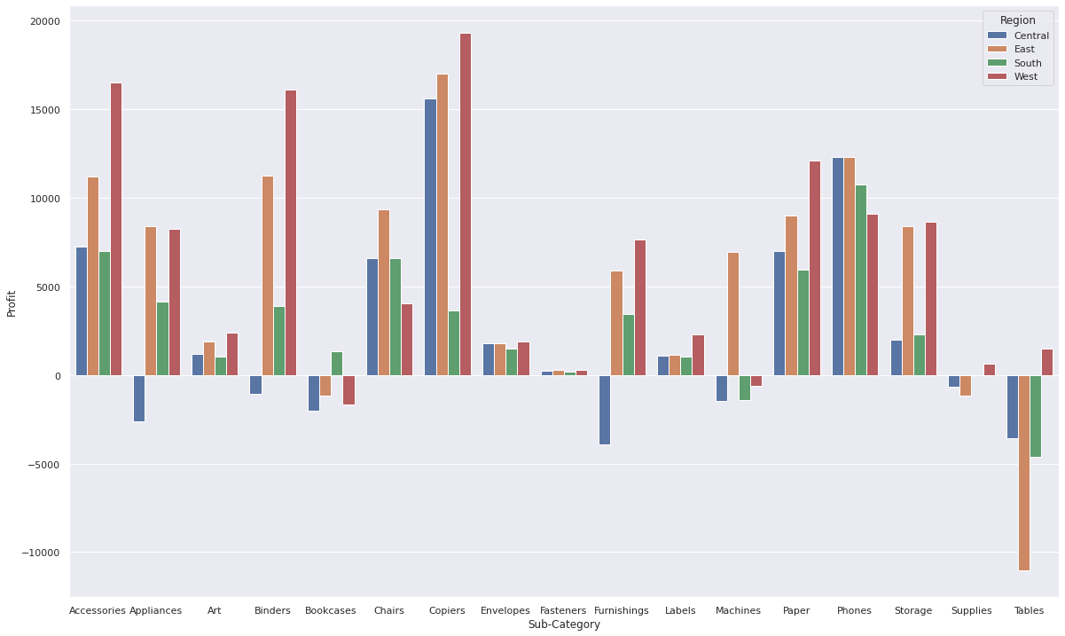
Profit distribution between Region and Sub-Category

Slide 62
Profit distribution between Region and Sub-Category
Accessories, Art, Chairs, Copiers, Envelopes, Fasteners, Labels, Paper, Phones, Storage are profitable in all regions.
Region | Loss making sub category
Central | Appliances, Binders, Bookcases, Furnishings, Machines, Supplies, Tables
East | Bookcases, Supplies, Tables
South | Machines, Tables
West | Bookcases, Machines

Slide 63
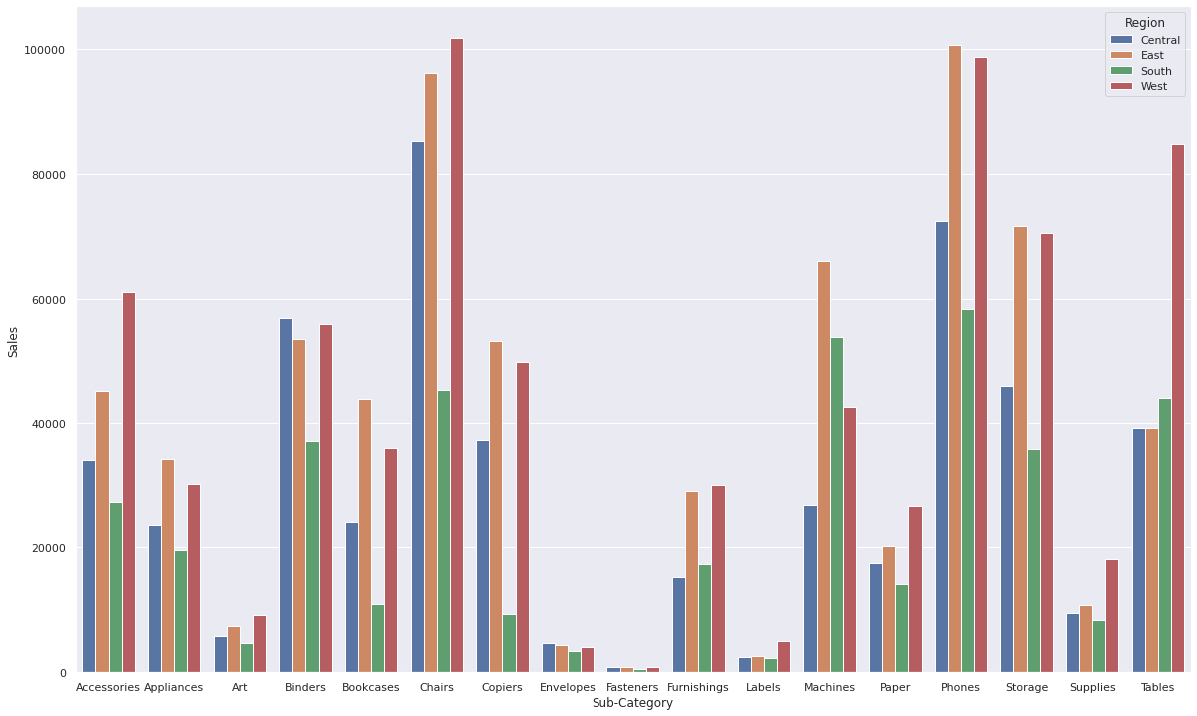
Sales distribution between Region and Sub-Category

Slide 64
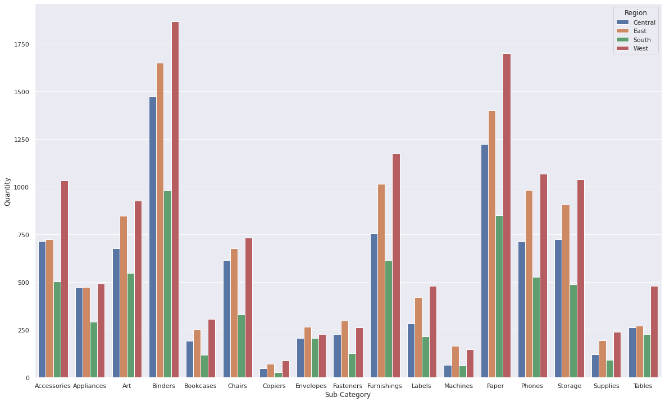
Quantity distribution between Region and Sub-Category

Slide 65
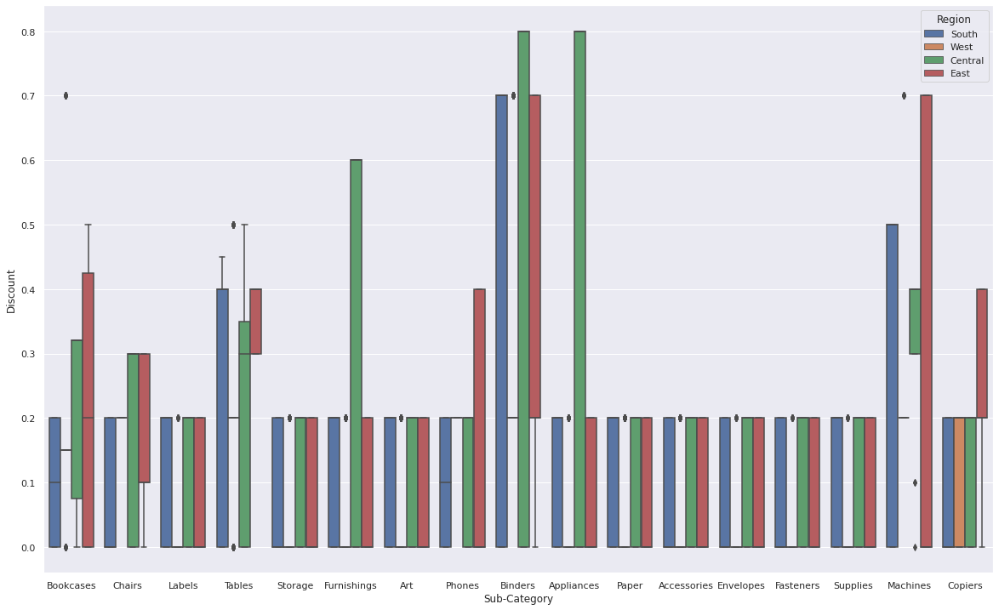
Discount distribution between Region and Sub-Category

Slide 66
Ship Mode and Sub Category wise
In depth analysis

Slide 67
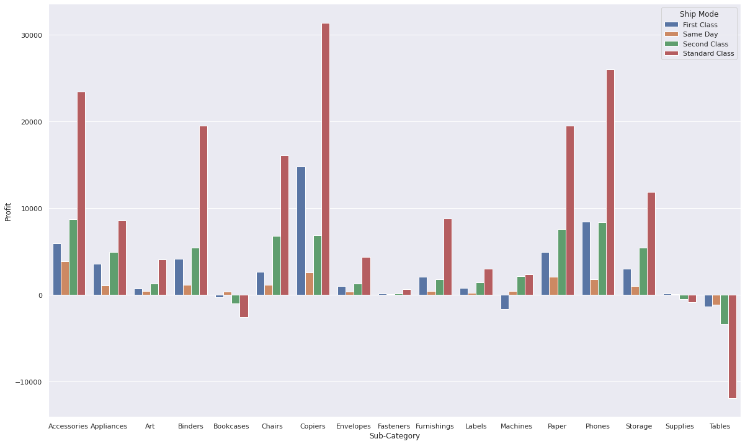
Profit distribution between Ship Mode and Sub-Category

Slide 68
Profit distribution between Ship Mode and Sub-Category
Accessories, Appliances, Art, Binders, Chairs, Copiers, Envelopes, Fasteners, Labels, Paper, Phones, Storage are profitable for all ship modes.
Ship Mode | Loss making sub category
First class | Bookcases, Machines, Tables
Same day | Tables
Second class | Bookcases, Supplies, Tables
Standard class | Bookcases, Supplies, Tables

Slide 69
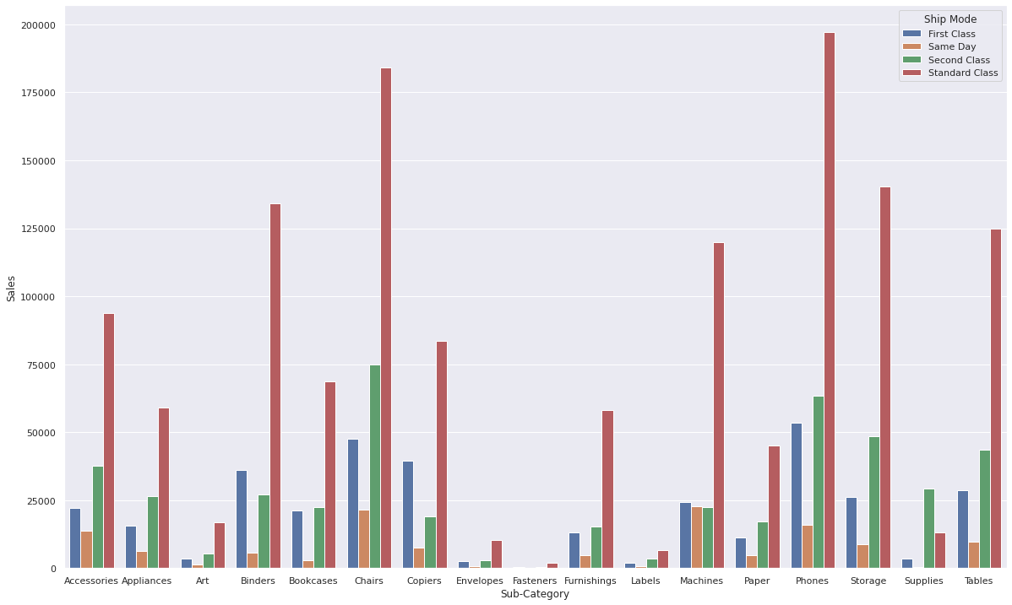
Sales distribution between Ship Mode and Sub-Category

Slide 70
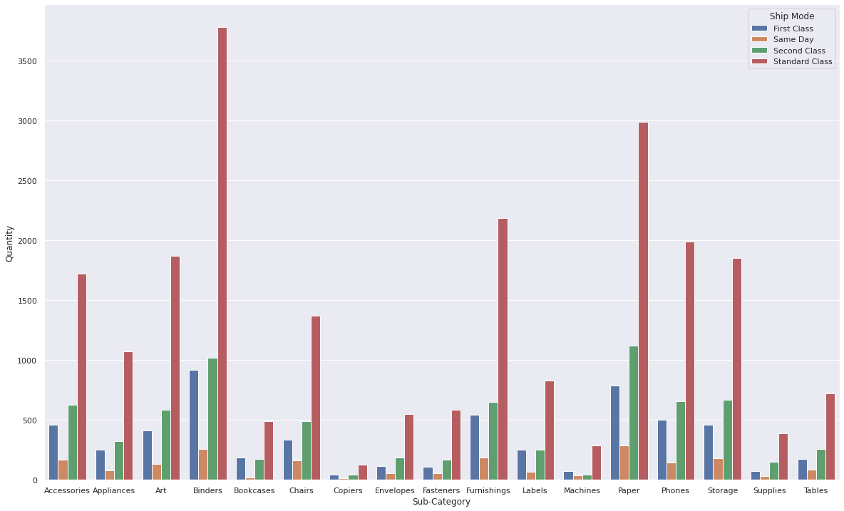
Quantity distribution between Ship Mode and Sub-Category

Slide 71
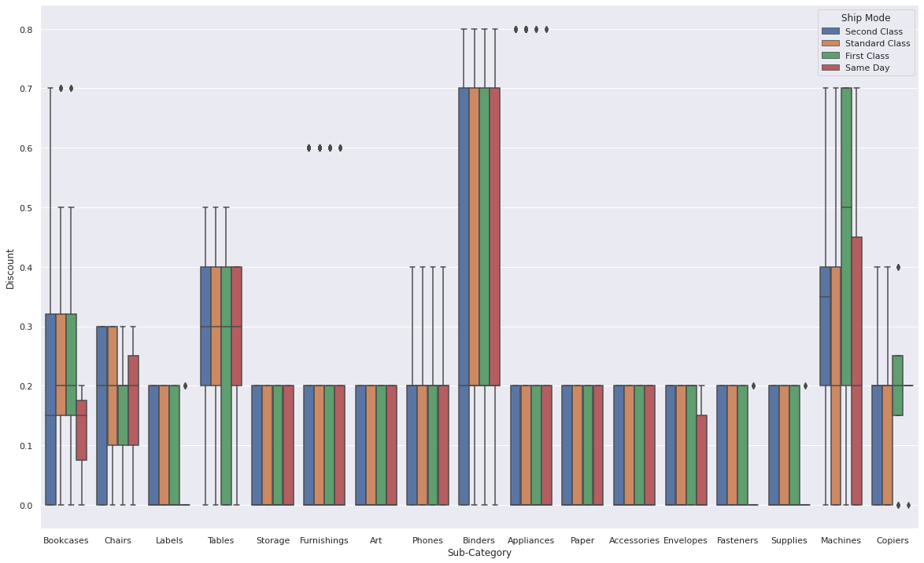
Discount distribution between Ship Mode and Sub-Category

Slide 72
Segment and Sub Category wise
In depth analysis

Slide 73
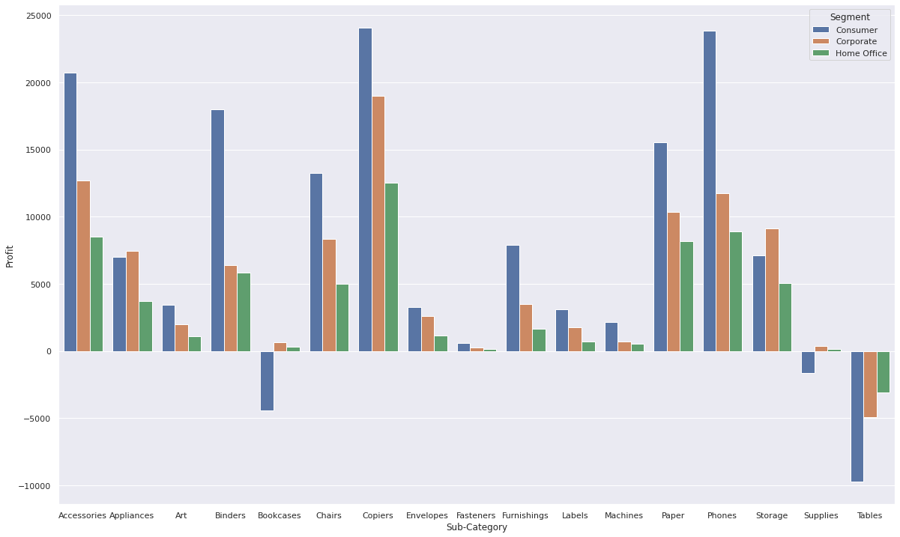
Profit distribution between Segment and Sub-Category

Slide 74
Profit distribution between Segment and Sub-Category
Accessories, Appliances, Art, Binders, Chairs, Copiers, Envelopes, Fasteners, Furnishings, Labels, Machines, Paper, Phones, Storage are profitable for all segments.
Segment | Loss making sub category
Consumer | Bookcases, Supplies, Tables
Corporate | Tables
Home Office | Tables

Slide 75
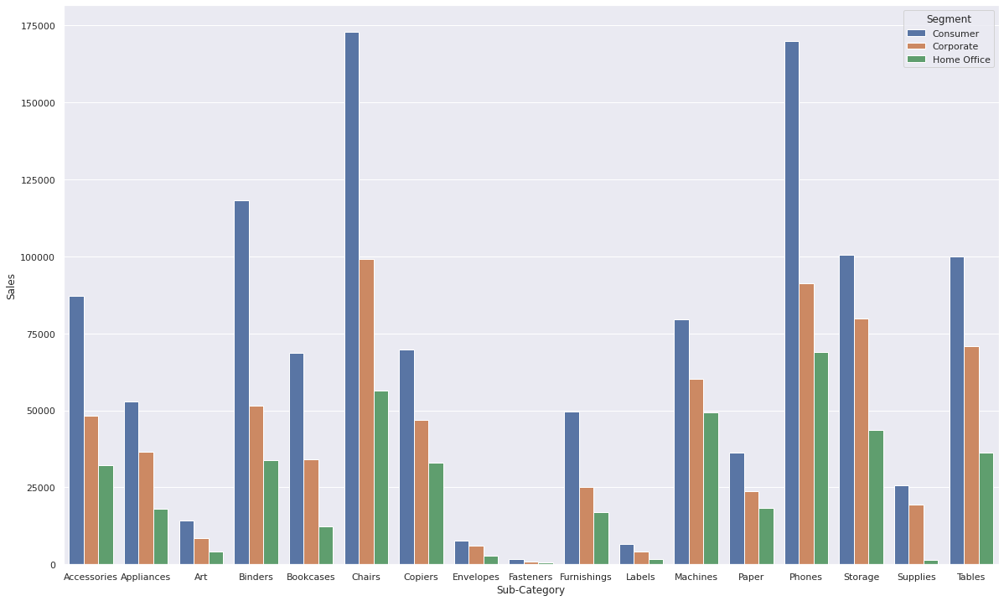
Sales distribution between Segment and Sub-Category

Slide 76
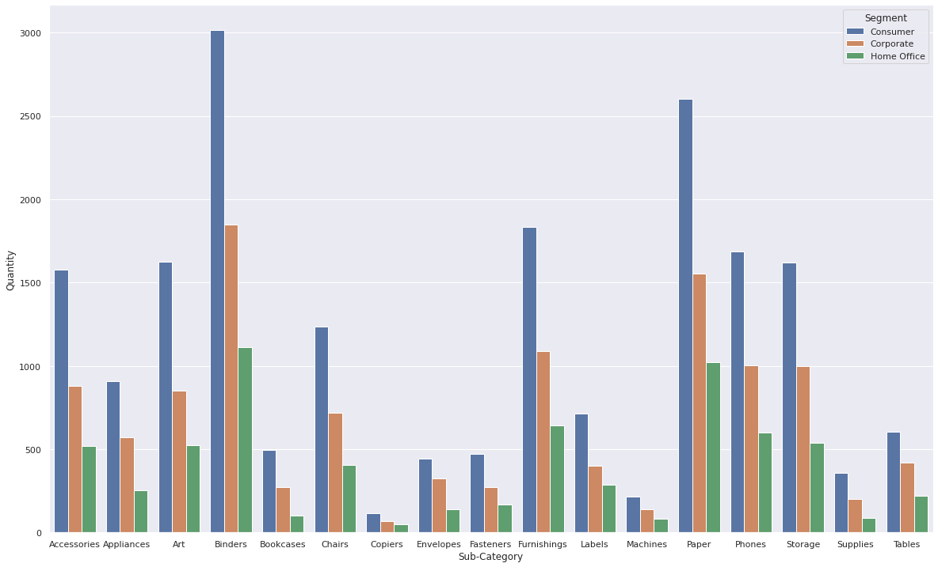
Quantity distribution between Segment and Sub-Category

Slide 77
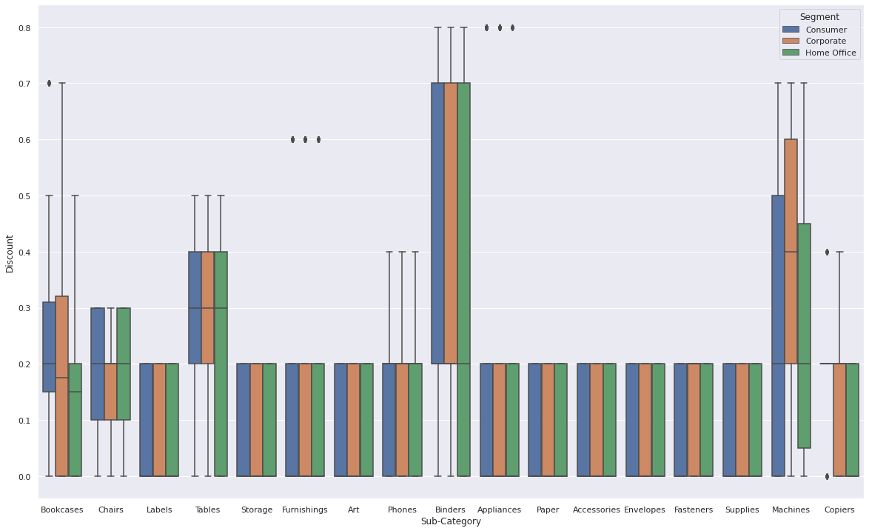
Discount distribution between Segment and Sub-Category

Slide 78
Ship Mode and Segment
In depth analysis

Slide 79
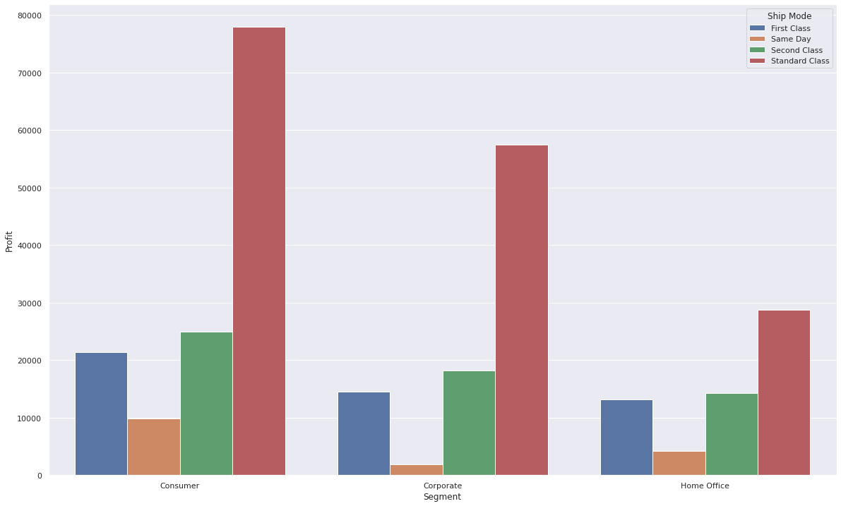
Profit distribution between Segment and Ship Mode

Slide 80
Sales distribution between Segment and Ship Mode

Slide 81
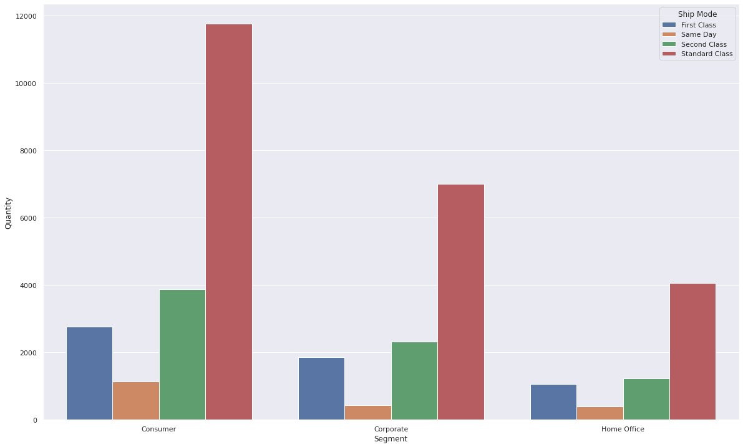
Quantity distribution between Segment and Ship Mode

Slide 82
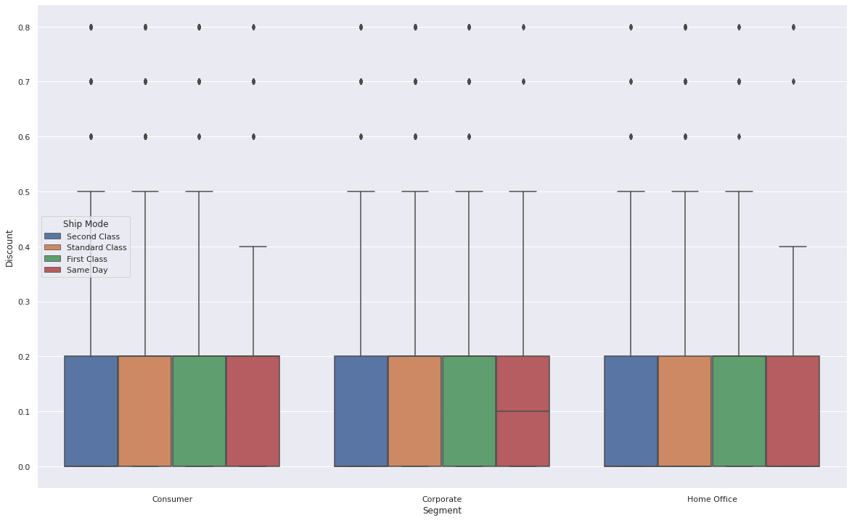
Discount distribution between Segment and Ship Mode

Slide 83
Problems
Found during Level 2 analysis

Slide 84
Problems in Superstore
Region | Loss making sub category
Central | Appliances, Binders, Bookcases, Furnishings, Machines, Supplies, Tables
East | Bookcases, Supplies, Tables
South | Machines, Tables
West | Bookcases, Machines
Same day shipping mode is loss making in southern region
Notes:
Critical region is when profit is less than mean profit

Slide 85
Critical regions in Superstore
Supplies in Southern region is a critical region as profit is only 1.877
Profit is very less for central region for same day mode
Consumer segment is weak in central region
Fasteners sub category has very less profit in all regions
Home office segment is weakest in southern region as compared to other regions

