Slide 1



Banking System in
Django
Anton Kamenov
Rafael Barbieru

Slide 2
Project Contents
Users – employees and customers
Employees features
    View – users, accounts
    Make – users, accounts
    Change – user information, accounts, account types
Customers’ features
    View - accounts, balances, profile, transfers
    Make – intra-transactions, inter-transactions, loans
    Change – phone number and use of multifactor-authentication
Other Features:
    Transfer Requests
    SMS notifications

Slide 3
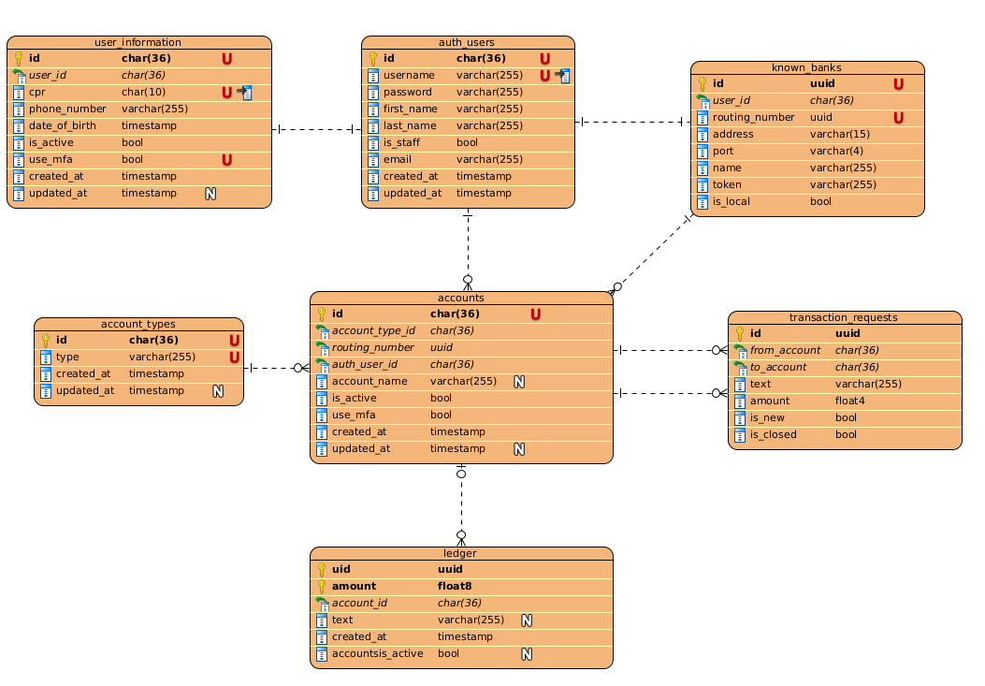
Database Schema
Account number – 2 parts – Bank routing number and account ID.
Table „transaction_request“ – used for one of our features

Slide 4
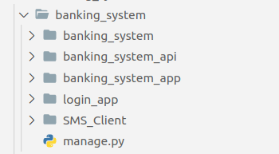
Project Structure
3 apps:
  banking_system_app
  banking_system_api
  login_app
SMS_Client – our own module

Slide 5
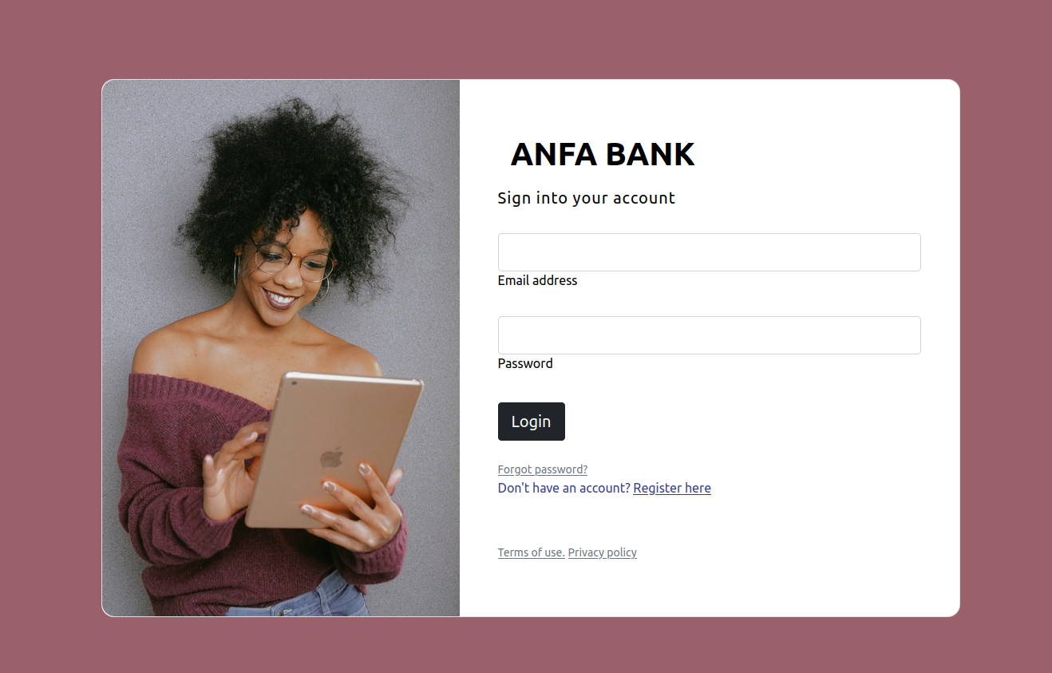
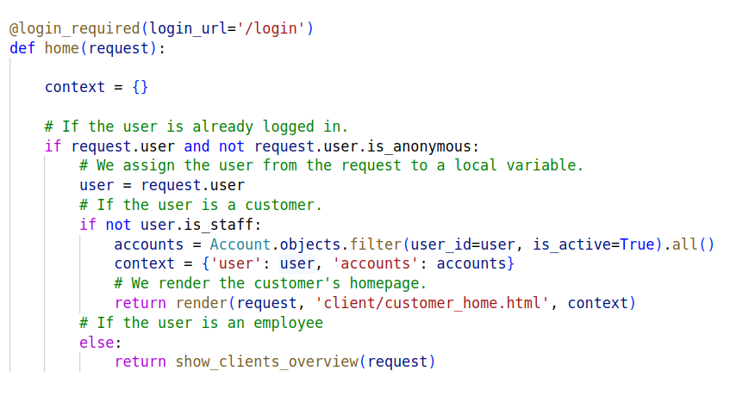
Customers and Employees
Two types of users – Customers and Employees
Both log-in from the same route
Redirected to different views

Slide 6
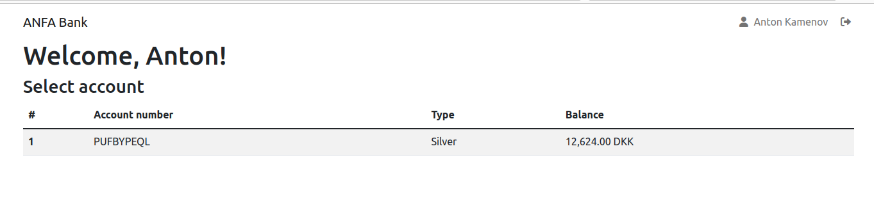
Home Page Customers
Can see accounts and Balances

Slide 7
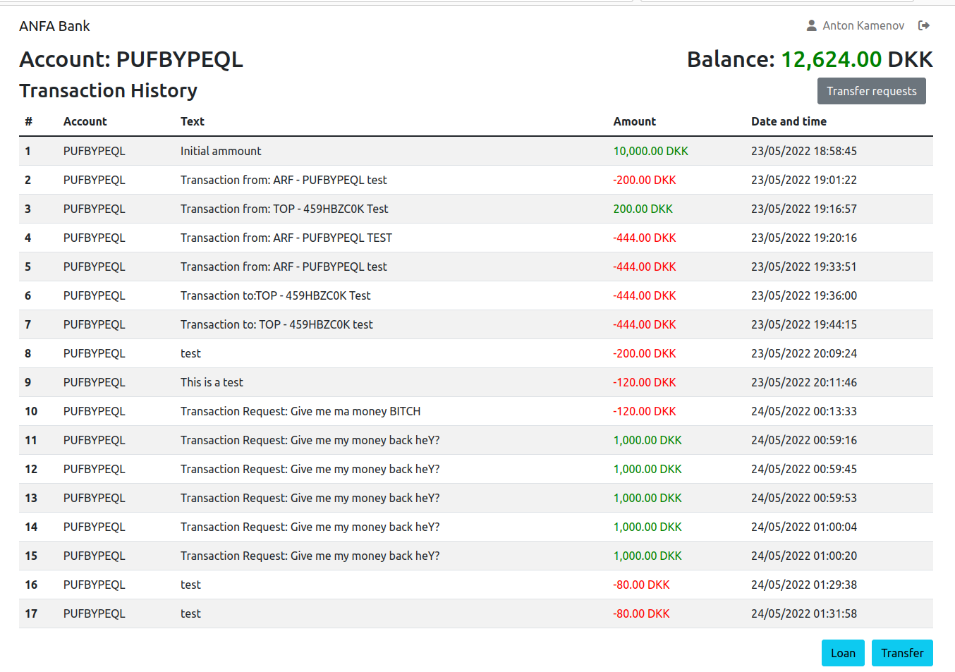
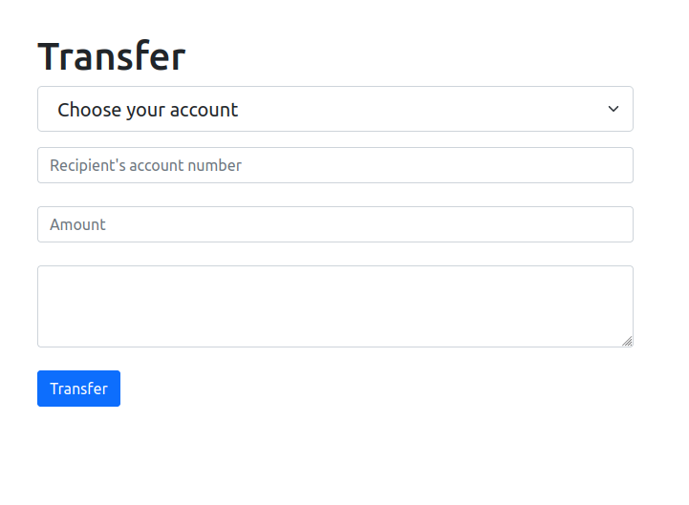
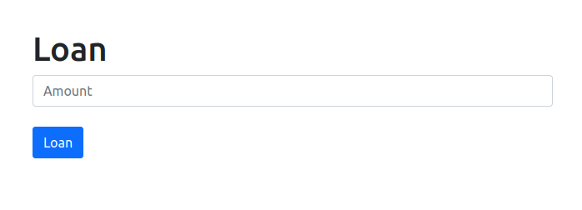
View Transactions

Slide 8
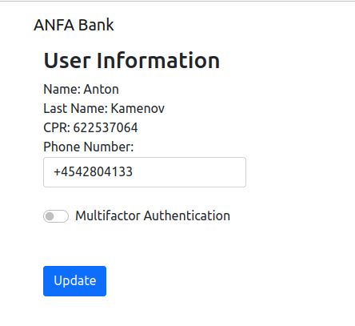
User Profile

Slide 9
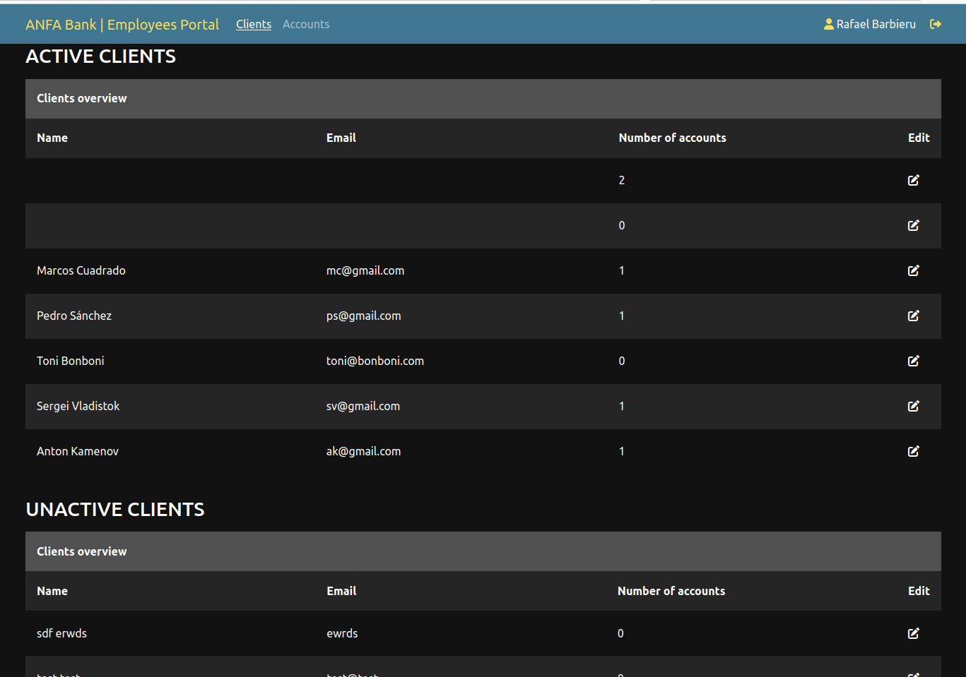
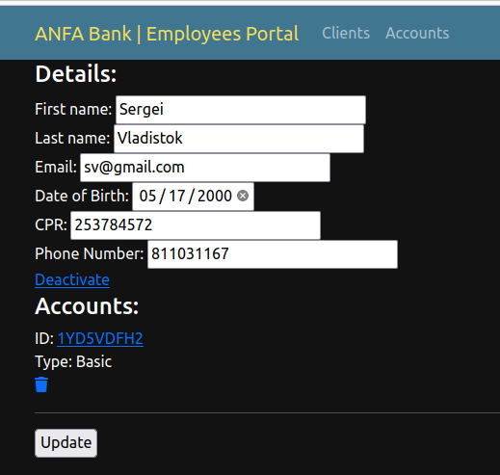
Home Page Employees
Different customer Details
CRUD operations

Slide 10
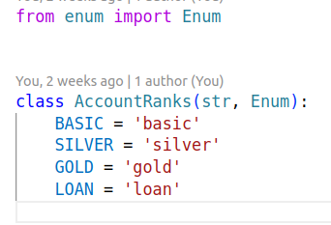
Account Types

Slide 11
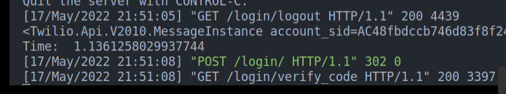
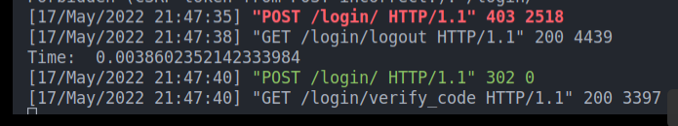
Task Ques
Multifactor authentication
Before:
After:

Slide 12
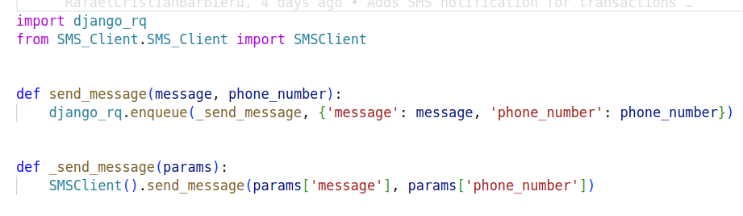
Task Ques

Slide 13
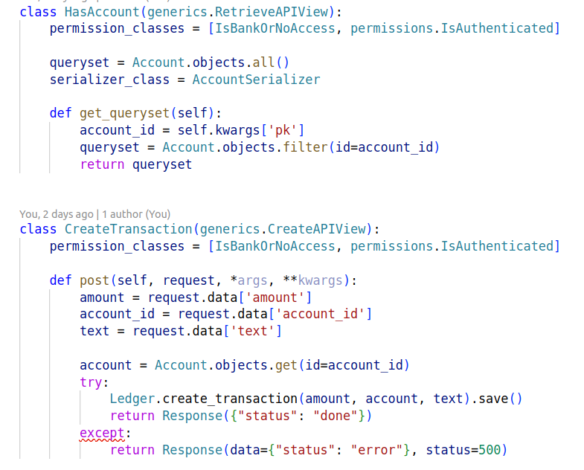
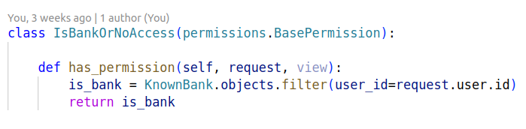
REST-API
Used mainly for inter-transfer
Permissions

Slide 14
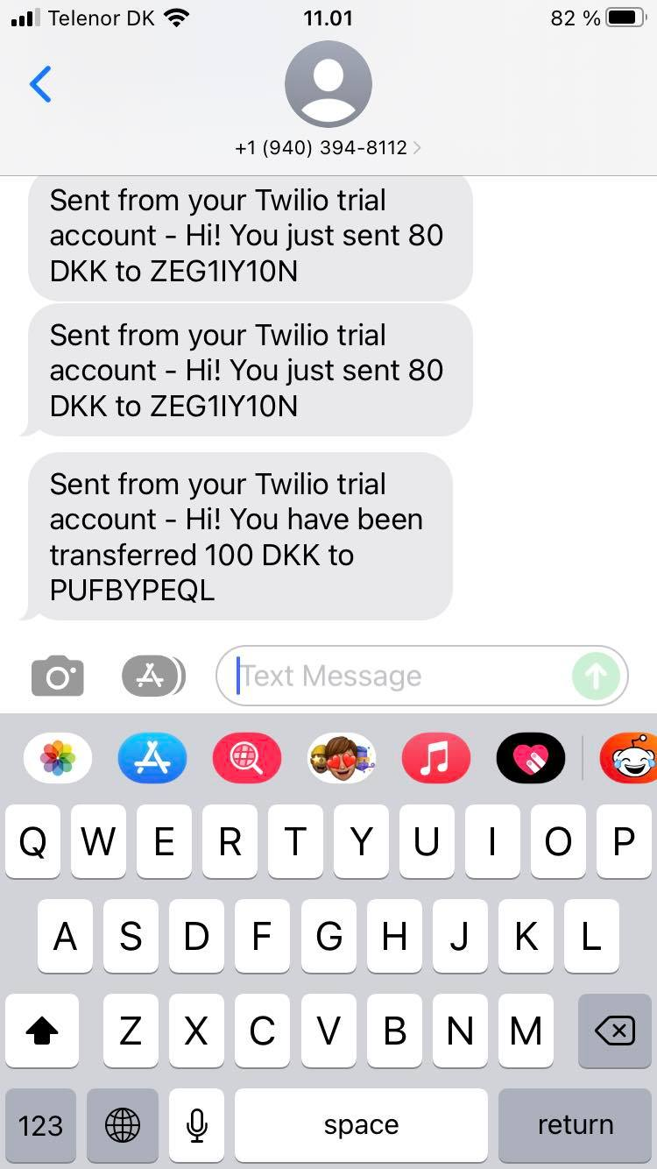
Feature 1 – SMS Notifications
SMS are send on transfer to both accounts

Slide 15
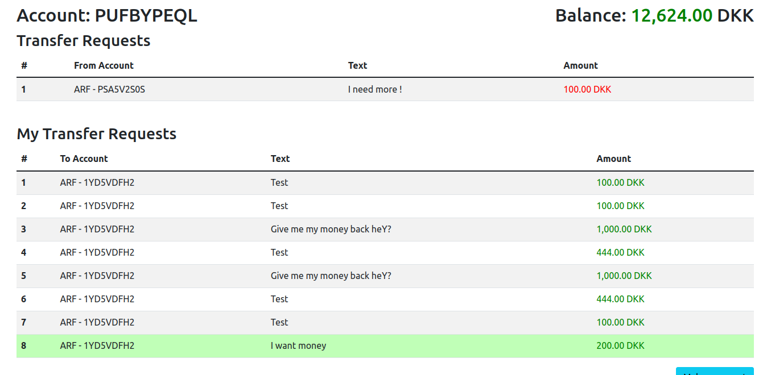
Feature 2 – Transaction Requests

