Slide 1
SignalR
Web-based real time communication

Slide 2
Usage
Live chat
Live games
Forex updates
Live odds updates
Push notifications
How
allows bi-directional communication between server and client

Slide 3
Overview & concepts
Uses a couple of mechanisms to provide bi-directional communication
Websockets
SEE(Server sent events)
Forever Frame
Long polling
Connection management API
Server-to-client remote procedure calls(RPC) API
Client-to-server API

Slide 4
Websockets
TCP-based standalone protocol
Data is sent as a whole “message” via message event handler
Use TCP sockets with additional header for metadata used by the event handler to re-assemble the TCP chunks which correspondents to concrete message
Client and server uses HTTP for handshake and after the connection is established they start using websocket protocol to communicate
Connection is persistent and the traffic is very lightweight
Works on Windows 8/Server 2012 or higher versions
Websockets comes with HTML5

Slide 5
SSE(Server sent events)
Server uses long running http connection(with a special mime – text/event-stream) to send data to the client.
Client uses regular http request to send data to the server,
SSE comes with HTML5. IE does not support this mechanism.
Appropriate in cases when only the server sends data to the client like push services or server does not support web sockets.

Slide 6
Forever Frame
The forever-frame technique uses HTTP 1.1 chunked encoding to establish a single, long-lived HTTP connection in a hidden iframe. Data is pushed incrementally from the server to the client over this connection, and rendered incrementally by your web browser in hidden frame.
Works with low latency only in IE.
Long polling
Client makes reular HTTP request to the server. The server holds the request open until new data is available. Once available, the server responds and sends the new information

Slide 7
Server to client API
Persistent connection API
Low level API with more control over the processes
Needs more effort
RPC is N/A
Messages are sent to everyone
Hub API
Easier to use
RPC is Available. The server can call client methods dynamicly
Messages could be sent to specific user, group of users or to everyone

Slide 8
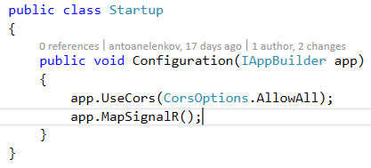

Using SignalR
Install SignalR nugget packeges
Register SignalR and allow cross origin resource sharing
Install client-side scripts

Slide 9
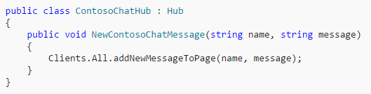
Hub API
Use the Hub class

Slide 10
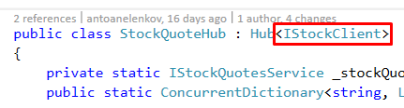
Hub API
Hub object lifetime – new instance is created each time the client makes call to the server or the client is reconnected. The object is not appropriate to maintain state from one method call to another one, another approach could be used such as static variables in the class.
Calling client methods is dynamic and developer should take care of proper named called methods. There is approach in which the developer is forced to use a set of methods:
Define all client methods in an interface and use the generic generic Hub class. Using missing interface methods will results in compile compile error.
Messages from server could be sent to specific user(connectionId), group of connections or all
Clients.All
Clients.Client(Context.ConnectionId)/Clients.Clients(connectionIdsCollections)
Clients.Group(groupName)/Clients.Groups(groupNamesCollection)
Managing groups
Groups.Add(Context.ConnextionId, groupName)
Groups.Remove(Context.ConnectionId, groupName)

Slide 11
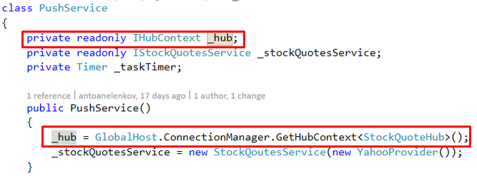
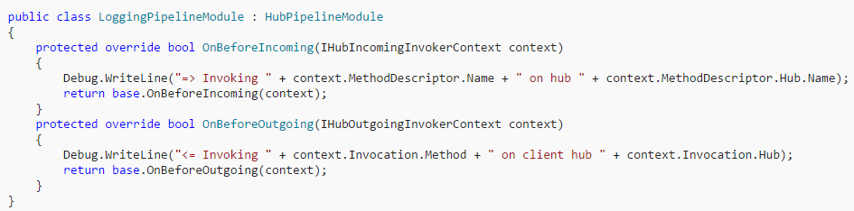
Hub API
How to call client methods and manage groups from outside the Hub class
Customizing Hubs pipeline

Slide 12
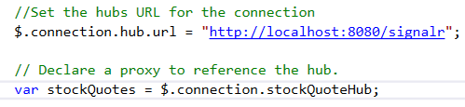

Client API
jQuery provides functionality for working with server hubs.
All examples will be shown with the generated proxy from jQuery. More information here - https://docs.microsoft.com/en-us/aspnet/signalr/overview/guide-to-the-api/hubs-api-guide-javascript-client#genproxy
Get proxy object to work with the server
Create a function which is called from the server to send messages

Slide 13
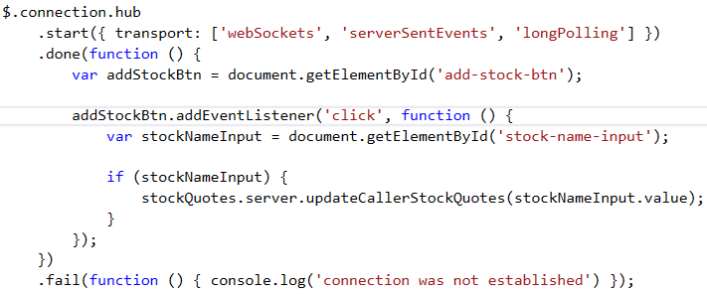

Client API
Establish connection with the server
Set query string paramaters

Slide 14

Client API
SignalR provides the following connection lifetime events that you can handle:
Starting: Raised before any data is sent over the connection.
received: Raised when any data is received on the connection. Provides the received data.
connectionSlow: Raised when the client detects a slow or frequently dropping connection.
reconnecting: Raised when the underlying transport begins reconnecting.
reconnected: Raised when the underlying transport has reconnected.
stateChanged: Raised when the connection state changes. Provides the old state and the new state (Connecting, Connected, Reconnecting, or Disconnected).
disconnected: Raised when the connection has disconnected

Slide 15


Client API
Error handling
Error in the connection
Error in the method invocation

Slide 16
SignalR LIVE DEMO

Slide 17
Finito

