Slide 1

Embedded Real-Time Project on S32K3X8EVB
QEMU Emulation, FreeRTOS Porting, UART, GPIO, and MPU Implementation
Computer Architecture and Operative Systems

Slide 2
Group 17 – team members
Ble Francesco, s343431@studenti.polito.it
Cocca Donatella, s347942@studenti.polito.it
Crudele Antonio, s338641@studenti.polito.it
Dokollari Megi, s346293@studenti.polito.it
Frisenda Giovanni, s337127@studenti.polito.it

Slide 3
index
Introduction & Objectives
Board Implementation
FreeRTOS Porting and Configuration
UART Driver
GPIO Driver
MPU Integration
Testing & Results
Conclusions

Slide 4
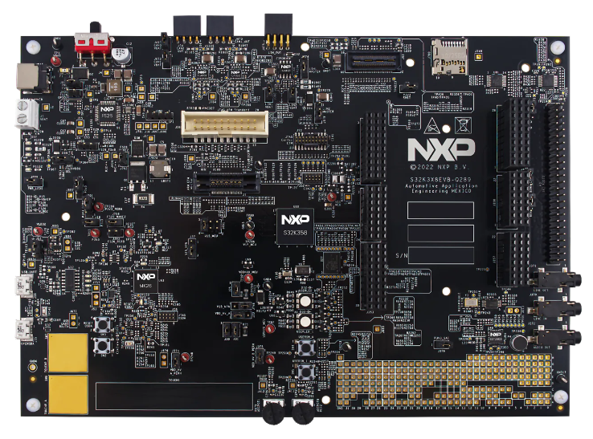
introduction
Goal: Implement and test a real-time system on the S32K3X8EVB board (via QEMU)
System environment:
  FreeRTOS for task scheduling and real-time behaviour
  QEMU for board emulation and debugging
Source: NXP official website

Slide 5
Project objectives
Components developed and tested:
  UART driver for serial communication
  GPIO driver with debouncing and control logic
  MPU configuration for memory protection and fault detection
Objectives:
  Verify correct integration of drivers and RTOS
  Demonstrate MPU protection with self-tests and forced-fault scenarios
  Provide a reproducible setup documented in GUIDE.md

Slide 6
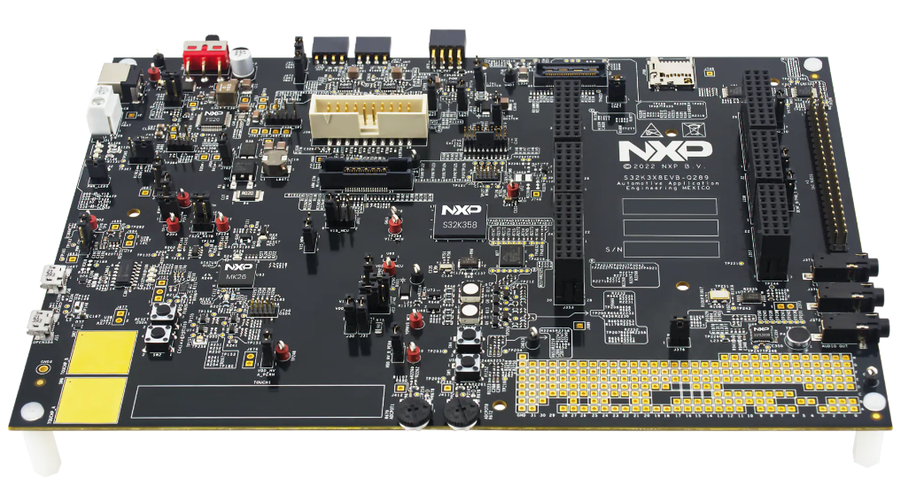
Board implementation
Target Board: S32K3X8EVB
Emulated in QEMU (custom machine type)
Provides:
  ARM Cortex-M7 CPU
  Flash, SRAM, peripheral regions
  Interfaces for GPIO and UART
Acts as the hardware foundation for FreeRTOS and drivers
Source: NXP official website

Slide 7
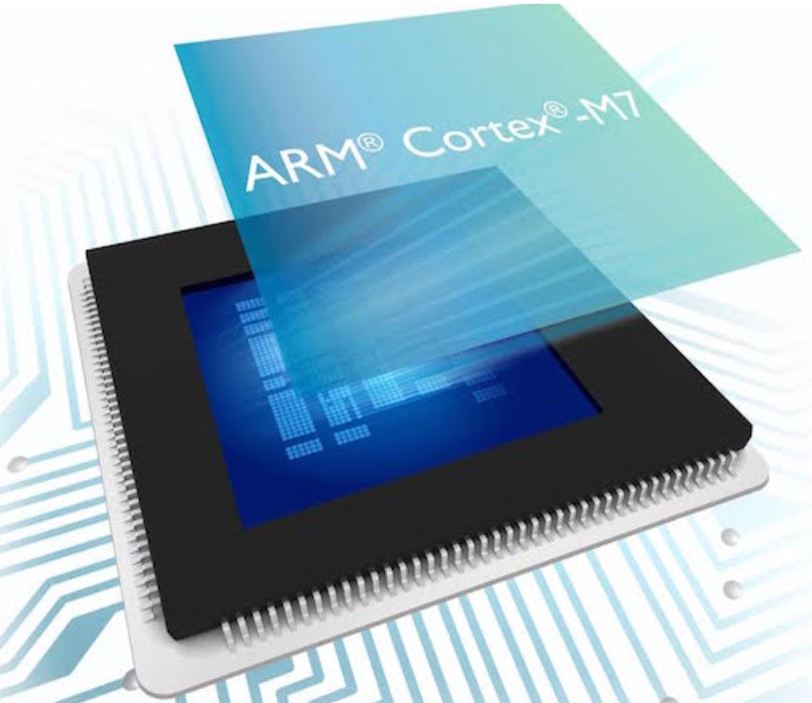

Freertos integration
FreeRTOS port for ARM Cortex-M7
Features used:
  Task creation and scheduling
  Delays with ‘vTaskDelay()’
  Heap management with ‘heap_4.c’
Integrated into QEMU build system
Provides the real-time layer for running application tasks
Source: tuttoandroid.net
Source: Wikipedia

Slide 8
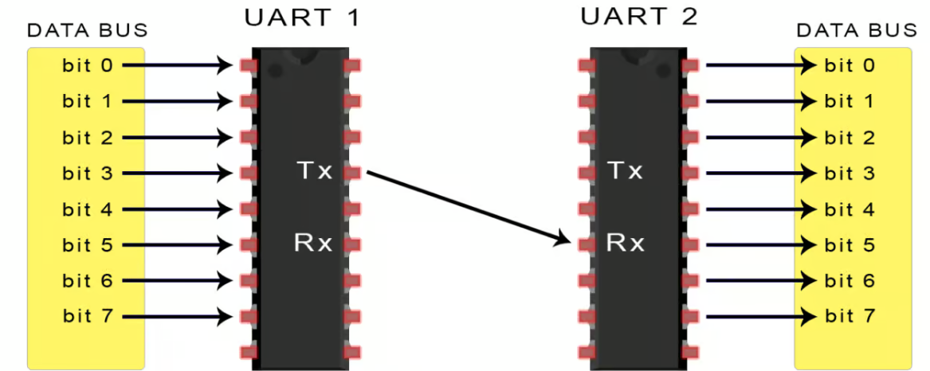
Universal asynchronous receiver/transmitter (UART) Driver
Purpose: Provide serial communication channel for debugging and logging
Implementation:
  Initialization function ‘UART_init()’
  Output through ‘UART_printf()’
Usage in project:
  Prints debug messages for GPIO, MPU self-test and fault detection
Source: circuitbasics.com

Slide 9
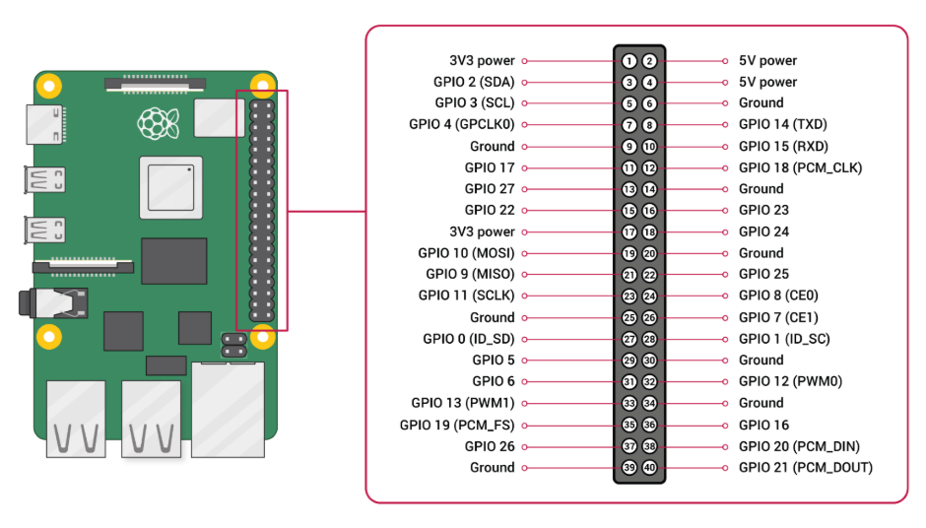
General purpose input/output (Gpio) driver
Purpose: Simulate an industrial control panel with buttons, LEDs, relays and sensors
Implementation:
  Debouncing algorithm for reliable button press detection
  Periodic task updates GPIO state every system tick
Usage in project:
  Demonstrates interaction between inputs (buttons) and outputs (LEDs/relays)
Source: learn.microsoft.com

Slide 10
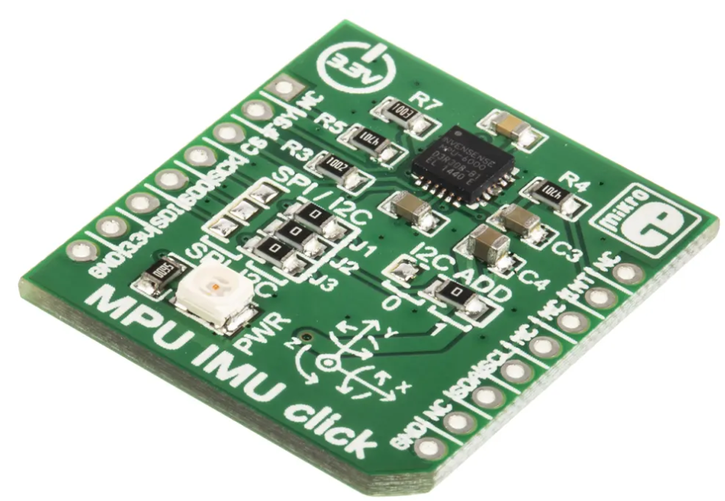
Memory protection unit (mpu)
Purpose: Enforce memory safety and detect invalid accesses
Regions Configured:
  Flash (0x00400000, RO, 8 MB)
  SRAM (0x20400000, RW, 1 MB)
  Peripherals (0x40000000, RW, 512 MB)
  Optional NO-ACCESS subregion for fault injection
Self-test:
  Runs automatically at startup
  Prints region configuration and verifies read/write permissions
Source: it.rs-online.com

Slide 11
MPU fault tests
MPU_fault_test():
  Attempts to write to Flash (RO region)
  Expected: MemManage fault
MPU_forced_fault():
  Attempts to write to NO-ACCESS SRAM subregion
  Correctly triggers a MemManage fault in QEMU
Fault handling:
  Captured by ‘MemManage_Handler’ or ‘HardFault_Handler’
  Diagnostic message printed via UART

Slide 12
Testing & results
UART: Correctly outputs messages and diagnostics
GPIO: Debouncing and control logic verified in emulation
MPU:
  Self-test confirms correct region configuration
  Forced fault test proves MPU protection works in QEMU

Slide 13
CONCLUSIONS
Board + FreeRTOS successfully integrated in QEMU
UART provides communication and debugging
GPIO with debouncing demonstrates task scheduling and I/O reliability
MPU enforces memory protection, with self-test and forced fault validation
Project shows a complete embedded system with real-time OS, drivers and safety features

Slide 14
REFERENCIES
Images:
https://www.nxp.com/part/S32K3X8EVB-Q289
https://www.nxp.com/design/design-center/development-boards-and-designs/S32K3X8EVB-Q289
https://it.wikipedia.org/wiki/FreeRTOS
https://www.tuttoandroid.net/hardware/arm-cortex-m7-e-il-processore-per-droni-e-oggetti-intelligenti-219796/
https://www.circuitbasics.com/basics-uart-communication/
https://learn.microsoft.com/it-it/dotnet/iot/tutorials/gpio-input
https://it.rs-online.com/web/p/strumenti-di-sviluppo-per-sensori/8231892

Slide 15

Thank you for your attention!

