Slide 1
Resolution Recommendator
- Anto Edison J

Slide 2
INTRODUCITON
Manual IT helpdesk operations often face delays due to repetitive issue analysis and resolution lookup.
My system automates the recommendation of solutions based on the nature of the IT issue, enhancing support efficiency.
It uses embeddings, and RAG in a chatbot interface to deliver accurate IT solutions through natural conversations.
Goal: Reduce downtime and improve user satisfaction by providing instant, accurate resolutions that does not require human intervention.

Slide 3
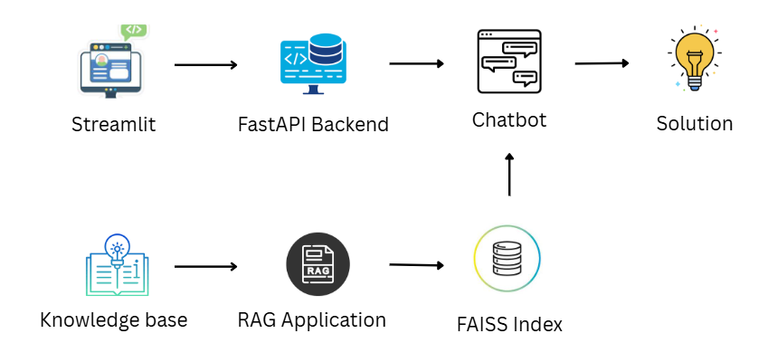
ARCHITECTURE

Slide 4

Classifier Agent
AGENTS
1
Chat Agent
2
Retriever Agent
3
Validator Agent
4
Dialog Agent
5
Solver Agent
5

Slide 5
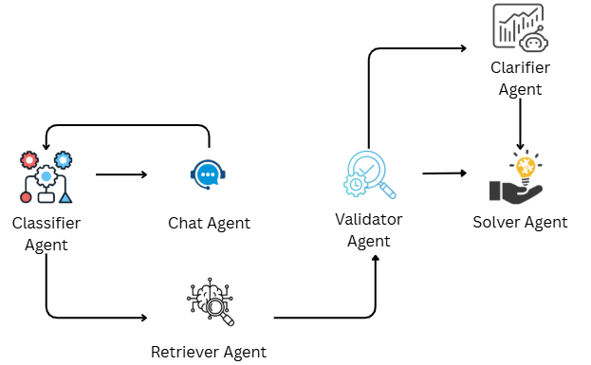
AGENT WORKFLOW

Slide 6
KEY FEATURES
Issue Classification and Matching: Identifies the type of issue
Clarification Loop: Dynamically interacts with the user to collect missing details
Context-Aware Recommendation: Uses past conversation memory and embeddings to fetch relevant resolutions.
Editable Knowledge Base: Easily extendable with new problem-solution entries in structured format.
Redundancy Handling: Avoids repeated queries when the resolution has already been provided.

Slide 7

DEMO OF THE SYSTEM

Slide 8
FUTURE ENCHANCEMENTS
Feedback Loop: Allow users to rate and refine solutions to improve response quality over time.
Ticket Generation: Automatically generate support tickets if the issue isn’t resolved.
Dashboard for IT Admins: Provide analytics on common issues, response times, and unresolved queries.
LangGraph-Based Agent Workflow: Implement LangGraph to manage complex multi-step agent interactions, enabling better control flow and decision-making in the chatbot’s reasoning process.

Slide 9

CONCLUSION
Fast and accurate IT resolutions
Reduces manual support workload
Smart clarification and response system
Easily scalable and integrable
Future-ready with feedback and LangGraph workflows

Slide 10
THANK YOU

