Slide 1
Multi-device Training and
Exploring Batch Repetition to Reduce Data IO
Anthony Fuller
Department of Systems and Computer Engineering
Carleton University, Ottawa, Canada
anthonyfuller@cmail.carleton.ca

Slide 2
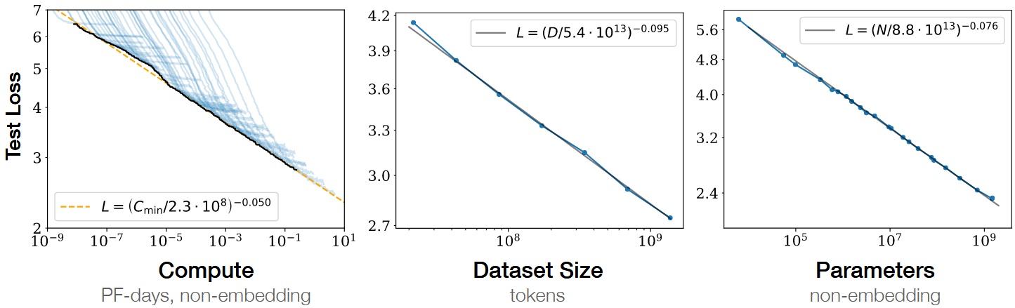
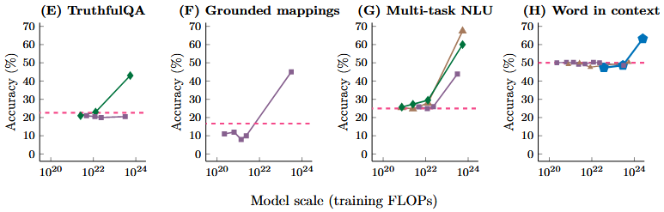
Why is compute important for DL?
More compute, data, parameters -> better models
Top: https://arxiv.org/abs/2001.08361 bottom: https://arxiv.org/abs/2206.07682

Slide 3
Presentation Outline
Part 1
Speedup deep learning model training using multiple devices in parallel via TPUv3, and compare with TPUv2 and a 3090 GPU
Part 2
Speedup deep learning model training by more effectively leveraging our computation via batch repetition

Slide 4
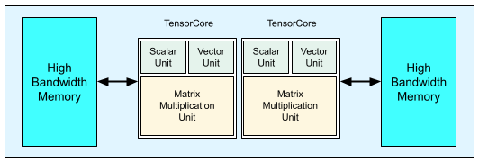
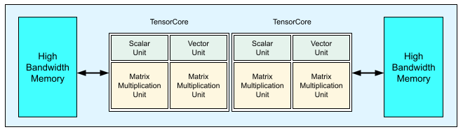
GPU vs TPU
GPU
Originally designed for graphics
But are great for DL due to SIMD
Many small matrix multiplication units (i.e., 4x8 sized tensor cores)
TPU
Designed for DL by Google
Fewer large matrix multiplication units (i.e., 128x128)
Via Google’s TRC program, I got access to TPUv3-8 and TPUv2-8 VMs
TPUv2
TPUv3
https://cloud.google.com/tpu/docs/system-architecture-tpu-vm

Slide 5
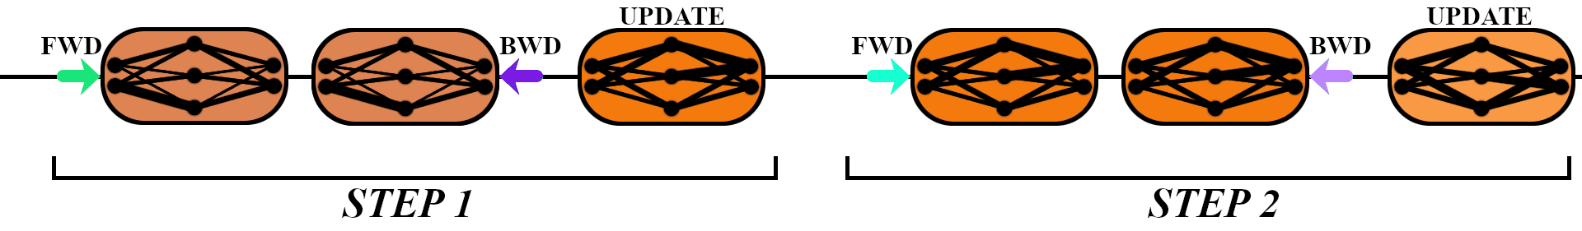
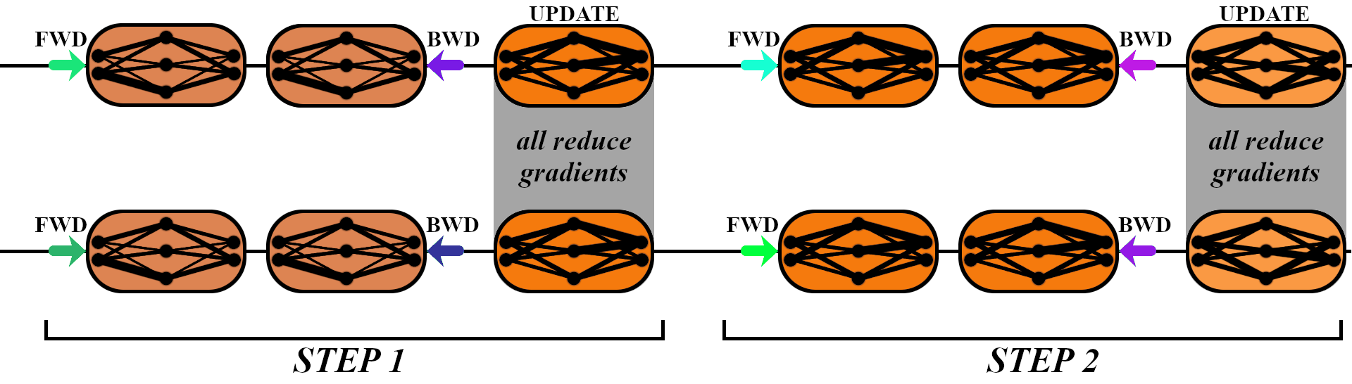
Training Models
Training on a single device
Training on multiple devices

Slide 6
Implementing Multi-device Training
Very similar to single device training, a few differences:
Wrap your model in XLA’s multiprocessor model wrapper
  WRAPPED_MODEL = xmp.MpModelWrapper(model)
Spawn multiple instances of your training loop
  xmp.spawn(training_function(), nprocs=8)
Setup data loader such that each process loads a different batch of data
Use XLA’s optimizer step, instead of PyTorch’s default
  xm.optimizer_step(optimizer)

Slide 7
Behind the scenes…
def optimizer_step(optimizer,
barrier=False,
optimizer_args={},
groups=None,
pin_layout=True):
reduce_gradients(optimizer, groups=groups, pin_layout=pin_layout)
loss = optimizer.step(**optimizer_args)
return loss
def reduce_gradients(optimizer, groups=None, pin_layout=True):
cctx = CollectiveContext()
count = max(cctx.replica_devcount, cctx.world_size)
if count > 1:
gradients = _fetch_gradients(optimizer)
all_reduce(
REDUCE_SUM,
gradients,
scale=1.0 / count,
groups=groups,
cctx=cctx,
pin_layout=pin_layout)

Slide 8
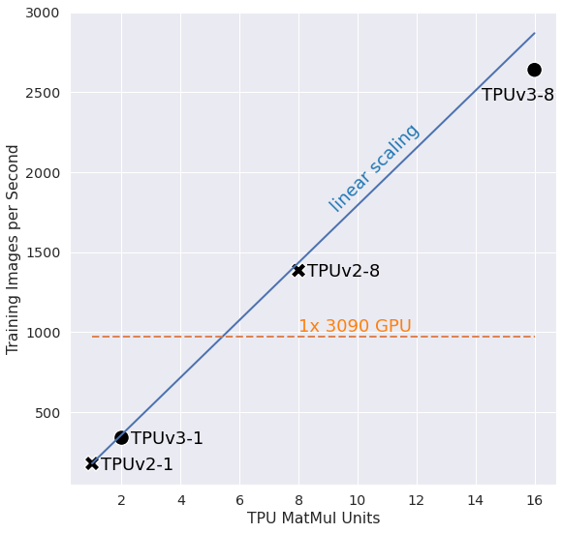
Scaling TPU MatMul Units

Slide 9
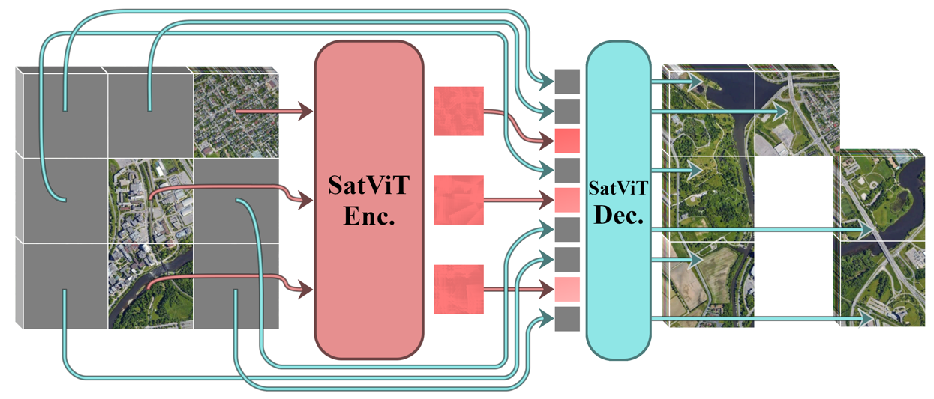
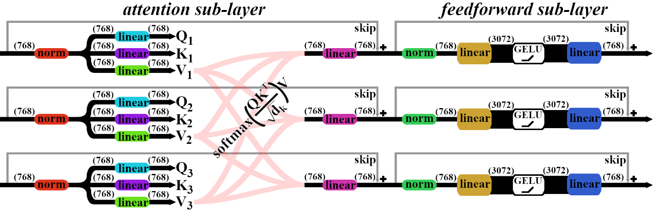
Data, Model, and Learning Algorithm
Dataset
1 million remote sensing images (multispectral optical and synthetic aperture radar) of shape {15, 112, 112}
Training Settings
Masked autoencoding
Batch size of 1024
204k steps
Evaluate with a held-out test set

Slide 10
Problem — Data IO Bottleneck
In The Past
DNN training could be performed with very high accelerator utilization
Because accelerators were slow compared to data IO
Because data types were light (text, small RGB images)
In The Present and Future
DNN training can be see lower accelerator utilization
Because of advancements in accelerator hardware and algorithms
Because data types can be heavy (video, 3D, remote sensing, medical imaging, etc.)

Slide 11
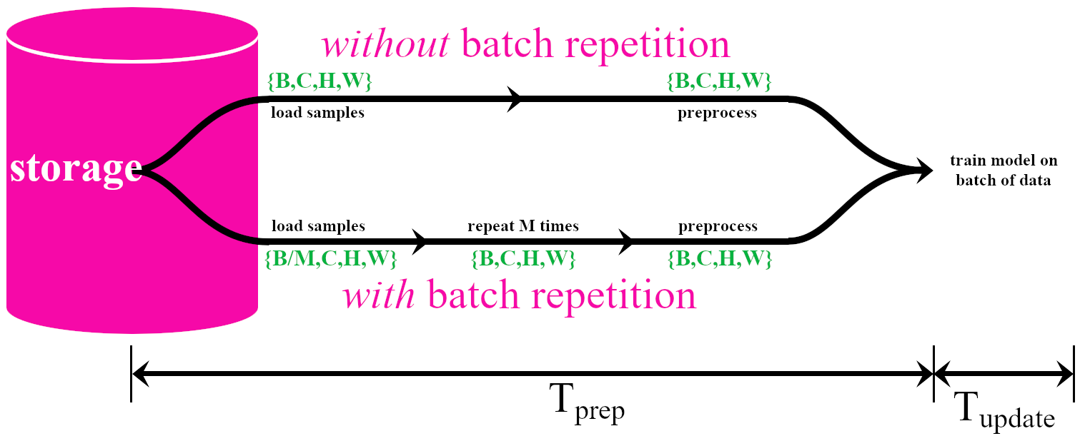


Solution — Batch Repetition
Utilization depends on
Model (architecture, size)
Hardware (HDDs, SSDs, memory, accelerator)
Learning algorithm
Data type (image, text, video)
More (file system, parallel loading)

Slide 12
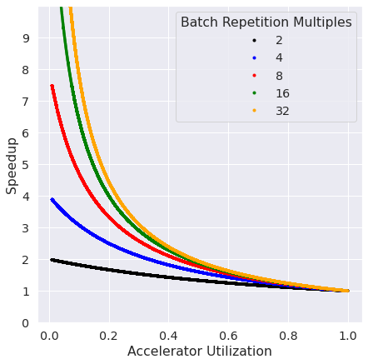
Building Intuition

Slide 13
Summary of Literature
Originally
Batch repetition was introduced at CVPR 2020, showing improved model accuracy (supervised training with CNNs) with decreased data IO as a bonus.
Lately
Batch repetition has been used with better models and algorithms (vision transformers and self-supervised learning), but not thoroughly studied — i.e., at higher M values, with different types of data augmentation, etc.
Batch repetition’s usage has been accelerating, many preprints in the past 6 months.

Slide 14
Experiments and Limitations!
Experiments
Train on TPUv3-8 sweeping M {2, 4, 8, 16, 32} and compare model accuracy with the baseline.
Limitations
I could not properly implement data augmentation on TPUs — this took a lot of time. Instead of flipping, cropping, rotating, I had to just add some Gaussian noise.
Likely caused by my data type (images were PyTorch tensors, not jpegs).
I also did not end up training for as long as I wanted, not as many TPUs and my main TPU VM was lost! (but not a serious limitation to the research)

Slide 15
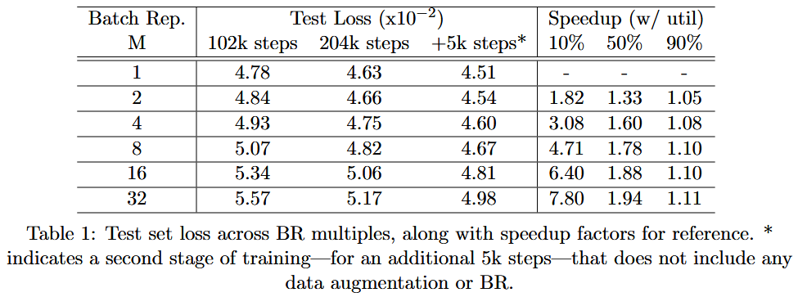
Results

Slide 16
Conclusion
Multi-device training
I succesfully sped-up training a SOTA DL model and algorithm on multicore TPUs (comparing with previous gen. and a 3090)
Multi-device training is the defacto approach to train large DL models
Batch Repetition
My initial results were not as good as I hoped
But I was able to recover much of the lost accuracy with a 2nd stage of training
This method is being adopted at a rapid pace (due to faster accelerators and bigger data), and deserves further study

Slide 17
My Questions
What is the main difference between GPUs and TPUs?
What is the main difference between single device and multi-device training?
What is batch repetition?

