Slide 1
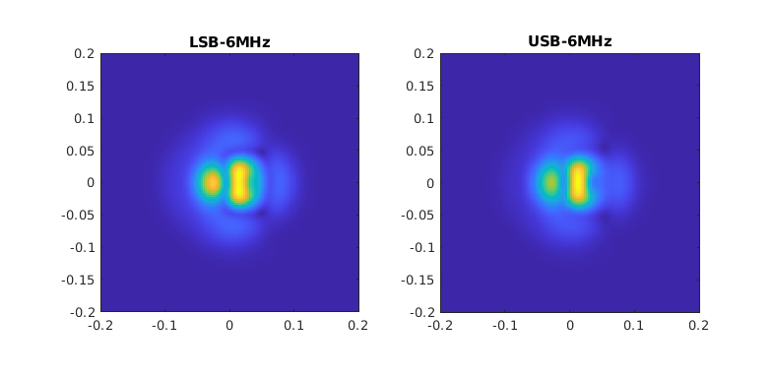
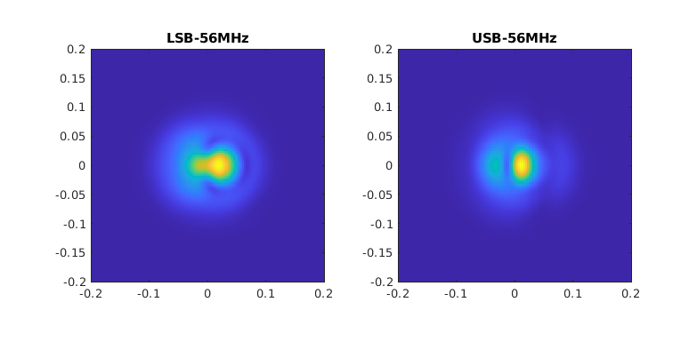
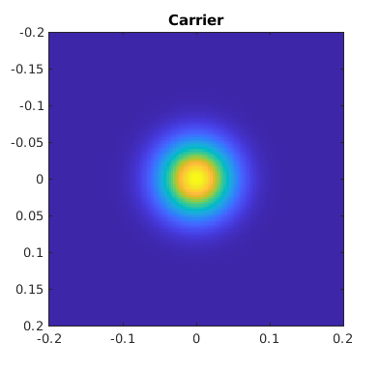
Reflected fields
PRM_RoC=1425m
PRM_tilt=100nm

Slide 2
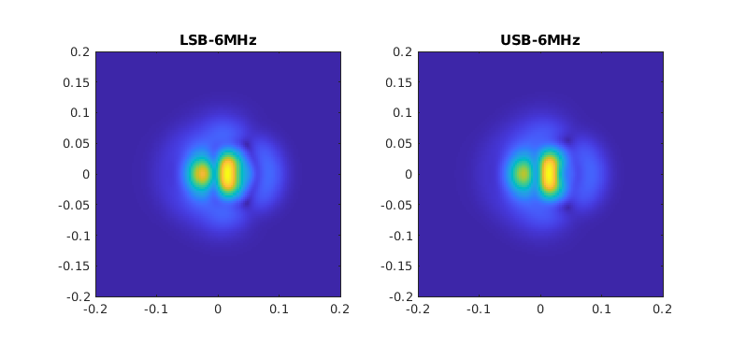
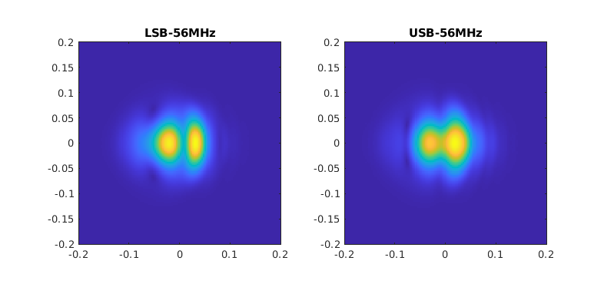
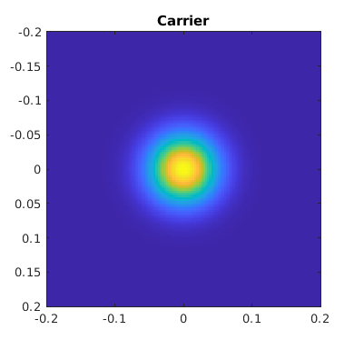
Reflected fields
PRM_RoC=1427m
PRM_tilt=100nm

Slide 3
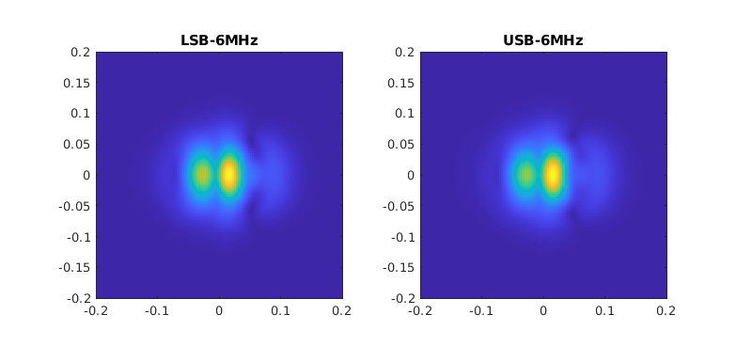
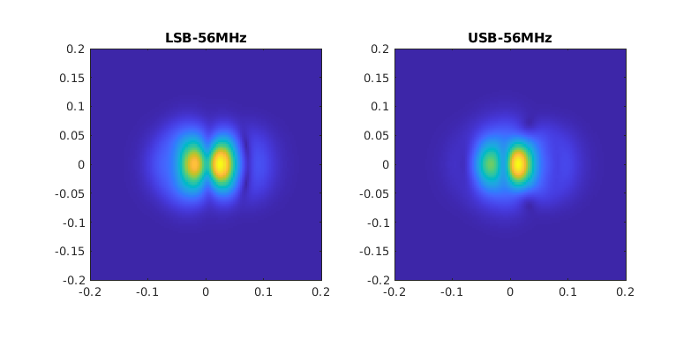
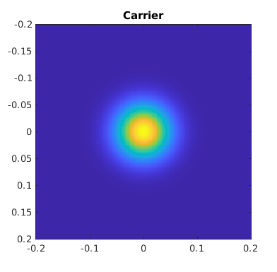
Reflected fields
PRM_RoC=1429m
PRM_tilt=100nm

Slide 4
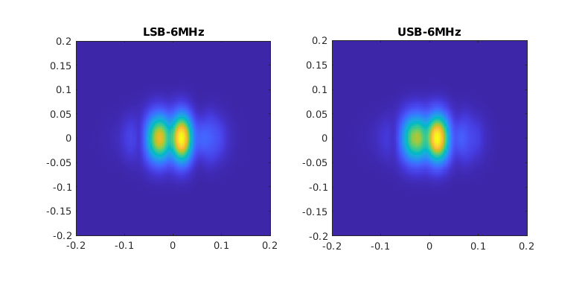
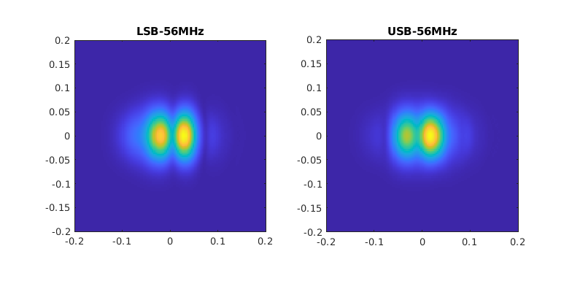

Reflected fields
PRM_RoC=1431m
PRM_tilt=100nm

Slide 5

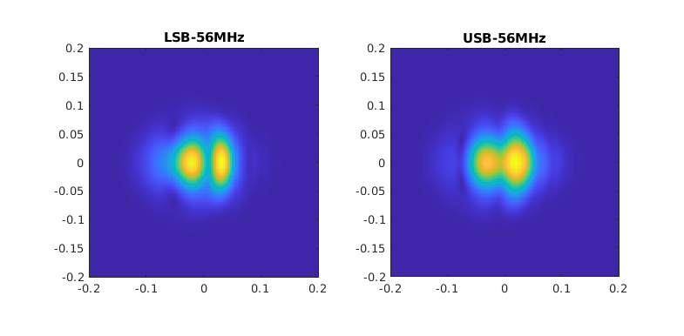

Reflected fields
PRM_RoC=1433m
PRM_tilt=100nm

Slide 6
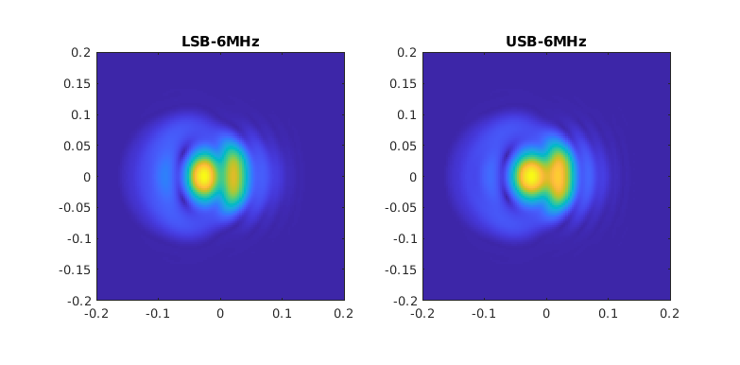
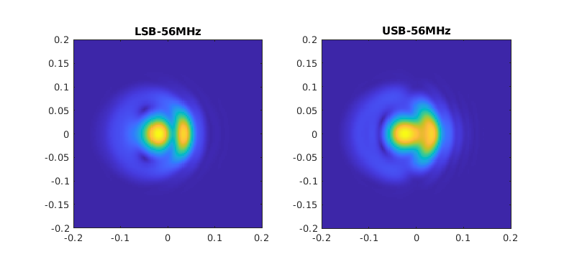

Reflected fields
PRM_RoC=1435m
PRM_tilt=100nm

