Slide 1



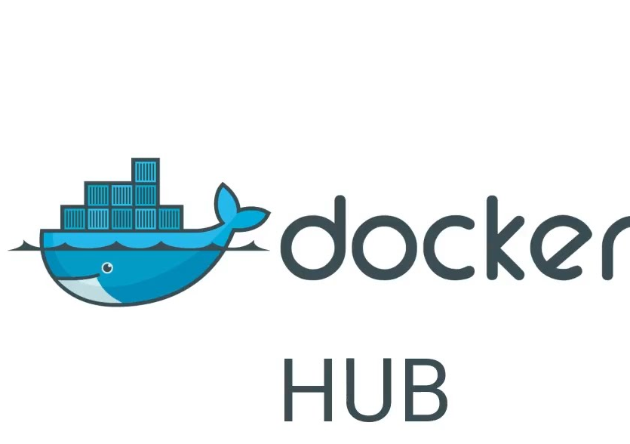



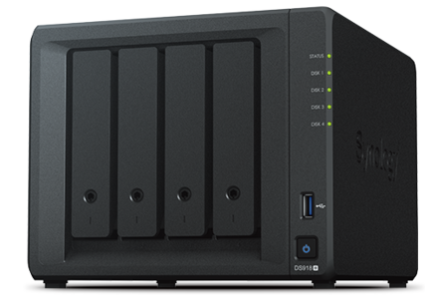
Du dev au run
build

Slide 2
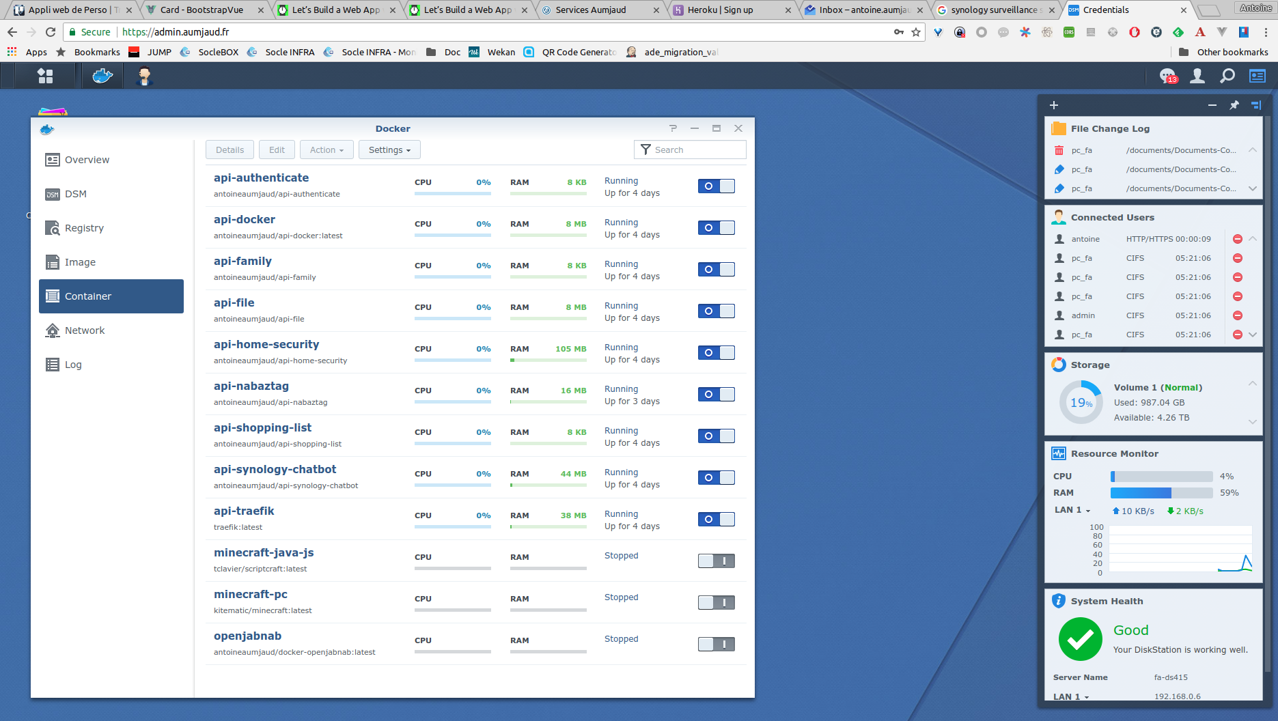
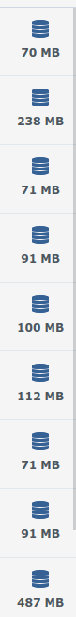


















Mes micro-services et ses interfaces
https://api-traefik.aumjaud.fr/
https://api-authenticate.aumjaud.fr/
https://api-docker.aumjaud.fr/
https://api-family.aumjaud.fr/
https://api-file.aumjaud.fr/
https://api-home-security.aumjaud.fr/
https://api-nabaztag.aumjaud.fr/
https://api-synology-chatbot.aumjaud.fr/
https://api-shopping-list.aumjaud.fr/
https://canda.aumjaud.fr
https://admin.aumjaud.fr
API
JavaLib
API
JavaLib
API
Authenticate
API
Docker
API
NodeLib
API
NodeLib
API
File
API
Family
API
Nabaztag
API
SynoChatbot
API
SNCF
API
HomeSecurity

Slide 3

Coté sécurité
HTTPS
Check signature
API
JavaLib
Token ou JWT
API
Authenticate
API
Docker
API
NodeLib
API
File
API
Family
API
Nabaztag
API
SynoChatbot
API
SNCF
API
HomeSecurity

Slide 4
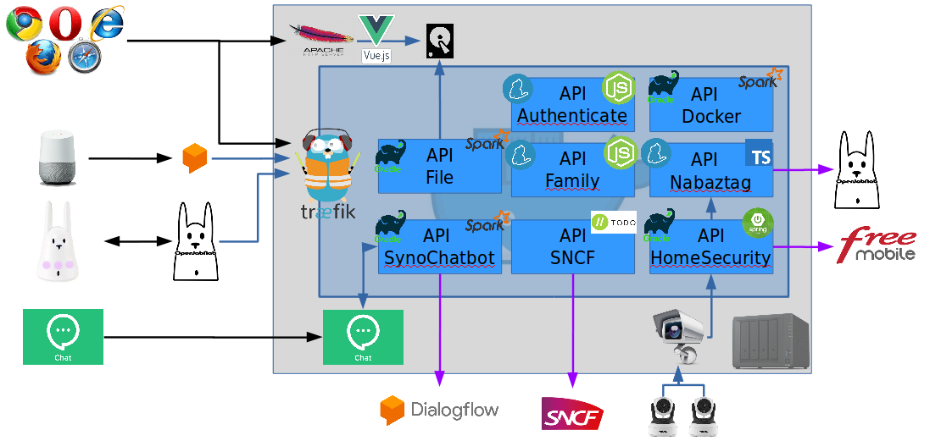
Vue globale
build
API
JavaLib
API
NodeLib

Slide 5
NEW API
1. GitHub: create repo (add tags)
2. Travis: activate this repo and add docker credentials
3. Docker: add badge and webhook
4. DS: Create new config in api/conf
5. DS: Modify : api-docker.properties to start this container
6. Reload api-docker container config

Slide 6
TODO
Node
  Autre API Express
  Logs (timestamp)
Docker
  Set memory on JVM J8
  Set memory on container
Exposition APIs (Open api 3 - swagger)

Slide 7
ISSUES
Montée en compétence
RAZ à chaque new techno
Risque sur élément extérieur
(GitHub Pages, Let’s Encrypt, Travis, DockerHub)

