Slide 1

UNDERSTANDING THE TOOLS
Make Figurines using AI for 3D printing
How easy and free it is

Slide 2
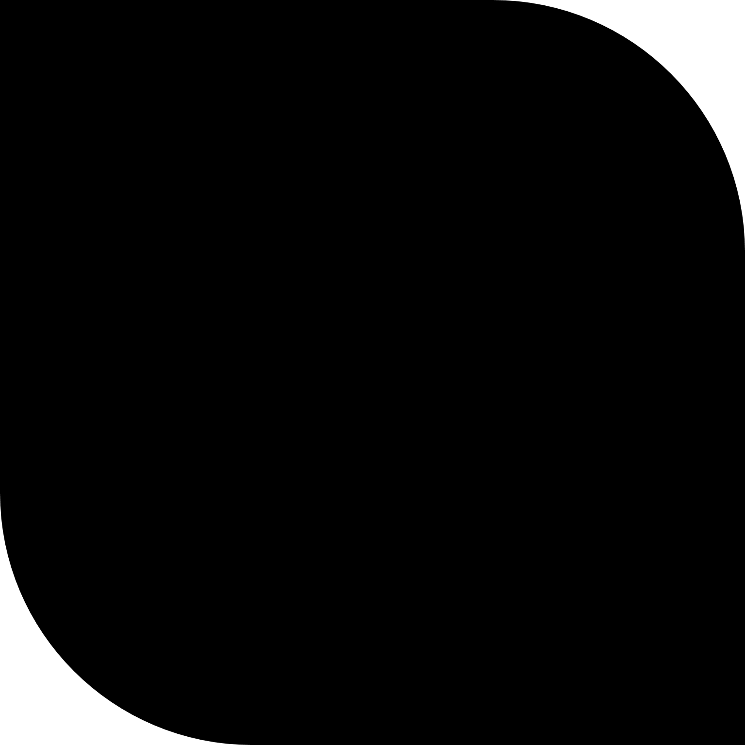
Use ChatGPT's Image Generation or Midjourney to Make a Toy Plastic Figure
Upload or Choose an Image
Start with a clear photo (portrait, object, etc.).
Choose an image with clear edges and lighting. Front-facing photos work best for 3D conversions.
Request the Toy Plastic Style
Ask ChatGPT:
“Convert this image into a toy-style plastic figure. Keep features but simplify and smoothen as if molded in plastic.”
I will generate a stylized, cartoony, toy-like version of the photo with:
Smooth edges
Bright colors
Plastic-like reflections
Minimal textures
2

Slide 3
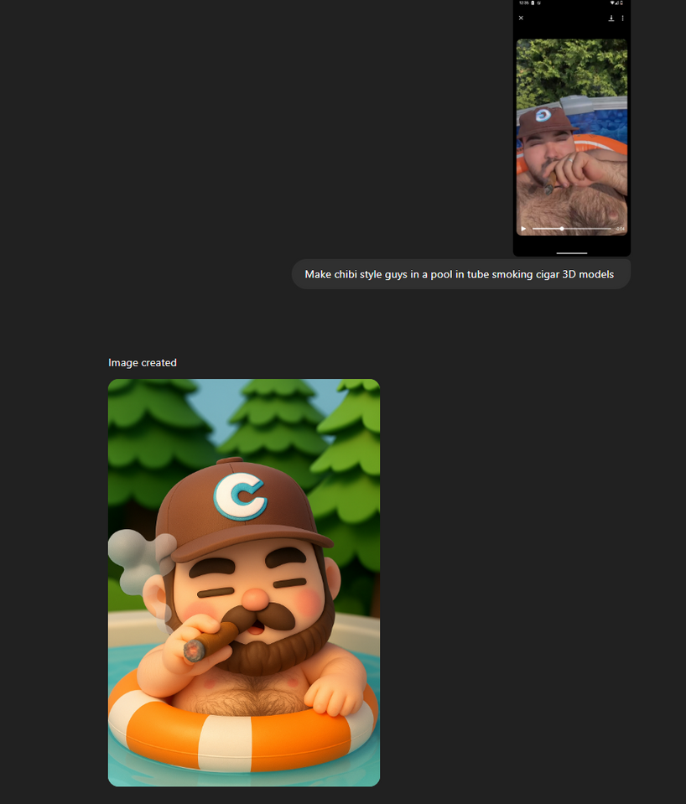
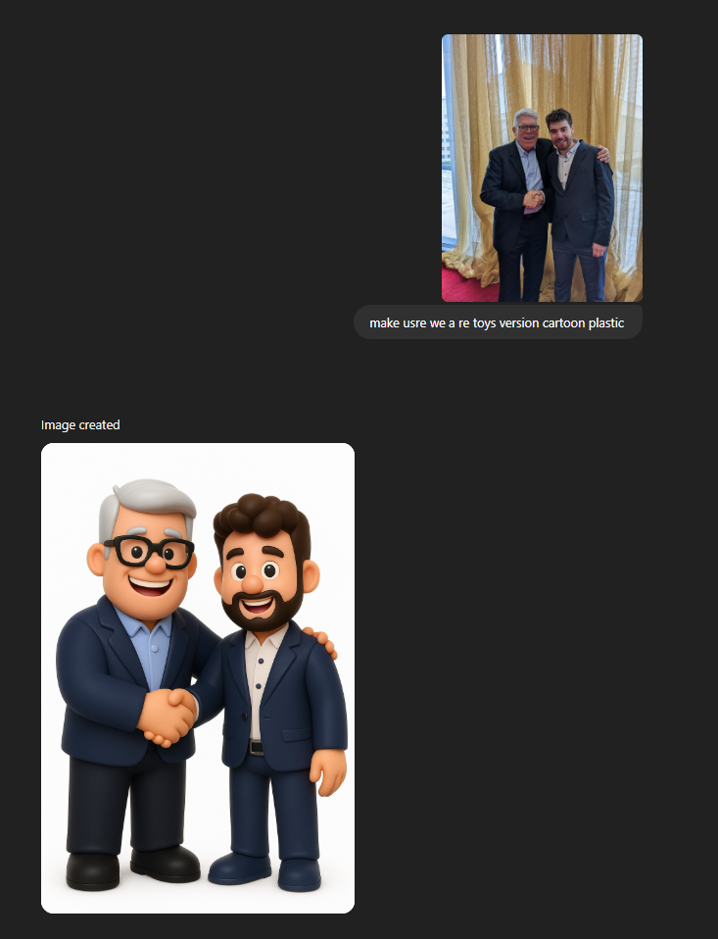
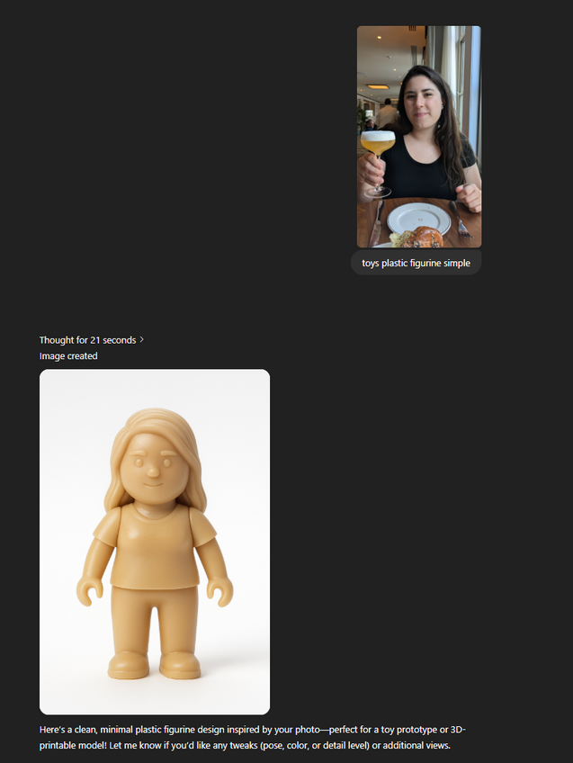
3

Slide 4
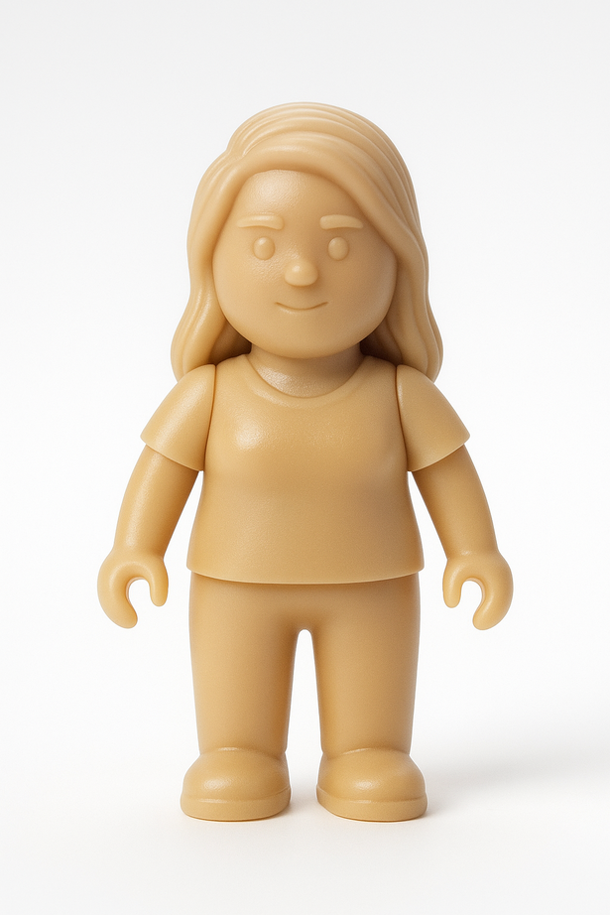
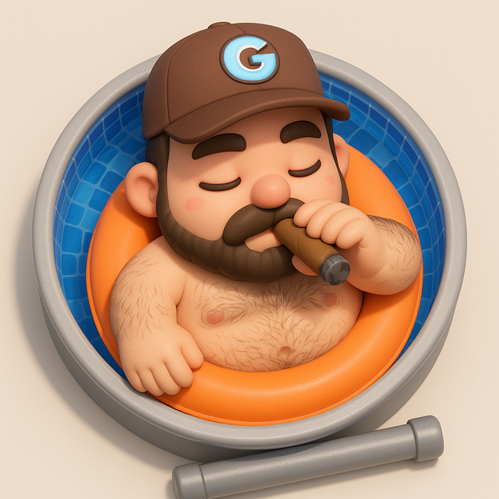
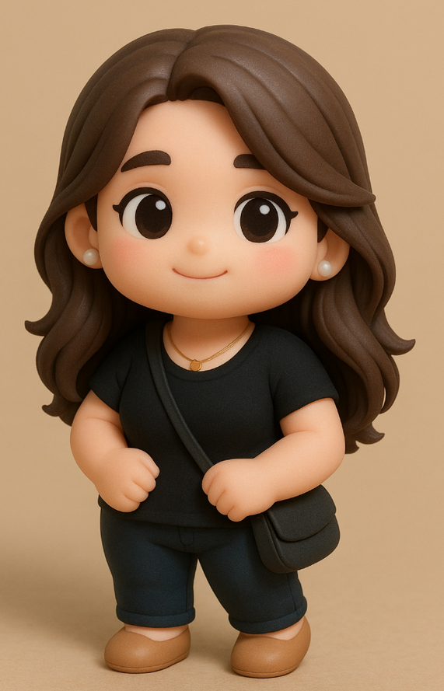
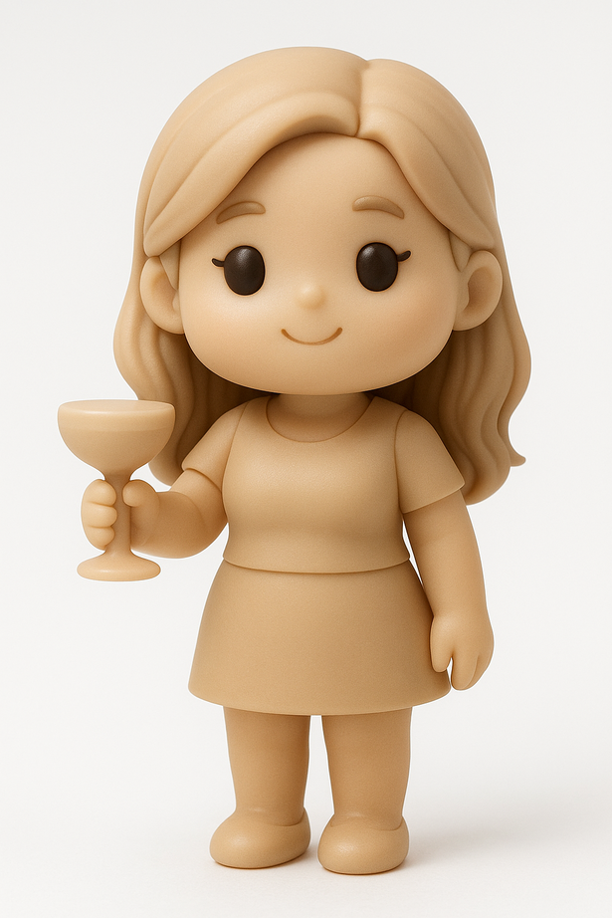
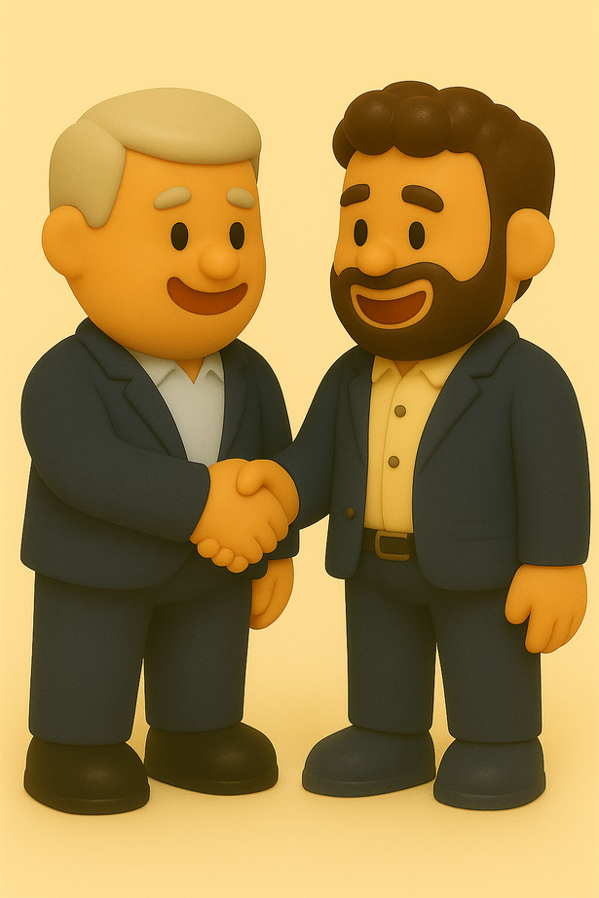
Examples
4

Slide 5
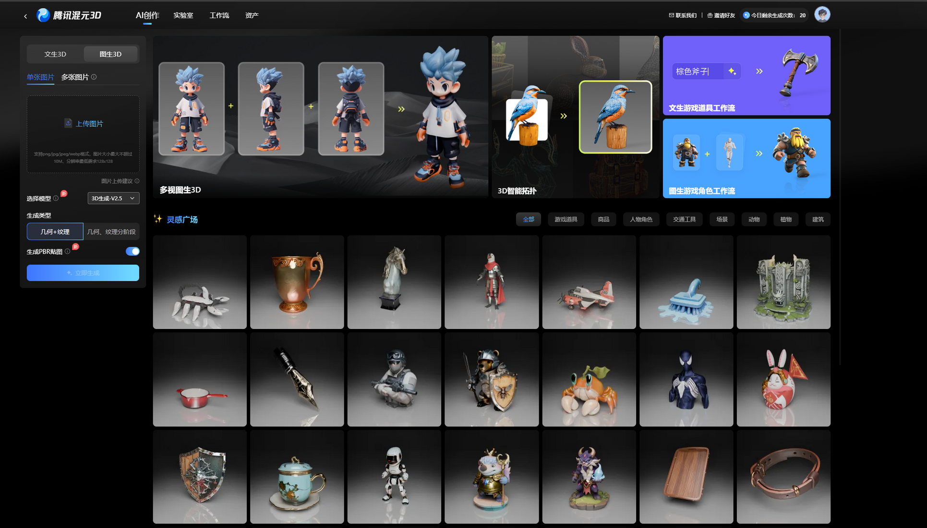
Convert to 3D Using Hunyuan 3D, Rodin
5

Slide 6
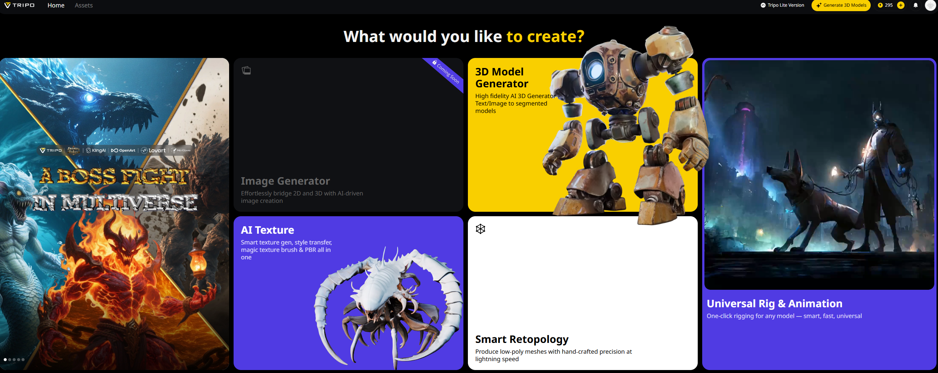
https://studio.tripo3d.ai/

Slide 7
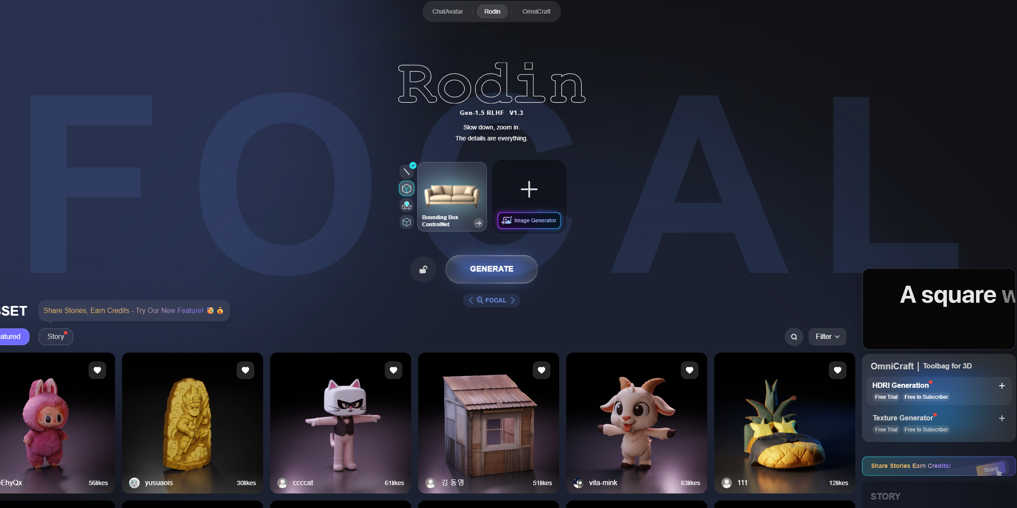
https://hyper3d.ai/

Slide 8
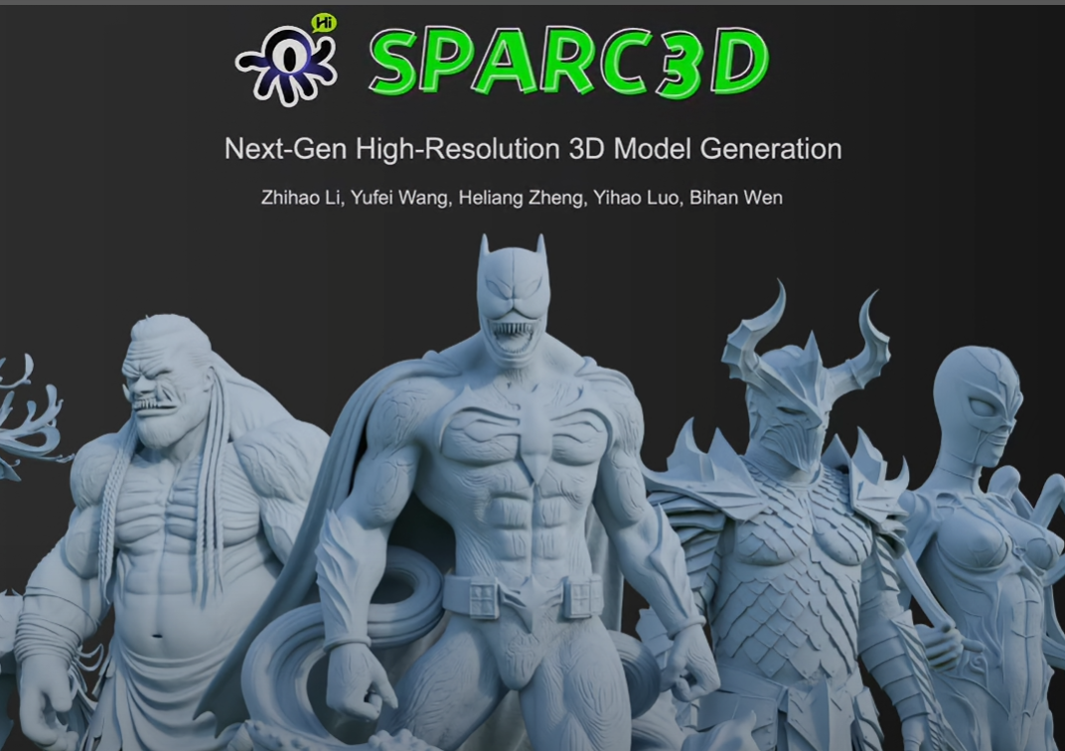
https://lizhihao6.github.io/Sparc3D/

Slide 9
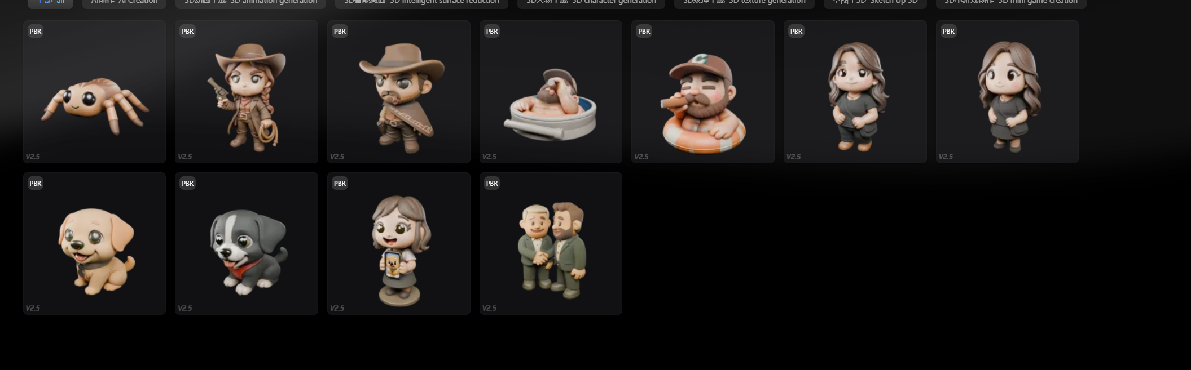

Slide 12
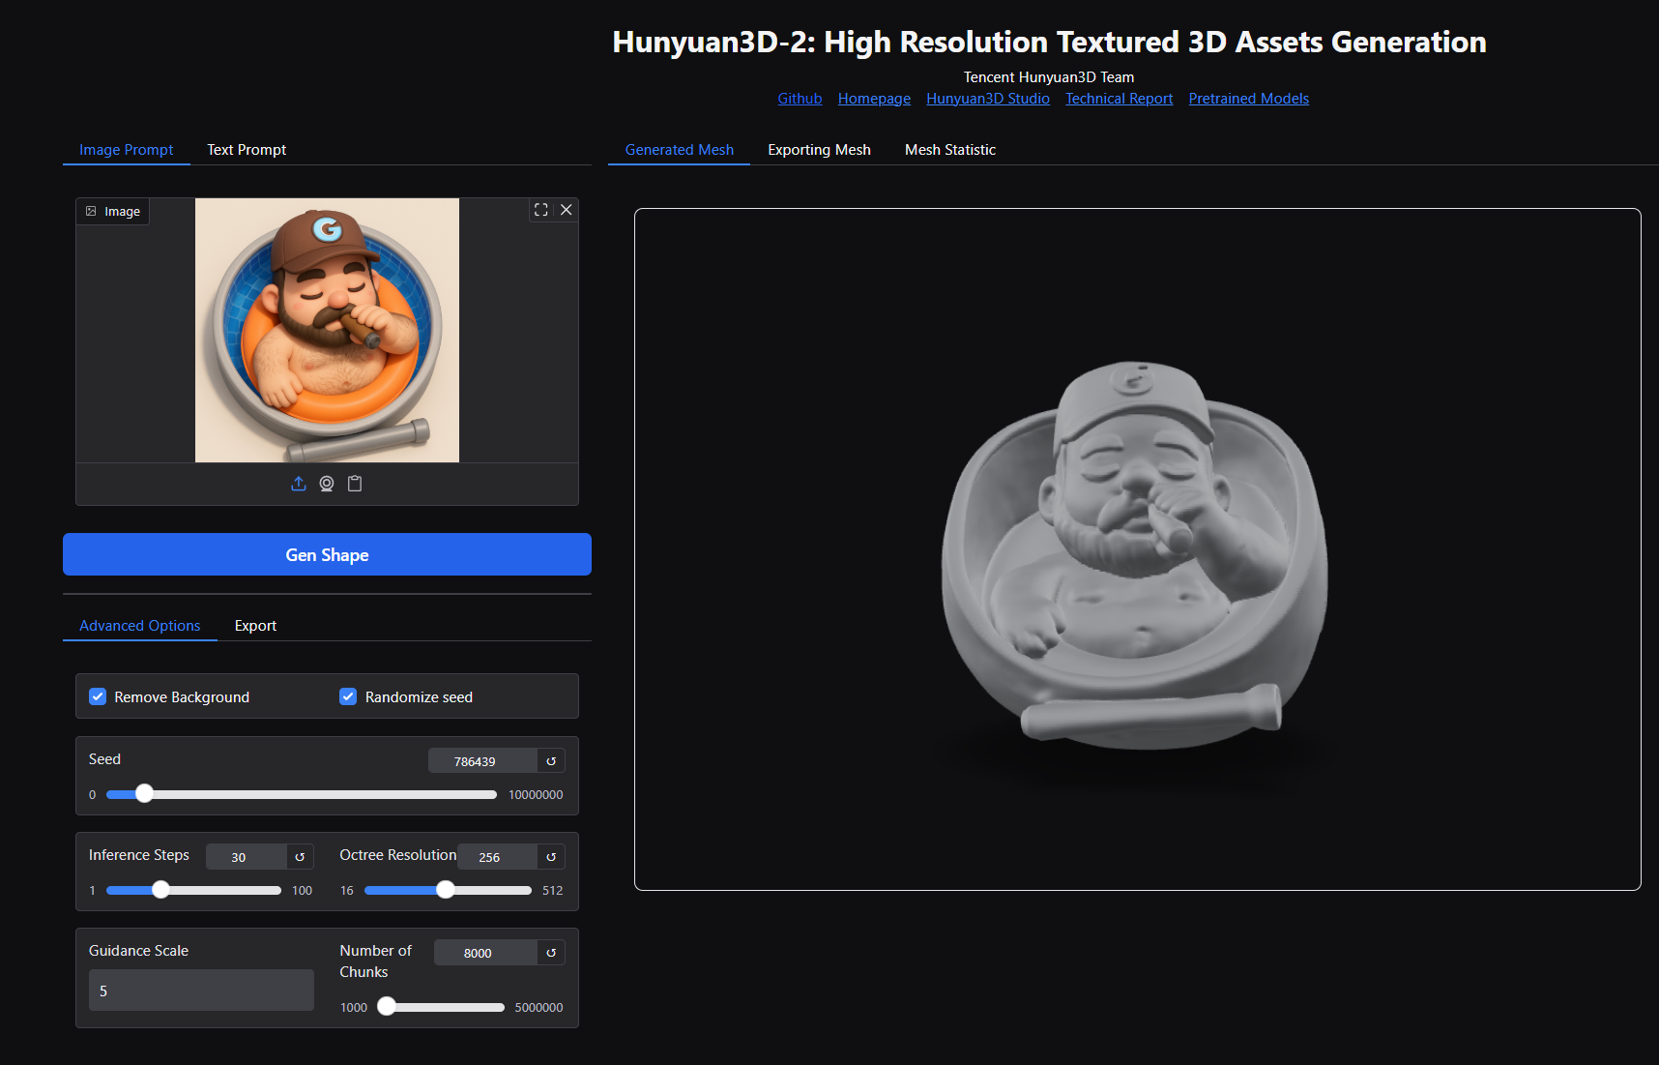
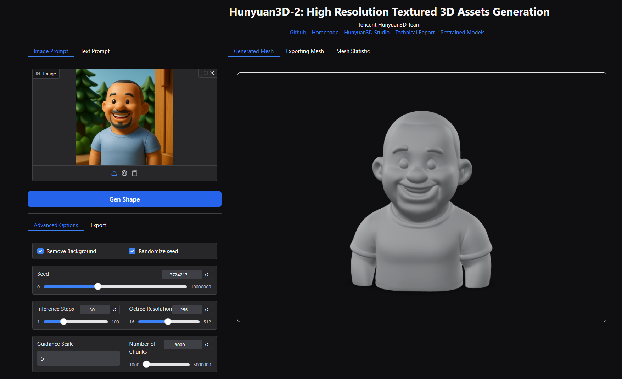
Pay around in the settings
6

Slide 13
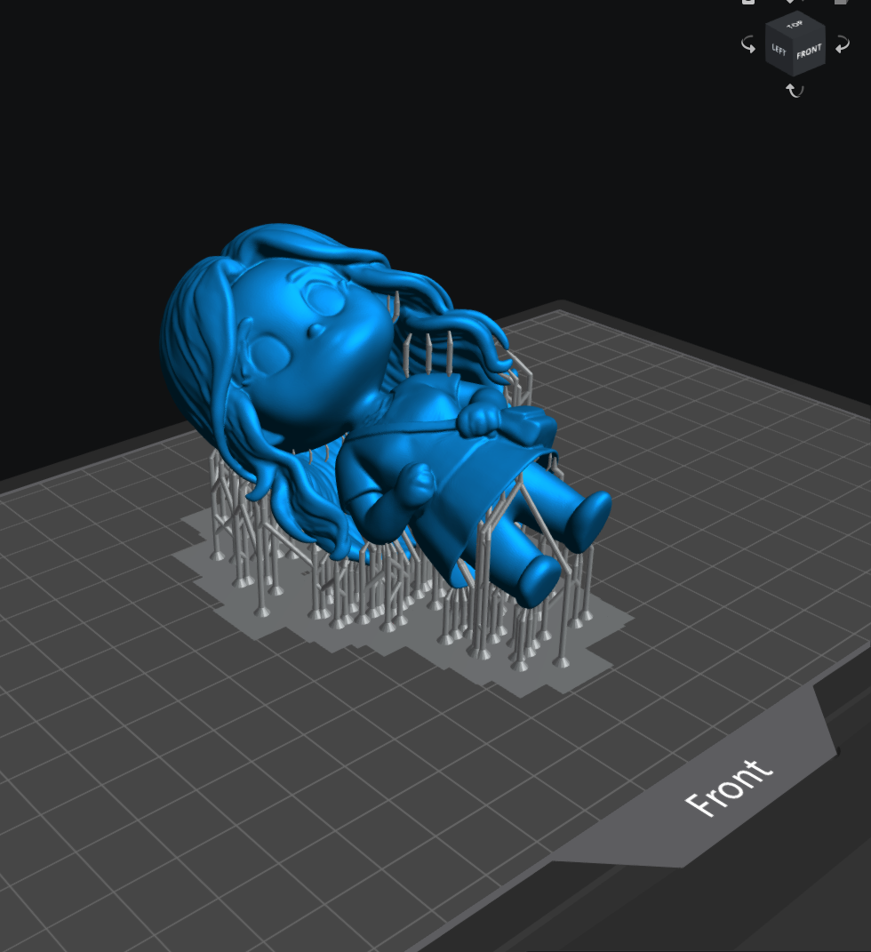
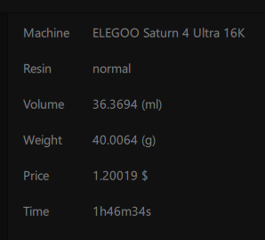
Print It
Nice resin print
7

Slide 14
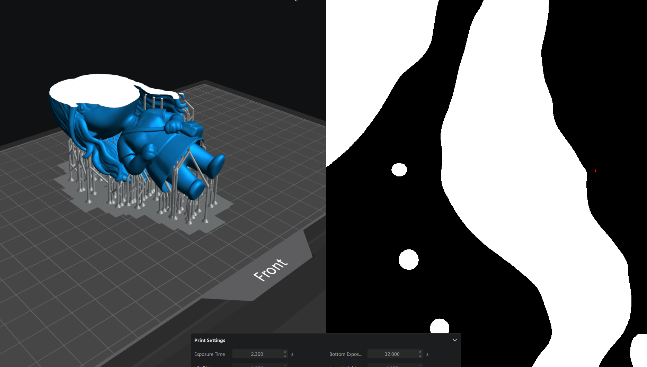

Issues Island
Use uvtools or another slicer
8

Slide 15
