Slide 1
The Amigos “This should work”
Notes:
I don’t really know what we need to have in this presentation

Slide 2
Original Design
Basic gaming concepts & Set small goals

Slide 3
Current Design
Multiple .h files
Over 30 functions
Unique RGB values
Reads player key inputs

Slide 4
Classes
Player
Turtle
Platform
Coin
Pipe

Slide 5
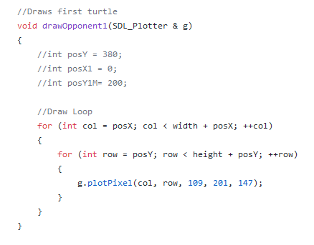
Draw Function

Slide 6
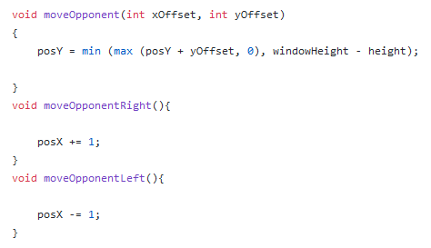
Move Function

Slide 7
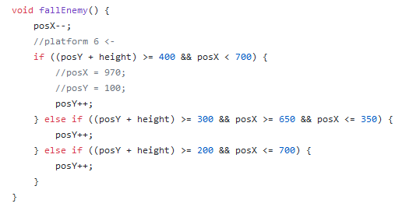
Fall Function

Slide 8
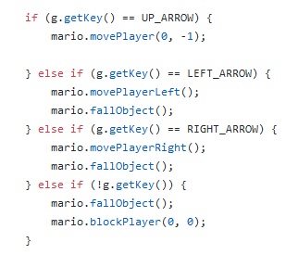
Key Input

Slide 9
Struggles
Unprepared
Time
SDL

Slide 10
What we would change
Add graphics
Scoring
Efficiency
Levels

