Slide 1
DataHawk - HomeProject
Antoine Messager

Slide 2
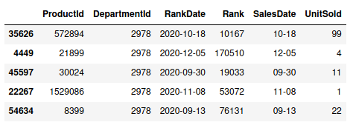
Analysis of the dataset
56,570 entries
6 characteristics :
  ProductId : unique id for each product (2,499 different products)
  DepartmentId : 2 departments
  RankDate = SalesDate : date of the ranking update
  Rank : rank of the product (the lower, the more it sells).
  UnitSold : number of untits sold on SalesDate

Slide 3
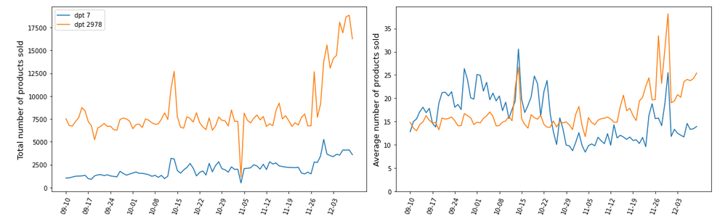
UnitSold per day
A few remarks :
An increase of the number of sales in december, probably because of « black friday » plus christmas.
The total and the average number of sales are relatively stable (although processes are not stationary) : the changes are not
The total sales of each department are correlated with one another
Average number sold each day is similar in each department

Slide 4
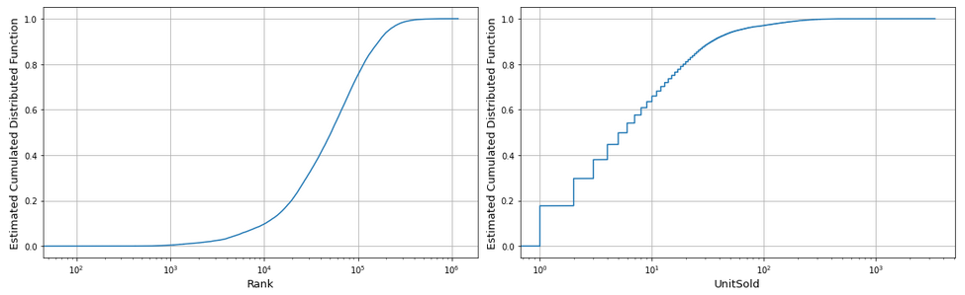
Rank and UnitSold
How to read : 10 % of the ranks are below 10⁴, 75 % of the ranks are below 10⁵ (hence 65 % between 10⁴ and 10⁵), 65 % of the sales of each product per day are made of less than 10 units, but there are a few sales of more than 1000 units per day.
The very large span of the distributions is to be noted, the model will have to deal with many characteristics distributed over sevral order of magnitudes (this increases the complexity of the task)

Slide 5
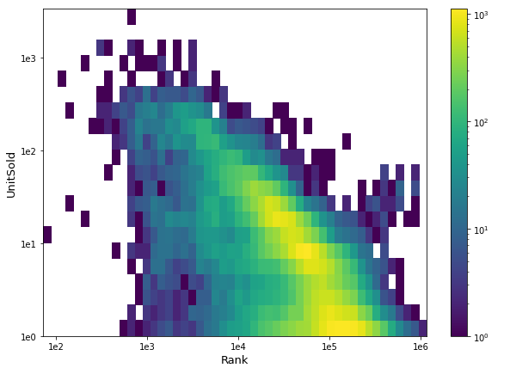
Rank vs UnitSold
How to read : there are approximately 1000 rows in the dataset for which the rank and the number of UnitSolds are equal to respectively and approximately 10⁵ and 10.
There is hence a negative correlation between the rank and the UnitSold (r² = -0.26) that needs to be exploited (NB : this correlation is independent of the DepartmentId). However the correlation is not very strong.

Slide 6
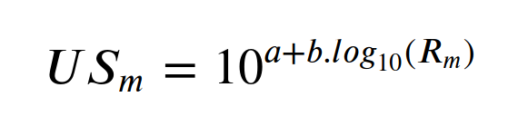
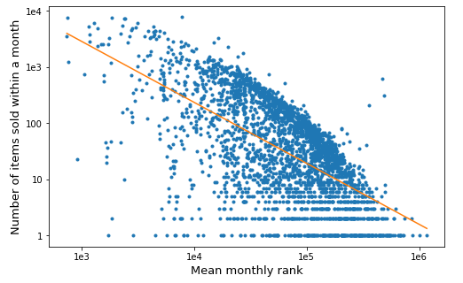
First Model : monthly linear regression
Aim : Given all the rank updates of a given month, predict the total number of items sold within this month
First Model: Exploit the correlation between ranks and UnitSold and build a linear model
Fitted linear model
Fitted slope coeff
UnitSold monthly
Fitted intercept
Monthly average rank

Slide 7

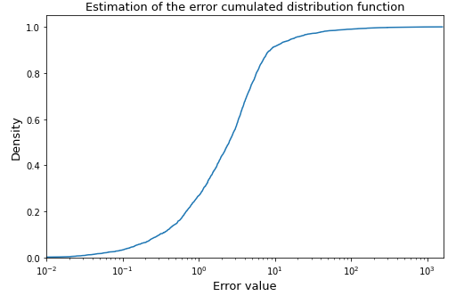
First Model : monthly linear regression
To measure the precision of the model, given the true number of sales US_{m} and the predicted number of sales Ûs_{m}, we assess the error by :
An error of 0,5, means that the prediction (e.g. ÛS_{m}=10) is 50 % away from the true value (e.g. US_{m}=15 or US_{m}=6.67).
NB: the error will be larger than 1 if ÛS_{m} > 2US_{m} or ÛS_{m} < 0.5US_{m}
Most predictions are roughly correct but some are very far-fetched. Hence, to capture this bidimensionality, I assess the goodness of the model with the mean and the median error: e_{mean}=746% and e_{med}=251 %.
It reads as 27% of the errors are below a 100% deviation (the median can be read at density=0.5)

Slide 8
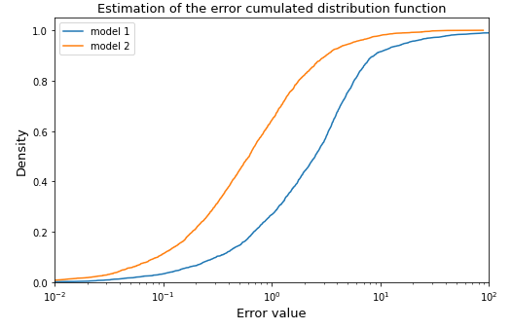

Second Model : daily linear regression
Idea: Fit a linear model of the daily number of items sold using the daily ranks to predict the montly sales by summing the daily predictions :
Fitted linear coefficients
UnitSold monthly
UnitSold daily
Daily Rank
The model is better, the error e_{med}=62 % and e_{mean}=154 % is smaller, but remains high.
NB: Including the departmentId only decreases the median error by 4% and the mean error by 10 %. Using a polynomial function to fit the daily sales using the daily ranks does not either improve a lot the performance.

Slide 9
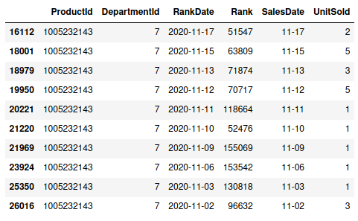

Third model : using ML library
Idea: Given the list of all the ranks with a month, use XGBoost algorithm to predict the total number of sales made within the month
Extract informations
Process
XGBoost
22.34
Predict ∑UnitSold

Slide 10
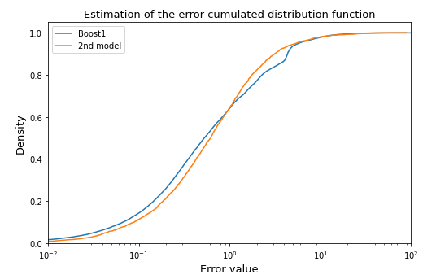
Third Model : using ML library
Results: The model performs similarly as the previous model : e_{mean}=195 % and e_{med}=53 %: the median error is better but the average one is worst.
The model was not trained using the daily ranks as the 2nd model. Hence adding the prediction from the 2nd model might improve the performance

Slide 11
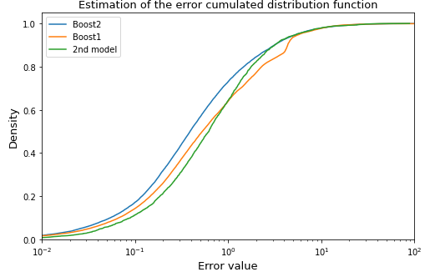
Fourth Model : XGBoost + 2nd model
Inputs: The prediction from the 2nd model, the list of ranks of a product at a given month plus the DepartmentId
e_{mean}=150%
e_{med}=39%
Results: The blue line corresponding to our model is drifted to the left, meaning that the error is significantly reduced.

Slide 12
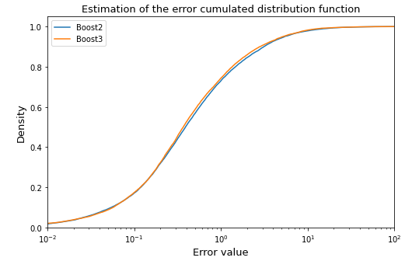
Final Model : XGBoost + 2nd model + temporal info
Inputs: This time, we also use information extracted from the temporality of the sales : are the sales happening around the same days ?
e_{mean}=130%
e_{med}=37%
Results: The median error is decreased by 2 % and the mean error by 20 %.

Slide 13
Conclusion
Given the list of ranks of a given month, the departmentId of the product and the dates of the sales, we have constructed a model that is able to predict the number of unit sold per month. A few predictions are very inaccurate (the worst 1 % have an average 2700 % deviation error), hence contributing to a large mean error, however most of them are within a 35 % deviation (as demonstrated by the median). The difficulty of the task remains within the wide range of number of sales and ranks and within the relatively poor correlation between these two characteristics.
A number of characteristics have not been exploited and the model can be further improved. For instance, it would be particularly interesting to exploit the amount of sales made of similar product that are known : this would allow us to deal with event like black friday where sales increase while ranks may not be updated. It will also interesting to look at the performance of a RNN (recurrent neural network).

