Slide 1
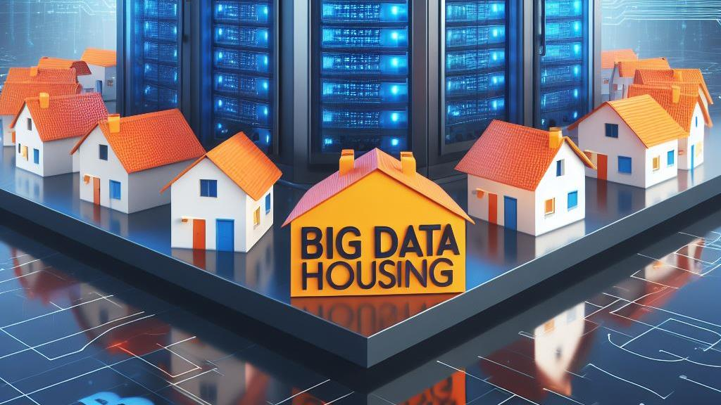

Slide 2
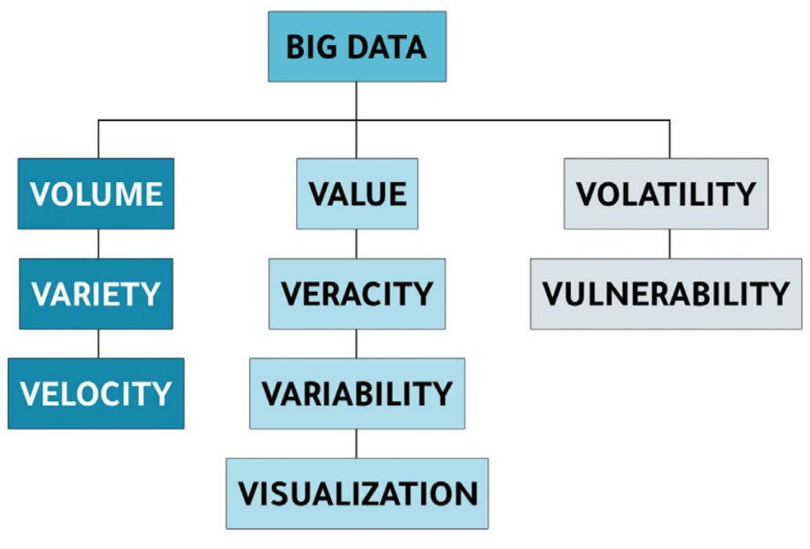

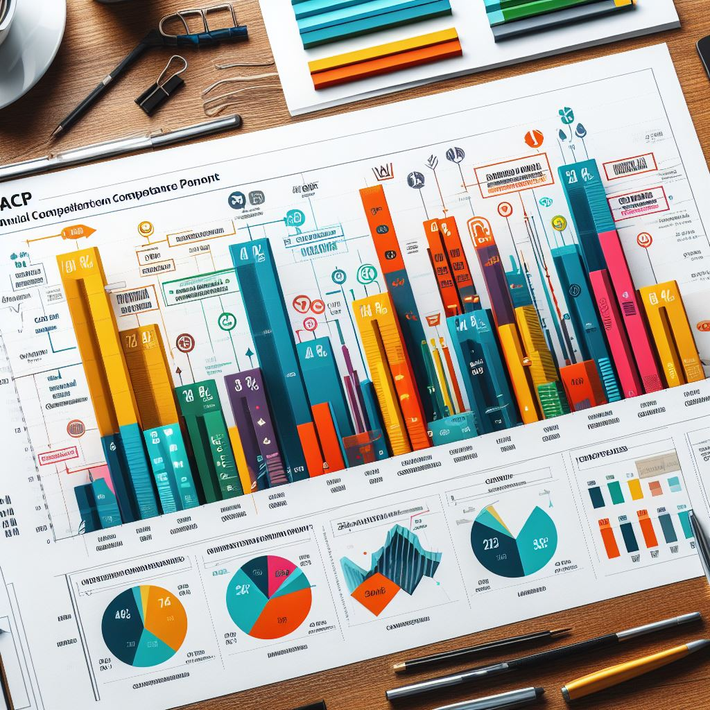
Big Data 101
Big Data can be defined as data or information characterized by a Volume, Velocity, and Variety so significant/high that they require specific technologies and analysis methods to transform them into value
Other "V's" :
  Variability
  Veracity
  Visualisation
  Value
2.5 Trillions of Data Bytes created each days
Data by data, Big Data. Hackenberger, 2019.
Notes:
Sources des graphiques :
Image du haut : Hackenberger BK. Data by data, Big Data. Croat Med J. 2019 Jun 13;60(3):290-292. doi: 10.3325/cmj.2019.60.290. PMID: 31187958; PMCID: PMC6563174.
IA générative de Bing, prompts : "Les trois V de la Big Data" et "Un dashboard analysant des Big Data"

Slide 3

The project
Develop an innovative app for comprehensive information and analysis of the housing market in France.
Offer a user-friendly and interactive experience for exploring housing statistics and insights.
Your users are professionals and decision-makers — real estate firms, local governments and data analysts — not individuals looking for housing.

Slide 4
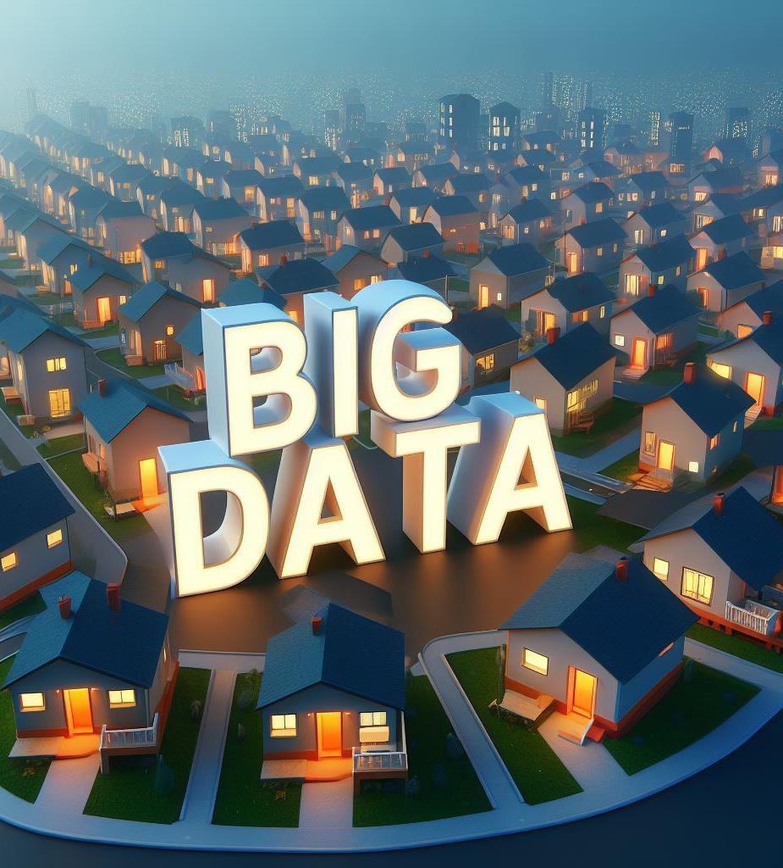
BIG DATA HOUSING
Statistical, textual, and cartographic analysis of real estate in France.
Project's Vs :
Volume
Variety
Volatility

Slide 5
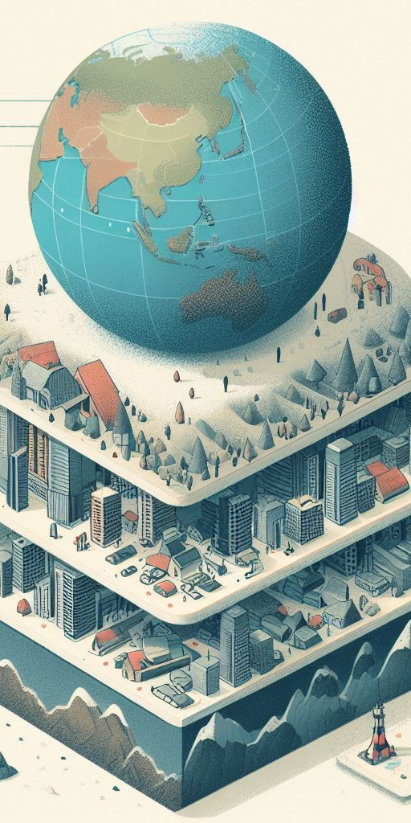

Data variety
Having a global but also local pespective on the topic of interest
Different data formats
A type of format correspond to a type of information
Diversifying formats to vary the angle of analysis
Origines variées
Attaining a better represantation of information
Depending on the origin, concernes are not the same
Diversity of analysis levels

Slide 6

Non relational Databases
The use of an appropriate database helps optimize storage
Due to the wide variaty/volatility of data it's advantageous to have a suitable storage system

Slide 7
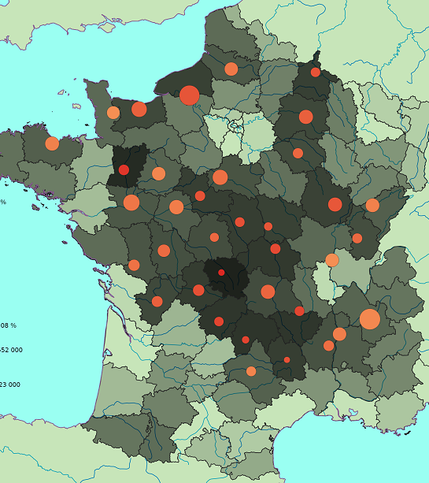

Cartographic data
Achieving a better representation in space
Integrating multiple levels of visualization, ex : bubblee plots + maps

Slide 8

The Data
Gouvernemental datasets
Using verified data
Open-source disponibility
API's
Other Datasets
Specific data
Different formats of data from DataGouv
Attention to usage conditions for scraping data

Slide 9


Processing
Using appropriate tools to process large volumes of data
Helps shorten calculation times
Managing calculations in the cloud

Slide 10
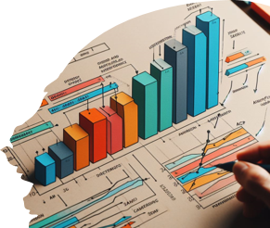
Visualizing data, what for ?
Visualizing data is making sense of information
Representing data in high dimensions : AI ?

Slide 11
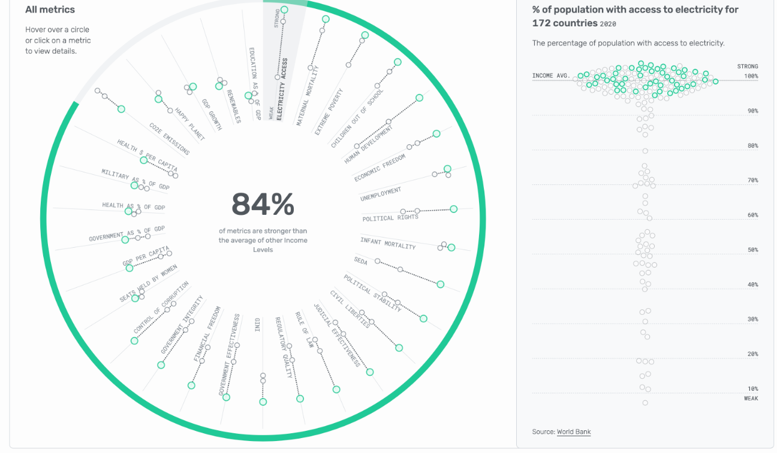
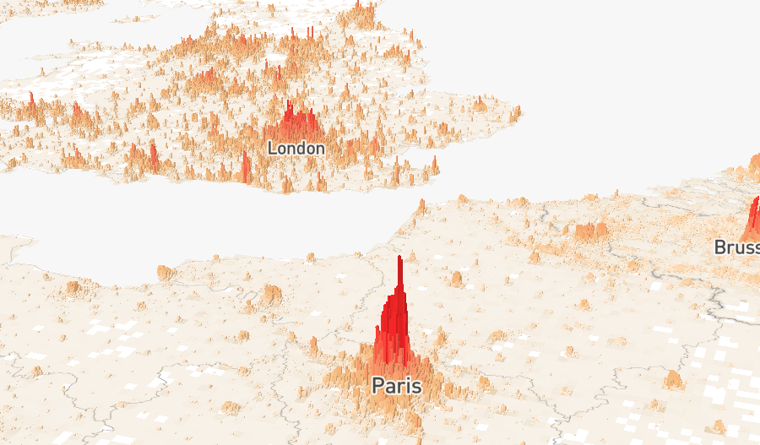
Dynamic visualization
Making data interactive :
  Users can select the information that interests them
  Filtering information to make the dashboard more readable

Slide 12
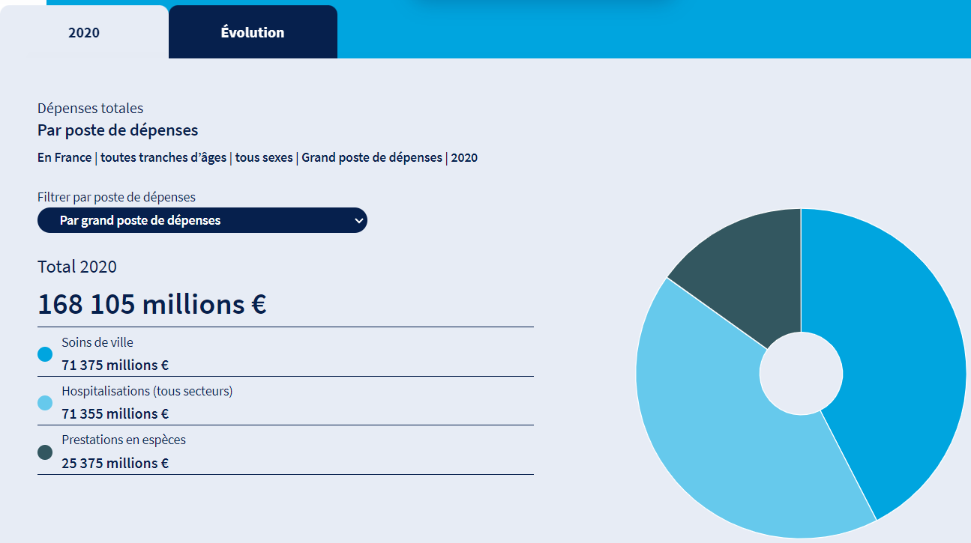
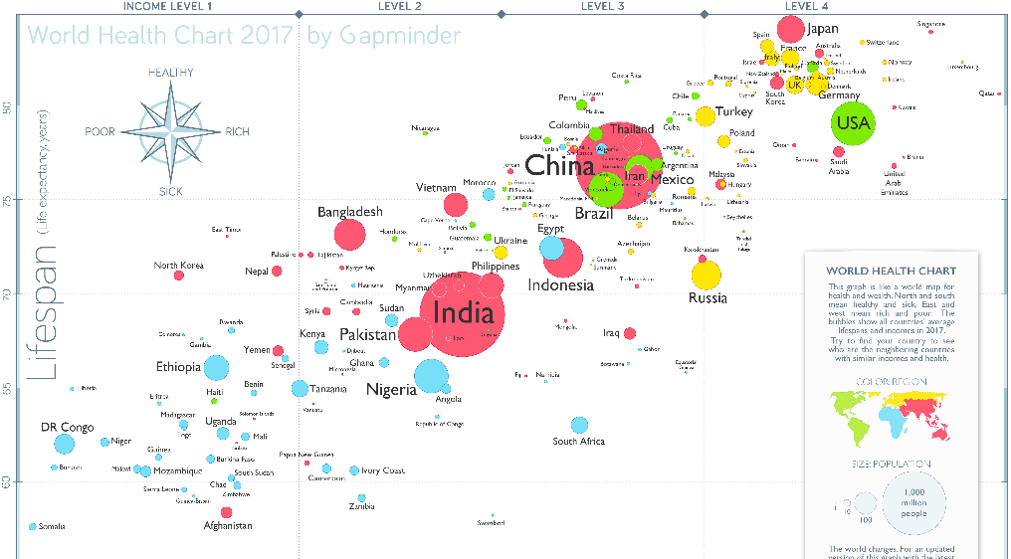
Real-Life examples for inspiration
Gapminder : it promotes a fact-based worldview through data visualization.
https://www.villesavivre.fr/ : a website for reviews and comparisons of communes in France.
Data pathologies : an initiative from Ameli, the french social care system.
Numbeo: provides information on various aspects of living, including housing costs, quality of life, etc.

Slide 13
Comment vous serez évalués — 6 axes
Collecte & sourcing /5 — ≥12 sources (max 50) dont ≥1 textuelle · 4 échelles · sourcing légal & documenté
Organisation des bases /5 — relationnel + NoSQL · schéma expliqué · clés communes · indexation
Traitement distribué /5 — Spark/Hadoop sur cluster multi-nœuds · nettoyage · ≥3 analyses
Analyse textuelle /4 — texte traité (sentiment / topics) exposé comme indicateur utilisable
Visualisation tables & cartes /6 — tables triables/filtrables · ≥1 carte · 3 échelles · croisement d’indicateurs
Application interactive /5 — app live · sélection zones/indicateurs · lit la base (pas de fichiers statiques)
Total /30 + bonus (déploiement en ligne, auth, temps réel, autres pays…)

Slide 14
Modalités & organisation
Projet en groupe (3–4 personnes)
Utilisateur cible : professionnels & décideurs — agences, collectivités, analystes (pas le particulier)
Évaluation finale « point de vue client » : démo live de l’app + soutenance technique façon commerciale
Livrables : application interactive déployée (local ou en ligne) · code source & config · schéma des bases · documentation d’architecture
Sources : DVF, INSEE, data.gouv.fr… + au moins une source à trouver légalement (collecte responsable)
Astuce outils : Streamlit · Spark/Databricks · Leaflet — parlez-en au pédago pour l’accès au cluster

Slide 15
Calendrier — T-DAT-901
Lun. 14 sept. 2026 · 14:00–17:30 · Kick Off
Ven. 25 sept. 2026 · 14:00–17:30 · Follow-Up 1 / 3
Ven. 20 nov. 2026 · 14:00–17:30 · Follow-Up 2 / 3
Ven. 8 janv. 2027 · 14:00–17:30 · Follow-Up 3 / 3
Ven. 12 févr. 2027 · 14:00–17:45 · Keynote finale

