Slide 1

Examining Crime and Temperature in Nashville, TN

Slide 2
What prompted this research?
My boss and his family attended a sporting event in Michigan. When his mother was worried about where they parked the car, he turns around and says, “It’s 14 degrees outside! No one is going to steal your car!”

Slide 3
What prompted this research?
My boss and his family attended a sporting event in Michigan. When his mother was worried about where they parked the car, he turns around and says, “It’s 14 degrees outside! No one is going to steal your car!”

Slide 4
Software Used
Jupyter Notebook for cleaning and analysis
Excel to import temperatures
Tableau for graphs

Slide 5
Data Collection, Cleaning, and Filtering
Data collection:
Data.Nashville.Gov
-Metro Nashville Police Department Incidents
NOAA (National Oceanic and Atmospheric Administration)
Data Cleaning:
Eliminated ‘POLICE INQUIRY’ as an Offense
Eliminated ‘UNFOUNDED’ as an Incident Status
Data Filtering:
Only used data from 2023
There were 393 offenses in Nashville- only used the top 5 for analysis

Slide 6
Agenda
Top 5 Nashville Offenses
Temperature Analysis
Temperature Analysis with Top 5 Combined

Slide 7
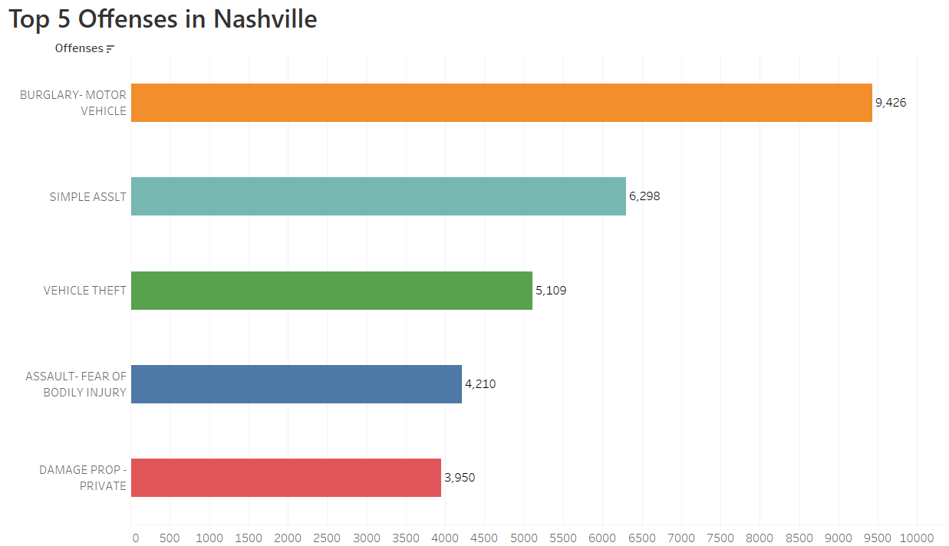

Slide 8
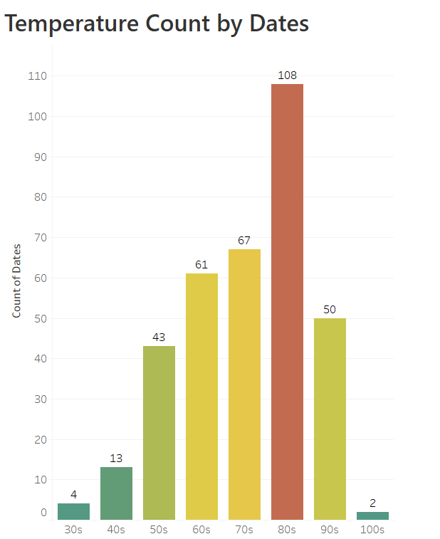

Slide 9
Motor Vehicle Burglary

Slide 10
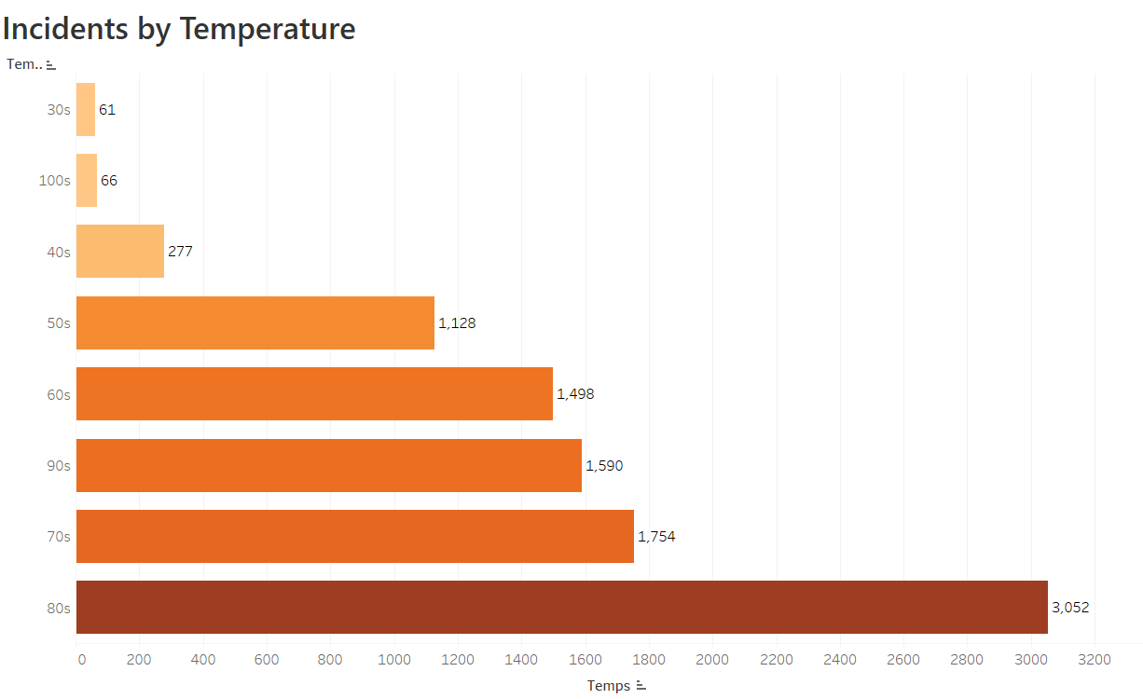

Slide 11
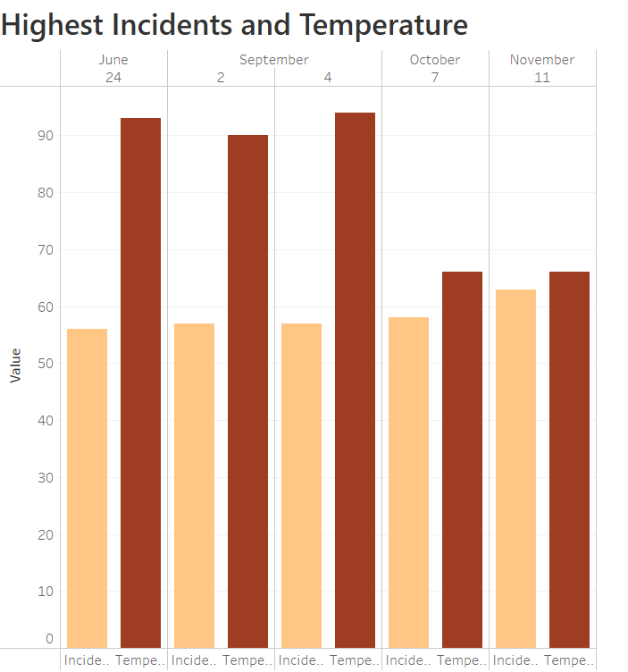

Slide 12
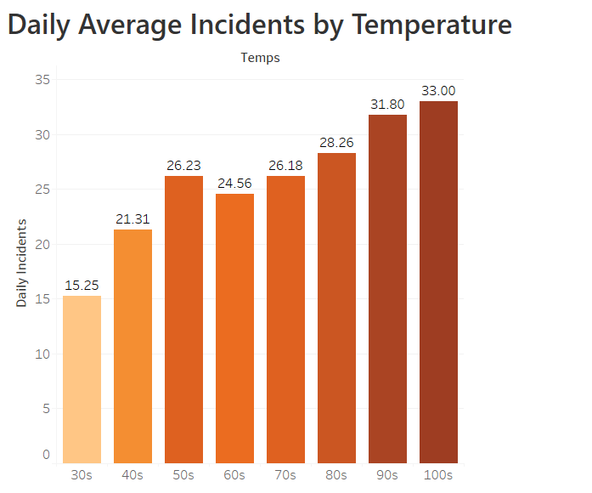

Slide 13
Simple Assault

Slide 14
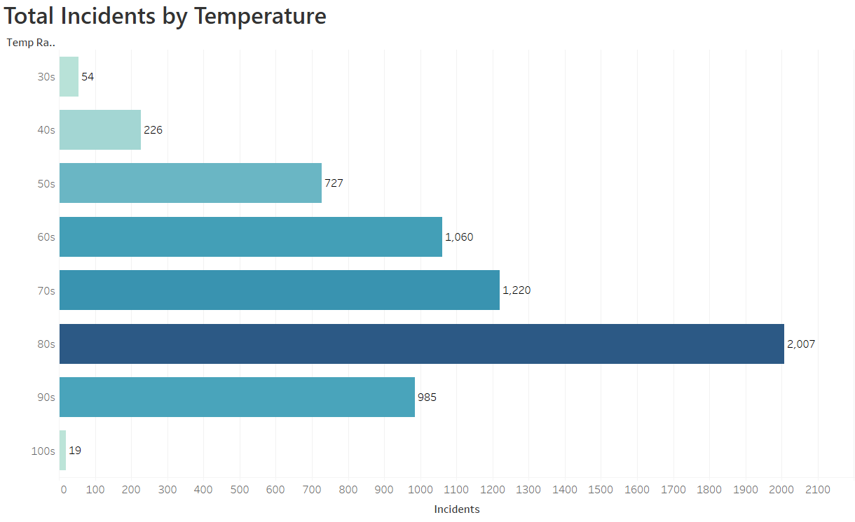

Slide 15
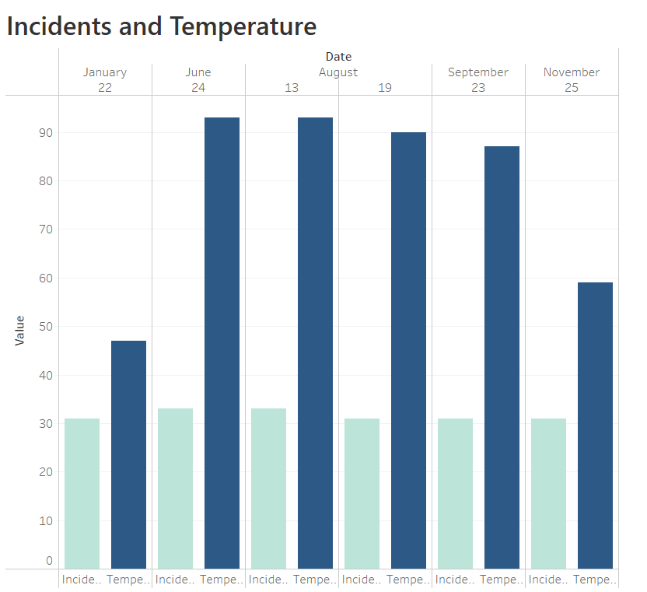

Slide 16
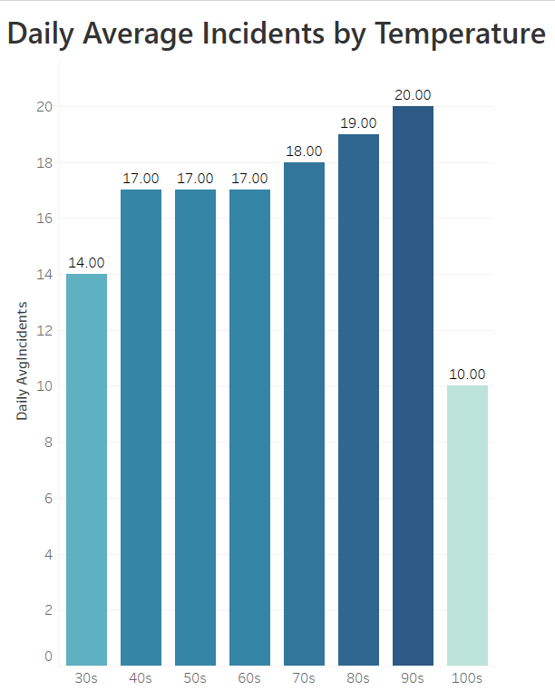

Slide 17
Vehicle Theft

Slide 18
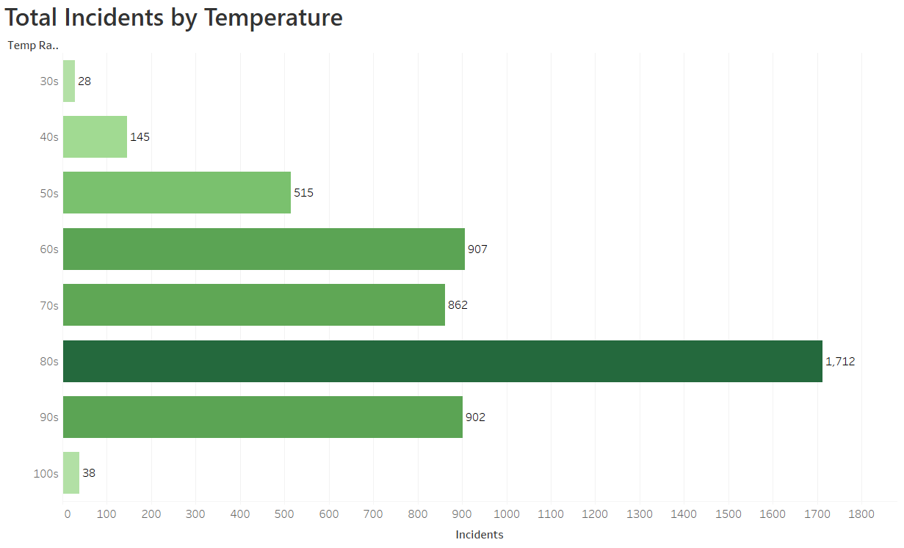

Slide 19
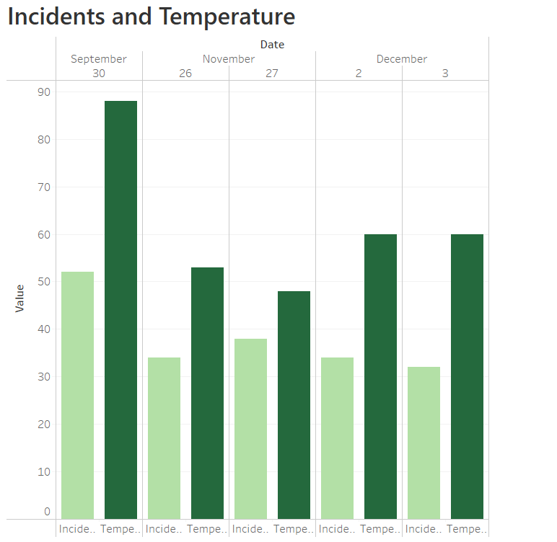


Slide 20
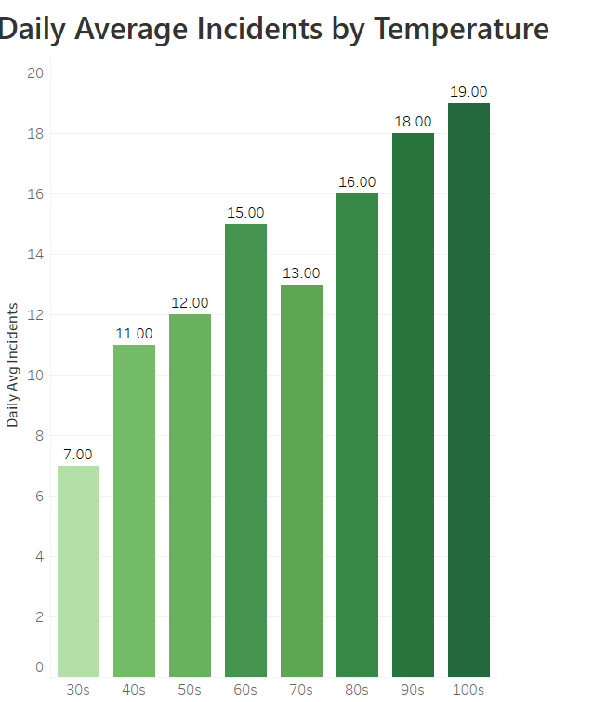

Slide 21
Assault-Fear of Bodily Injury

Slide 22
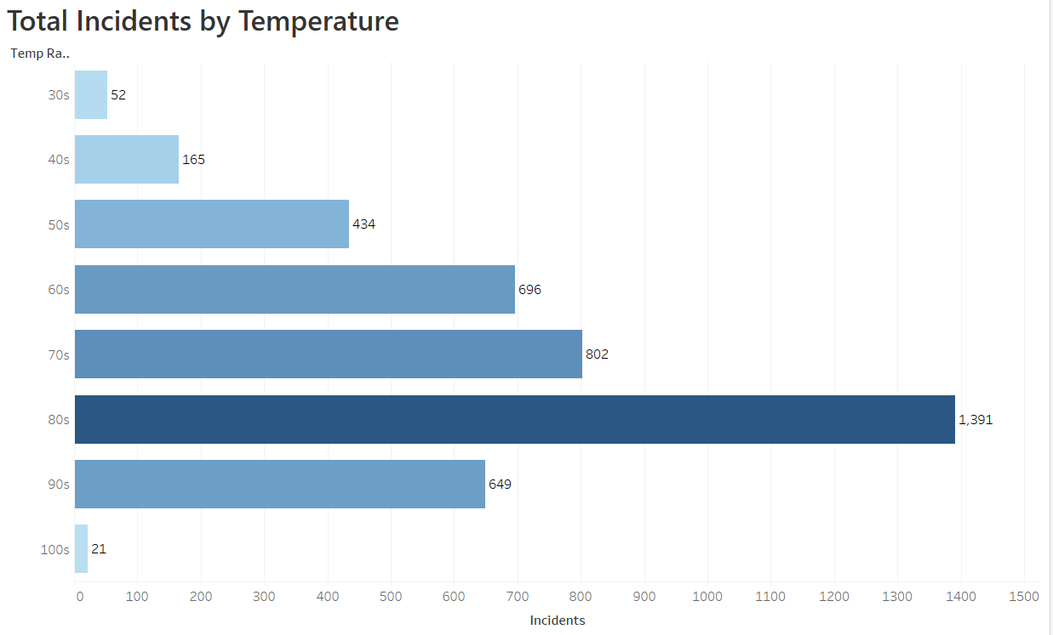

Slide 23
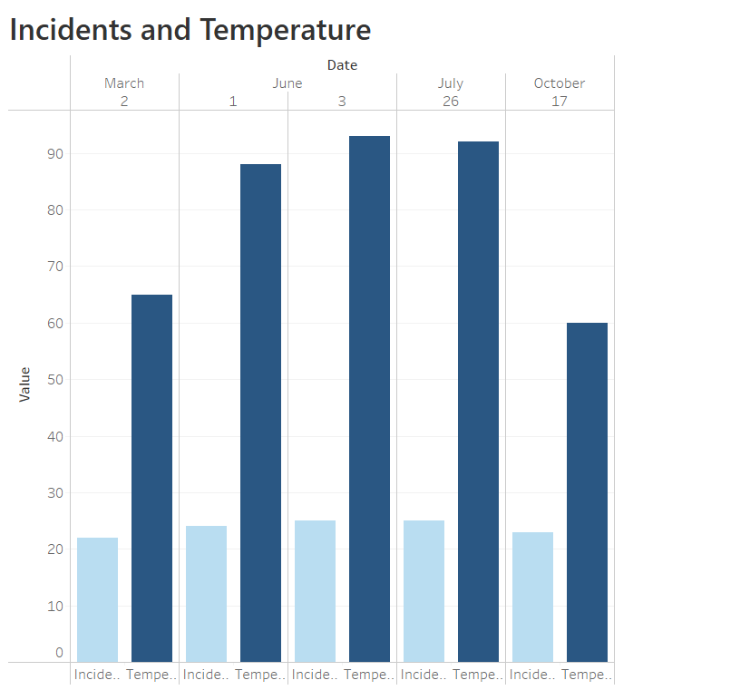


Slide 24
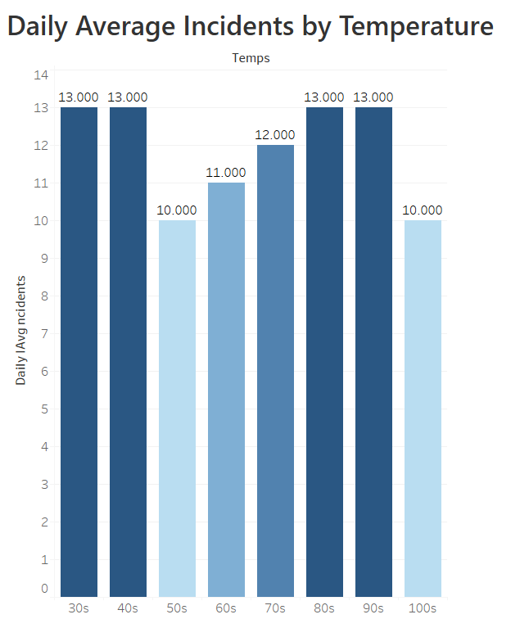

Slide 25
Damage of Private Property

Slide 26
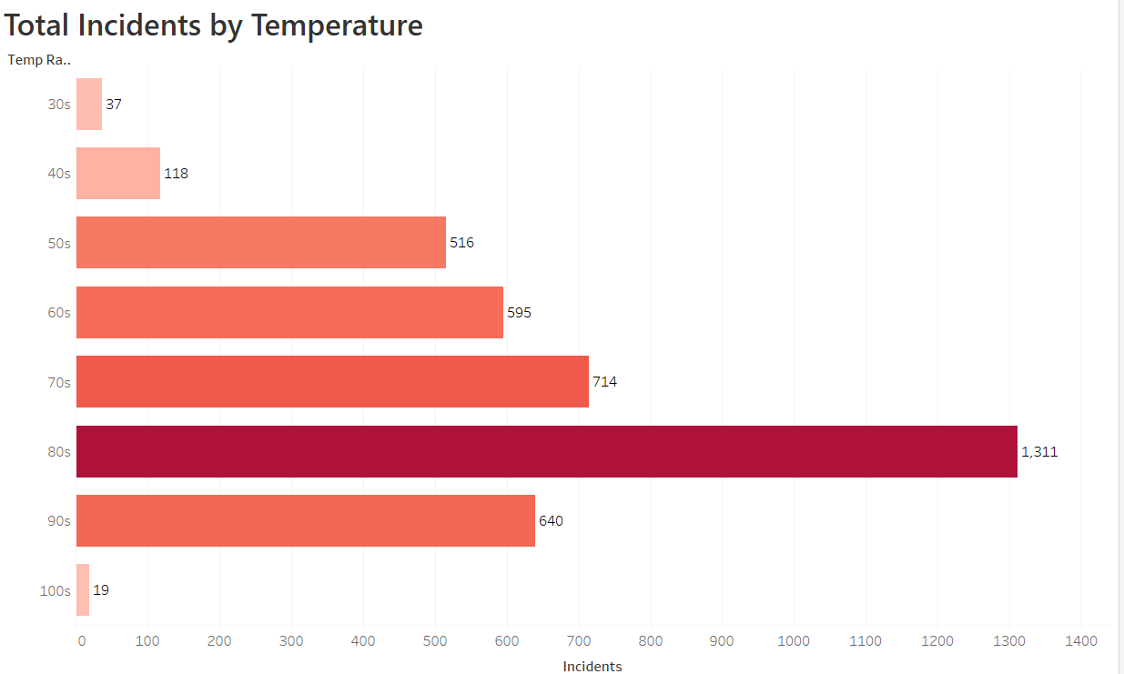

Slide 27
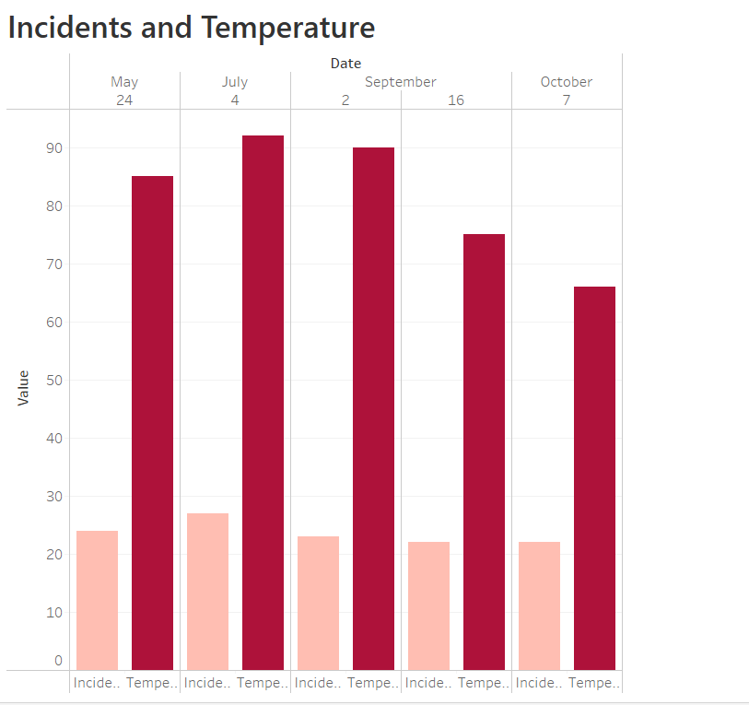

Slide 28
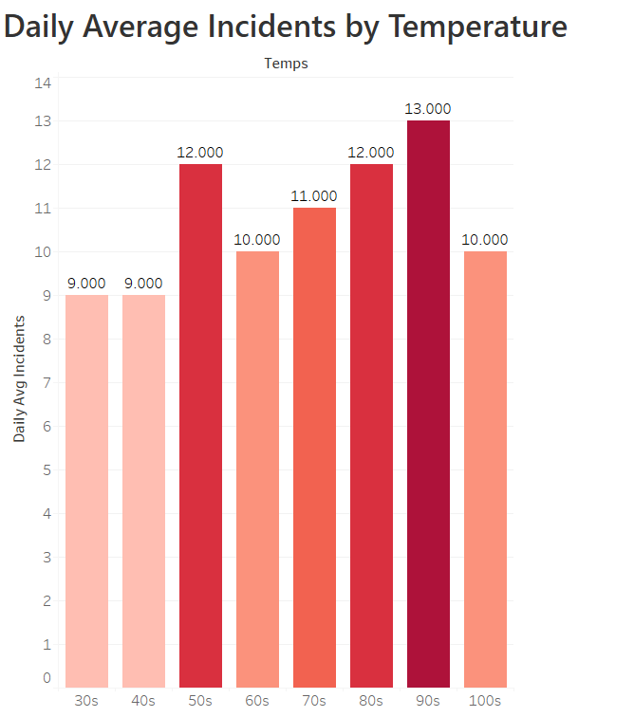

Slide 29
Examination of Nashville’s Top 5 Crimes and Temperature

Slide 30
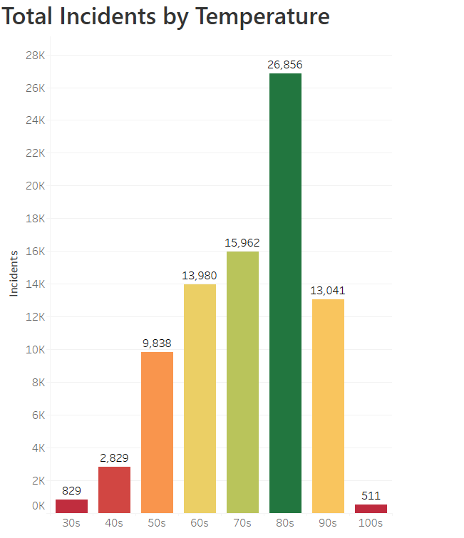

Slide 31
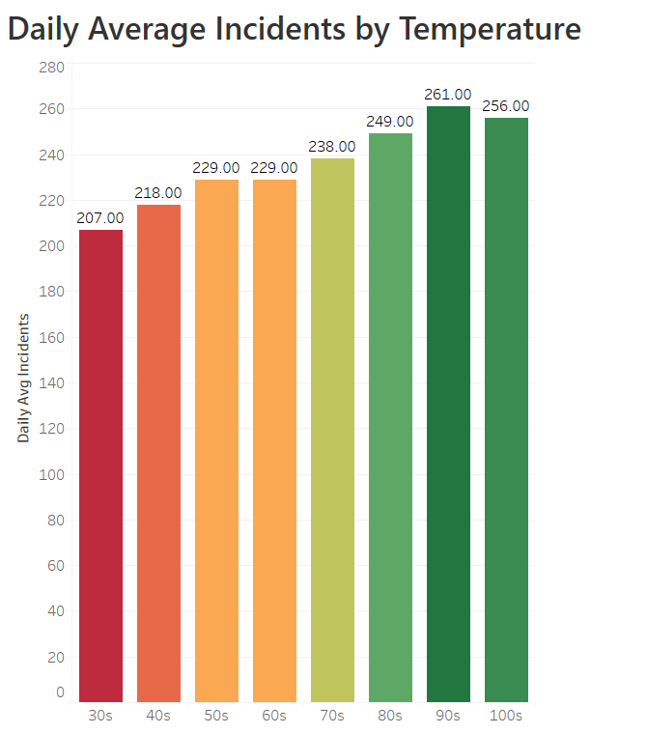

Slide 32
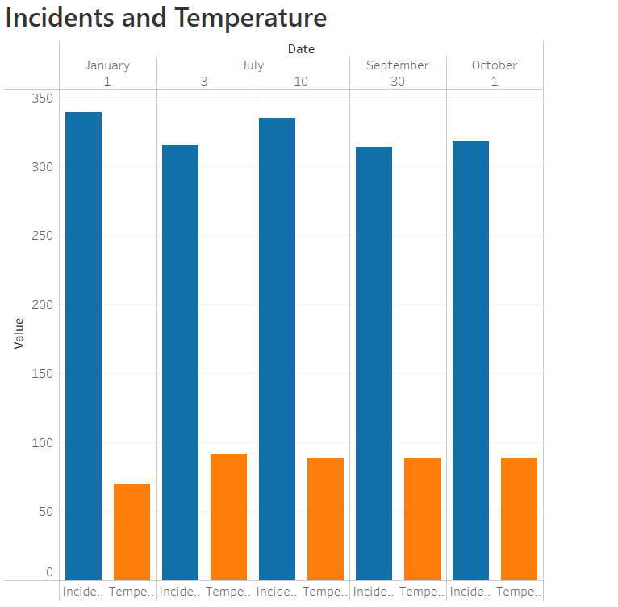

Slide 33
In Conclusion…
Crime (violent and non-violent) occurs in warmer temperatures.
Crime occurs more often when the temperatures are in the 80s.
Crime occurs less during extreme cold or hot temperatures.

