Slide 1
Agenda
Introduction & Objectives
Criminal Incidents, Recorded Offences (Antoinette)
Victim Reports & Family Incidents (Jacqueline)
Crime status & Police Service Areas (Kelvin)
Victoria Crimes Trends from September 2012 to 2021 (Anh)

Slide 2
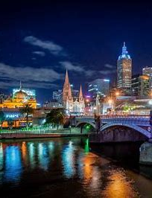
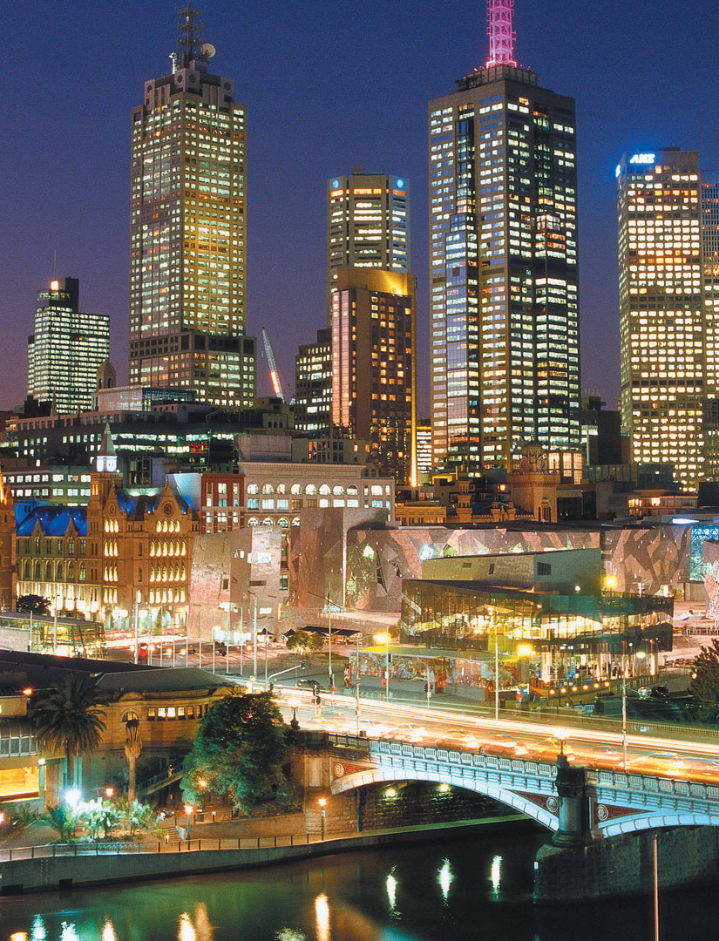
How are police coping with criminal incidents?
CRIMINAL INCIDENTS
Over the LAST Ten Years

Slide 3
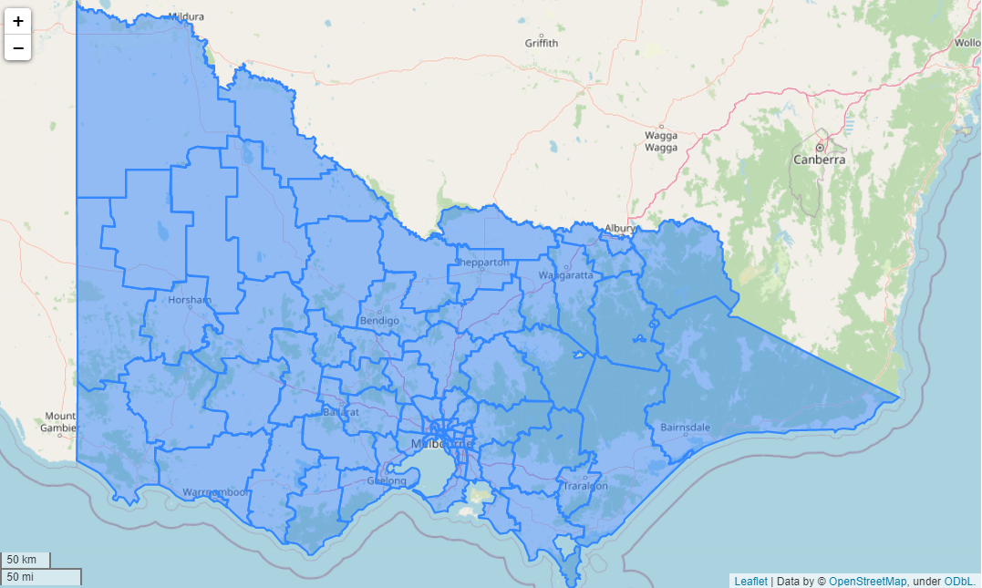
Local government areas (LGAs)
The 79 Victorian LGAs: are classified as cities (34), shires (38), rural cities (6) and boroughs (1).

Slide 4
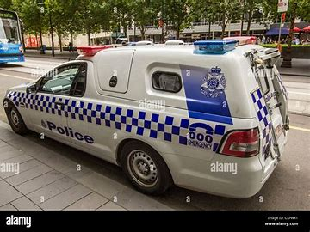
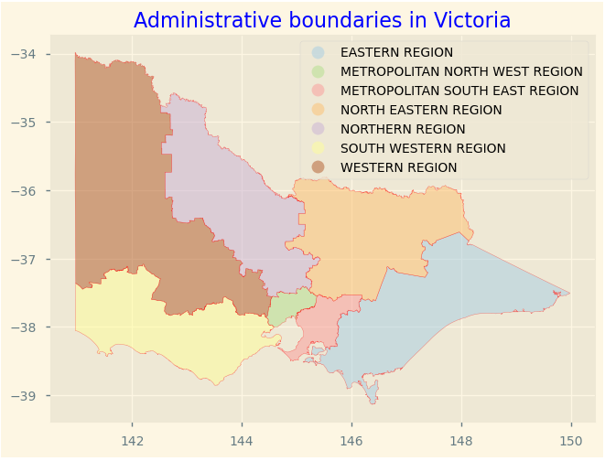
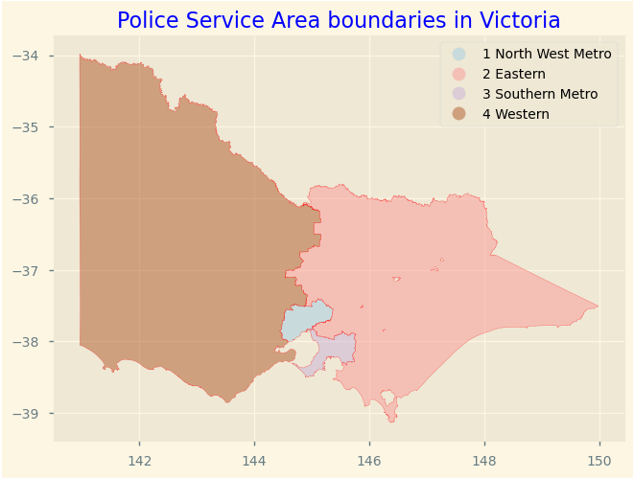
Where are Police Service Areas?
Notes:
There are too many LGA’s, those must be allocated into seven administrative regions for ease of referencing
For more simplicity and better service, the police further group LGA into only four regions

Slide 5
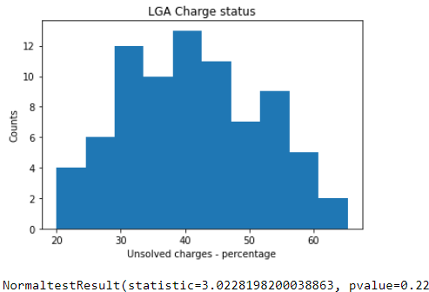
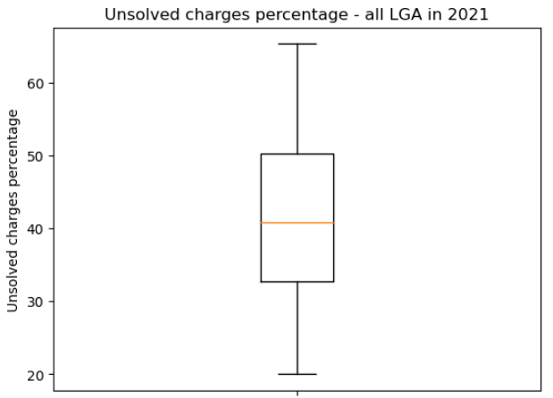
Data is normally distributed, no outliners identified
Unsolved charge percentage - 2021
Notes:
For purpose of understanding progress of a criminal case, criminal charges statuses are grouped into two main categories, solved or unsolved.
But we pick unsolved charge to examine how efficient..
We took a snapshot of criminal incident unsolved charge status in 2021 and concluded the data is normal distributed and there are no outliners.

Slide 6
Unsolved charge percentage - 2021
Mean unsolved: 41.5%
Median unsolved: 40.8%
Standard deviation: 10.4%
68% of LGA has unsolved charge percentage between 31.1% and 51.9% 95% of LGA has unsolved charge percentage between 20.7% and 62.3% 99.7% of LGA has unsolved charge percentage between 10.3% and 72.7%
Notes:
On average, a LGA has unsolved charges rate of 41.5% with a standard deviation of 10.4%.
95% of LGA has unsolved charge percentage between 20.7% and 62.3%

Slide 7
Top vs bottom 5 LGA in 2021
Ranking | Local Government Area | Incidents Recorded | Total Incidents | Unsolved Status Percentage
1 | Swan Hill | 362 | 1810 | 20.00
2 | Southern Grampians | 172 | 780 | 22.05
3 | Ararat | 259 | 1134 | 22.84
4 | Wangaratta | 395 | 1631 | 24.22
5 | Northern Grampians | 233 | 879 | 26.51
... | ... | ... | ... | ...
75 | Bayside | 2007 | 3435 | 58.43
76 | Glen Eira | 3276 | 5440 | 60.22
77 | Maribyrnong | 4180 | 6903 | 60.55
78 | Boroondara | 3473 | 5535 | 62.75
79 | Queenscliffe | 47 | 72 | 65.28

Slide 8
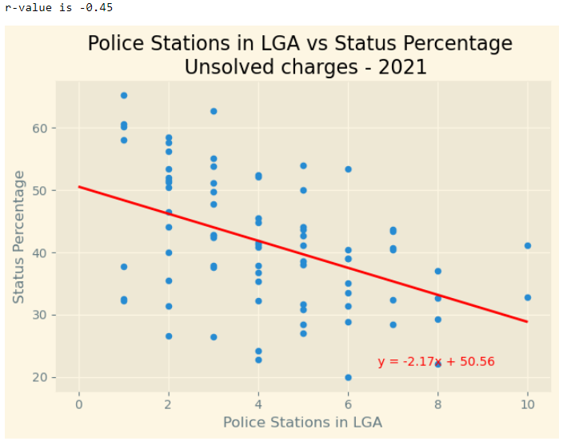

More police stations in each LGA, the lower the unsolved charge percentage
Standard error r² is 20.25%
Notes:
In 2021, there’s a medium negative correlation between number of police station in each LGA and percentage of unsolved charge (r-value is -0.45). The more police station a LGA has, the less is charge status percentage

Slide 9
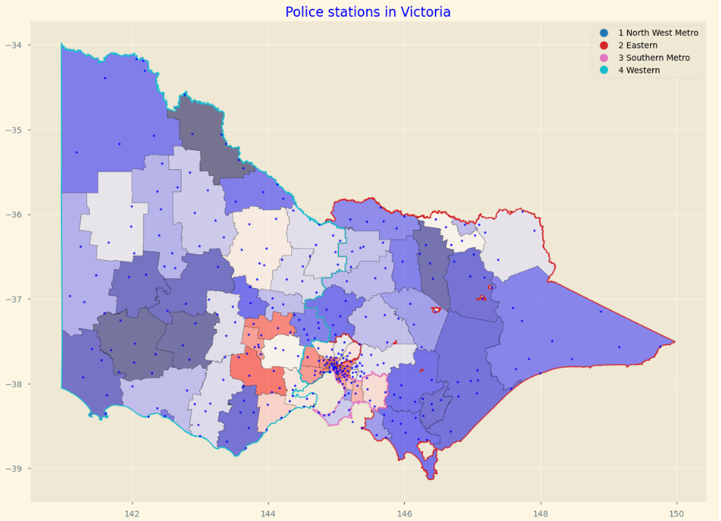

Notes:
building more polices closer to the center metropolitan

Slide 10
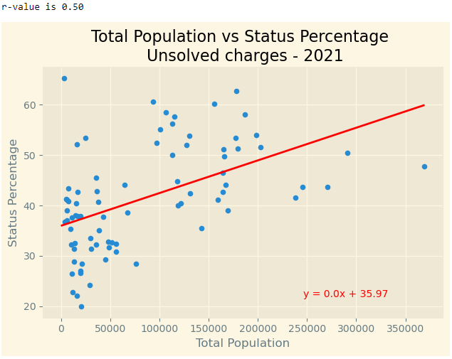

As the population increases in a LGA, the higher the percentage of unsolved charges
Standard error r² is 25%

Slide 11
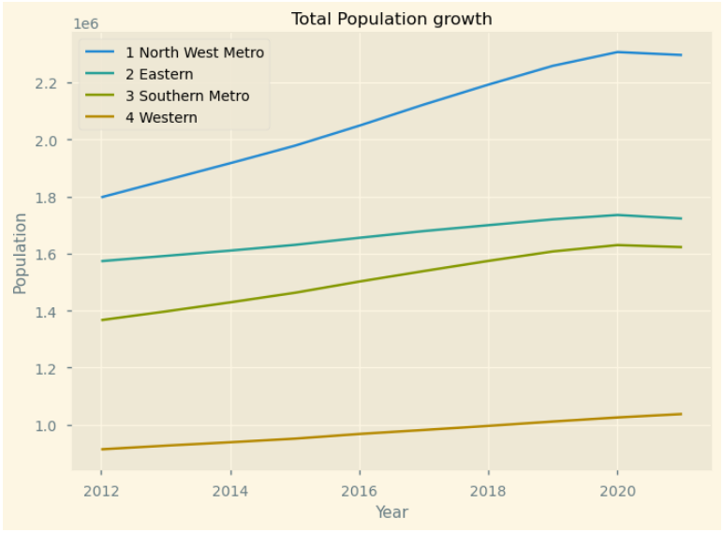
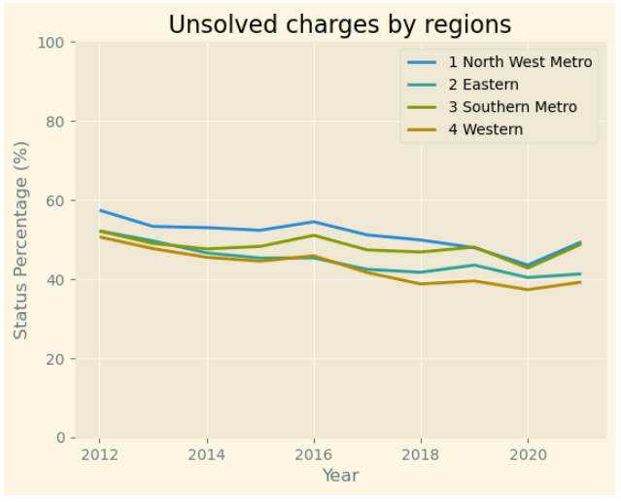


Time series analysis over 10 years
Notes:
LGAs dataset are grouped into four PSA regions for this analysis
In for each region, unsolved charge percentage, however, showed decreased in trend despite the increase in population.
Especially for North West metropolitan region, the population growth rate was higher, but the unsolved charge percentage reduced at a little higher rate compared to other regions.
On the other hand, Southern metropolitan with lower population growth rate compared to North Western metropolitan, but the unsolved charge percentage reached to equivalent level in last three years.

Slide 12
Agenda
Introduction & Objectives
Criminal Incidents, Recorded Offences (Antoinette)
Victim Reports & Family Incidents (Jacqueline)
Crime status & Police Service Areas (Kelvin)
Victoria Crimes Trends from September 2012 to 2021 (Anh)

