Slide 1
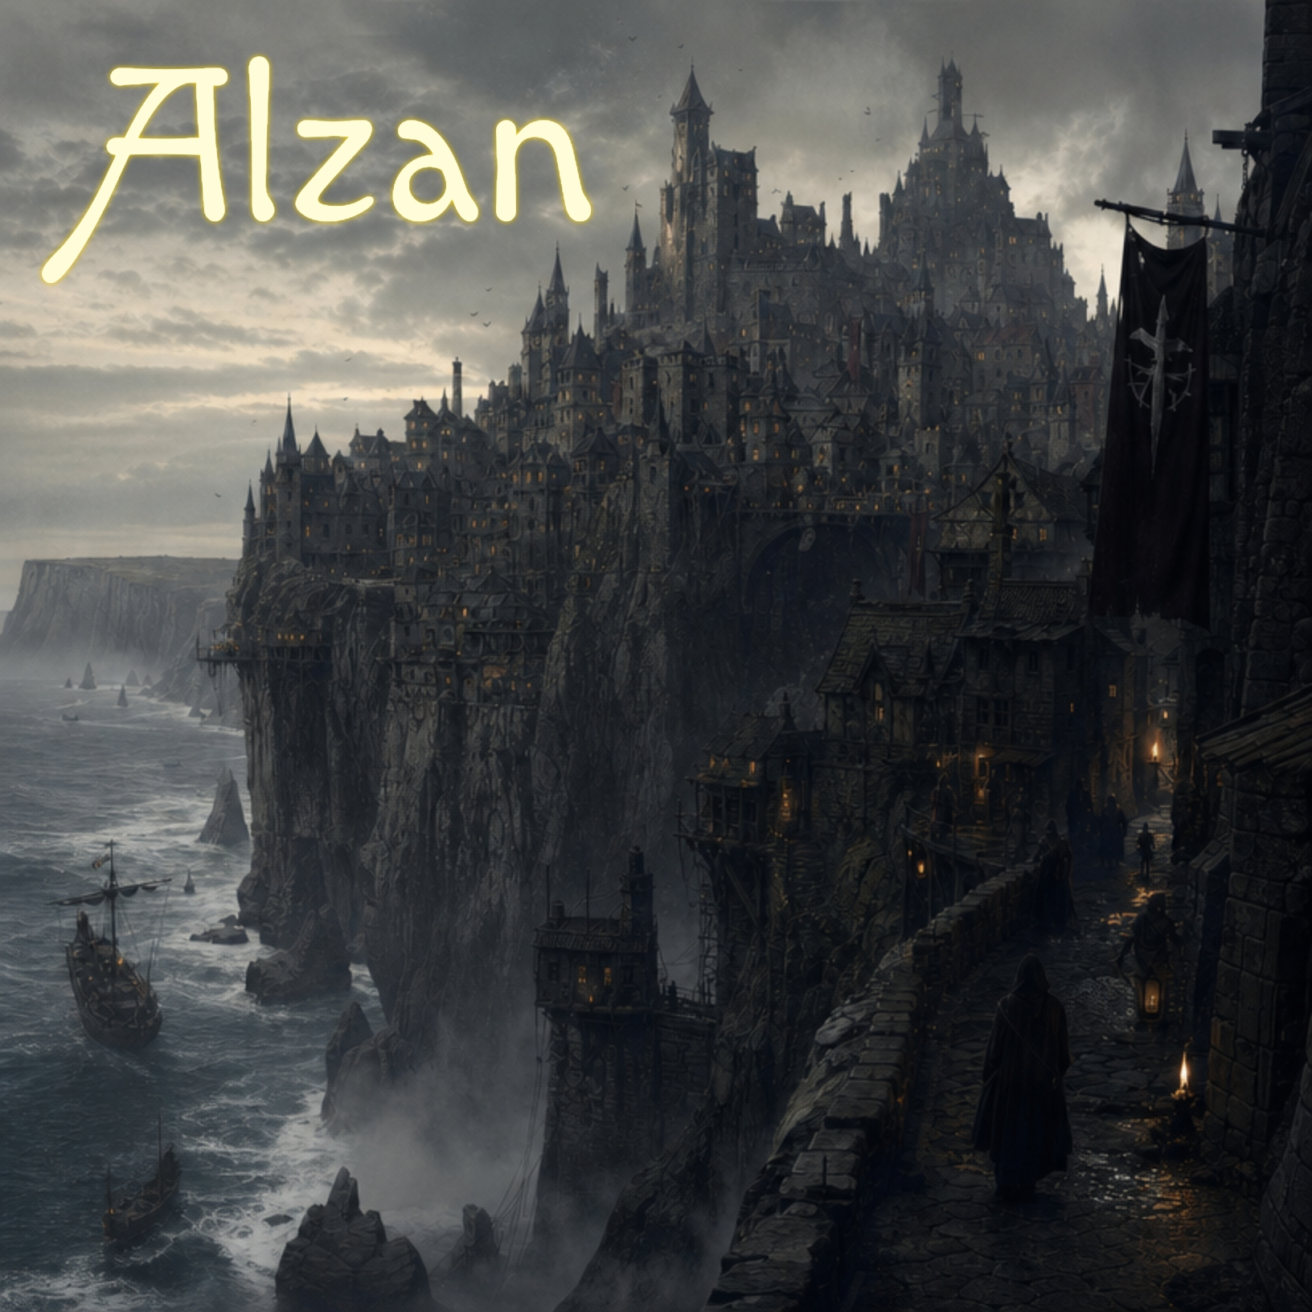

Slide 2

City of Alzan
Original game by Trevor Toms
Unfortunately, the city is surrounded by extremely high walls, and so you must find a way to scale them.
Apple II 64K version
© 2026, Brutal Deluxe Software
Antoine Vignau & Olivier Zardini
Visit brutaldeluxe.fr
The plot takes place in a fictitious city named Alzan, which is built on top of the sea cliffs, and is inhabited by thieves and cut-throats.
Your quest is to find a way out of the city before they grab you, or before the plague takes hold of you.

Slide 3
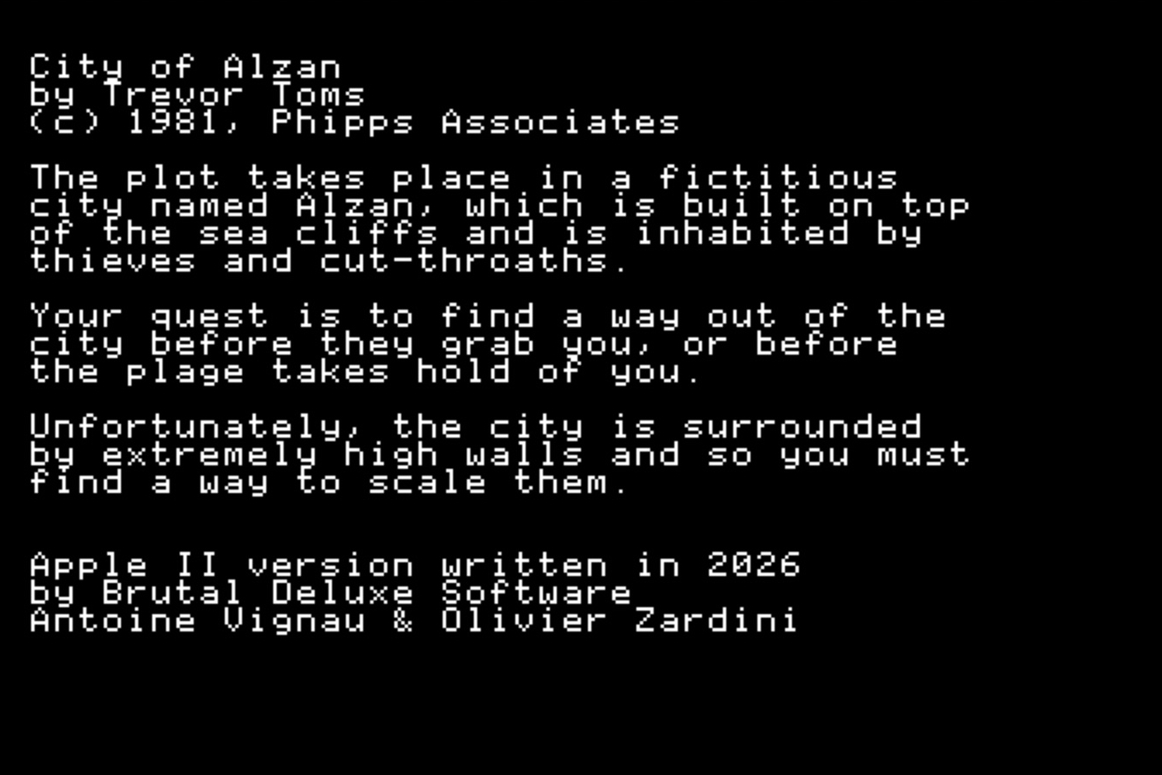
How to play?
Insert the diskette into the disk drive and turn on your computer.
After a few seconds, the title screen is displayed, and a music score is played.
Press a key to play.

Slide 4
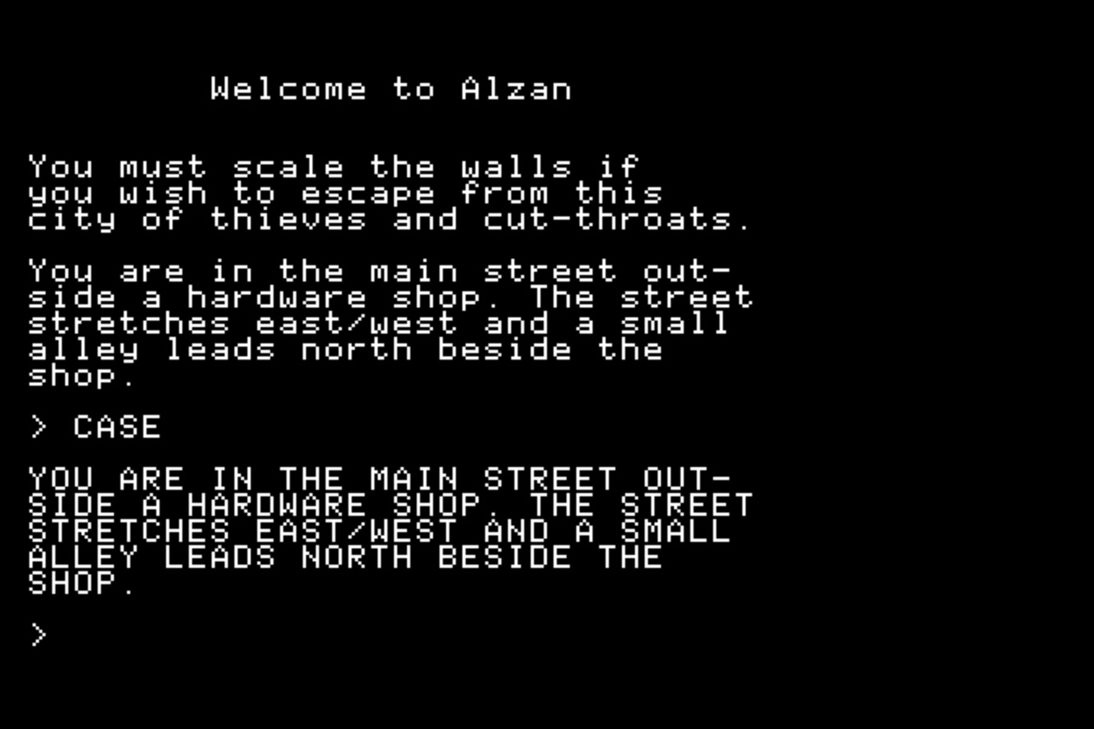
Vocabulary
The parser recognizes a verb and a noun. You can move by entering the following commands:
North, South, East, West, Up, Down
The other commands are yet to be found.
Type CASE to switch between lower- and upper- case display. The game sets the right case at boot time.

