Slide 1
Career Readiness: What Students See vs. What Supervisors See
Debrief: Career Readiness Survey Analysis Antoine Ward, MPH

Slide 2
The Question We Asked
Do students and their workplace supervisors see student career readiness the same way?
~840 students rated themselves on 22 competencies
~1,000 supervisors rated students on the identical 22
Competencies roll up to 7 NACE career readiness dimensions
Rating scale: 1–4
Same questions, two vantage points, so every disagreement is a perception gap we can measure.

Slide 3
The Headline Finding
Students under-rate themselves
on all seven dimensions.
Not overconfidence: a confidence gap. The opposite of what the conventional wisdom predicts.

Slide 4
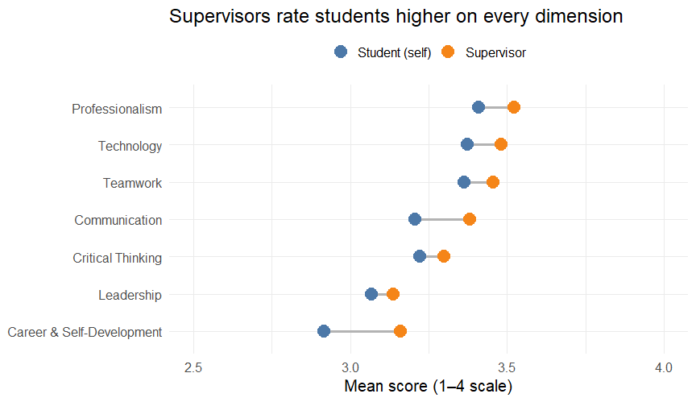
Self vs. Supervisor by Dimension

Slide 5
The Full Ranking
Dimension | Student mean | Student rank | Supervisor mean | Supervisor rank
Professionalism | 3.410 | 1 | 3.521 | 1
Technology | 3.373 | 2 | 3.480 | 2
Teamwork | 3.364 | 3 | 3.456 | 3
Critical Thinking | 3.223 | 4 | 3.300 | 5
Communication | 3.207 | 5 | 3.381 | 4
Leadership | 3.069 | 6 | 3.137 | 7
Career & Self-Development | 2.917 | 7 | 3.160 | 6
Strongest to weakest, side by side
The order barely changes between raters. Professionalism and Teamwork sit at the top for both; Leadership and Career & Self-Development sit at the bottom.

Slide 6
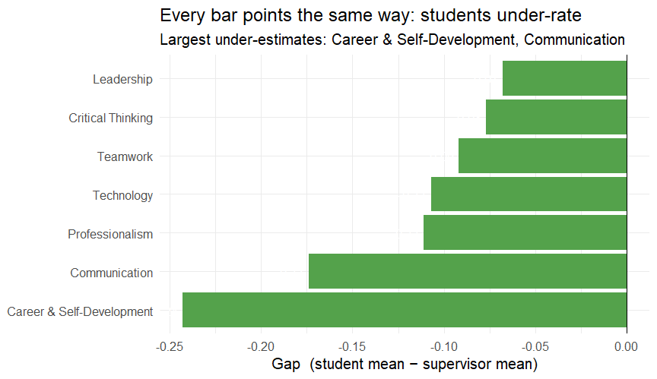
Where the Gap is Largest

Slide 7
The Numbers Behind the Gaps
Dimension | Student | Supervisor | Gap | Cohen’s d
Career & Self-Development | 2.92 | 3.16 | -0.24 | -0.29
Communication | 3.21 | 3.38 | -0.17 | -0.22
Professionalism | 3.41 | 3.52 | -0.11 | -0.13
Technology | 3.37 | 3.48 | -0.11 | -0.13
Teamwork | 3.36 | 3.46 | -0.09 | -0.12
Critical Thinking | 3.22 | 3.30 | -0.08 | -0.09
Leadership | 3.07 | 3.14 | -0.07 | -0.08
Every row reads student under-rates: the pattern is perfectly consistent, even where the gap itself is small.

Slide 8
Two Different “Weakest” Dimensions
Vantage point | Weakest dimension | Score
Students (self) | Career & Self-Development | 2.92 / 4
Supervisors | Leadership | 3.14 / 4
That divergence is the insight:
Leadership is weakest by external assessment: the clear skill-development target
Career & Self-Development combines students’ lowest self-rating and their largest under-estimate (−0.24): a confidence & awareness target, not just a skill one

Slide 9
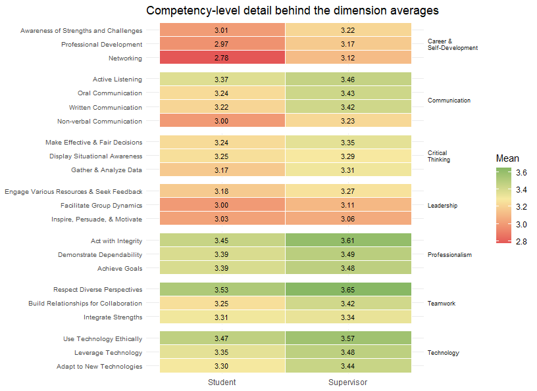
Inside the Dimensions: All 22 Competencies

Slide 10
What the Heatmap Adds
Dimension averages can hide uneven competencies. Three details worth naming:
Act with Integrity and Demonstrate Dependability are the highest-rated competencies overall: the engine behind Professionalism’s top ranking.
Within Leadership, the weakness is not uniform: Inspire, Persuade & Motivate sits lower than Engage Resources & Seek Feedback, so leadership programming should target influence skills specifically, not leadership generically.
Networking is among students’ lowest self-ratings, consistent with the Career & Self-Development confidence story.

Slide 11
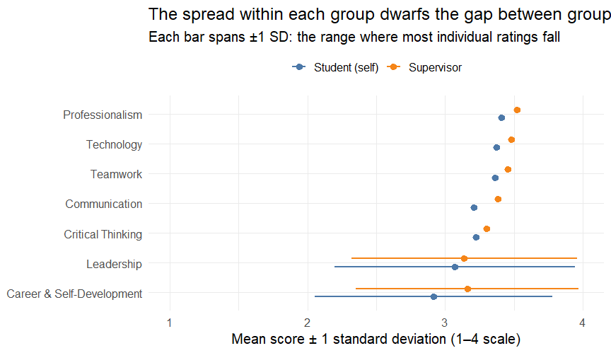
Individuals Vary More Than Groups Differ

Slide 12
How Big Are These Gaps, Honestly?
Cohen’s d answers one question: “Is this gap large enough to matter, or just noise?” It rescales the raw gap by how spread out people’s scores naturally are: the spread you just saw. A 0.24-point gap on a tight, consistent dimension counts for more than the same 0.24 points where scores bounce around.
Rule of thumb:
Our largest gap (Career & Self-Development) is d = −0.29 (small). No dimension reaches 0.5.
Translation: students and supervisors are broadly calibrated. These gaps are monitor items, not crises, but their perfect directional consistency (7 of 7 negative) is a real pattern worth acting on regardless of size.

Slide 13
One Agreement Worth Noting
Rated by Mean (1-4) N Observer 3.521 1002 Student 3.410 841
Both groups rank Professionalism as the top strength (3.41 self, 3.52 supervisor). Agreement at the top says the assessment is coherent, which strengthens confidence in the gaps.

Slide 14
Recommendations
Build skills where supervisors see the need: Leadership (3.14/4). Prioritize facilitation, delegation, and peer-leadership practice inside experiential placements (e.g., rotate students through a project-lead role for at least one deliverable per placement).
Build confidence where students underclaim: Career & Self-Development. Students demonstrate more competence than they recognize; add structured self-assessment checkpoints and strengths-based reflection at the midpoint and end of each placement.
Close the calibration loop: structured supervisor feedback. The uniform under-rating suggests students rarely hear how supervisors rate them. Build a short mid-placement feedback conversation into every experiential learning opportunity; even 15 minutes moves the needle.
Track this survey longitudinally. Re-run it each term to see whether the gap narrows as feedback practices take hold, turning this one-time snapshot into a measure of program impact.

Slide 15
Methodology & Caveats
Pipeline: medallion lakehouse (Bronze → Silver → Gold) on Databricks; analysis reproducible in SQL, PySpark, and R
Unit of analysis: dimension scores averaged within respondent first; effect sizes count people, not survey items
Unpaired comparison: student and supervisor pools, not matched pairs; gaps describe group-level divergence, not individual miscalibration
Cross-sectional: associations, not causal claims
Scale note: Equity & Inclusion (8th NACE competency) was not surveyed

Slide 16
Questions
Code, data pipeline, and full write-up: github.com/antoinewrd1/career-readiness-analytics

