Slide 1
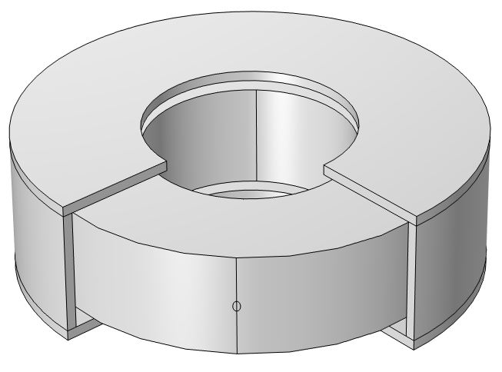
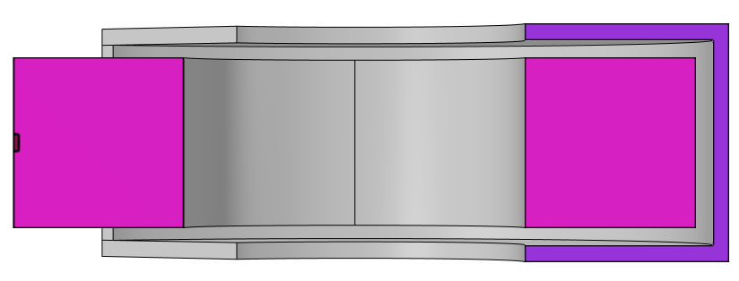
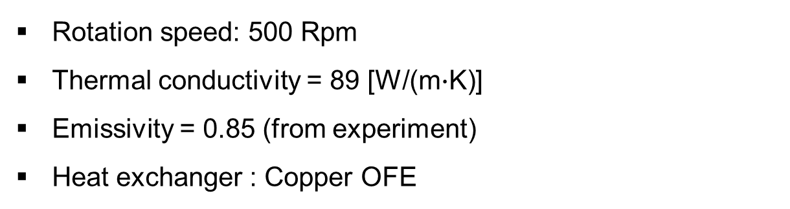
Graphite rotating beam dump
Rotation speed: 500 Rpm
Thermal conductivity = 89 [W/(m$∙$K)]
Emissivity = 0.85 (from experiment)
Heat exchanger : Copper OFE
420 mm
10 mm
200 mm
400 mm
100 mm
10 mm
140 mm
Heat

Slide 2
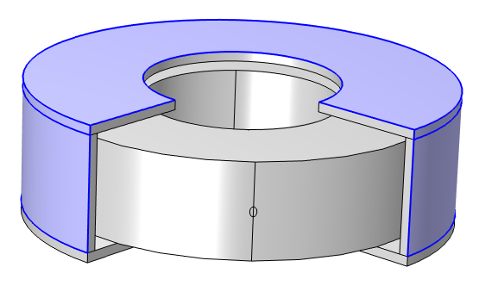

Conditions
All surface : Radiation heat transfer
Heat Deposited (40 kW)
Convection (h = 500 [$W/m^{2}∙K$])

Slide 3
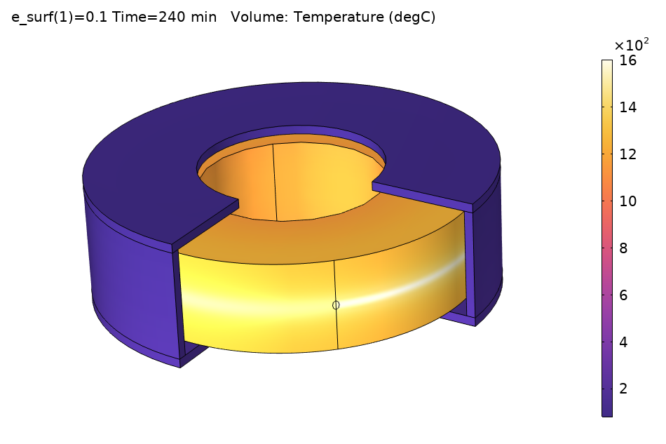
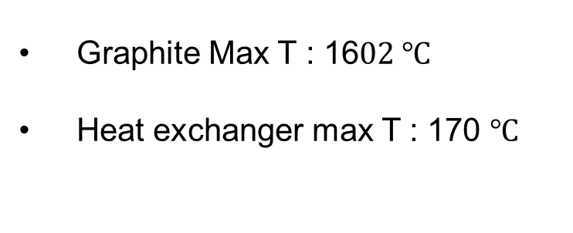
Temperature distribution results ($ε$ = 0.1)
Graphite Max T : 16$02 ℃$
Heat exchanger max T : 170 $℃$

Slide 4
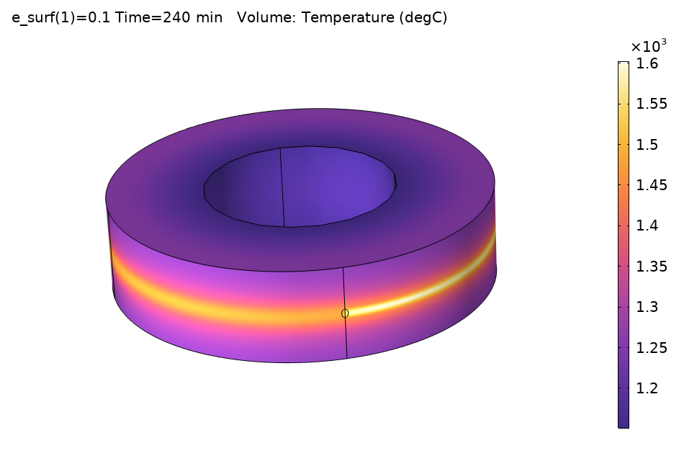
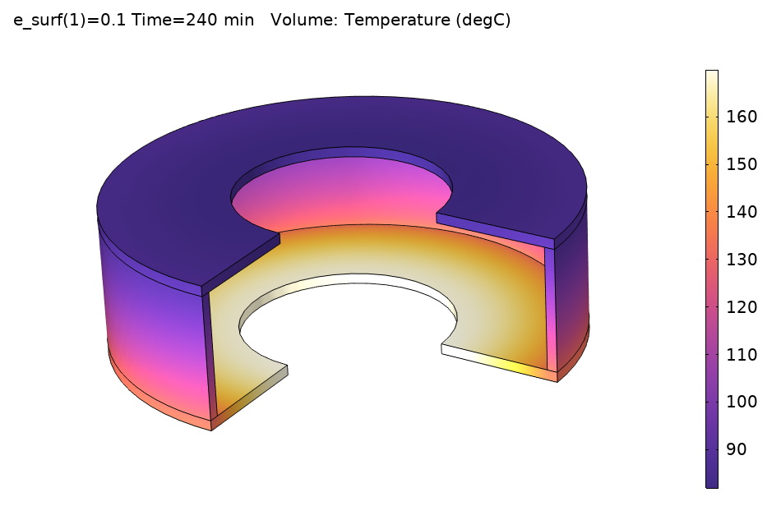
Temperature distribution results ($ε$ = 0.1)

Slide 5
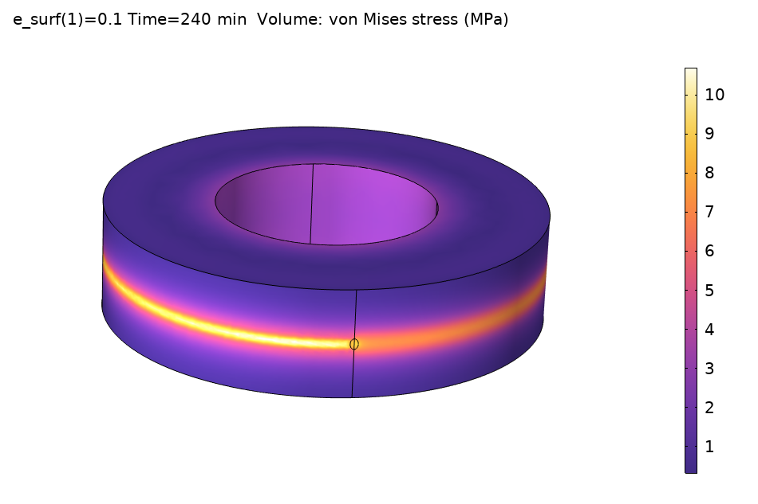
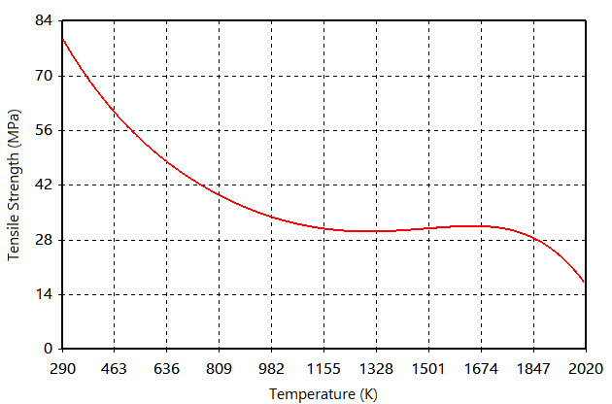
Thermal stress results ($ε$ = 0.1)
Max thermal stress: 10.7 MPa
Tensile strength from Graphite JTA

Slide 6
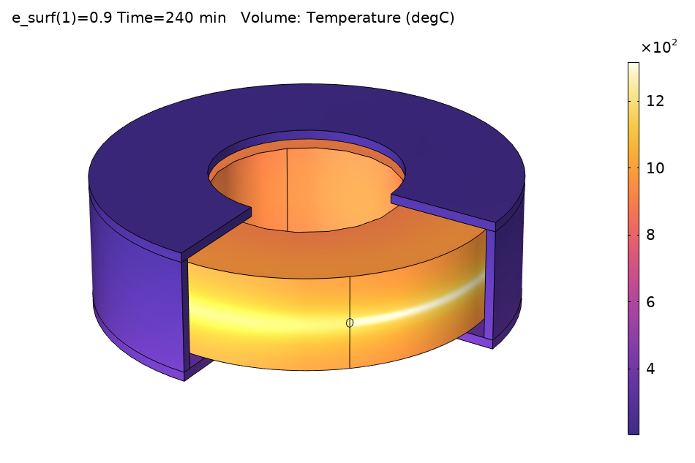
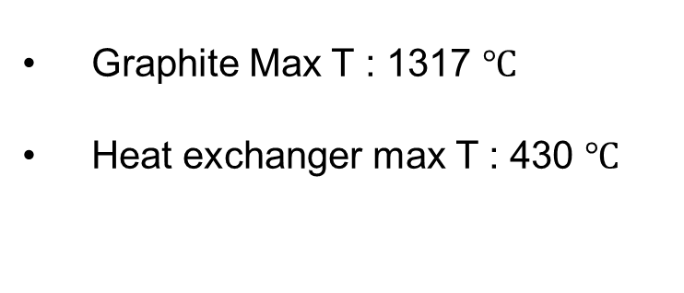
Temperature distribution results ($ε$ = 0.9)
Graphite Max T : 1317 $℃$
Heat exchanger max T : 430 $℃$

Slide 7
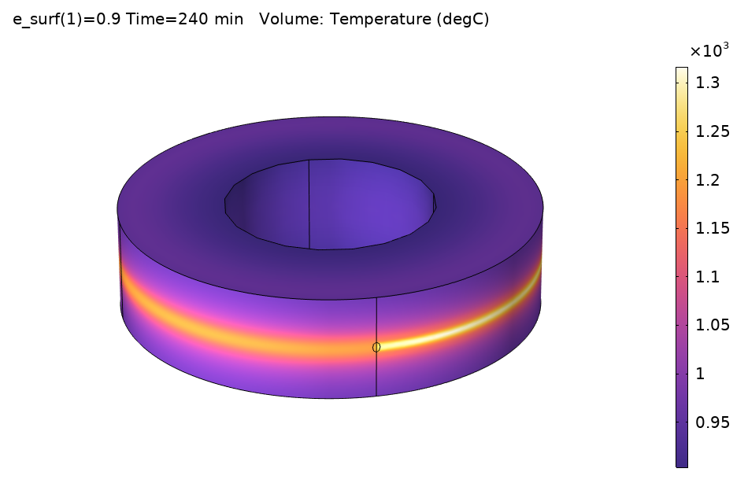
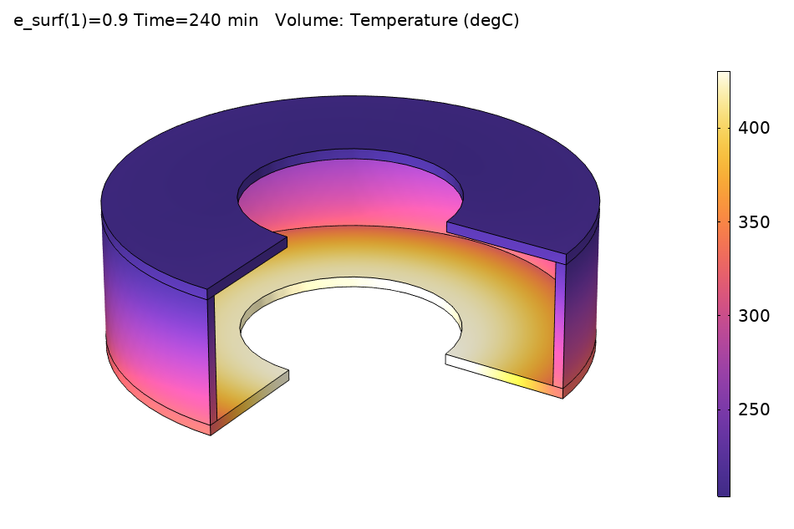
Temperature distribution results ($ε$ = 0.9)

Slide 8
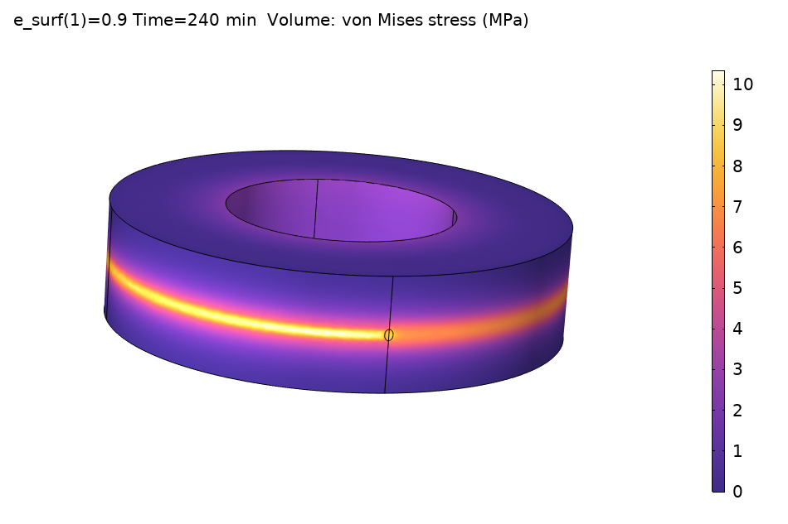
Thermal stress results ($ε$ = 0.9)
Max thermal stress: 10.3 MPa
Tensile strength from Graphite JTA

Slide 9
Further work
Size optimization to reduce heat exchanger T and Graphite MaxT
Fluid simulation to know the heat transfer coefficient
Noble design idea investigation
Realistic model design
Diameter : Nathan design
Thickness : 10 ~ 20 cm
Cooling : Side HXs
Actual depth profiles

