Slide 1
CFD Simulation of the Target Door for Water Temperature Limits
Geunhyeong Lee
5/5/2025

Slide 2

Overview
Target door CFD simulation was perform to know the water temperature limitation (< 100 $℃$)
Thermal load: 1~6 kW deposited power on the front door
Limitation: heat surface was assumed same heat distribution
Current heat exchanger performance was estimated by the COMSOL results
Remarks
Current heat exchanger would sustain by ~50 kW of primary beam power at 25% heat deposition
The detailed performance estimation should be coupled with target system heat deposition

Slide 3
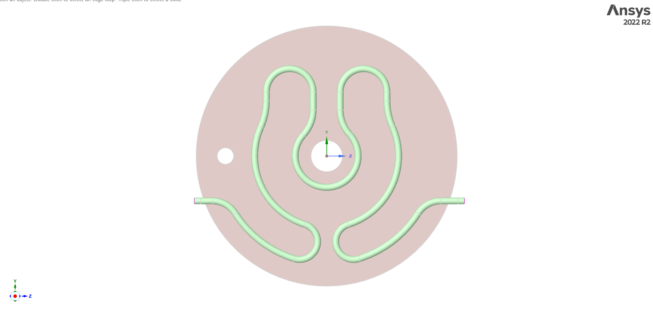
Simulation condition
Geometrical model
Unnecessary holes were removed
Fluid in
Fluid out

Slide 4
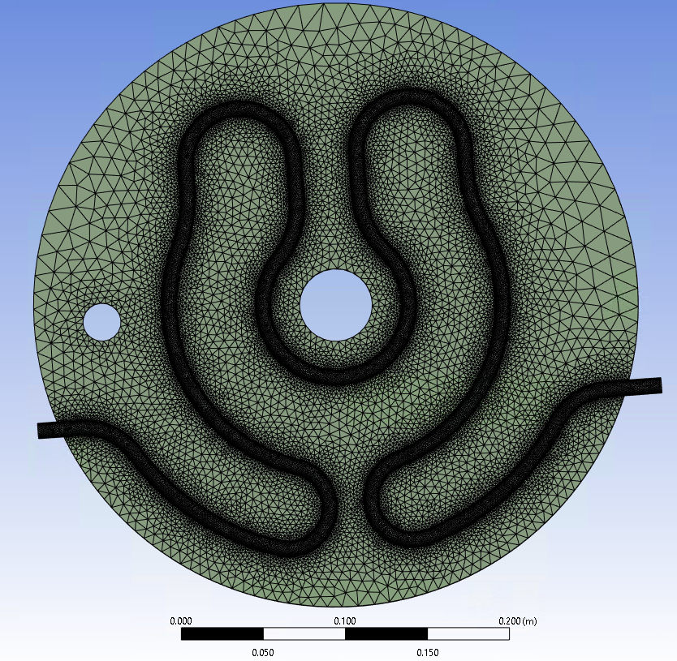
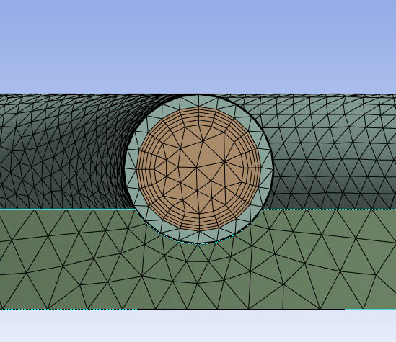
Simulation condition
Mesh
Using the default mesh in ANSYS Fluent
5 inflation layers were added to improve turbulent flow resolution
Min. Orthogonal Quality: 0.15
Max. Aspect Ratio: 18
Fluid path mesh
Overall mesh shape

Slide 5
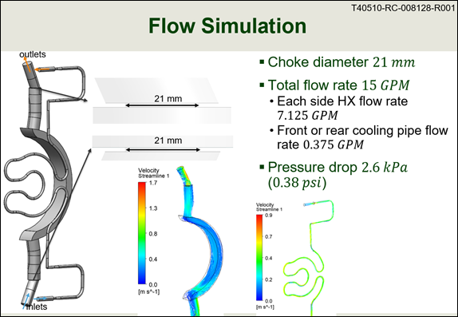
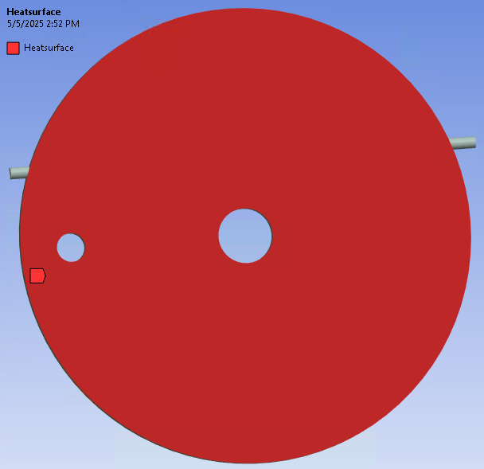
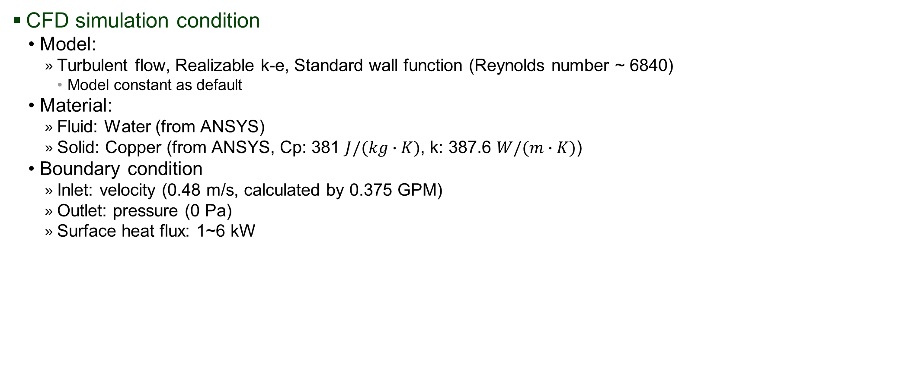
Simulation condition
CFD simulation condition
Model:
Turbulent flow, Realizable k-e, Standard wall function (Reynolds number ~ 6840)
Model constant as default
Material:
Fluid: Water (from ANSYS)
Solid: Copper (from ANSYS, Cp: 381 $J/(kg∙K)$, k: 387.6 $W/(m∙K)$)
Boundary condition
Inlet: velocity (0.48 m/s, calculated by 0.375 GPM)
Outlet: pressure (0 Pa)
Surface heat flux: 1~6 kW
Reference data

Slide 6
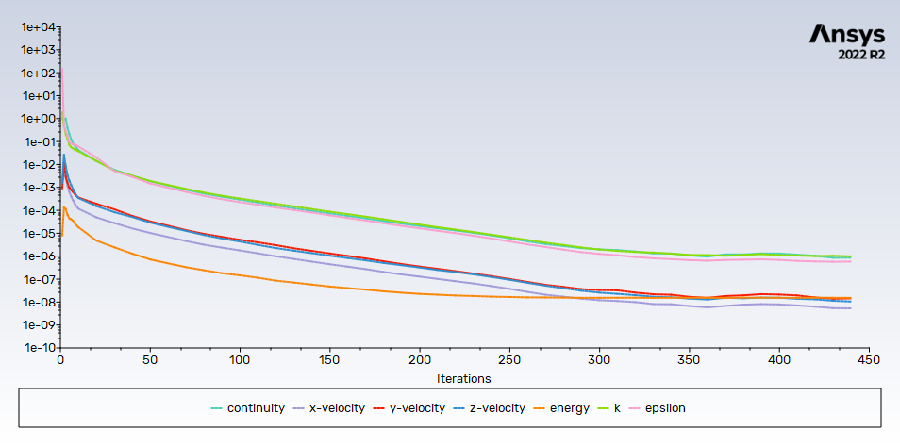
Simulation condition
Convergence condition: 1e-6 for all residuals, converged in ~440 iterations.

Slide 7
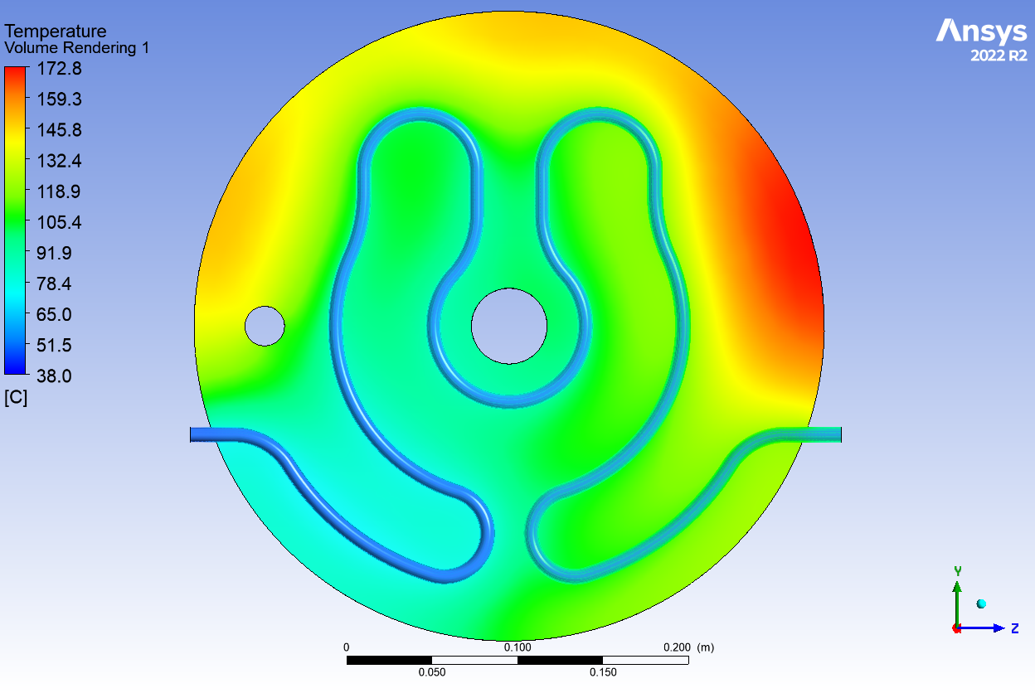
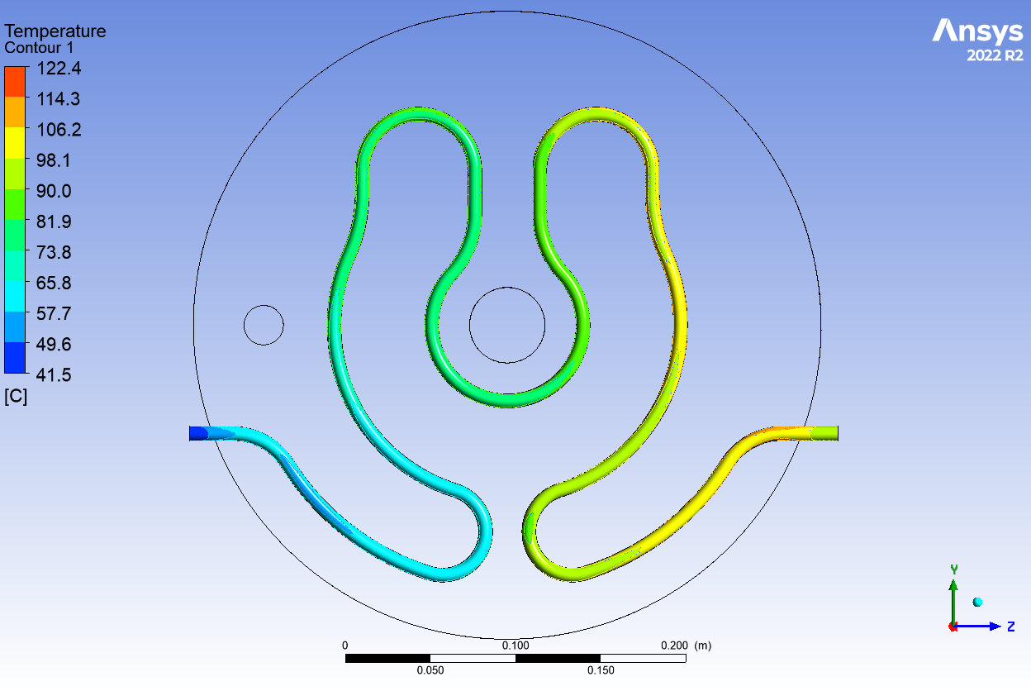
Simulation results
Temperature results at 4 kW

Slide 8
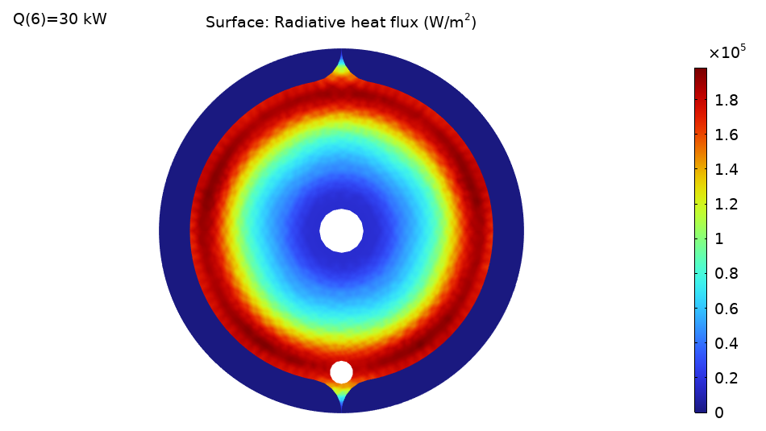

Target System Simulation Results (COMSOL)
Front door radiative heat flux calculated by COMSOL ($ε$ = 0.85 at all surface)
28.1 % heat deposited at the front door
for reference, 16.9 % heat deposited at the back door)
Radiative heat flux distribution on the front door at 30 kW heat deposition

Slide 9
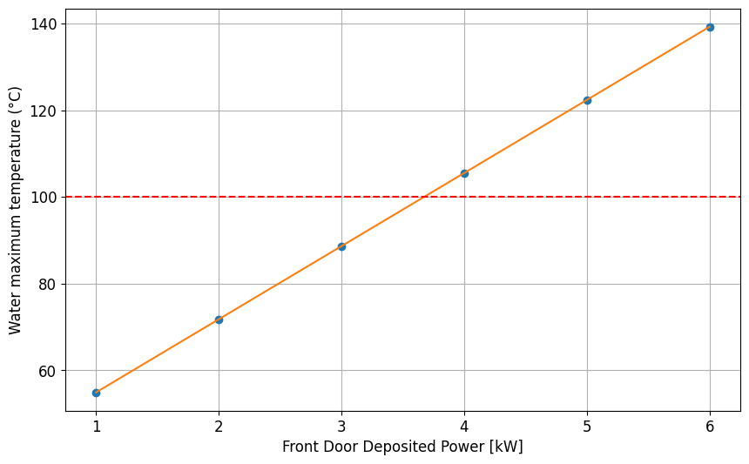


Conclusions
The CFD simulation for the target system front door was performed
The CFD results assumed uniform heat deposition on the door surface
The outer surface area receives more heat; this should be considered for accurate estimation
If the target deposition is 25% under the full coating condition, it could support a primary beam power of 52 kW before reaching a water temperature of 100 $℃$
T [$℃$] = 16.9Q [kW] + 38
3.67 kW

