Slide 1
LPCS Drift Tube Temperature Comparison
Geunhyeong Lee
10/30/2025

Slide 2
Introduction
The currently installed LPCS drift tube was analyzed by comparing the experimental data.
The simulation condition was given by Kei (20251020_CSS_spot_fukushima.pptx)
Details are in the appendix
Appendix1: Material propreties
Appendix2: Boundary conditions
Other simulation condition details (mesh independent, Gnielinski correction, flow conditions) in the previous calculation (“N:\leeg\Presentation\ LPCS_drift_tube_transient”)

Slide 3
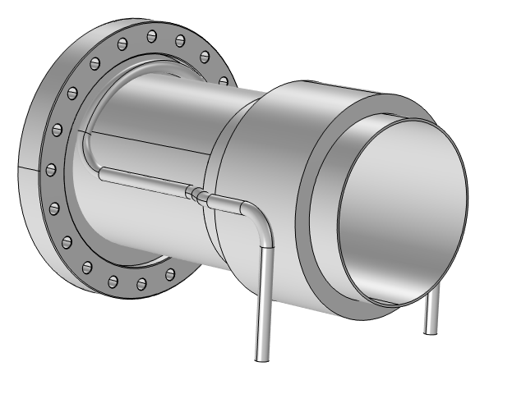
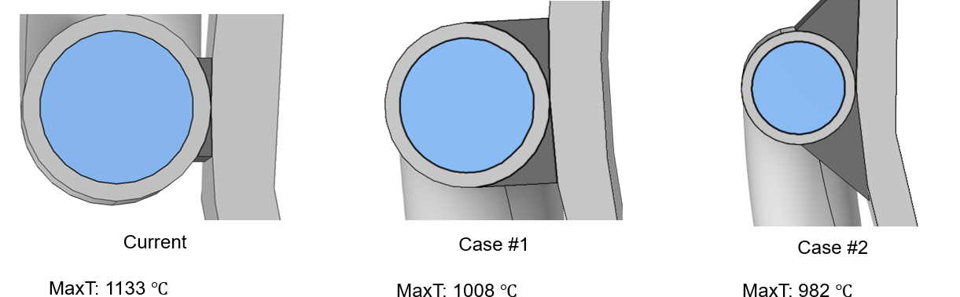
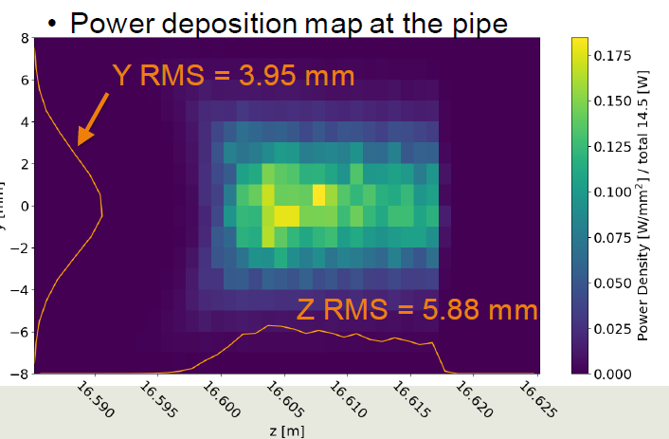

Variables
The temperature-dependent variables for current analysis
Power input
14.5 W
Beam size
$σ_{y}=3.95 mm, σ_{z}=5.88 mm$
Beam location
5 mm, 10 mm, 15 mm from the end of the pipe
Brazing thickness
< 15 % difference from previous analysis (340W power deposition)
Beam
20251020_CSS_spot_fukushima.pptx

Slide 4
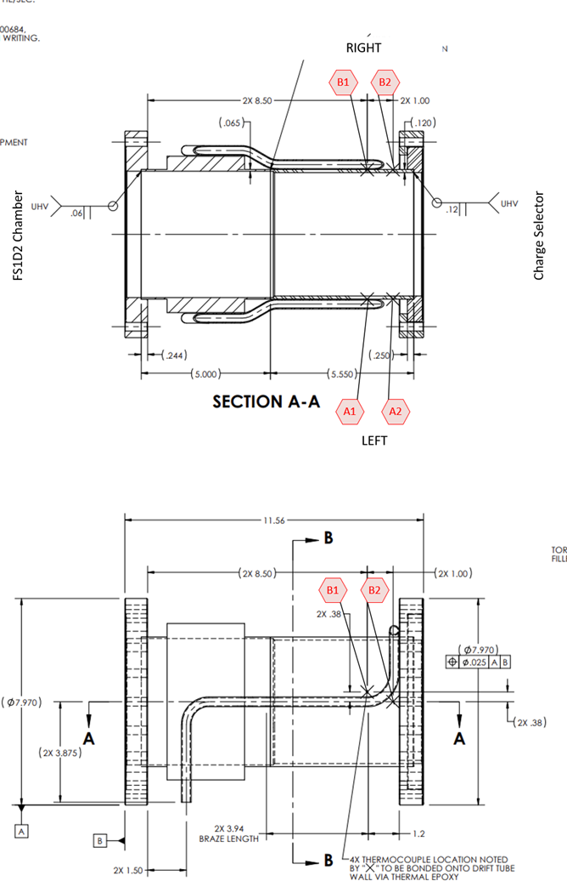
Measured point
4 temperature measurement sensors

Slide 5
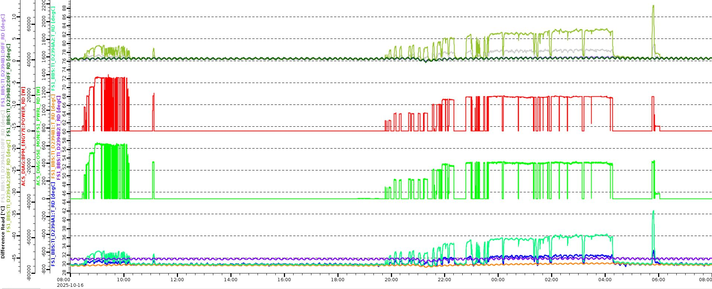
Experimental data
Temperature difference measurements
A1: 2.3 C, A2: 7 C
A2
A1

Slide 6
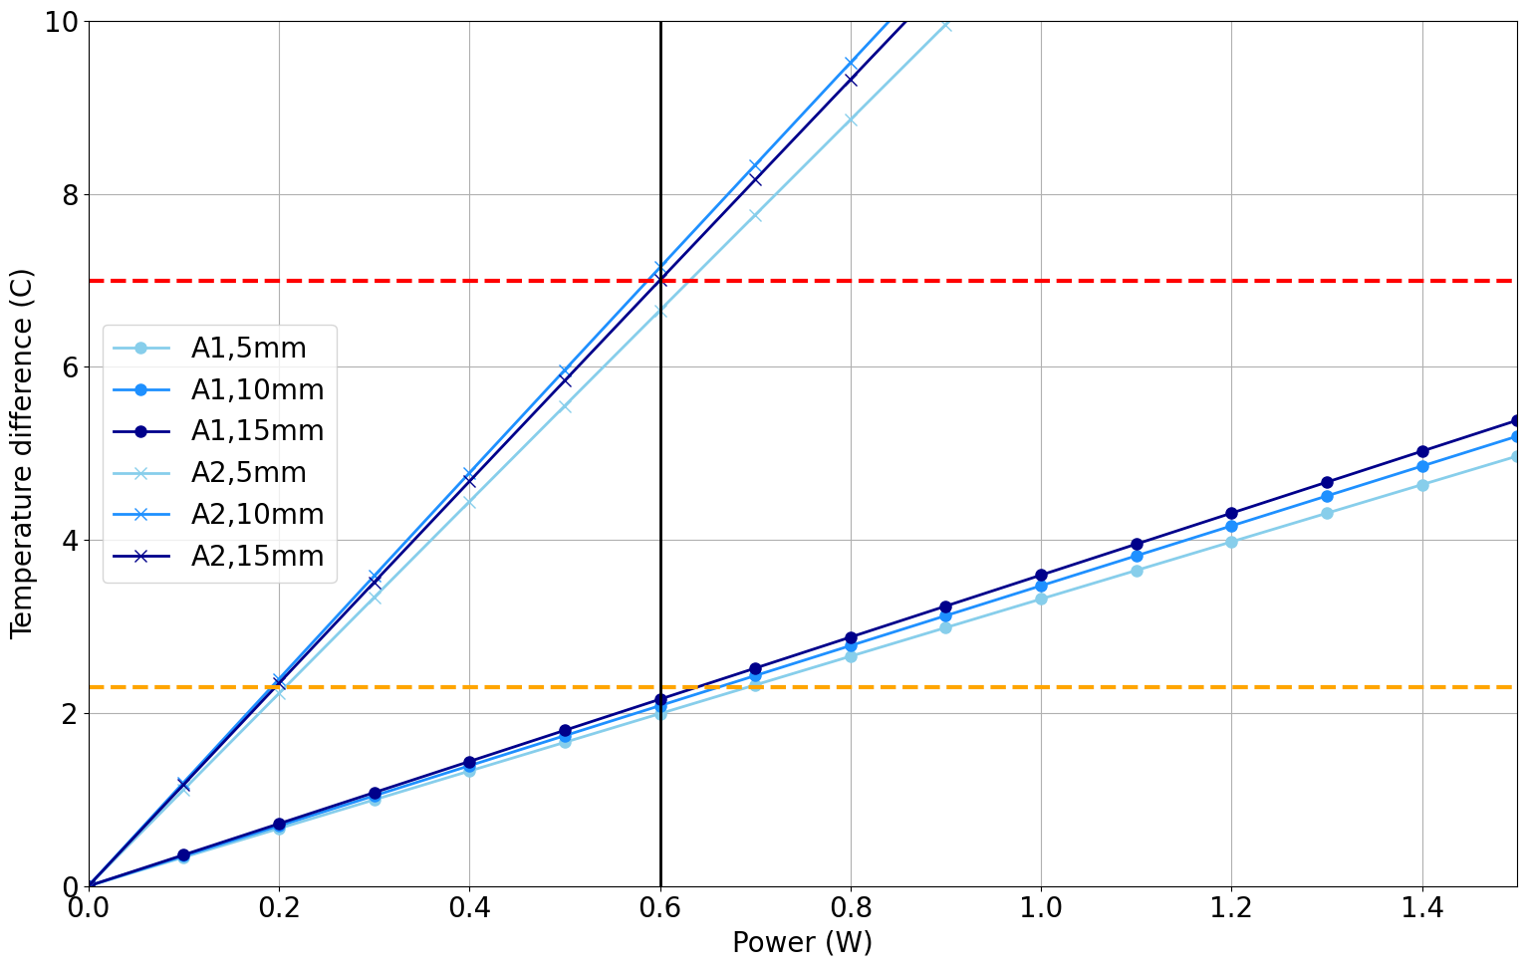
Simulation results
Simulation results
Power change at designated points (5mm, 10 mm, 15 mm from the end of pipe)
0
Match around 0.6 W
5 ~ 15 mm
A2 (T = 7 C)
A1 (T = 2.3 C)

Slide 7
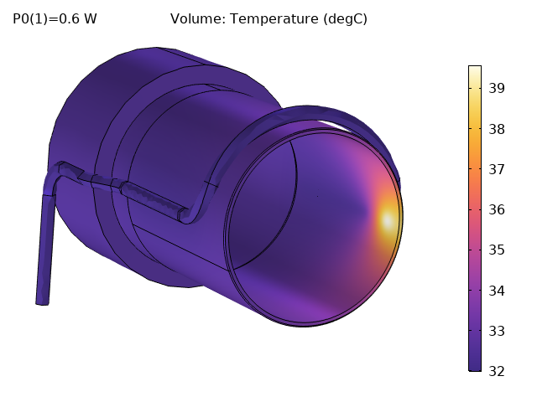
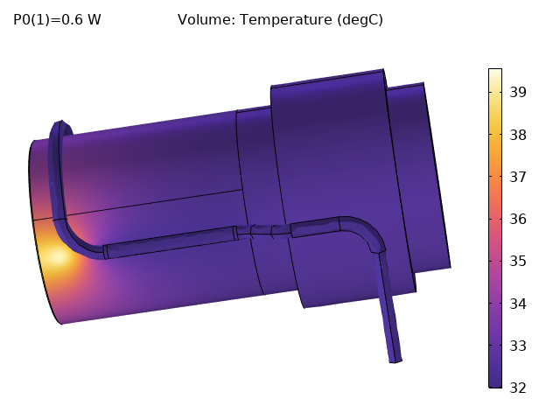
Simulation results
Temperature distribution
0.6 W deposited
10 mm distance from the end of pipe

Slide 8
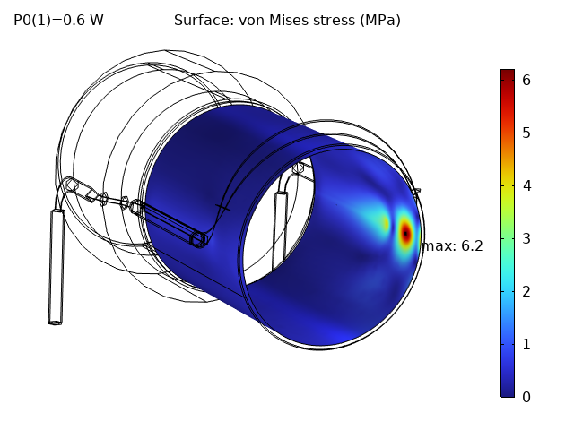
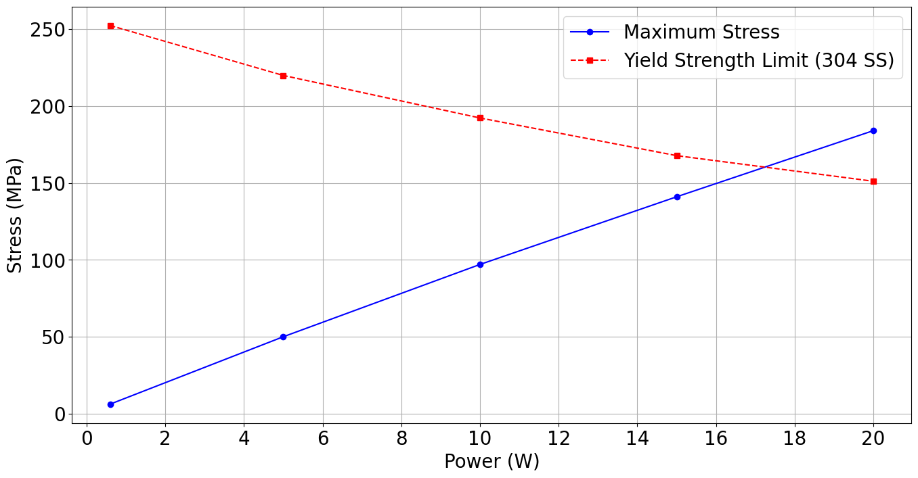
Simulation results
Power limitation
The maximum stress is over the yield strength at 17.2 W
Water channel temperature < 100 C at this point
17.2 W

Slide 9
Conclusion
The deposited power for the Oct 17, 2025 case was calculated to be 0.6 W.
The power limitation based on yield strength was 17.2 W.

Slide 10
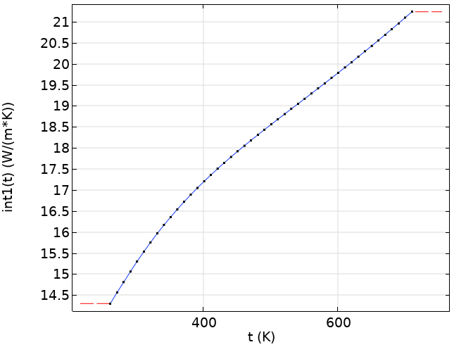
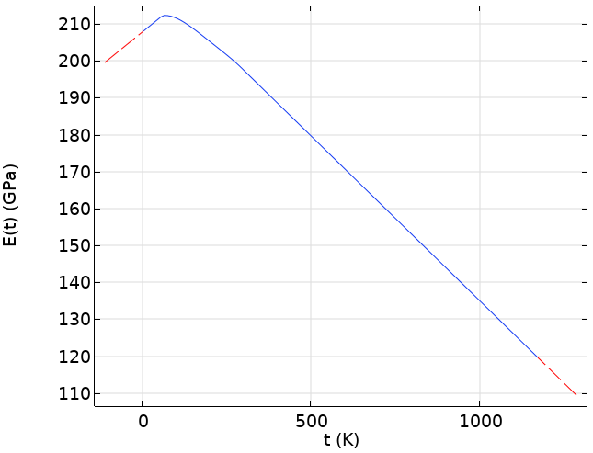
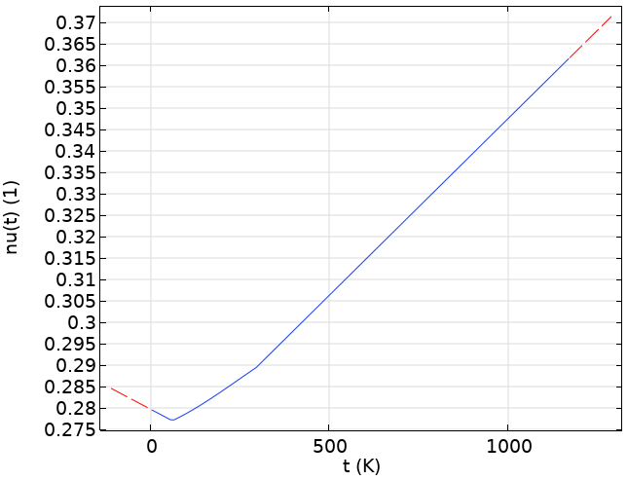
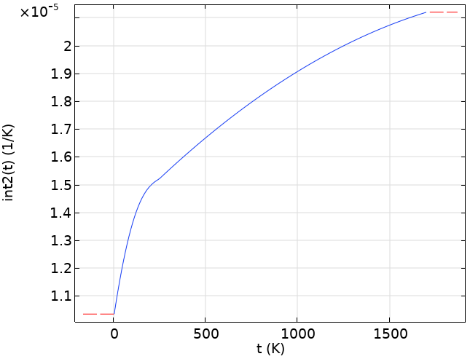
Appendix 1: Material properties
Stainless Steel 304 (from MPDB)
Welding material (SILVALOY 721, ~72% silver, ~28% copper)
Thermal conductivity: 200 W/mK
Others as silver properties
Thermal conductivity
Thermal expansion
Young’s Modulus
Poisson’s ratio

Slide 11
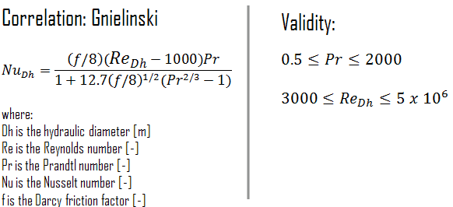
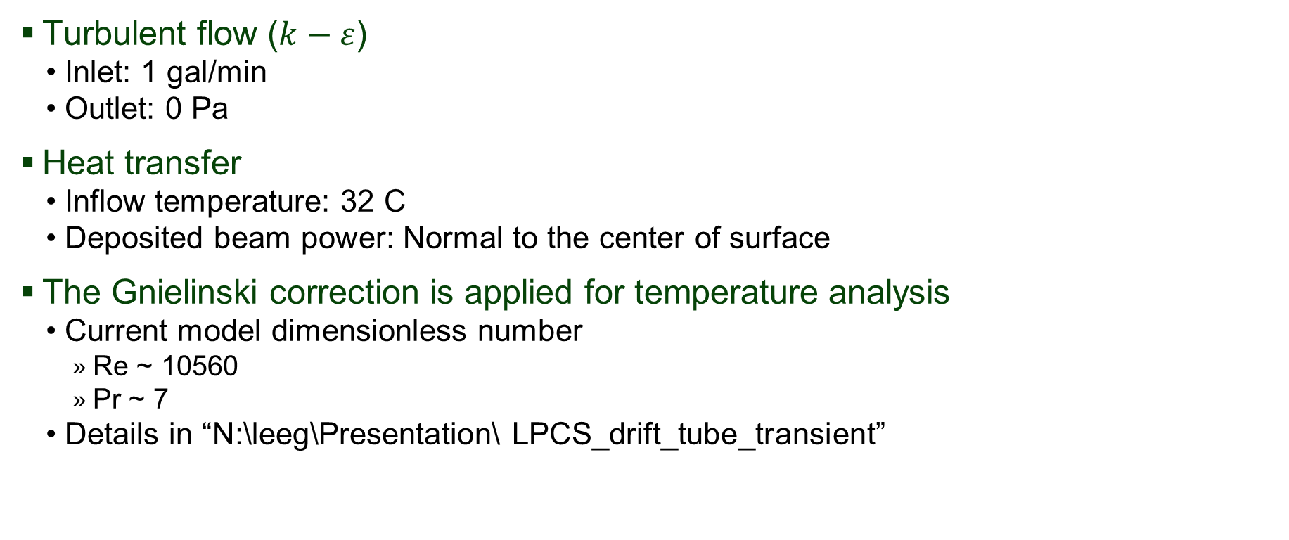
Appendix 2: Boundary condition
Turbulent flow ($k−ε$)
Inlet: 1 gal/min
Outlet: 0 Pa
Heat transfer
Inflow temperature: 32 C
Deposited beam power: Normal to the center of surface
The Gnielinski correction is applied for temperature analysis
Current model dimensionless number
Re ~ 10560
Pr ~ 7
Details in “N:\leeg\Presentation\ LPCS_drift_tube_transient”

