Slide 1
BioSAXS
Documentation
Alejandro de Maria Antolinos
28/03/2012

Slide 2
Index
Samples. List of terms related to samples
Data Acquisition. List of terms related to data Acquisition
Use cases
Sample Changer
ISPYB – BsxCube Interface

Slide 3
SAMPLES

Slide 4
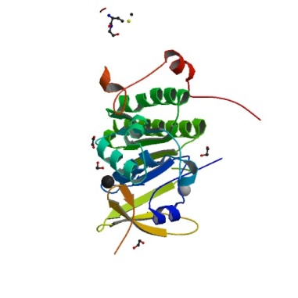
List of terms related to samples
= Macromolecule
A macromolecule is a biological construct
In solution for investigation
A*
ABC
= assembly
A*B*
Description of an assembly containing
multiple macromolecules
Biological assembly
for investigation
A*C*
E*
B*
D*
EBD
assembly ‘Y’
C*
assembly ‘X’
It could be in rare cases more then one assembly the macromolecule belongs to so we should be careful of how to describe
this and or strict with the definition

Slide 5
List of terms related to samples
= Macromolecule: biological construct in solution for investigation
Acronym
Molecular Mass
Number of individual protein chain and residues in each
Number of individual DNA strands and bases in each
Number of individual RNA strands and bases in each
Sequence
assembly (s)
List of regions indicating which part of the assembly(s) the macromolecule is
List of possible structures (PDB)
Which part of the macromolecule the structure is
= assembly: Description of an assembly containing multiple macromolecules
Macromolecule
List of macromolecules

Slide 6
List of terms related to samples
= Buffer: the matched solution in which a sample is suspended
Name/Acronym
Concentration = 0
Temperature
Set Point
Measure for each frame
Type of measurement
Volume to load
pH
Composition
List of additives
= Sample: Specific measurement details for the macromolecule
Macromolecule
Buffer
Concentration > 0
Temperature
Set Point
Measure for each frame
Name: MACROMOLECULE acronym_BUFFER acronym_CONCENTRATION ???
Type of measurement
Volume to load
Comments

Slide 7
List of terms related to samples
= Additive: Any component of the buffer which will be varied in an experiment (salts, ligands, detergents, lipids, deuteration)
Name
Quantity
Type
Buffer
= Structure
A PDB file or accession code
List of what data this structure is associated with
assembly
Macromolecule

Slide 8
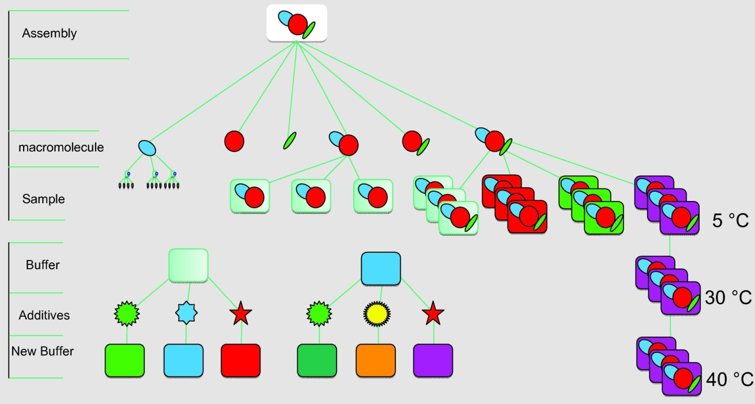

Slide 9
Visual Data Model Draft for Assembly
N
N
1
A assembly has 1..N macromolecules
A macromolecule has 0..N samples
N
1
A sample has 1 buffer associated
………
1
A buffer has 0..N additives
………
Sample: macromolecule + buffer
assembly
macromolecule
Additives

Slide 10
Data Acquisition

Slide 11
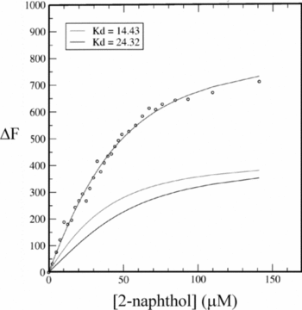
List of terms related to data acquisition
= Frame: One individual exposure of the detector (.edf image and 1D curve .dat)
= Measurement/Run: all frames for an individual acquisition (buffer or sample)
= DataCollection: combination of runs (buffer, sample, buffer)
In rare cases it could be (buffer, n*(buffer OR sample), buffer)
DataCollectionGroup : combined DataCollection for one macromolecule (minimum 3 concentrations). In a collection, by definition all samples are in the same buffer there is only one buffer measurement between samples which is classed as both the buffer_after in the first DC and the buffer_before in the subsequent DC.
DC 1
DC 2
DC 3
DC n
…………………….
Data collection Group for one macromolecule

Slide 12
Visual Data Model Draft for Data Collection
….
….
Run
DataCollection
Frame
….
………
….
….
Data Collection Array
Data Collection Group
….
Data Collection
Run
Frame
Assembly
Macromolecule
Buffer + Sample + Buffer
Buffer or Sample

Slide 13
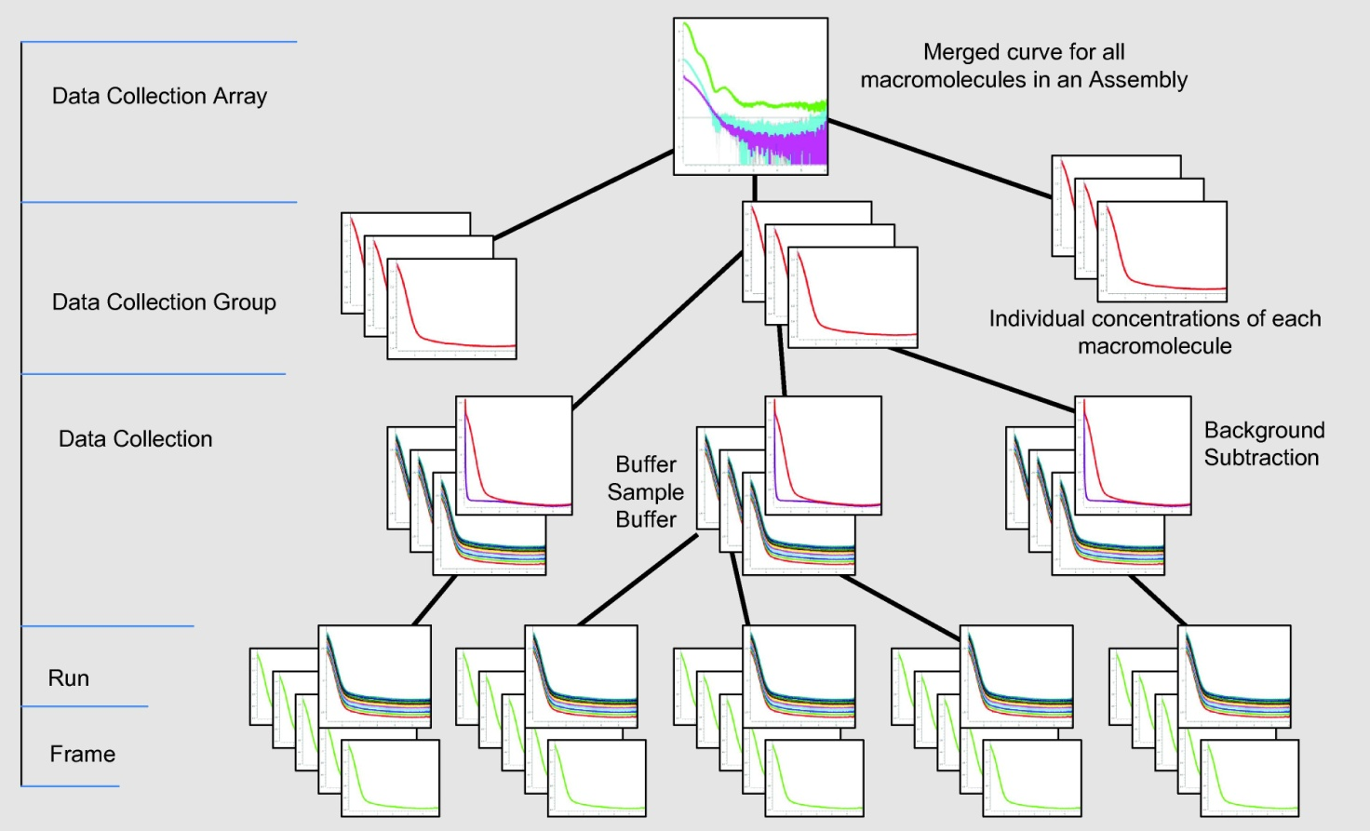

Slide 14
Use Cases

Slide 15
Case 1: How do the subunits fit together
An enzyme which in its functional form is comprised of 3 individual subunits (A, B and C). The first part of the Experiment ( P1) is to determine how the subunits fit together.
P1 will comprises data collections of:
- A, B and C individually
- The dimeric assemblyes of AB and BC
- The trimeric assembly ABC
Thus the assembly will have 6 individual macromolecules associated with it (A, B, C, AB, BC and ABC). Each with a minimum of 3 samples, all with the same buffer conditions
A*
Samples with different concentrations
B*
C*
……………
B1
where n>=3
A*B*
Buffer
A*C*
A*B*C*

Slide 16
Case 1: How do the subunits fit together
Samples with different concentrations
A
…………..
B1
B1
B
B1
…………..
B1
C
…………..
B1
B1
Buffer 1
AB
B_AB
…………..
B_AB
AC
B1
…………..
B1
ABC
B_ABC
…………..
B_ABC
All buffers for the same assembly should have the same conditions ? By default yes BUT they could change

Slide 17
Case 1: How do the subunits fit together
A
B1
B
B1
C
B1
AB
B_AB
AC
B1
ABC
B_ABC

Slide 18
Case 1: How do the subunits fit together
Measurements
A
Samples with different concentration (minimum 3)
B
C
……..
AB
run
AC
By definition is the same buffer
ABC
BUFFER + SAMPLE+ BUFFER
It could be in rare cases BUFFER + ….. + SAMPLE + SAMPLE + …. +BUFFER

Slide 19
Case 1: How do the subunits fit together
Measurements
A
B
C
……..
AB
DC
DC
DC
DC
DC
DC
DC
DC
DC
AC
ABC
Data Collection Group
DC = DataCollection
Because there is only one buffer the datacollections overlap

Slide 20
Case 1: How do the subunits fit together
Data collected with no optimization
A
……..
Data Collection Group for A
B
……..
Data Collection Group for B
C
……..
Data Collection Group for C
Data Collection Array
AB
……..
Data Collection Group for AB
AC
……..
Data Collection Group for AC
ABC
……..
Data Collection Group for ABC

Slide 21
Case 1: How do the subunits fit together
Time Sequence Measurements
With No optimization
A
AC
B
AB
C
ABC
Problem is that we measure twice the same buffer
With optimization
A
AC
B
C
AB
ABC
Switching buffers with the same conditions in order to put them together
Data Collections are overlapping to avoid the extra buffer measurement
time

Slide 22
Case 1: How do the subunits fit together
Data collected with buffer optimization
A
……..
Data Collection Group for A
B
……..
Data Collection Group for B
C
……..
Data Collection Group for C
Data Collection Array
AC
……..
Data Collection Group for AB
AB
……..
Data Collection Group for AC
ABC
……..
Data Collection Group for ABC
Because buffer for macromolecules A, B and C are the same no an extra buffer measurement is necessary between their data collections when measured sequentially

Slide 23
Minimal version ESRFcentric (but not too much) for testing
Implementing WUI from Data Collection
Data Analysis
July
Aug
Sep
Oct.
Nov
Dec
Jan
Feb
Mar
Apr
May
June
July
Aug
Sep
RFF
BM29
Holydays
DC Analysis
DC Imp
WOF
Request For Feedback
Installation on BM29
Implementation of WS
Work on feedback if any

Slide 24
Case 2: How does the enzyme function
P2 will comprises data collections of:
The trimeric assembly ABC (same conditions as for P1)
Plus a data collection for each buffer condition (Ligands and additives required for activity and /or non hydrolysable homologues to isolate the various stages of the reaction).
Thus the macromolecule ABC will have an additional n*3 samples where n is the number of buffer conditions that need to be measured.
A
B
No measurements
Samples
C
AB
AC
ABC
B1
B2
……………
Buffers Conditions c1
Buffers Conditions c2
ABC_B1_10_4C
ABC_B1_30_4C
ABC_B1_50_4C
ABC_B2_10_10C
ABC_B2_30_10C
ABC_B2_50_10C

Slide 25
Case 2: How does the enzyme function
Measurements
A
B
C
AB
AC
Buffer conditions 1
Buffer conditions 2
Buffer conditions 3
ABC
…..

Slide 26
Case 3: Kinetic
Designed to follow the reaction from start to finish (minutes or hours). In principle is one sample and by definition one condition, but the sample could be separate volumes from a large well and buffers could be measured as well
Total Time for measurements
Reacting Sample
Reaction starts
Reaction ends
Frame
Frame
Frame
Frame
Frame
Frame
Frame
Frame
Frame
Frame
Frame
Time between measurements
Time (t)

Slide 27
Case 3: Kinetic
If time between measurements > time for each measurement (buffer) then intersperse buffer measurements between samples.
Total Time for measurements
Reacting Sample
Reaction starts
Reaction ends
Frame
Frame
Frame
Frame
Frame
Frame
Frame
Frame
Frame
Frame
Frame
Frame
Frame
Buffer
Buffer
Buffer
Buffer
Buffer
Buffer
Buffer
Time (t)

Slide 28
Sample Changer

Slide 29
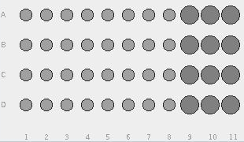
Plate Groups and Plates
Plate Group
Slot 1
Between 1 and 3 plates
Same storage temperature
It could contain different samples from different assemblies
Slot 2
Order the plates by something (ex. Temperature,
number of samples/buffer)?
Slot 3
Plate position

Slide 30
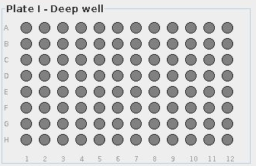
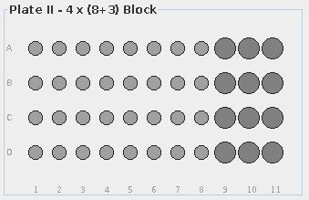
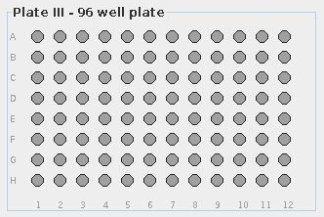
Types of Plates
Attributes of the type:
Row count
Column count
Volume for each well
How can we fill the plate?
With samples and buffers associated to the same assembly
With samples and buffers coming from different assemblies
Only buffers
Only samples

Slide 31
Session A (Static Wizard)
Samples
A
A
A
Buffer_A_10_1
A
B
B
B
AB
Buffer_C_20_1
B
AB
AB
AB
Assemblies
AB
Buffer_AB_30_1
Experiment
Buffers
Wizard:
How many macromolecules in ?
How many buffer conditions?
Define macromolecules / buffer?
Define the position
AB
A
B
AB
Plate Group (sample changer)
Plate Position

Slide 32
Session B (Static Wizard)
Samples
Assemblies
A
A
A
Buffer_A_10_1
A
B
B
B
AB
Buffer_C_20_1
B
AB
AB
AB
AB
Buffer_AB_30_1
Experiment AB
Buffers
Samples
Plate Group (sample changer)
C
C
C
Buffer_A_10_1
A
B
B
B
BC
Buffer_B_20_1
B
BC
BC
BC
AB
Buffer_BC_30_1
Static wizard allows just one assembly
Experiment AC

Slide 33
Session A
Assemblies
A
A
A
Buffer_A_10_1
A
B
B
B
AB
B
Buffer_C_20_1
Buffers
Plate Group (sample changer)
Session B
Assemblies
AB
AB
AB
AB
AB
Buffer_B_30_1
Buffers
Plate Group (sample changer)

Slide 34
ISPYB – BsxCube Interface

Slide 35
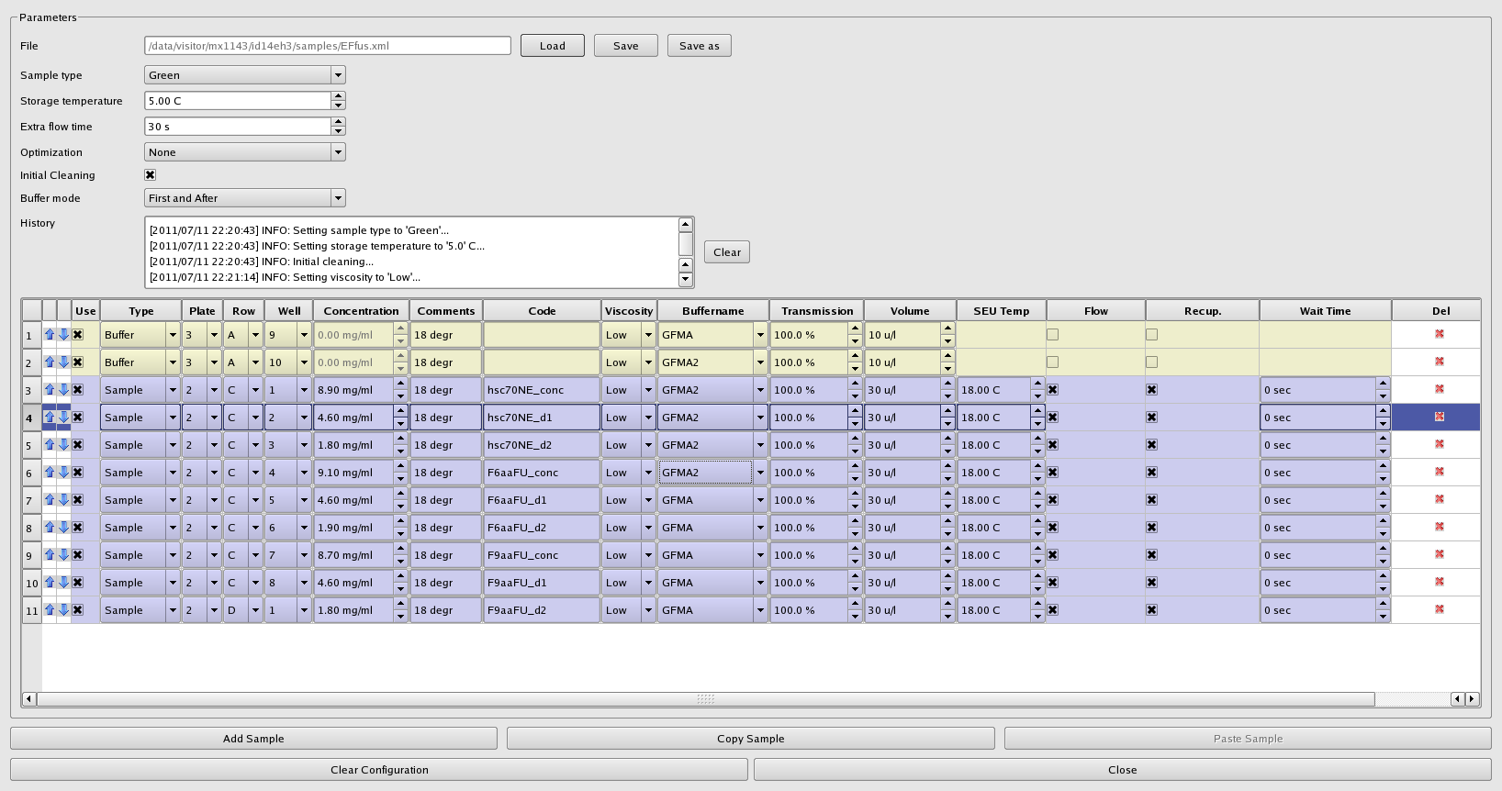

Slide 36
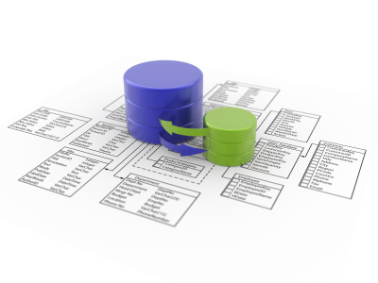
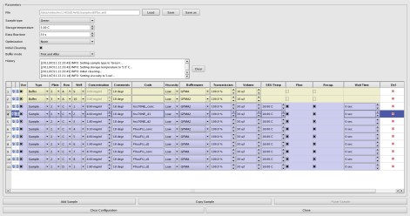
Robot
ISPyB
BsxCube
User logs in
Click on load robot from ISPyB
findActiveSessionsByUserId
Reading actives sessions for user
Return all actives sessions of this user
User chooses one
findPlateGroupsfromSessionId
Reading Plate groups of projects? associated to this sessionId
Return all plate groups of this session
User chooses one
findPlateGroupByPlateGroupId
Reading all information about plateGroupId
Return all plate group information
bsxCube fills the table

Slide 37
Robot
ISPyB
BsxCube
Modifications
Collect the data
updateModification
Persist modifications
Store data collections
Persist data collections

