Slide 1
Web development
Programming is not about hacking things, it is but mostly about engineering things: )

Slide 2

MVC

Slide 3
ORM
Object-relational mapping (ORM, O/RM, and O/R mapping tool) in computer science is a programming technique for converting data between incompatible type systems in object-oriented programming languages.
This creates, in effect, a "virtual object database" that can be used from within the programming language.
There are both free and commercial packages available that perform object-relational mapping, although some programmers opt to construct their own ORM tools.

Slide 4
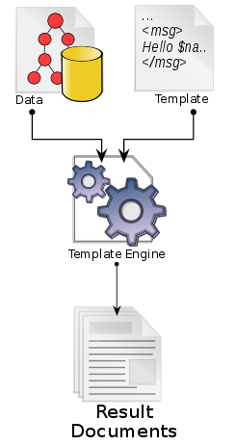
Template Engine
Smarty
Blade
PHPTAL
PHP : )

Slide 5
REST
In computing, representational state transfer (REST) is an architectural style consisting of a coordinated set of components, connectors, and data elements within a distributed hypermedia system, where the focus is on component roles and a specific set of interactions between data elements rather than implementation details.
Its purpose is to induce performance, scalability, simplicity, modifiability, visibility, portability, and reliability.
REST is the software architectural style of the World Wide Web.
GET, POST, PUT, DELETE

Slide 6

FRAMEWORK
Laravel
Nette
CodeIgniter
Zend Framework 2
Yii
CakePHP
Slim

Slide 7
Good vs Bad
Comments! Comments! Comments!
and again comments… everywhere (git commit, functions, classes, variables, or even particular line of non-trivial code)
code style (PHPCS aka CodeSniffer)
variables, functions, comments and … in English
In case of fire -> git commit -> git push -> run
var_dump + var_export + exceptions + comments
complexity of functions
naming of variables and functions (also classes)
code responsibility boundaries

Slide 8
Biggest problems
Naming <= small problem
Searching <= medium problem
Self-confidence <= HUGE PROBLEM

Slide 9
LARAVEL FW
MVC
ORM (Eloquent ORM)
Blade
REST routing policies (resources)
Artisan script
DB Migrations/Seeds
A lot of extensions and modules through composer loader

Slide 10
Skype PHP Application(s)
Stratus Framework (similar to Laravel)
Application map (REST connections)
Dataflow transports (REST, DB, QueueC)
Business logic (engineering part)

Slide 11
QA
Any questions?

