Slide 1
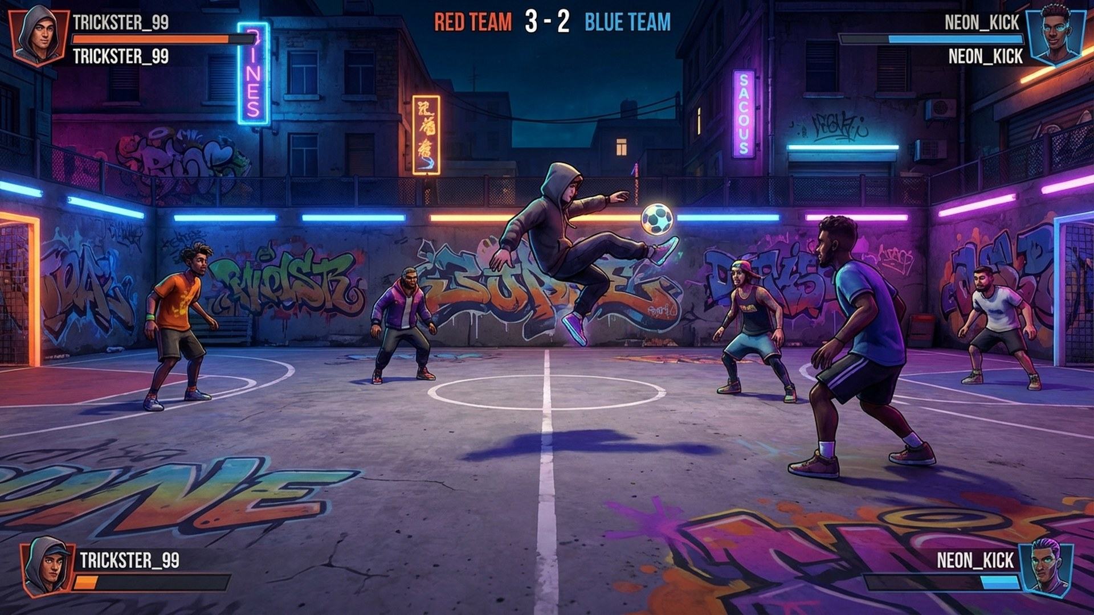

STREET
CHAMP
Project Pitch — PlayStation 5
April 2026
EASYCHAMP, INC.
easychamp.com

Slide 2
CONCEPT OVERVIEW
The Game
Street Champ is a fast-paced, arcade-style 3v3 street football game built for PS5. Players assemble crews, master trick moves, and compete in iconic urban courts worldwide. Think FIFA Street meets modern indie craft — tight controls, expressive animations, and addictive online competition.
3v3
8+
50+
Players per side
Urban courts worldwide
Trick moves to master
2 / 11

Slide 3
TARGET PLATFORM
Built for PlayStation 5
PRIMARY PLATFORM
ENGINE
DualSense Haptics
Unreal Engine 5
Feel every touch, tackle, and trick
Nanite, Lumen, MetaHuman pipeline
Adaptive Triggers
Variable resistance for power shots
SSD Streaming
STRETCH GOAL
Instant court loading, zero wait
PlayStation 4
3D Audio
Scaled-down visuals, same core gameplay.
110M+ installed base.
Tempest-powered crowd and ball acoustics
3 / 11

Slide 4
APPEAL
Gameplay & Genre
Arcade Sports / Multiplayer
CORE LOOP
Pick Crew
▶
Enter Match
▶
Score with Style
▶
Earn Rep
▶
Unlock
KEY DIFFERENTIATORS
01
02
03
Trick System
Crew Chemistry
Court Hazards
Flashy moves boost your score multiplier — but can be intercepted. High risk, high reward.
Teammates who play together develop unique combo moves and synergies over time.
Each venue has unique elements — puddles, walls for ricochets, spectator distractions.
4 / 11

Slide 5
POSITIONING
Release Strategy
Q2 2027
Q4 2027
2028+
Early Access
Full Launch
Live Service
Core gameplay, 4 courts,
online matchmaking
8 courts, story mode,
ranked play, 20+ characters
Seasonal content drops,
new courts & tournaments
$19.99
Premium Indie Tier
Digital-first on PlayStation Store
Post-Launch Content
Seasonal drops — new courts, characters,
limited-time tournament modes
5 / 11

Slide 6
AUDIENCE
Who Plays
60%
PRIMARY
25%
SECONDARY
15%
TERTIARY
Competitive Casuals
Couch Co-op Players
Content Creators
Males 16–34
Friends & families
Streamers & clip makers
FIFA players who want something faster, more accessible, and more expressive.
Local 3v3 split-screen brings back the shared-screen sports game experience.
The trick system generates shareable highlights. Built-in replay tools.
14-YEAR MARKET GAP
No active street football franchise on PlayStation since FIFA Street 4 (2012). Massive unserved demand.
6 / 11

Slide 7
SCOPE
Features & Mechanics
3v3 Online Multiplayer
Local Co-op
Story Mode
Ranked and casual matchmaking
Split-screen for up to 6 players
Campaign through global street leagues
Crew System
Trick Engine
Court Editor
Recruit, customize, level up your squad
50+ moves with skill-based combos
Community courts, PS5 share integration
DUALSENSE INTEGRATION
Haptic ball control · Adaptive trigger power shots · Controller speaker crowd chants
Team of 3–5 · Unreal Engine 5 · 18-month production timeline
7 / 11

Slide 8

THEME
Look & Feel
ART STYLE
Stylized Semi-Realistic
Where Fortnite's expressiveness meets authentic street culture. Bold outlines, vibrant lighting, graffiti environments. Diverse, customizable characters with real streetwear.
AUDIO
Lo-fi hip-hop, electronic beats. Dynamic crowd reactions. Street ambience — traffic, boomboxes, urban life.
Court Environment Concept
INSPIRATION
Jet Set Radio — Style
NBA Street — Gameplay
Rocket League — Comp. Loop
8 / 11

Slide 9
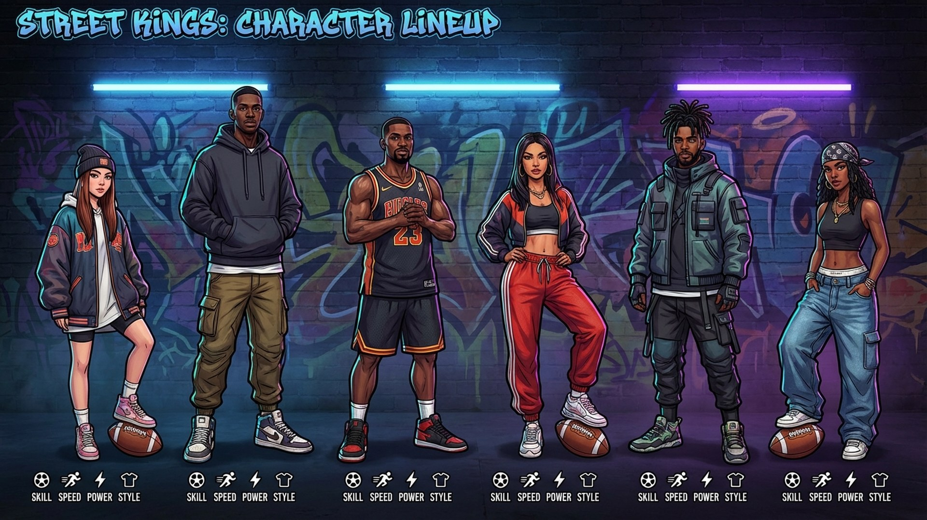
SUPPORTING VISUALS
Concept Art
Character Roster Concept
In-Game Gameplay Concept
9 / 11
Environment Concept

Slide 10
TEAM & STUDIO
About EasyChamp
EASYCHAMP, INC.
FOUNDER & CEO
Entity
Delaware C-Corporation
Anton Abyzov
Founded
August 2021
Software engineer with 10+ years of experience building scalable systems and real-time applications. Leading the studio's expansion into interactive entertainment with a focus on multiplayer game architecture.
Focus
Software & Interactive Entertainment
HQ
Sunny Isles Beach, FL
Team
3–5 (founder + contractors)
WHAT WE’RE SEEKING
PlayStation dev kit access to optimize for PS5 hardware, DualSense features, and console certification pipeline.
STATUS: Core prototype in development · Unreal Engine 5 · Vertical slice targeting Q3 2026
10 / 11

Slide 11

Thank you.
Let’s build something great for PlayStation.
Company
EasyChamp, Inc.
Contact
Anton Abyzov — Founder & CEO
Email
admin@easychamp.com
Location
Sunny Isles Beach, FL, USA
Web
easychamp.com
EASYCHAMP, INC.
CONFIDENTIAL

