Slide 1

DEVDAY EXCHANGE HACKATHON · MIAMI · NOVEMBER 2026
SpecWithCode Classroom
Free AI study help that never runs out
For K-12 schools. Pools the AI plans a school already has and switches when one runs out, so no student gets cut off mid-class.
specwithcode-classroom.vercel.app
Anton Abyzov

Slide 2

THE PROBLEM
Free AI runs out by mid-morning
10:40
Kids whose families pay
Keep going. Paid tier, no cap, homework done.
A typical moment the free tier hits its cap. Second period, and the help is gone.
Everyone else
"You have reached your limit." Stuck until tomorrow.
Meanwhile the school already holds AI capacity it never uses: grant credits, a district free tier, a spare plan, a computer signed in to Codex. It sits behind four logins.

Slide 3
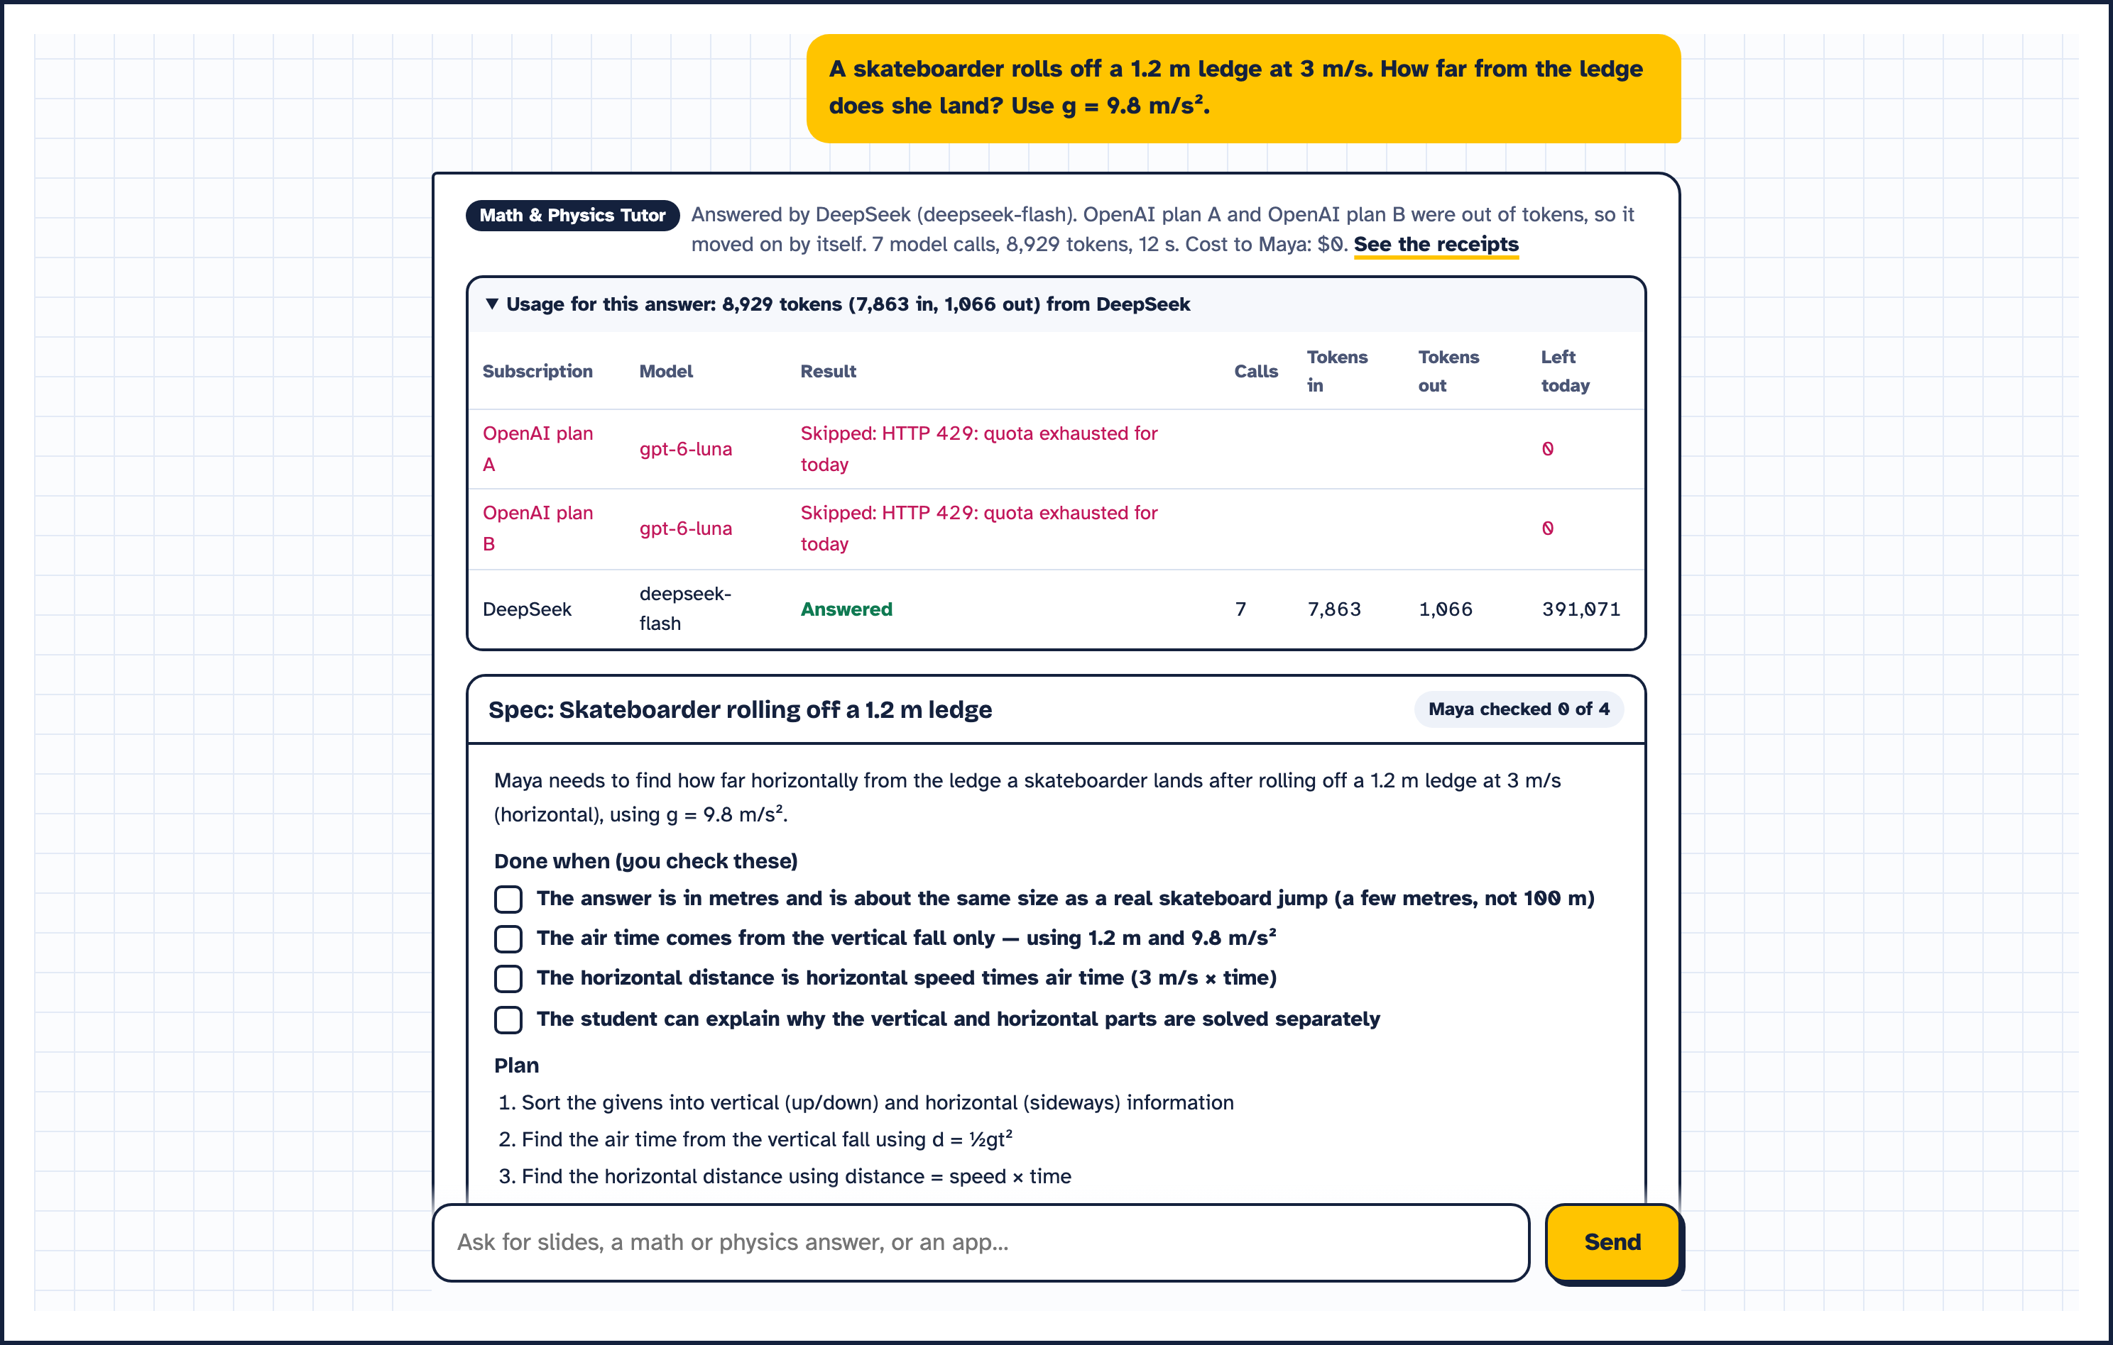
THE IDEA
Pool what the school already has
1
OpenAI plans on GPT-6 Luna
Each plan the school holds, in turn
2
Gemini free tier
On the district account
3
DeepSeek
A low-cost backup
4
A school Mac on Codex
Billed to its ChatGPT plan
Tried in order. On a 429, a quota error or a spent daily budget, the next call goes to the next one. Students never see an error.

Slide 4
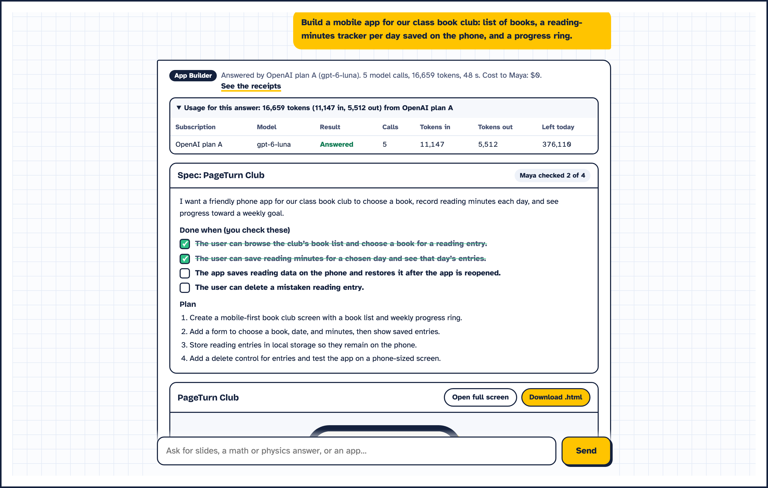
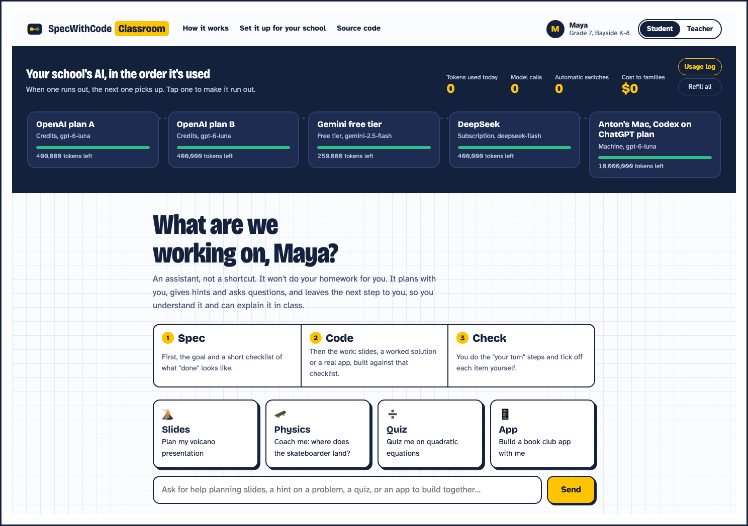
HOW STUDENTS WORK
Spec, Code, Check: an assistant, not a shortcut
1
Spec
A "done when" checklist first
2
Code
The agent does the heavy lifting
3
Check
The student ticks it off and does the last step
Left: the spec an app starts from. Right: student mode, where hints and "your turn" steps replace ready answers.

Slide 5
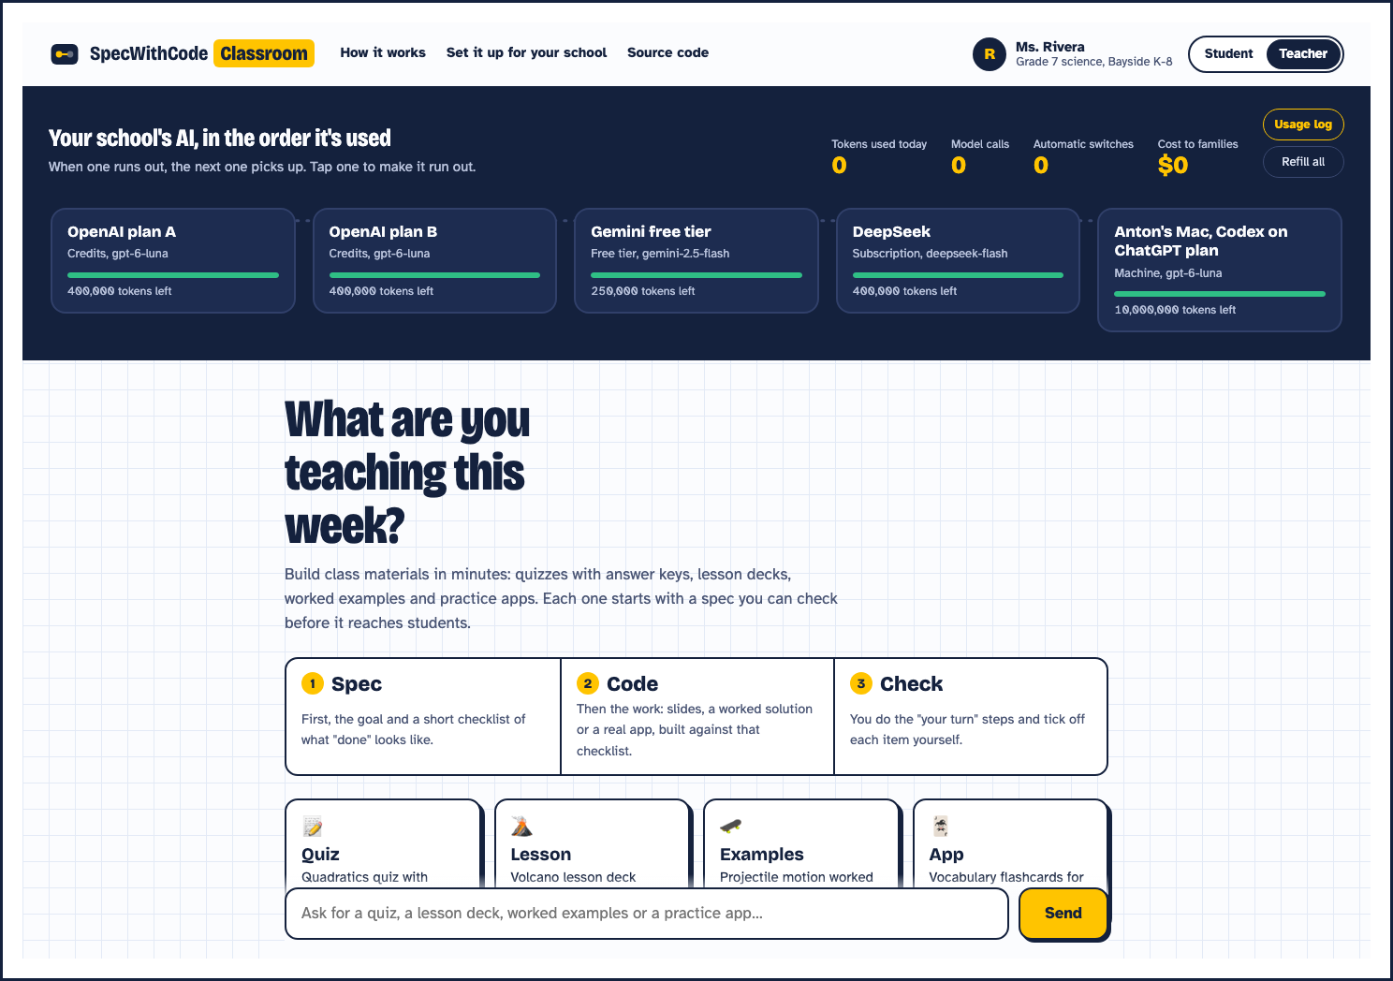
FOR TEACHERS
Teachers get their time back
1
Quizzes with answer keys
Each one starts from a spec you check
2
Lesson decks
Slides with speaker notes, downloadable .pptx
3
Check student answers
Feedback on what is right and what to fix

Slide 6
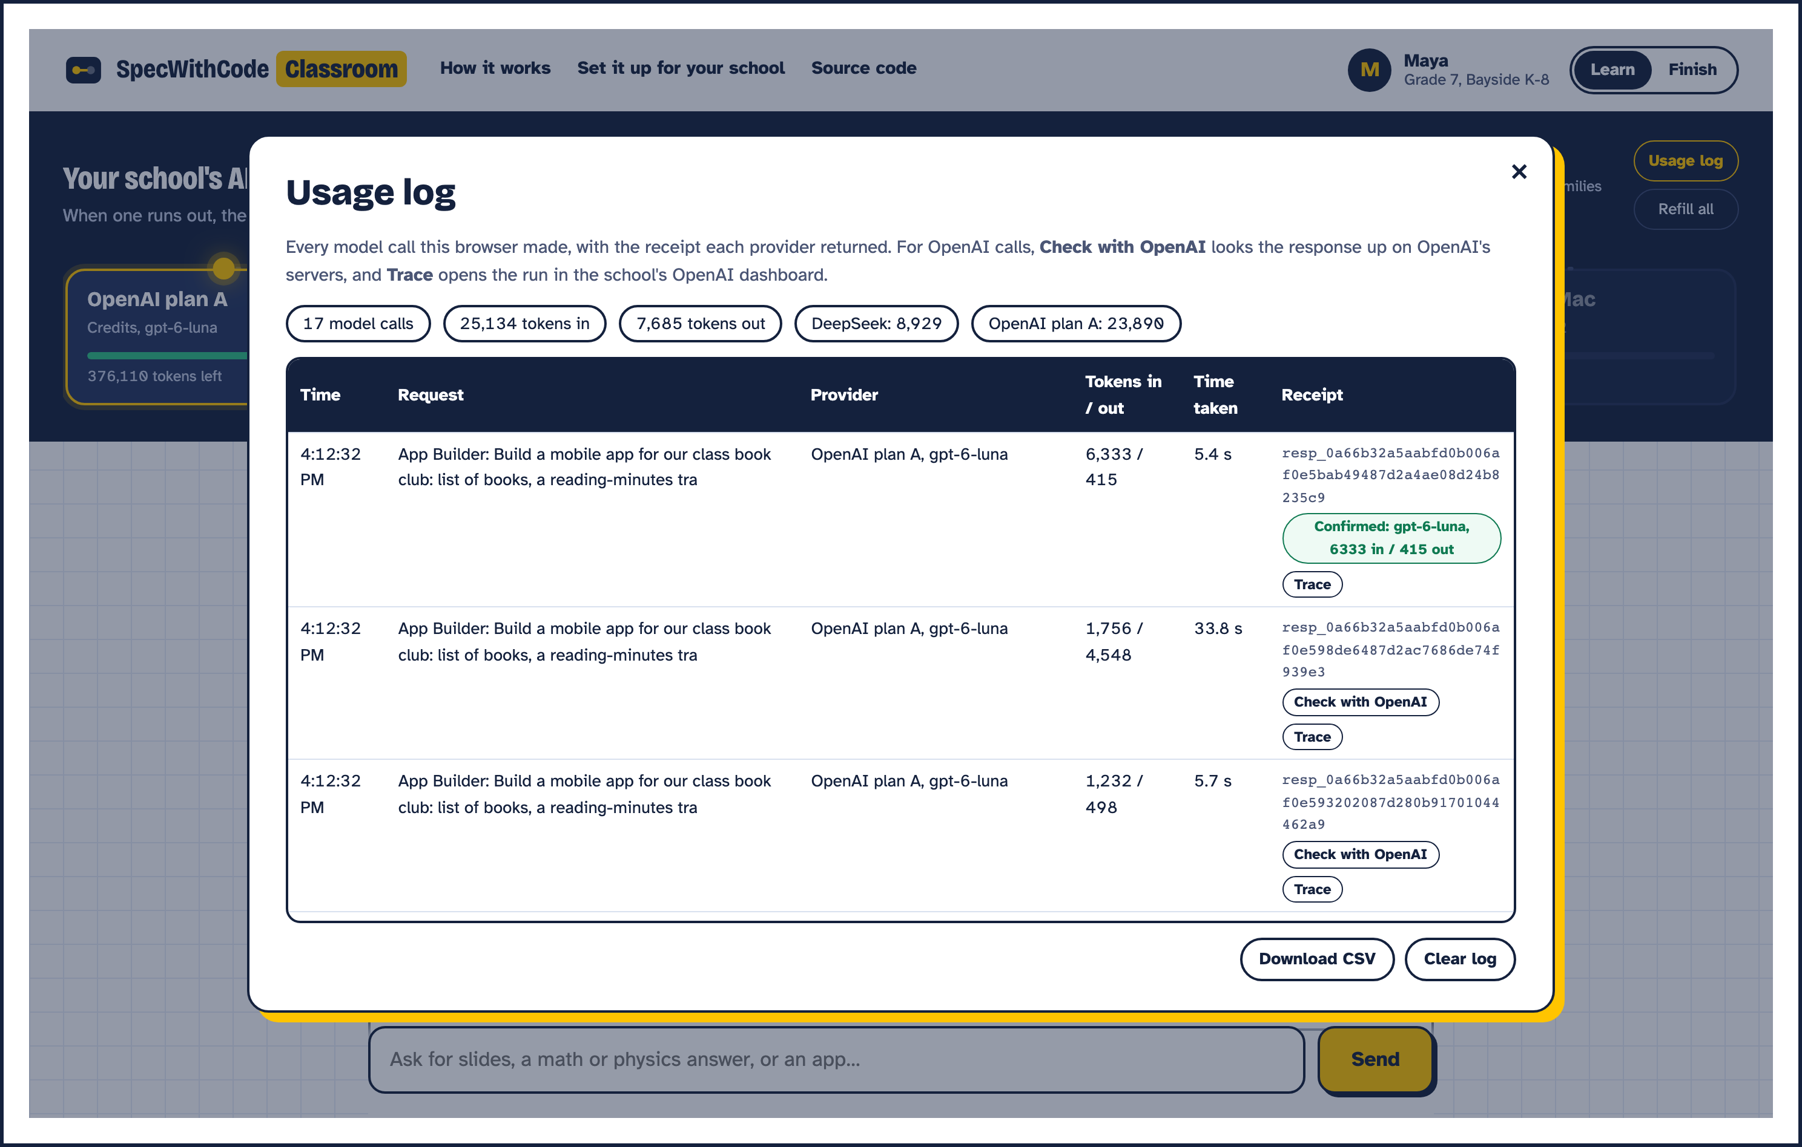
PROOF
Every answer comes with a receipt
1
Per-call receipts
Provider, tokens in and out, and the provider's response id
2
Check with OpenAI
One click looks the response up on OpenAI's servers
3
Agents SDK traces
Open the full trace of the run

Slide 7
UNDER THE HOOD
How it's built
1
OpenAI Agents SDK
Coach agent hands off to Slides Studio, a Math and Physics Tutor and an App Builder. K-12 input guardrail. Custom FailoverModel walks the ring.
2
OpenAI API
Responses API with gpt-6-luna on every OpenAI plan the school holds. Traces go to the school's OpenAI dashboard.
3
Codex
Wrote the offline test suite for the router and slide exporter, and joins the ring as a school machine.
4
FastAPI on Vercel
Plain HTML, CSS and JS front end. One deploy, no install for students.
Coach
›
Specialist
›
FailoverModel
›
OpenAI A
›
OpenAI B
›
Gemini
›
DeepSeek
›
School Mac

Slide 8
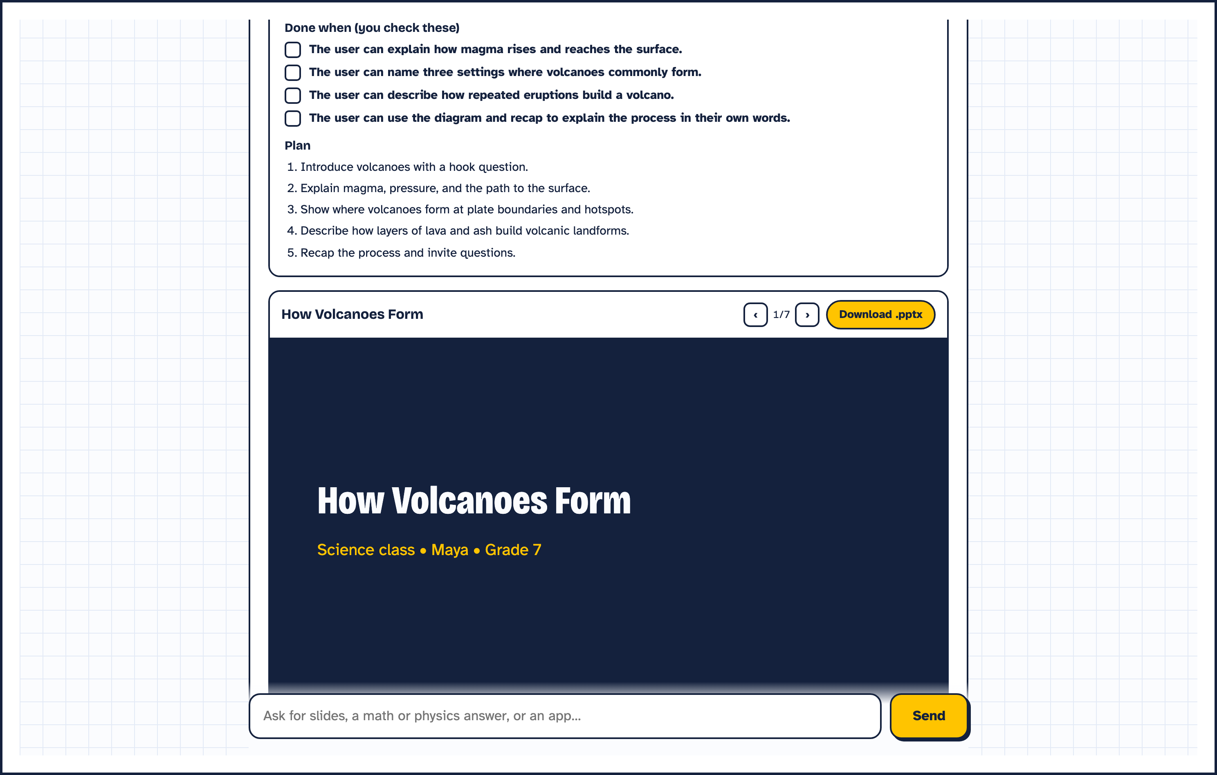
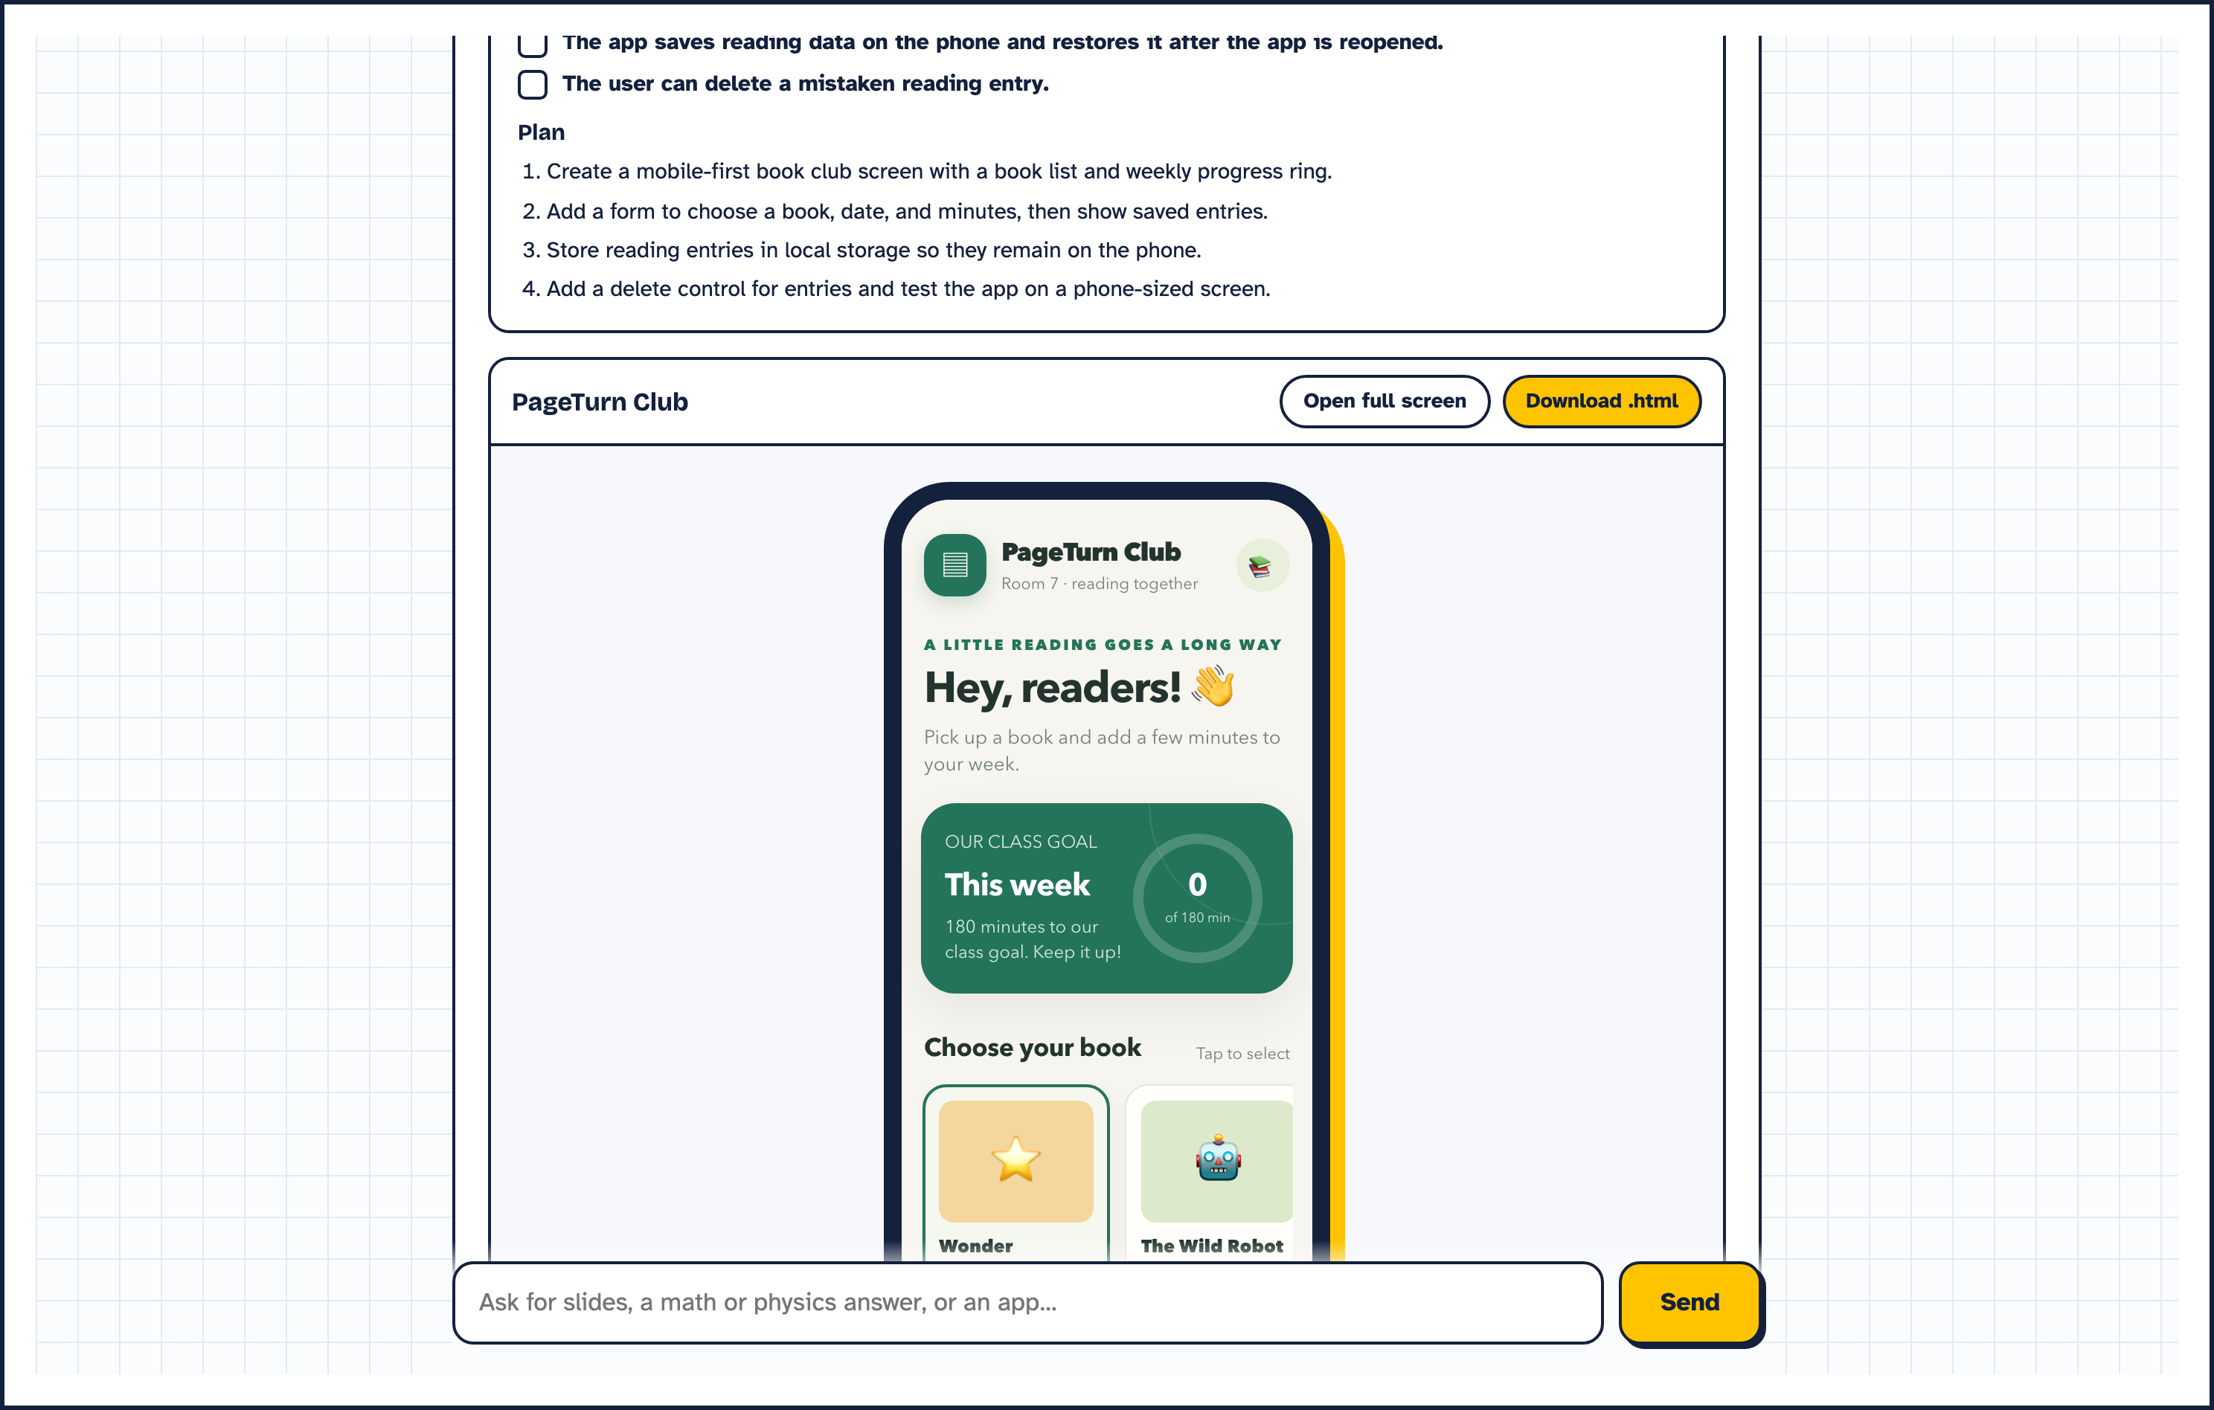
TRY IT
Use it in class today
specwithcode-classroom.vercel.app
github.com/anton-abyzov/specwithcode-classroom
$0 to families. Built for South Florida K-12 schools.

