Slide 1
SQL Database for Research 101
University of Strathclyde

Slide 2
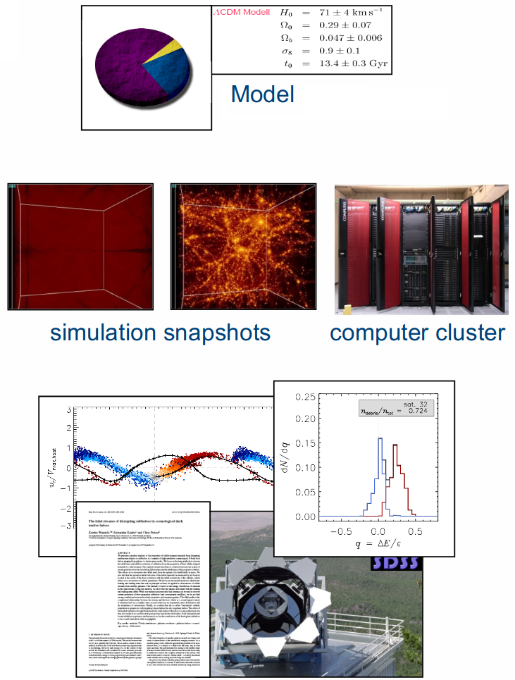
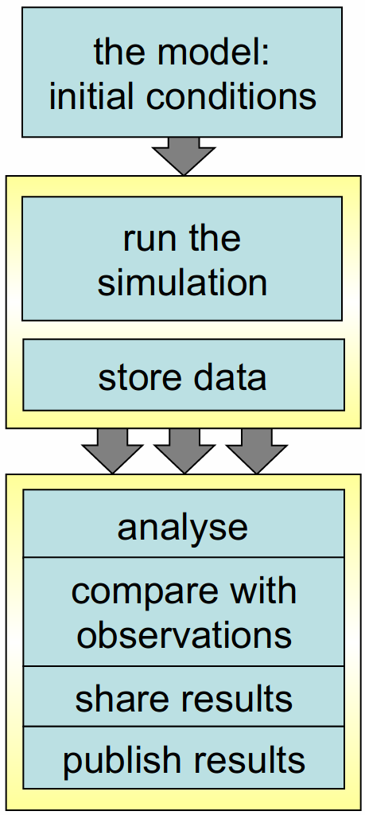
Motivation: workflow is clear, right?

Slide 3
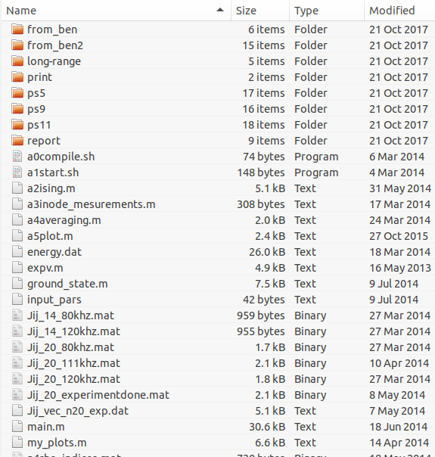
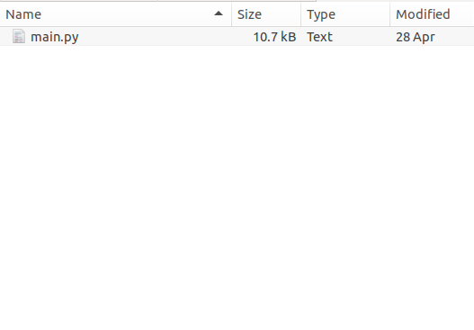
Motivation: organization is important
Project beginning
Project end
???

Slide 4
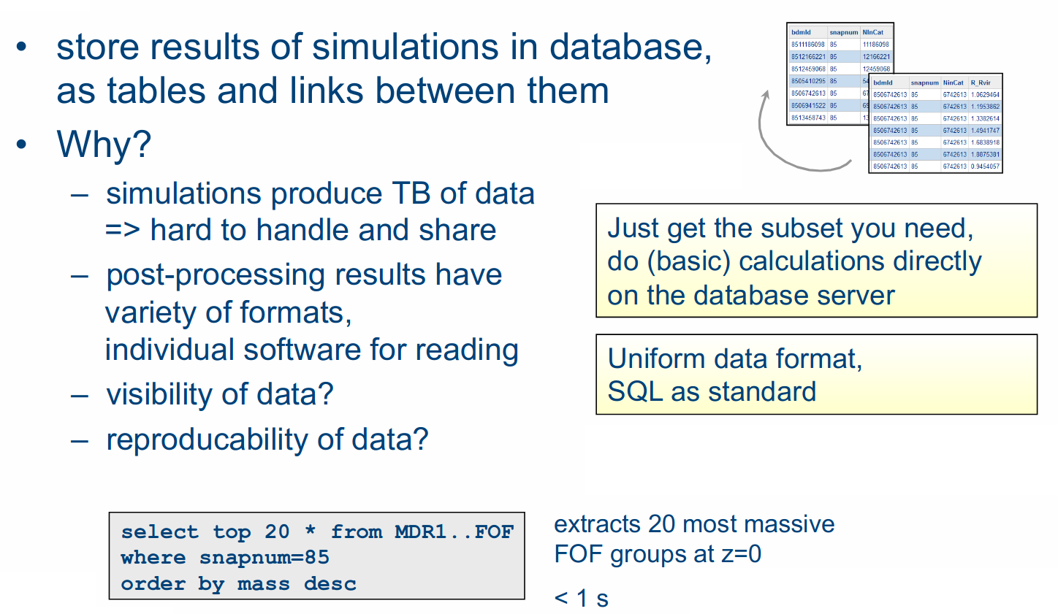
Simulation Databases can help

Slide 5
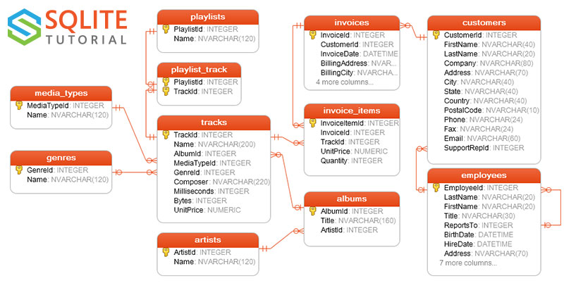
Example Database

Slide 6
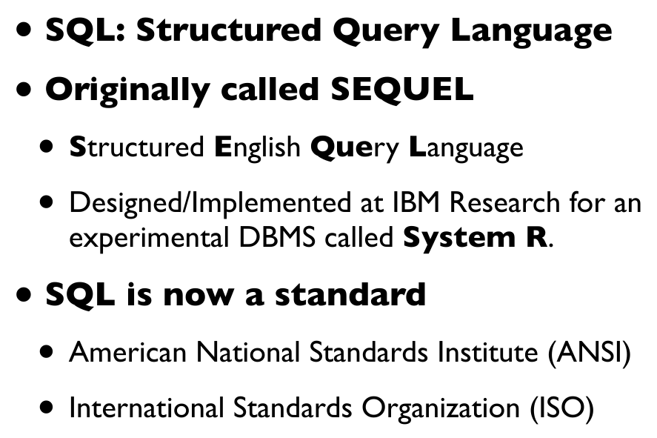
SQL Language
There are
different
flavours of
SQL, but
their syntax
is very
similar

Slide 7
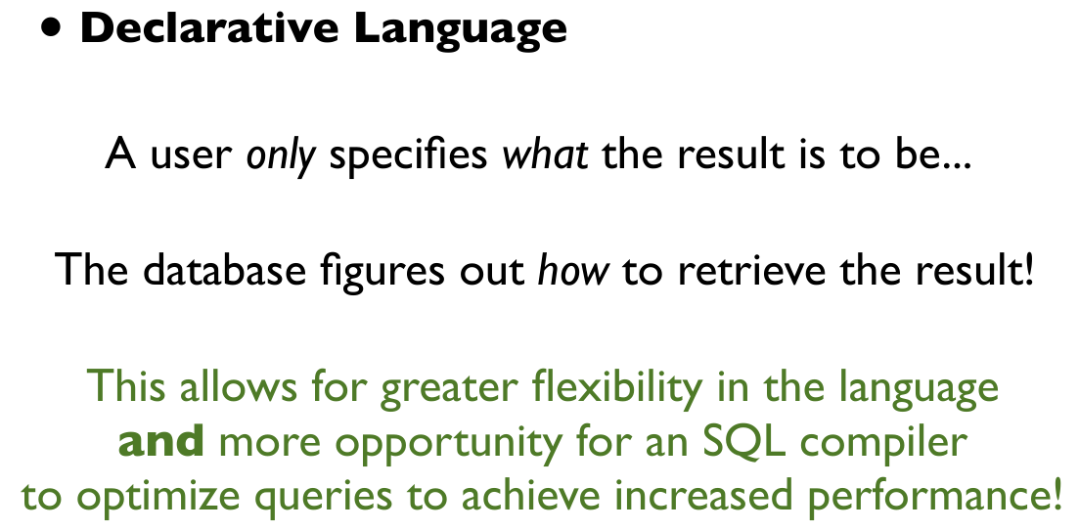
SQL Language

Slide 8
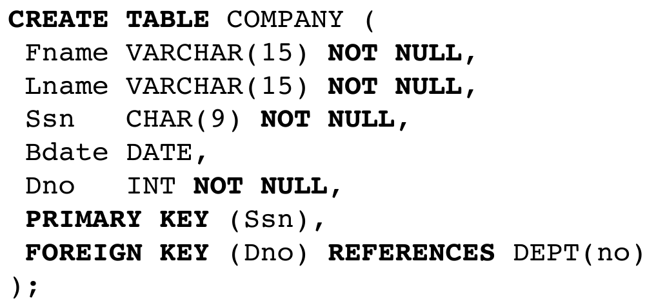
Create Table

Slide 9
Data Types
Numeric
Character string
Bit string (BLOB)
Boolean
Time

Slide 10
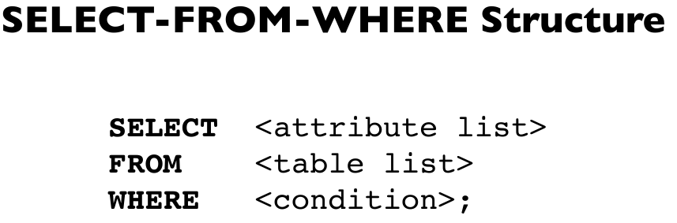
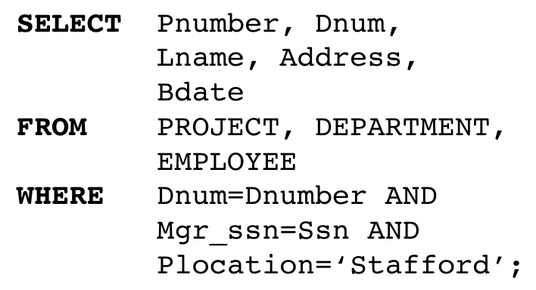
Retrival Queries

Slide 11
Research application
All modern languages have Application Programming Interface for SQL databases
Python solutions:
  sqlite3 – interface SQLite
  SQLAlchemy – Python SQL toolkit
  pandas – data analysis toolkit
  more...
Let’s look at the practical...

