Slide 1

gRPC

Slide 2
Introduction to gRPC
gRPC - Google Remote Procedure Call:
open-source framework developed by Google to handle remote procedure calls (RPCs)
supports multiple programming languages: C#, C++, Java, Python, Go …
utilizes Protobuf and HTTP/2

Slide 3
How gRPC Works
Proto definition: the service is defined, specifying the methods that can be called remotely with their parameters and return types
Code generation: gRPC automatically generates client and server code in multiple languages
Execution: clients can call methods on a server as if they were local to their own process

Slide 4
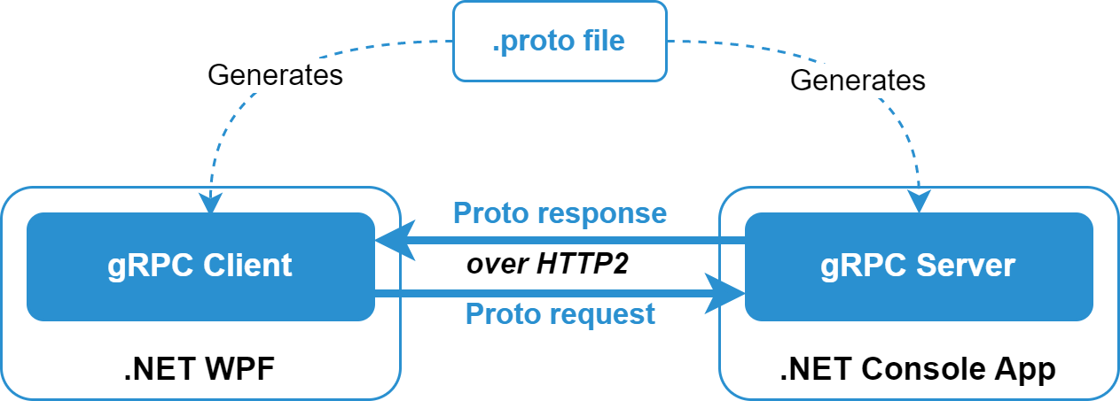
How gRPC Works

