Slide 1
OVERVIEW OF CYBER SECURITY AUDITING STANDARDS
May 26, 2024
Anton Mishchenko
Notes:
*Slide note goes here*

Slide 2
Intro/Overview
ISO 9001 main clauses & PDCA cycle
References
2
1
3
Number of ISO 9001 certificates issued per year
4
Notes:
*Slide note goes here*

Slide 3
ISO 9001 main clauses & PDCA cycle
Plan
Do
Check
Act
Plan – Clause 6
Do – Clause 7, 8
Check – Clause 9
Act – Clause 10
Context/Leadership – Clause 4, 5
Context
&
Leadership
Notes:
Plan – Clause 6 (Planning)
Do – Clause 7 (Support), Clause 8 (operation)
Check – Clause 9 (performance Evaluation)
Act – Clause 10 (Improvement)
Con./Led. Clause 4 (Context of the organization), Clause 5 (Leadership)

Slide 4

ISMS system ISO Standards
ISO 27006
liability
conflicts of interest
committees
training and education
ISO 27007
management
skillsets
compliance
Notes:
*Slide note goes here*

Slide 5
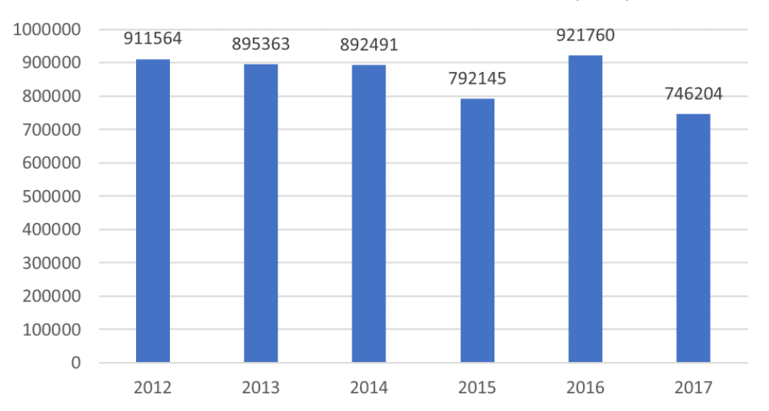
Number of ISO 9001 certificates issued per year
Notes:
*Slide note goes here*

Slide 6
References
Hammar, M. (2024, March 4). What is the ISO 9001 standard? A straightforward overview. Retrieved from 9001Academy: https://advisera.com/9001academy/what-is-iso-9001/
International Organization for Standardization. (2015). Information technology — Security techniques — Requirements for bodies providing audit and certification of information security management systems. (ISO/IEC 27006, 3rd ed.).
International Organization for Standardization. (2020). Information security, cybersecurity and privacy protection — Guidelines for information security management systems auditing. (ISO/IEC 27007, 3rd ed.).
Kent, K. &. (2006). Guide to computer security log management. (NIST Special Publication 800-92).
National Institute of Standards and Technology. (2020). Security and privacy controls for information systems and organizations. (NIST Special Publication 800-53 Revision 5).
Telecommunication Standardization Sector of the International Telecommunications Union (ITU-T). (1995). Security audit and alarms framework. X.816.
Notes:
Closing remarks

