Slide 1
THEORY OF ARTIFICIAL INTELLIGENCE
Lecture 2 — Classical & Local Search
How a Rational Agent Actually Finds a Sequence of Actions
Graduate Seminar • Fall Term
Notes:
This lecture compresses AIMA Ch. 3 (classical search) and Ch. 4 (local search) into one session. It is genuinely dense — if it runs long, the clean seam to split into two sessions is right before the 'From Classical to Local Search' section header partway through. Everything after that point is self-contained.

Slide 2
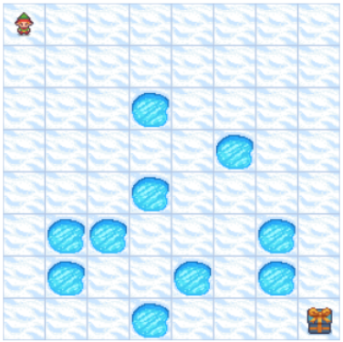
RECAP
From Task Environments to Search
Problem-solving agent – takes a sequence of actions to the goal
episodic
fully observable
single-agent
deterministic
static
Discrete
In this setting, rational decision-making reduces to search: find a sequence of actions from the initial state to a goal state
Uninformed | Informed
Depth-First Search (DFS) | Greedy Best-First Search
Breadth-First Search (BFS) | A*
Uniform-Cost Search (UCS)
Lecture A — Classical & Local Search
1
Notes:
This is the direct continuation of the agent-types material from Lecture 2 — goal-based agents were defined by asking 'what will happen if I do action A'; search is what happens when you chain that question many steps deep.

Slide 3
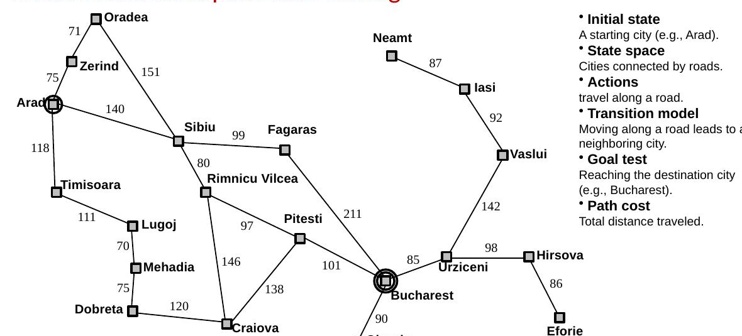
PROBLEM FORMULATION
A Real-World Example: Route Finding
Lecture A — Classical & Local Search
2
Notes:
This is the Romania road map — our running example for the rest of today's lecture. Initial state: a starting city (Arad). Goal test: reaching the destination (Bucharest). Path cost: total distance traveled. We'll use this exact map to compare every algorithm we cover.

Slide 4
PROBLEM FORMULATION
The Six Parts of a Search Problem
Initial state s₀
Where the agent starts
State space S
All states reachable from s₀ by any sequence of actions
Actions A(s)
Actions available to the agent at state s
Transition model
Result(s, a) → s′, for every s, s′ ∈ S and a ∈ A(s)
Goal test G(s)
Does state s satisfy the goal? → {true, false}
Path cost g(p)
g(p) = Σ c(s, a, s′) summed along the path
You already formalized the vacuum world exactly this way in Lecture 1 — this is the same five-part structure, generalized. Once formulated, solving proceeds in two stages: search (offline exploration) and execution (carrying out the chosen plan).
Lecture A — Classical & Local Search
3
Notes:
One-slide recap since the format itself was already covered via the vacuum world. Move quickly — the point is just to re-anchor the vocabulary before two new examples.

Slide 5
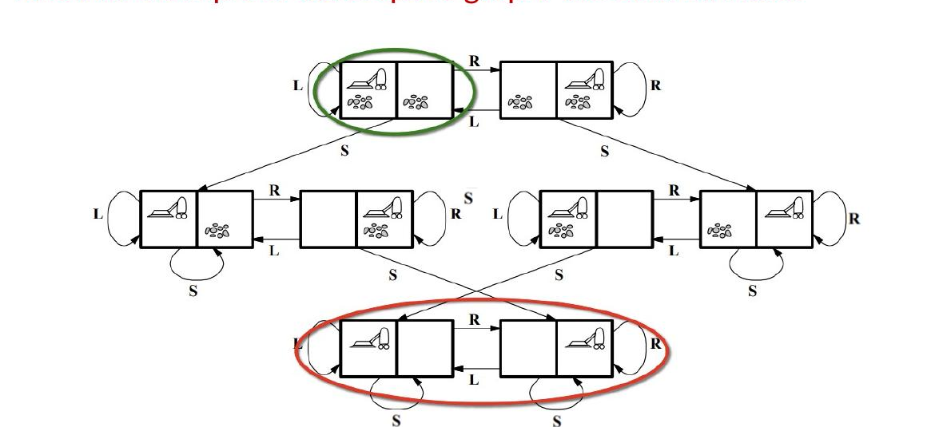
REPRESENTATION
Callback: The Vacuum World's Full State Space
Lecture A — Classical & Local Search
4
Notes:
This is the complete 8-state graph for the vacuum world from Lecture 2 — the same environment, now drawn out fully as a state space graph rather than a percept-action table. L, R, S label the actions (Left, Right, Suck); self-loops are no-op moves at a boundary. Small enough to draw completely by hand — most real state spaces are not.

Slide 6
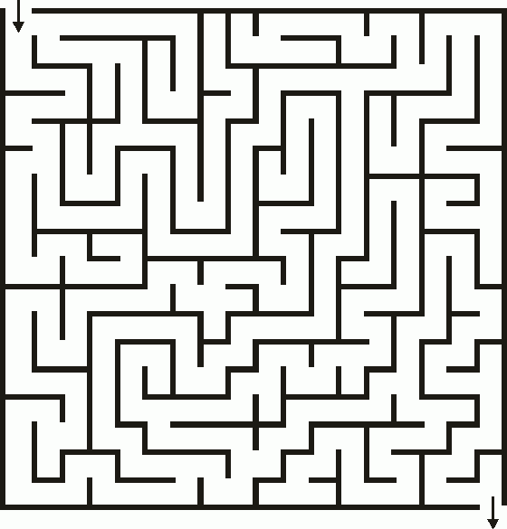
PROBLEM FORMULATION
Example: A Maze as a Search Problem
Initial state — the starting cell
State space — all reachable grid cells
Actions — move up, down, left, or right (if not blocked)
Transition model — moving in a direction leads to a neighboring cell
Goal test — reaching the exit cell
Path cost (optional) — number of steps taken
Lecture A — Classical & Local Search
5
Notes:
A maze is the cleanest possible instance of the six-part formulation — every part maps to something visually obvious. Good one to formalize together on the board before moving to a less visual example.

Slide 7
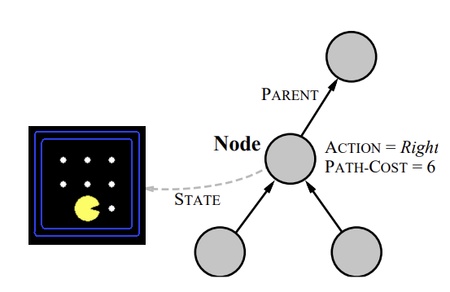
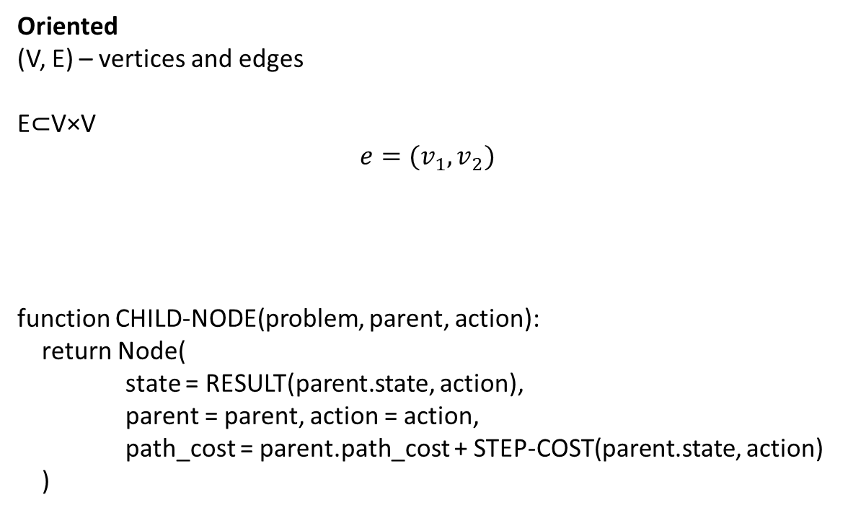
PROBLEM FORMULATION
Graphs and Nodes
Oriented
(V, E) – vertices and edges
E$⊂$V×V
$$e=(v_{1},v_{2})$$
function CHILD-NODE(problem, parent, action):
return Node(
state = RESULT(parent.state, action),
parent = parent, action = action,
path_cost = parent.path_cost + STEP-COST(parent.state, action)
)
Lecture A — Classical & Local Search
6
Notes:
This is the Romania road map — our running example for the rest of today's lecture. Initial state: a starting city (Arad). Goal test: reaching the destination (Bucharest). Path cost: total distance traveled. We'll use this exact map to compare every algorithm we cover.

Slide 8
PART 1
Uninformed Search
Using only the problem definition — no sense of which unexplored node is more promising
Notes:
Transition into the algorithm family. Everything in this section only ever asks 'is this a goal?' — nothing here knows anything about direction toward the goal. That's what Part 2 (informed search) adds.

Slide 9
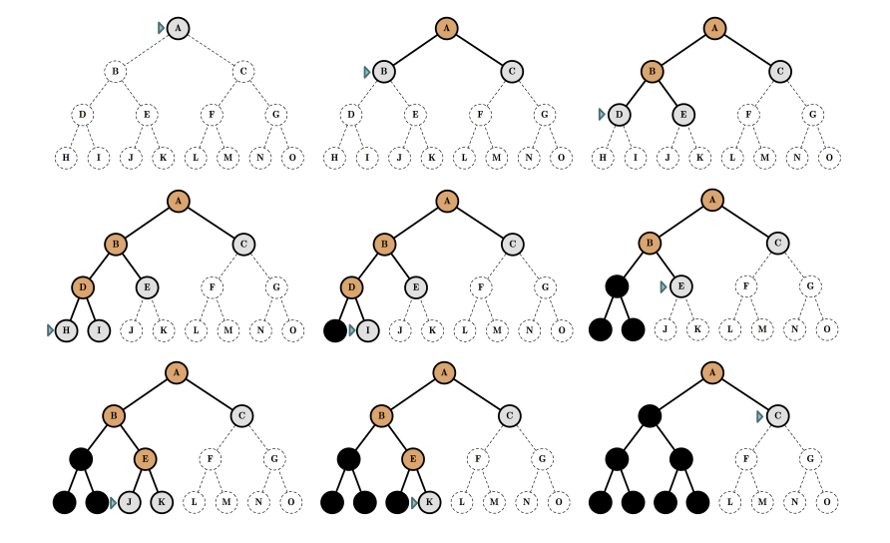
UNINFORMED SEARCH
Depth-First Search (DFS) frontier is a LIFO stack
Frontier — nodes generated but not yet expanded
Expansion — generating child nodes by applying actions to a selected node
Selection (the search strategy) — deciding which frontier node to expand next
function DFS(problem):
frontier ← Stack([Node(state=problem.initial, parent=None,
action=None, path_cost=0)])
explored ← {}
while frontier is not empty:
node ← frontier.pop()
if node.state in explored:
continue
explored.add(node.state)
if GOAL-TEST(node.state):
return SOLUTION(node)
for action in ACTIONS(problem, node.state):
child ← CHILD-NODE(problem, node, action)
if child.state not in explored:
frontier.push(child)
return failure
Lecture A — Classical & Local Search
8
Notes:
The 'why a stack' framing: DFS always follows the most recent choice as deep as possible — a stack naturally expands the most recently added node. Backtracking emerges for free from popping.

Slide 10
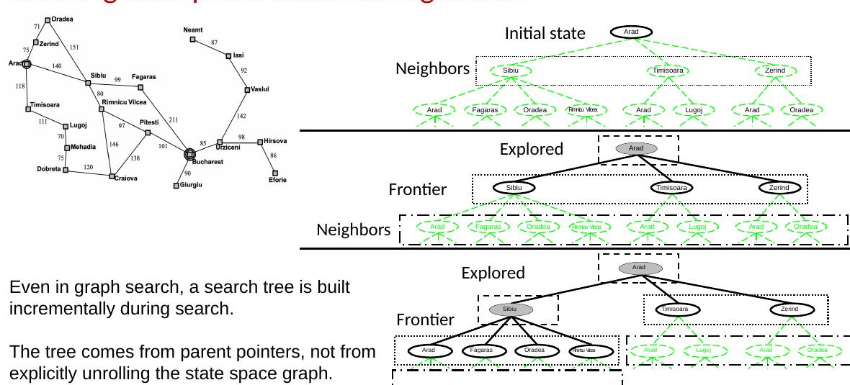
REPRESENTATION
Running Example: The Frontier During Search
Lecture A — Classical & Local Search
9
Notes:
Even in graph search, the search tree is built incrementally — it comes from parent pointers accumulated during search, not from unrolling the whole state space graph up front. Trace the Explored / Frontier / Neighbors regions across the three snapshots.

Slide 11
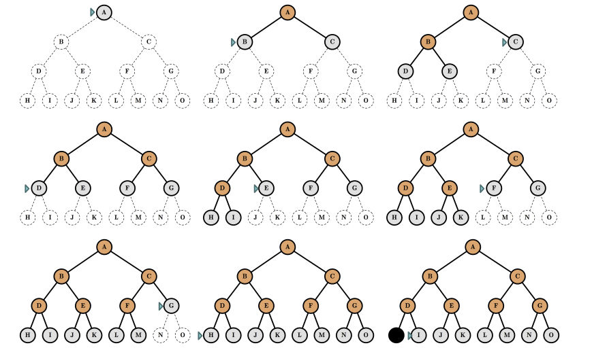
UNINFORMED SEARCH
Breadth-First Search (BFS) uses a FIFO stack
Strategy: expand the shallowest frontier node first
Implementation: frontier is a FIFO queue
Explores all possibilities level by level, systematically
All nodes at depth d enter the queue before any node at depth d+1
High memory — must store an entire frontier layer at once
function BFS(problem):
root ← Node(state=problem.initial, parent=None,
action=None, path_cost=0)
if GOAL-TEST(root.state):
return SOLUTION(root)
frontier ← Queue([root]) # FIFO, not a stack
frontier_states ← {root.state}
explored ← {}
while frontier is not empty:
node ← frontier.dequeue()
explored.add(node.state)
for action in ACTIONS(problem, node.state):
child ← CHILD-NODE(problem, node, action)
if child.state not in explored /
and child.state not in frontier_states:
if GOAL-TEST(child.state):
return SOLUTION(child)
frontier.enqueue(child)
frontier_states.add(child.state)
return failure
Lecture A — Classical & Local Search
10
Notes:
Direct contrast with DFS: same six lines of logic, one data structure swapped. That's the whole lesson of this pair of slides — make sure it lands before moving on.

Slide 12
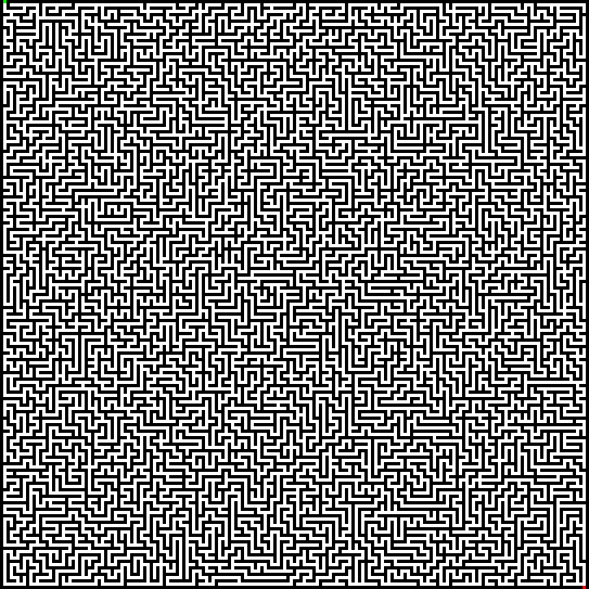
UNINFORMED SEARCH
Meet the Family: DFS, BFS
DFS
BFS
Source: Imgur
Lecture A — Classical & Local Search
11
Notes:
IDS (Iterative Deepening Search) runs depth-limited DFS with an increasing depth limit — it gets BFS's completeness with DFS's memory footprint, at the cost of repeated work. UCS (Uniform-Cost Search) expands the lowest cumulative-cost node first — it's Dijkstra's algorithm applied to search, and it's what you need the moment step costs aren't all equal.

Slide 13
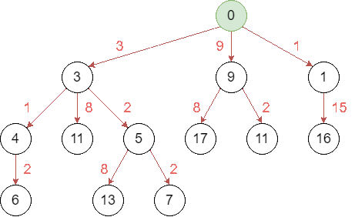
UNINFORMED SEARCH
Uniform-Cost Search (UCS)
Goal:
Find a path with minimal total cost
Strategy:
Expand the node with the lowest path cost g(n)
Implementation:
The frontier is stored in a min heap (or priority heap), ordered by cumulative cost
Source: Medium
Lecture A — Classical & Local Search
12
Notes:
Reference slide. The big-picture takeaway: BFS/IDS/UCS are all complete and (conditionally) optimal, but their time and space complexity are both exponential in the worst case — that exponential wall is exactly what motivates adding information via heuristics next.

Slide 14
PART 2
Informed Search
Adding a heuristic function h(n): an estimate of cost from n to the goal
Notes:
Everything in Part 1 ignored where the goal was. Everything from here on uses an estimate of distance-to-goal to aim the search rather than explore blindly.

Slide 15
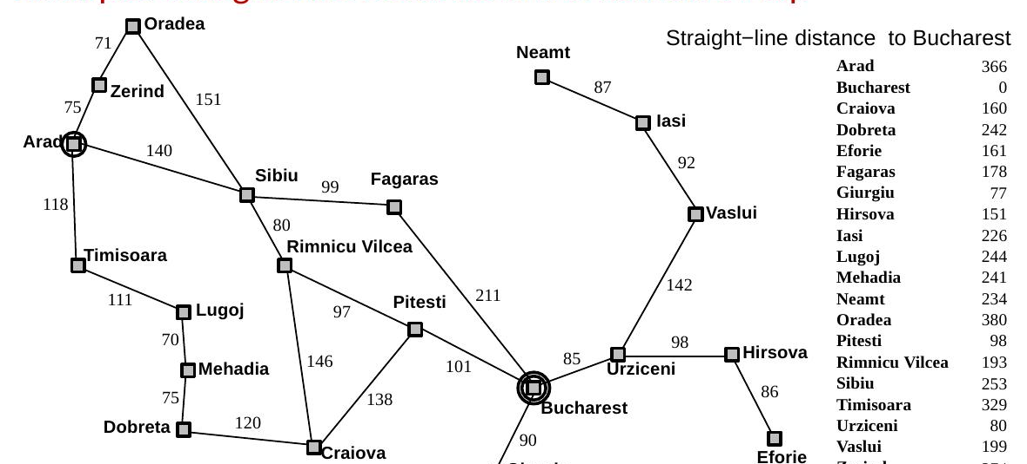
INFORMED SEARCH
Heuristic Functions: Straight-Line Distance
Lecture A — Classical & Local Search
13
Notes:
h(n) = straight-line distance from n to Bucharest, one fixed number per city, known in advance. This is the heuristic we'll use for every informed-search example today. Note it's an estimate, not a guarantee — the actual road distance can be longer.

Slide 16
INFORMED SEARCH
Best-First Search
Algorithm | Priority f(n) | What it prefers
Uniform-Cost Search (UCS) | f(n) = g(n) | cheapest path from start
Greedy Best-First Search | f(n) = h(n) | apparently closest to goal
A* | f(n) = g(n)+h(n) | best combination of cost-so-far + estimated remaining cost
Best-First Search | general framework | expand the node with smallest evaluation function
Lecture A — Classical & Local Search
14
Notes:
This slide is the pivot for the whole second half: informed search isn't a new algorithm family, it's the same best-first-search idea from UCS, now with an added term for 'how close does this look to the goal.'

Slide 17
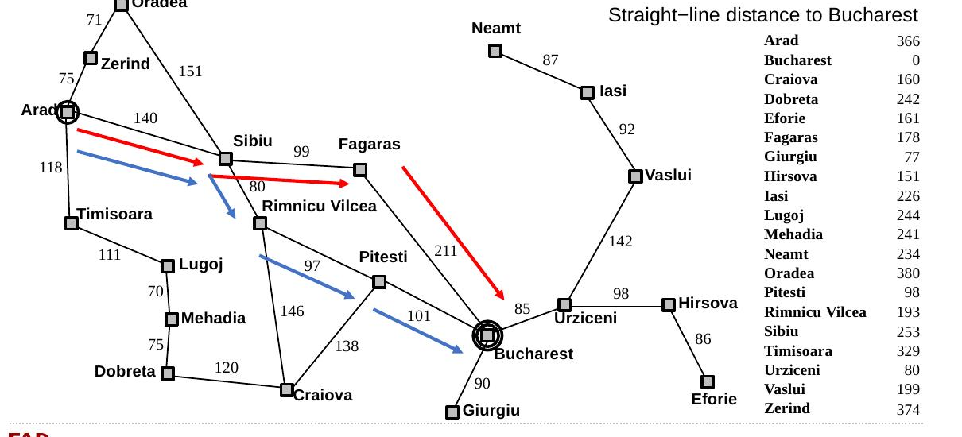
INFORMED SEARCH
Greedy Best-First Search: Romania Map
Lecture A — Classical & Local Search
15
Notes:
Greedy picks Arad → Sibiu → Fagaras → Bucharest, cost 450 — because Fagaras looks close to Bucharest in a straight line. It never considers that the road through Rimnicu Vilcea and Pitesti, while looking less direct, is actually shorter (418). Fewest nodes expanded, worse answer.

Slide 18
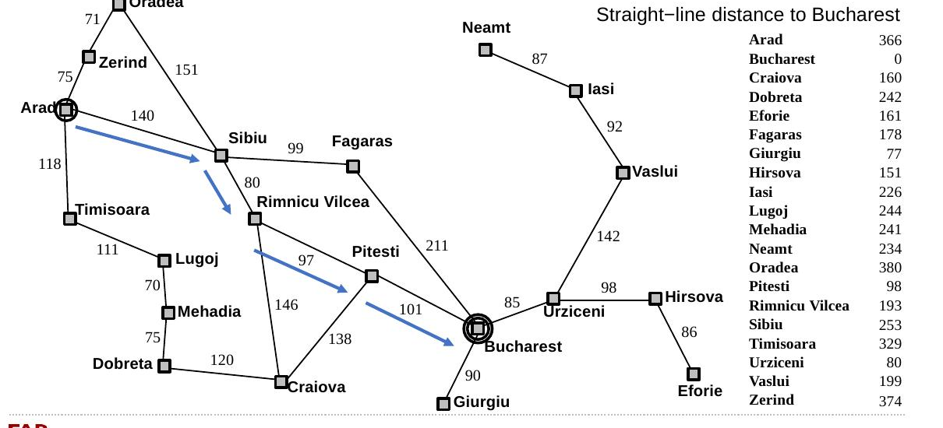
INFORMED SEARCH
A* Search: Romania Map
Lecture A — Classical & Local Search
16
Notes:
A* finds Arad → Sibiu → Rimnicu Vilcea → Pitesti → Bucharest, cost 418 — the true optimum. It expands more nodes than greedy did, but it never gets fooled the way greedy did, because it never forgets what a path has already cost.

Slide 19
PART 3
Local Search & Optimization
Trading completeness and optimality for constant memory and scalability
Notes:
Second half begins here. The N-Queens problem is the running example — you already have a full notebook implementation of everything in this section (hill-climbing, simulated annealing, genetic algorithm) to demo live or assign.

Slide 20
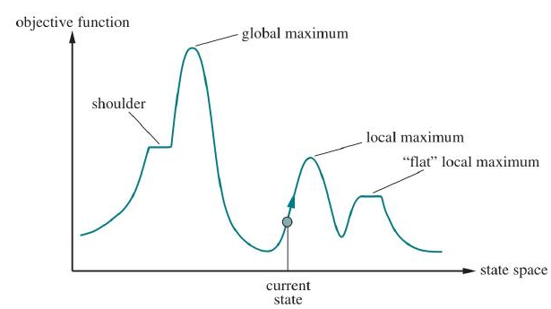
LOCAL SEARCH
The State Space as a Landscape
Each state is a complete configuration, not a partial path
An evaluation function J(x) assigns a quality to each state
Picture the state space as a landscape: states → locations, J(x) → elevation
Local moves define which states are neighbors — there is no global view of the landscape, only what's nearby
Search becomes movement: the algorithm moves from state to state based purely on local comparison
Lecture A — Classical & Local Search
17
Notes:
This single image is worth spending real time on — every local search algorithm for the rest of the lecture is a different strategy for moving around exactly this landscape: shoulders, plateaus, local maxima, the global maximum.

Slide 21
LOCAL SEARCH
Hill Climbing
Start from an initial state
Evaluate neighboring states using J(x)
Move to a neighbor with a higher value; repeat until no neighbor improves
Uses only local neighborhood information — no search tree, no backtracking, a single current state
Terminates at a local optimum — not necessarily the global one
function HILL_CLIMBING(state):
loop:
neighbor = highest-valued
successor of state
if neighbor.value <=
state.value:
return state
state = neighbor
# 'greedy local search' —
# always moves uphill,
# never accepts a worse move
Lecture A — Classical & Local Search
18
Notes:
Also called 'greedy local search' for the same reason greedy best-first search got its name — always take the immediately best-looking option, no lookahead.

Slide 22
LOCAL SEARCH
Dealing with Local Optima
Random-restart hill climbing — if stuck, restart from a new random state; repeat until solved
Guaranteed to eventually succeed on a finite state space, given enough restarts
Sideways moves — allow a bounded number of moves to equally-good neighbors, to cross plateaus
Both are still fundamentally hill climbing — the next two methods change the acceptance rule itself
Lecture A — Classical & Local Search
19
Notes:
In the notebook, random-restart hill-climbing hits 100% success 'by construction' — flag that this isn't really a fair efficiency comparison against simulated annealing or a genetic algorithm, since restarts have no fixed budget. Good discussion prompt already built into the notebook.

Slide 23
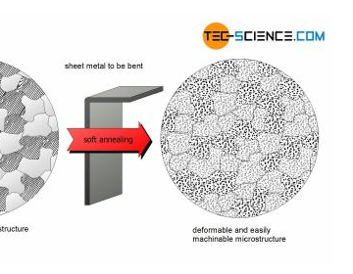
LOCAL SEARCH
Simulated Annealing
Physical intuition: annealing metal — heat it, then cool slowly so atoms settle into a low-energy structure
High temperature → exploration: allow moves that make things worse
Low temperature → exploitation: settle into good local structure
A worsening move is accepted with probability that shrinks as temperature cools — exactly like the physical process
With a slow enough cooling schedule, simulated annealing converges to the global optimum with probability approaching 1
Lecture A — Classical & Local Search
20
Notes:
The key idea worth stating explicitly: this is hill climbing with one rule relaxed — sometimes accept a worse move, and do so less and less often over time. In the N-Queens notebook, simulated annealing reliably outperforms plain hill-climbing.

Slide 24
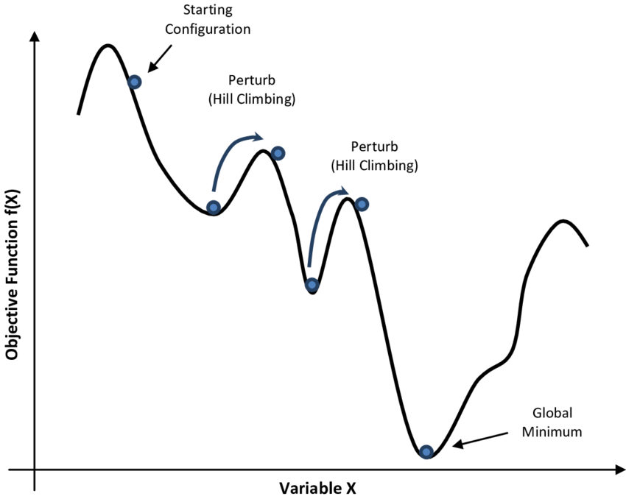
LOCAL SEARCH
Simulated Annealing
Core idea: relax hill climbing by allowing controlled non-improving moves (randomness is deliberate, not arbitrary)
Temperature controls behavior
  High temperature: worse moves are often accepted
  → enables escape from local optima
  Low temperature: worse moves are rarely accepted
  → behavior approaches hill climbing
Cooling schedule
  Gradually reduces randomness over time
  Governs the transition from exploration to exploitation
Landscape intuition
  Like gently shaking a ball on a rugged surface
  Strong shaking helps escape shallow traps, while weak shaking allows settling into a deep basin
Lecture A — Classical & Local Search
21
Notes:
Good moment for a live show-of-hands prediction before revealing the notebook's actual success-rate numbers for each method on 8-Queens.

Slide 25
LOCAL SEARCH
Local Beam Search
Keep k states instead of just one, generate all their successors, keep the best k overall
Not the same as k independent random restarts — the k states share information: a good state can 'recruit' the whole search toward its neighborhood
Can suffer from lack of diversity — all k states clustering in the same region of the landscape
A natural stepping stone toward maintaining a whole population — which is exactly what a genetic algorithm does next
Lecture A — Classical & Local Search
22
Notes:
One slide, kept brief by design — its main job here is as a conceptual bridge from 'one state' (hill climbing/SA) to 'a population' (genetic algorithms).

Slide 26
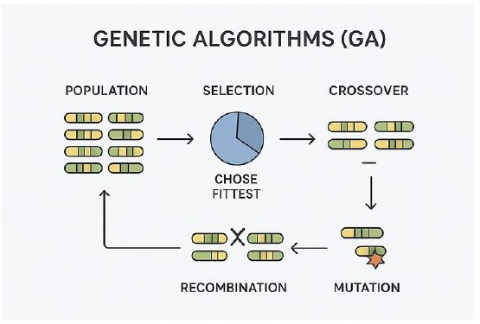
LOCAL SEARCH
Genetic Algorithms
A population-based search method inspired by biological evolution
Each state is encoded as a chromosome (often a bit string)
Selection — fitter individuals are more likely to reproduce
Crossover — parents exchange parts of their chromosomes
Mutation — small random changes maintain diversity
The population evolves toward better solutions over generations
Lecture A — Classical & Local Search
23
Notes:
This is local beam search with two additions: recombination (crossover mixes information between two states, not just selection among existing ones) and mutation (keeps the population from converging too early). Both examples on the next slide are genuinely fun to show live.

Slide 27
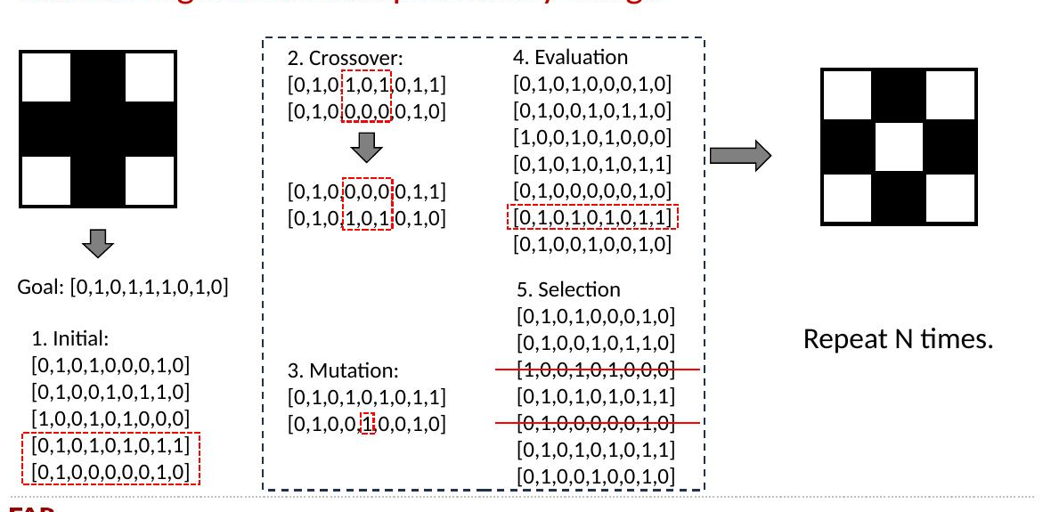
LOCAL SEARCH
Genetic Algorithm Example: A Minimal Trace
Lecture A — Classical & Local Search
24
Notes:
A small enough example to trace by hand: chromosomes are 8-bit strings representing a 3×3 checkerboard pattern. Walk through one generation live — initial population, crossover at a cut point, mutation flipping a single bit, evaluation against the goal string, and selection for the next generation.

Slide 28
WRAP-UP
Conclusions
Classical search: systematic exploration of paths, from blind (BFS/DFS/UCS) to informed (Greedy/A*)
A heuristic doesn't just speed things up — admissibility and consistency determine whether the answer is still guaranteed correct
Local search drops the path entirely: O(1) memory, at the cost of completeness and optimality guarantees
Hill climbing, simulated annealing, and genetic algorithms are three different answers to the same question: how do you move through a landscape you can only see locally?
Lecture A — Classical & Local Search
25
Notes:
Keep brief — signpost, not new content.

Slide 29

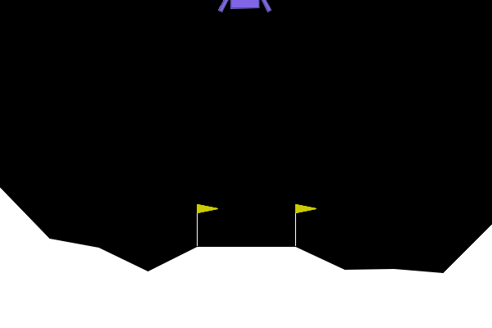
WRAP-UP
Gymnasium
https://github.com/anton-selitskiy/SB_TAI/blob/main/Week01/search_algorithms_frozenlake.ipynb
Lecture A — Classical & Local Search
25
Notes:
Keep brief — signpost, not new content.

