Slide 1


ExcellenTrip
Anton Rubenchik Iakov Aizenberg
Jonathan Shlomi Evgeny Shulga

Slide 2
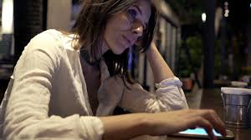
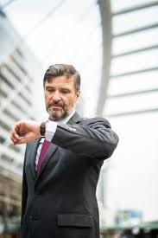

Problem to be solved
One-day trip disadvantages:
You are limited in time
You do not know the city (museums, theaters, shops etc.)
You want to get the maximum out of your time
We will provide the solution!

Slide 3
Our solution
MOBILE & WEB-BASED APPLICATION which provides fast trip evaluation based on user request: Shops, Food, Museums, Culture, Sight Seeing, Nature
A person, limited in time, will be able to enjoy a museum, visit a shop and even have time for a concert and will not miss the plane

Slide 4
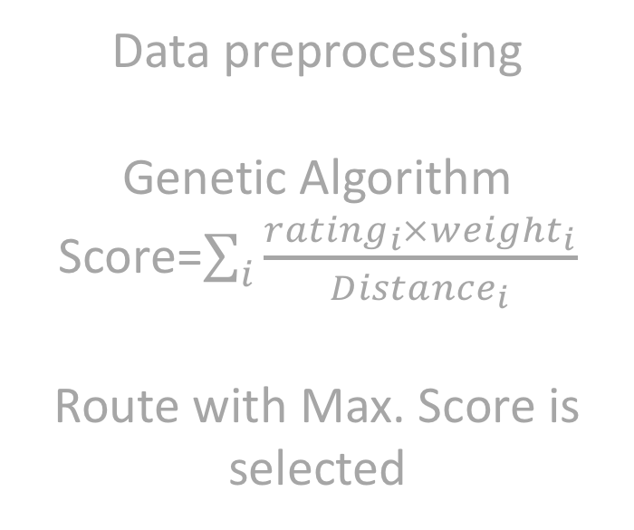
How it works?
Data collection
Data preprocessing
Genetic Algorithm
Score=$\sum_{i}{\frac{{rating}_{i}×{weight}_{i}}{{Distance}_{i}}}$
Route with Max. Score is selected
Optimal trip is found
Personal input

Slide 5
How it works?
Data collection
Optimal trip is found
Personal input

Slide 6
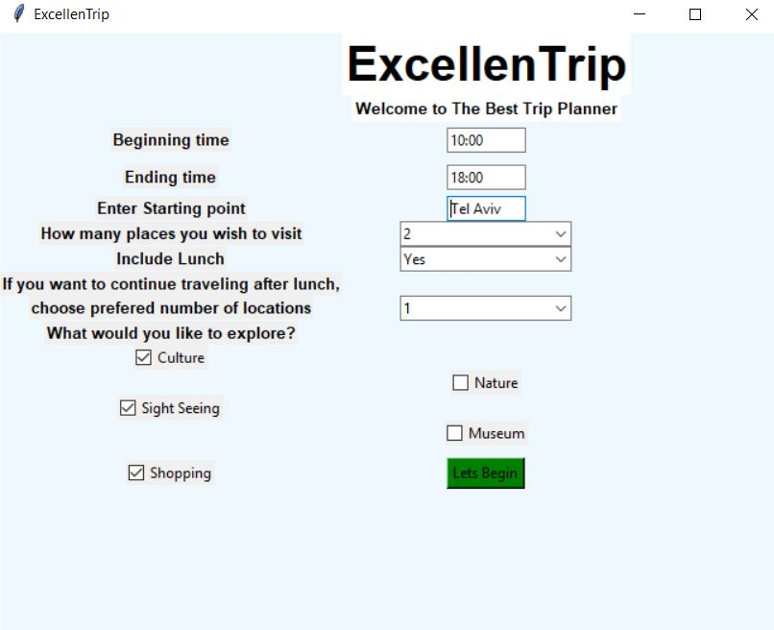
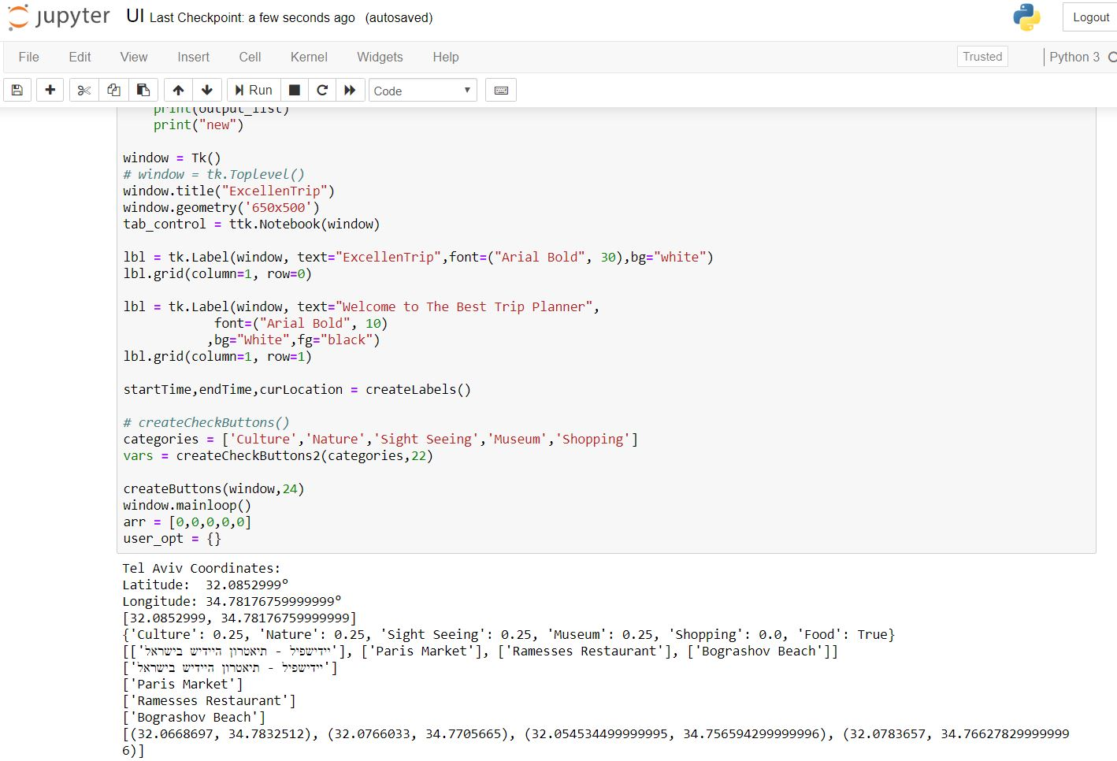
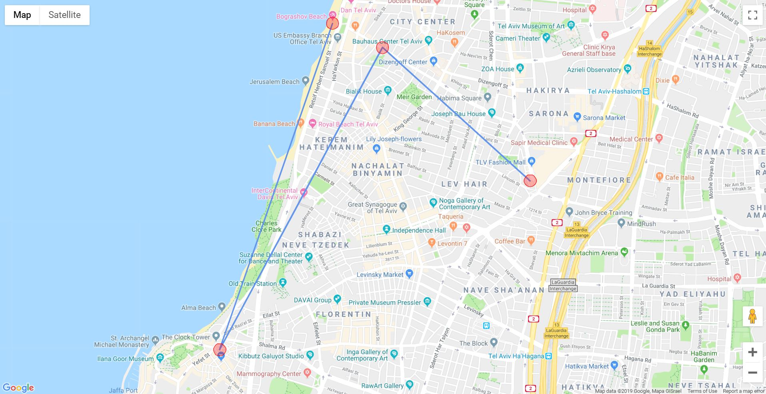
How it works?

Slide 7
Business model
In 2017, 3.6 M people visited Israel, and 9.4% of them for business
Each year, around 61.5 M European citizens travel for business
$
Shop
Theatre
etc.
Visitor
$
Adv
directions
%$
ExcellenTrip
request
Adv
Adv
Marketing: social networks (accounts of business coaches on Facebook and Instagram), partner programs with shops and attractions etc.

Slide 8





Our advantages
Competitors:
Main disadvantages:
Do not provide flexible trips
Take “huge” amount of time to setup a trip
Our Advantages:
Interactive interface
Time optimization
Provides service for busy users
Personal oriented
Provide small business with new customers
Future Plans:
Connection with Facebook and Instagram to provide predictions for future trips. Using the data collected from our users we’ll be ready to build more efficient algorithms.

Slide 9
Our team
Anton Rubenchik
antonru142@gmail.com
Iakov Aizenberg
iakov.aizenberg@gmail.com
Jonathan Shlomi
jonathanshlomi@gmail.com
Evgeny Shulga
eshulga@cern.ch
The Open University of Israel
BSc student in Computer Science
Weizmann Institute of Science
PhD student in Physics
Weizmann Institute of Science
PhD student in Physics
Weizmann Institute of Science
Post-Doc in Physics

Slide 10
Thank you for your attention

