Slide 1
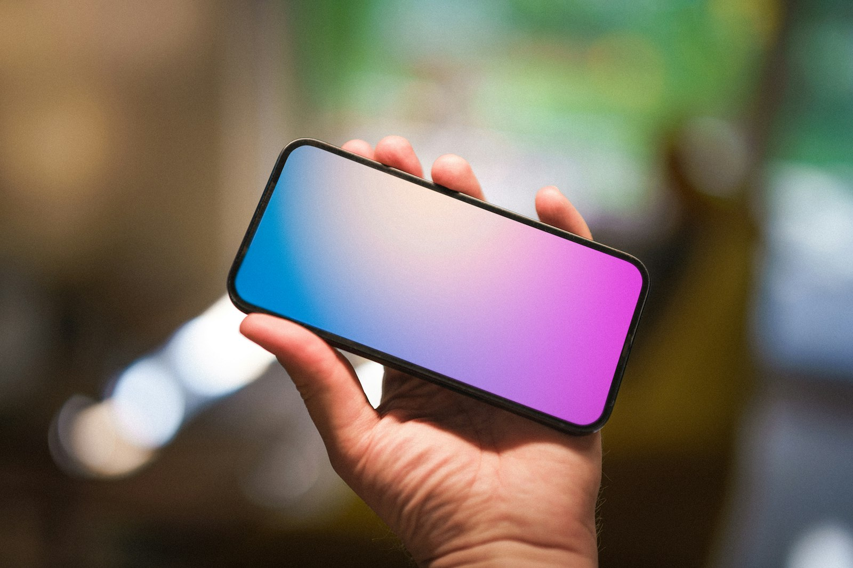
Notes:
Technology is everywhere. But behind every screen, every device, there's a human story — our story.

Slide 2

Notes:
We use technology to stay connected. Families, friends, even complete strangers — all within a tap.

Slide 3
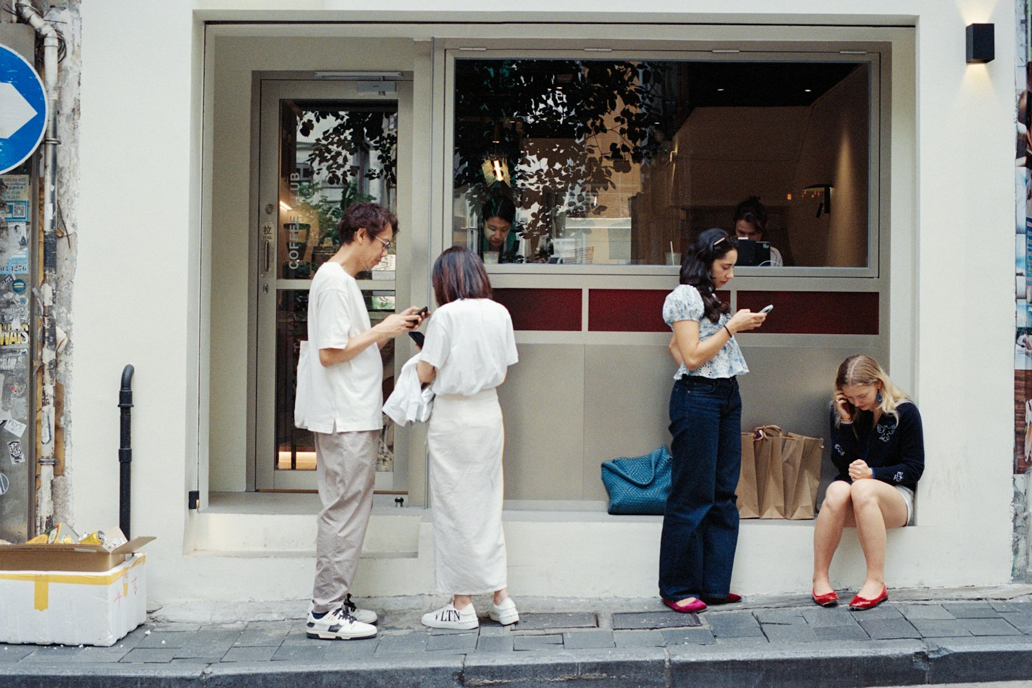
Notes:
But sometimes, the more connected we are online, the more disconnected we become in real life.

Slide 4
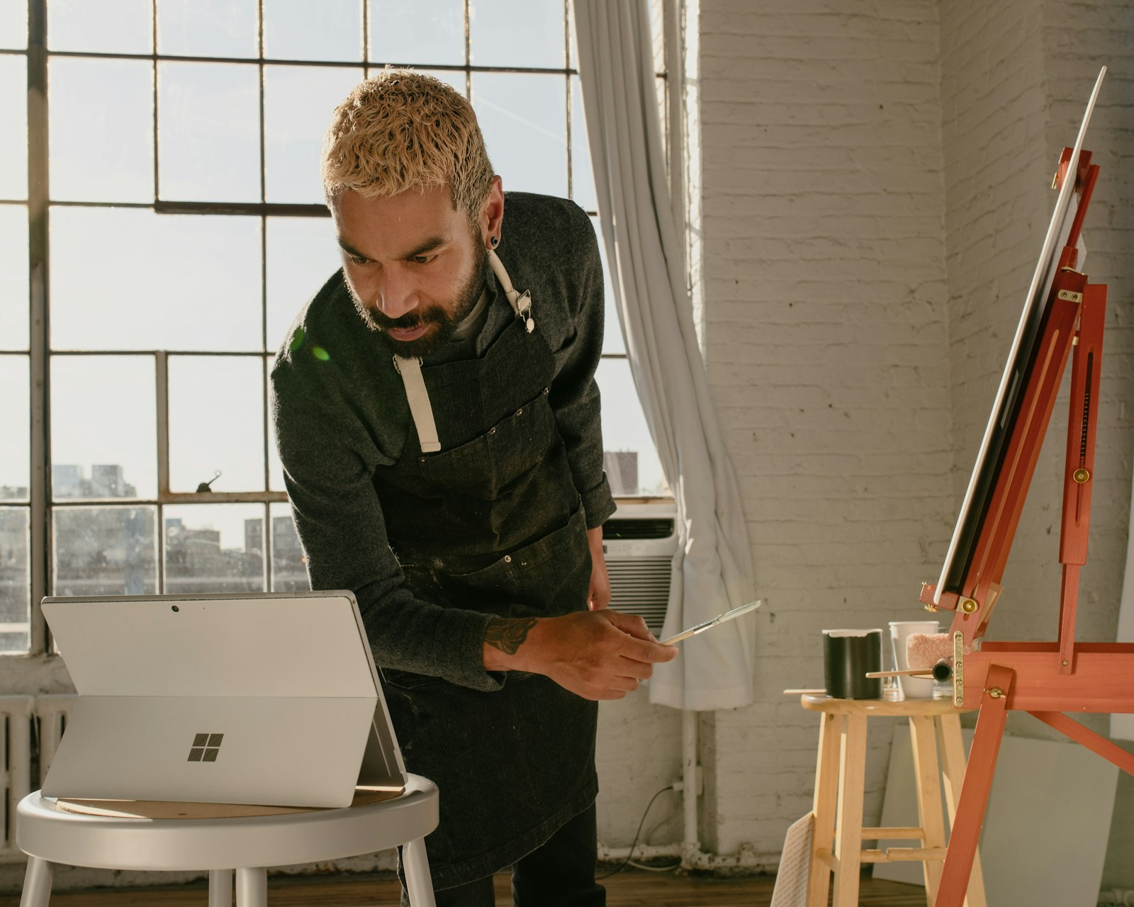
Notes:
Technology also sets our imagination free. We can create art, music, and worlds that never existed before.

Slide 5
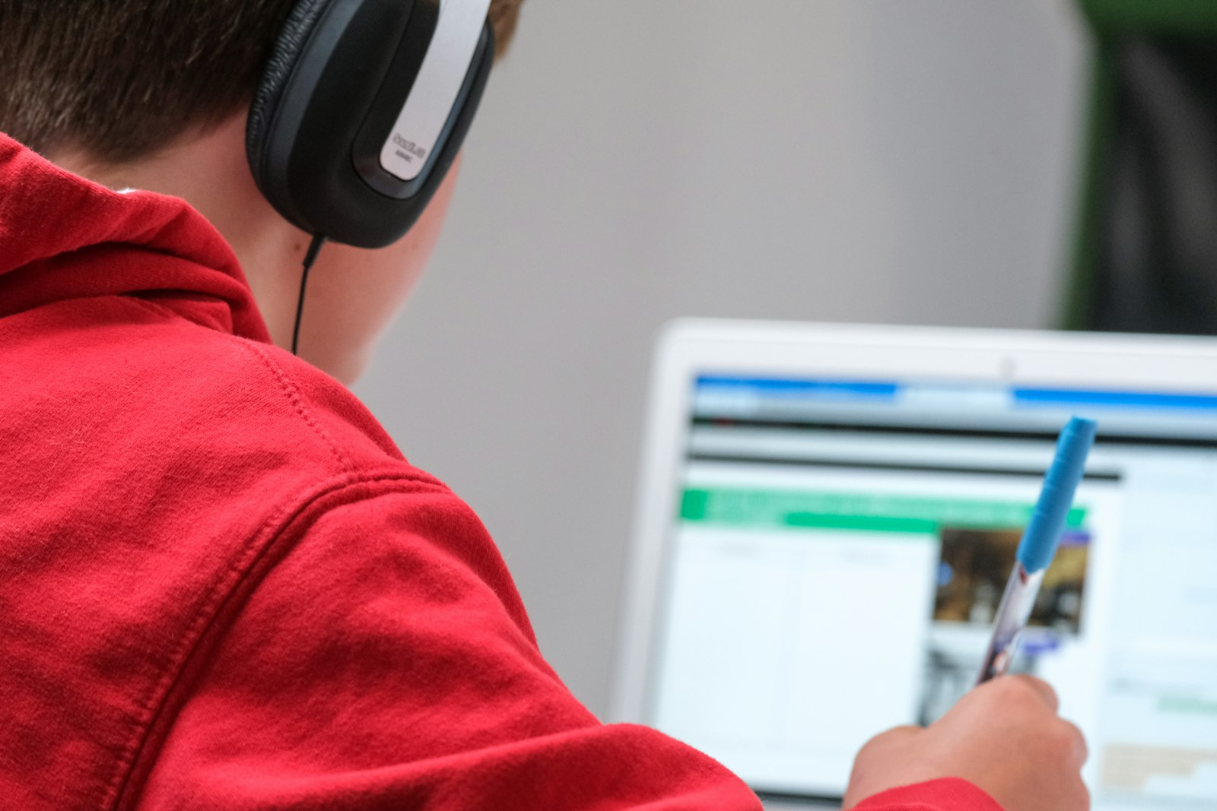
Notes:
Our jobs, our classrooms — they've moved into the digital world. Flexibility and freedom, but also pressure and burnout.

Slide 6
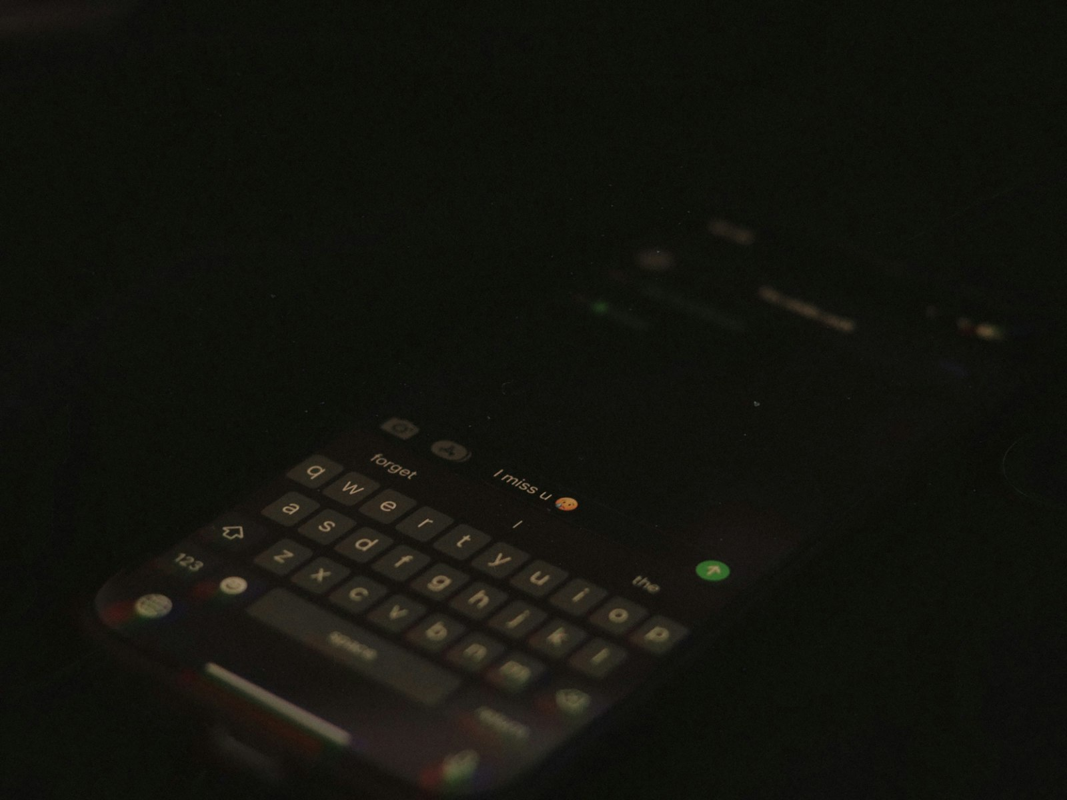
Notes:
We scroll, we click, we refresh. Sometimes technology doesn't serve us — it controls us.

Slide 7

Notes:
Yet technology can bring out the best in us. It helps us save lives, solve problems, and share kindness.

Slide 8

Notes:
Technology is not just about machines — it's about who we become when we use them. The question is: are we in control, or just along for the ride?

