Slide 1

The SBML Java™ library

Slide 2

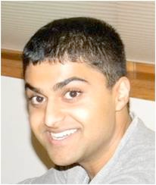

Concept of JSBML
Compromise
High compatibility to libSBML
Java-like library
Main developers
Nicolas Rodriguez, Alex Thomas, Andreas Dräger
Mailing lists:
private: jsbml-team@caltech.edu
public: jsbml-development@googlegroups.com

Slide 3

How to get started?

Slide 4
Obtaining JSBML
Every stable and experimental release is available for download at http://sourceforge.net/projects/jsbml/files/jsbml/
Download the file jsbml-X.Y-with-dependencies.jar
Once you have added it to the Java CLASSPATH, you can start working with JSBML.

Slide 5
How to compile JSBML-qual
Creating a JAR file with the latest code from the repository:
Checkout the sources from sourceforge
svn co svn://svn.code.sf.net/p/jsbml/code/trunk JSBML
cd JSBML/core
ant jar
cd ../extensions/qual
ant jar
now, include the jar file from core/build, core/lib, extension/qual/build
Generating a big jar, including JSBML-qual:
cd ../..
cp -v extensions/qual/build/*.jar core/lib/
cd core
ant bigjar
now, you have a jsbml-X.Y-with-dependencies.jar that contains JSBML-qual as well
Since JSBML 1.0β1 a precompiled version of JSBML-qual is already available for download at http://sourceforge.net/projects/jsbml/files/jsbml/

Slide 6
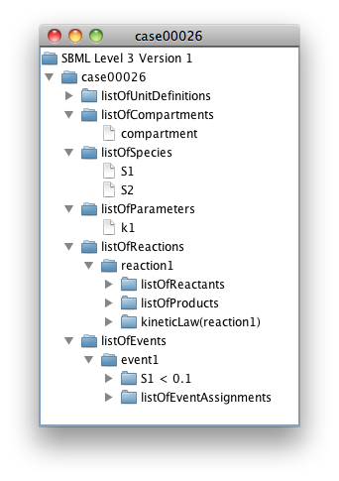
Visualizing the content of an SBML file
import java.io.File;
import javax.swing.*;
import org.sbml.jsbml.*;
/**
* Displays the content of an SBML file in a {@link JTree}
*/
public class JSBMLvisualizer extends JFrame {
/**
* @param document The SBML root node of an SBML file
*/
public JSBMLvisualizer(SBMLDocument document) {
super(document.getModel().getId());
getContentPane().add(new JScrollPane(new JTree(document)));
pack();
setVisible(true);
}
/**
* Main routine. Note: this does not perform any error checking,
* but should. It is an illustration only.
* @param args Expects a valid path to an SBML file.
*/
public static void main(String[] args) throws Exception {
UIManager.setLookAndFeel(UIManager.getSystemLookAndFeelClassName());
new JSBMLvisualizer(SBMLReader.read(new File(args[0])));
}
}
Example output when reading an SBML file with the code on the left from the SBML Test Suite with JSBML (on Mac OS X)
Notes:
TODO : Try to do an example with a qual model ?

Slide 7
How does XML parsing work?
Mapping between SBML elements and Java classes: /jsbml-trunk/resources/org/sbml/jsbml/resources/cfg/SBMLCoreElements.xml
Then each SBase has a readAttributes and writeAttributes methods that take care of reading and writing the attributes of the element.
The parsing is done in:
org.sbml.jsbml.xml.stax: main entry point of the parsing, using Stax.
org.sbml.jsbml.xml.parsers: parser independent of the underlying XML parsing library used.
For extension packages a similar parsing/writing mechanism is used

Slide 8
Creating a new SBML model from scratch
public JSBMLexample() throws Exception {
// Create a new SBMLDocument object, using SBML Level 3 Version 1.
SBMLDocument doc = new SBMLDocument(3, 1);
doc.addTreeNodeChangeListener(this);
// Create a new SBML model, and add a compartment to it.
Model model = doc.createModel("test_model");
Compartment compartment = model.createCompartment("default");
compartment.setSize(1d);
// Create a model history object and add author information to it.
History hist = model.getHistory(); // Will create the History, if it does not exist
Creator creator = new Creator("Given Name", "Family Name", "Organization", "My@EMail.com");
hist.addCreator(creator);
// Create some sample content in the SBML model.
Species specOne = model.createSpecies("test_spec1", compartment);
Species specTwo = model.createSpecies("test_spec2", compartment);
Reaction sbReaction = model.createReaction("reaction_id");
// Add a substrate (SBO:0000015) and product (SBO:0000011) to the reaction.
SpeciesReference subs = sbReaction.createReactant(specOne);
subs.setSBOTerm(15);
SpeciesReference prod = sbReaction.createProduct(specTwo);
prod.setSBOTerm(11);
// For brevity, WE DO NOT PERFORM ERROR CHECKING, but you should,
// using the method doc.checkConsistency() and then checking the error log.
// Write the SBML document to a file.
SBMLWriter.write(doc, "test.xml", "JSBMLexample", "1.0");
}

Slide 9
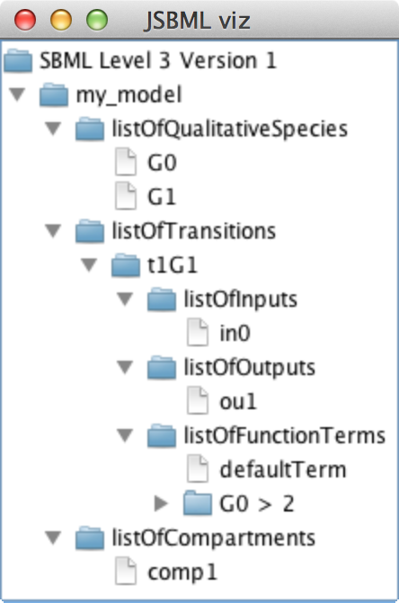
How to create a simple qual model in JSBML?
int level = 3, version = 1;
SBMLDocument doc = new SBMLDocument(level, version);
Model model = doc.createModel("my_model");
// Creating the qualitative model extension and adding it to the document
QualModelPlugin qualPlugin = new QualModelPlugin(model);
model.addExtension(QualConstants.getNamespaceURI(level, version), qualPlugin);
// ListOfCompartments
Compartment comp1 = model.createCompartment("comp1");
comp1.setConstant(true);
// ListOfQualitativeSpecies
QualitativeSpecies g0 = qualPlugin.createQualitativeSpecies("G0", comp1, false);
QualitativeSpecies g1 = qualPlugin.createQualitativeSpecies("G1", comp1, false);
// ListOfTransitions
Transition t1G1 = qualPlugin.createTransition("t1G1");
// ListOfInputs
t1G1.createInput("in0", g0, InputTransitionEffect.consumption);
// ListOfOutputs
t1G1.createOutput("ou1", g1, OutputTransitionEffect.assignmentLevel);
// ListOfFunctionTerms
FunctionTerm defTerm = new FunctionTerm(level, version);
defTerm.setDefaultTerm(true);
defTerm.setResultLevel(0);
FunctionTerm ft1 = new FunctionTerm(level, version);
ft1.setResultLevel(1);
try {
ft1.setMath(ASTNode.parseFormula("G0 > 2"));
} catch (ParseException exc) {
exc.printStackTrace();
}
// G0 and G1
ASTNode andNode = new ASTNode(ASTNode.Type.LOGICAL_AND);
andNode.addChild(new ASTNode(g0.getId()));
andNode.addChild(new ASTNode(g1.getId()));
t1G1.addFunctionTerm(defTerm);
t1G1.addFunctionTerm(ft1);

Slide 10
The resulting Qual model
<?xml version='1.0' encoding='UTF-8' standalone='no'?>
<sbml xmlns="http://www.sbml.org/sbml/level3/version1/core" qual:required="true" level="3" xmlns:qual="http://www.sbml.org/sbml/level3/version1/qual/version1" version="1">
<model id="my_model">
<qual:listOfQualitativeSpecies xmlns:qual="http://www.sbml.org/sbml/level3/version1/qual/version1">
<qual:qualitativeSpecies qual:constant="false" qual:compartment="comp1" qual:id="G0"/>
<qual:qualitativeSpecies qual:constant="false" qual:compartment="comp1" qual:id="G1"/>
</qual:listOfQualitativeSpecies>
<qual:listOfTransitions xmlns:qual="http://www.sbml.org/sbml/level3/version1/qual/version1">
<qual:transition qual:id="t1G1">
<qual:listOfInputs>
<qual:input qual:transitionEffect="consumption" qual:qualitativeSpecies="G0" qual:id="in0"/>
</qual:listOfInputs>
<qual:listOfOutputs>
<qual:output qual:transitionEffect="assignmentLevel" qual:qualitativeSpecies="G1" qual:id="ou1"/>
</qual:listOfOutputs>
<qual:listOfFunctionTerms>
<qual:defaultTerm qual:resultLevel="0">
</qual:defaultTerm>
<qual:functionTerm qual:resultLevel="1">
<math xmlns="http://www.w3.org/1998/Math/MathML">
<apply>
<gt/>
<ci> G0 </ci>
<cn type="integer"> 2 </cn>
</apply>
</math>
</qual:functionTerm>
</qual:listOfFunctionTerms>
</qual:transition>
</qual:listOfTransitions>
<listOfCompartments>
<compartment id="comp1" constant="true"/>
</listOfCompartments>
</model>
</sbml>

Slide 11
Recent Changes in JSBML with relevance for qual
File /core/resources/org/sbml/jsbml/resources/cfg/PackageParserNamespaces.xml has been deleted
SBMLReader and SBMLWriter now based on Java annotations ⇾ when using Eclipse and directly operating on the trunk, configuration needs to be updated as described here: https://code.google.com/p/spi/wiki/EclipseSettings
libSBML now also supports qual and the SBML online validator validates qual models
Naming conventions of qual objects: QualitativeModel is now deprecated (at the moment in the trunk, but at latest with the next release of 1.0 also in the stable version)
Please use QualModelPlugin instead. Reason: Compatibility to libSBML’s naming conventions
Improved support for MAVEN: All pom.xml files have been updated

Slide 12
Modules

Slide 13
Download of modules
LibSBML input/output:
svn co svn://svn.code.sf.net/p/jsbml/code/trunk/modules/libSBMLio libSBMLio
CellDesigner bridge:
svn co svn://svn.code.sf.net/p/jsbml/code/trunk/modules/celldesigner celldesigner
Further modules: Android, compare, libSBMLcompat
LibSBML compatibility module for switching between libSBML and JSBML still under development

Slide 14
LibSBML module
public static void main(String[] args) {
try {
// Load LibSBML:
System.loadLibrary("sbmlj");
// Extra check to be sure we have access to libSBML:
Class.forName("org.sbml.libsbml.libsbml");
// Read SBML file using LibSBML and convert it to JSBML:
SBMLInputConverter<org.sbml.libsbml.Model> reader = new LibSBMLReader();
SBMLDocument doc = reader.convertSBMLDocument(args[0]);
//SBMLDocument doc = new SBMLDocument(2,4);
org.sbml.libsbml.SBMLDocument libDoc = reader.getOriginalModel().getSBMLDocument();
//org.sbml.libsbml.SBMLDocument libDoc = new org.sbml.libsbml.SBMLDocument(2,4);
doc.addTreeNodeChangeListener(new LibSBMLChangeListener(libDoc));
// Run some application:
new JSBMLVisualizer(doc);
} catch (Throwable exc) {
exc.printStackTrace();
}
}

Slide 15

CellDesigner module
Turning an existing application into a plugin for CellDesigner
Only implementation of two abstract classes required
Declares
Invokes
PluginAction
CellDesignerPlugin
Loads on start
Calls
CellDesigner

Slide 16
CellDesigner module: Example for a PluginAction
public class SimpleCellDesignerPluginAction extends PluginAction {
/** The plugin that is triggered when this object receives appropriate actions. */
private SimpleCellDesignerPlugin plugin;
/** @param plugin */
public SimpleCellDesignerPluginAction(SimpleCellDesignerPlugin plugin) {
this.plugin = plugin;
}
@Override
public void myActionPerformed(ActionEvent evt) {
if (evt.getSource() instanceof JMenuItem) {
JMenuItem item = (JMenuItem) evt.getSource();
if (item.getText().equals(SimpleCellDesignerPlugin.ACTION)) {
try {
plugin.startPlugin();
} catch (XMLStreamException exc) {
JOptionPane.showMessageDialog(item, exc.getMessage(),
exc.getClass().toString(), JOptionPane.ERROR_MESSAGE);
exc.printStackTrace();
}
}
} else {
JOptionPane.showMessageDialog(null, "Unsupported source of action "
+ evt.getSource().getClass().getName(), "Invalid Action",
JOptionPane.WARNING_MESSAGE);
}
}
}

Slide 17
CellDesigner module: Example for a CellDesignerPlugin
public class SimpleCellDesignerPlugin extends AbstractCellDesignerPlugin {
public static final String ACTION = "Display full model tree";
public static final String APPLICATION_NAME = "Simple Plugin";
private PluginSBMLReader reader;
/** Creates a new CellDesigner plugin with an entry in the menu bar. */
public SimpleCellDesignerPlugin() {
try {
reader = new PluginSBMLReader(SBO.getPossibleEnzymes());
addPluginMenu();
} catch (Throwable exc) {
exc.printStackTrace();
}
}
@Override
public void addPluginMenu() {
PluginMenu menu = new PluginMenu(APPLICATION_NAME);
PluginMenuItem menuItem = new PluginMenuItem(ACTION, new SimpleCellDesignerPluginAction(this));
menu.add(menuItem);
}
/** Performs the action for which this plugin is designed.
* @throws XMLStreamException If the given SBML model contains errors.
*/
public void startPlugin() throws XMLStreamException {
Model model = reader.convertModel(getSelectedModel());
model.getSBMLDocument().addTreeNodeChangeListener(new PluginChangeListener(this));
new JSBMLvisualizer(model.getSBMLDocument());
}
}

Slide 18
Some more details

Slide 19
Using annotation
Species species = model.createSpecies("species", comp1);
species.addCVTerm(new CVTerm(CVTerm.Qualifier.BQB_IS,
"http://identifiers.org/go/GO:0006915",
"http://identifiers.org/kegg.genes/hsa:321"));
species.addCVTerm(new CVTerm(CVTerm.Qualifier.BQB_IS_DESCRIBED_BY,
"http://identifiers.org/pubmed/16333295"));
species.addCVTerm(new CVTerm(CVTerm.Qualifier.BQB_IS_ENCODED_BY,
"http://identifiers.org/ensembl/ENSG00000085662"));
species.addCVTerm(new CVTerm(CVTerm.Qualifier.BQB_OCCURS_IN,
"http://identifiers.org/kegg.reaction/R01787"));
/* This method call will return a List of Species that are annotated with the Qualifier
* 'occursIn' and a resource attached to this qualifier that contains the String 'kegg'.
*/
model.getListOfSpecies().filter(new CVTermFilter(CVTerm.Qualifier.BQB_OCCURS_IN, ".*kegg.*"));

Slide 20
How to contribute
Creating a patch:
Checkout the sources from sourceforge
svn co svn://svn.code.sf.net/p/jsbml/code/trunk JSBML
Do your modifications, then create a patch file:
svn diff > jsbml-patch.txt
Attach it to a tracker item or send it through the development list.
Bug tracker: http://sourceforge.net/p/jsbml/bugs/
Pivotal : https://www.pivotaltracker.com/projects/499447
Mailing lists:
jsbml-development@caltech.edu: public list with discussion about the development of JSBML and support for users.
jsbml-team@caltech.edu: private list for the JSBML team were anybody can send mails for support or bugs reports.

Slide 21

Thanks http://sbml.org/Software/JSBML

