Slide 1

The SBML Java™ library

Slide 2
Concept of JSBML
Compromise:
High compatibility to libSBML
Java-like library
Main developers
Nicolas Rodriguez and Andreas Dräger
Both available during the meeting any time to answer JSBML-related questions

Slide 3

How to get started?

Slide 4
Obtaining JSBML
https://sourceforge.net/projects/jsbml/files/jsbml/0.8-b2/
Download the file jsbml-0.8-b2-with-dependencies.jar.
Once you have added it to the Java CLASSPATH, you can start working with JSBML.

Slide 5
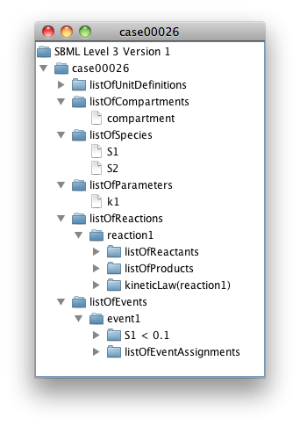
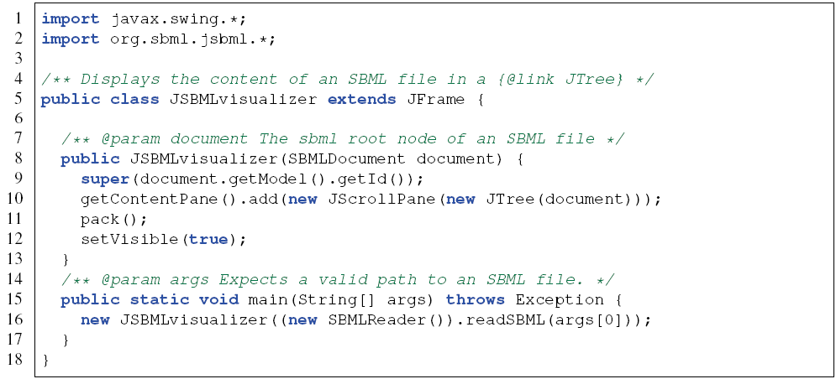
Visualizing the content of an SBML file

Slide 6
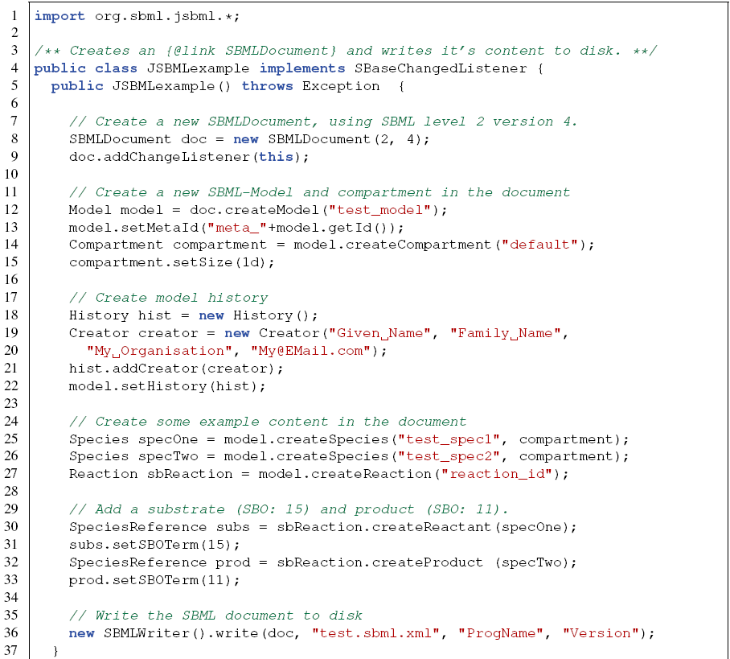
Creating a new model

Slide 7
Listening to changes
public void sbaseAdded(SBase sb) {
System.out.println("[ADD] " + sb);
}
public void sbaseRemoved(SBase sb) {
System.out.println("[RMV] " + sb);
}
public void stateChanged(SBaseChangedEvent ev) {
System.out.println("[CHG] " + ev);
}

Slide 8
Data types

Slide 9
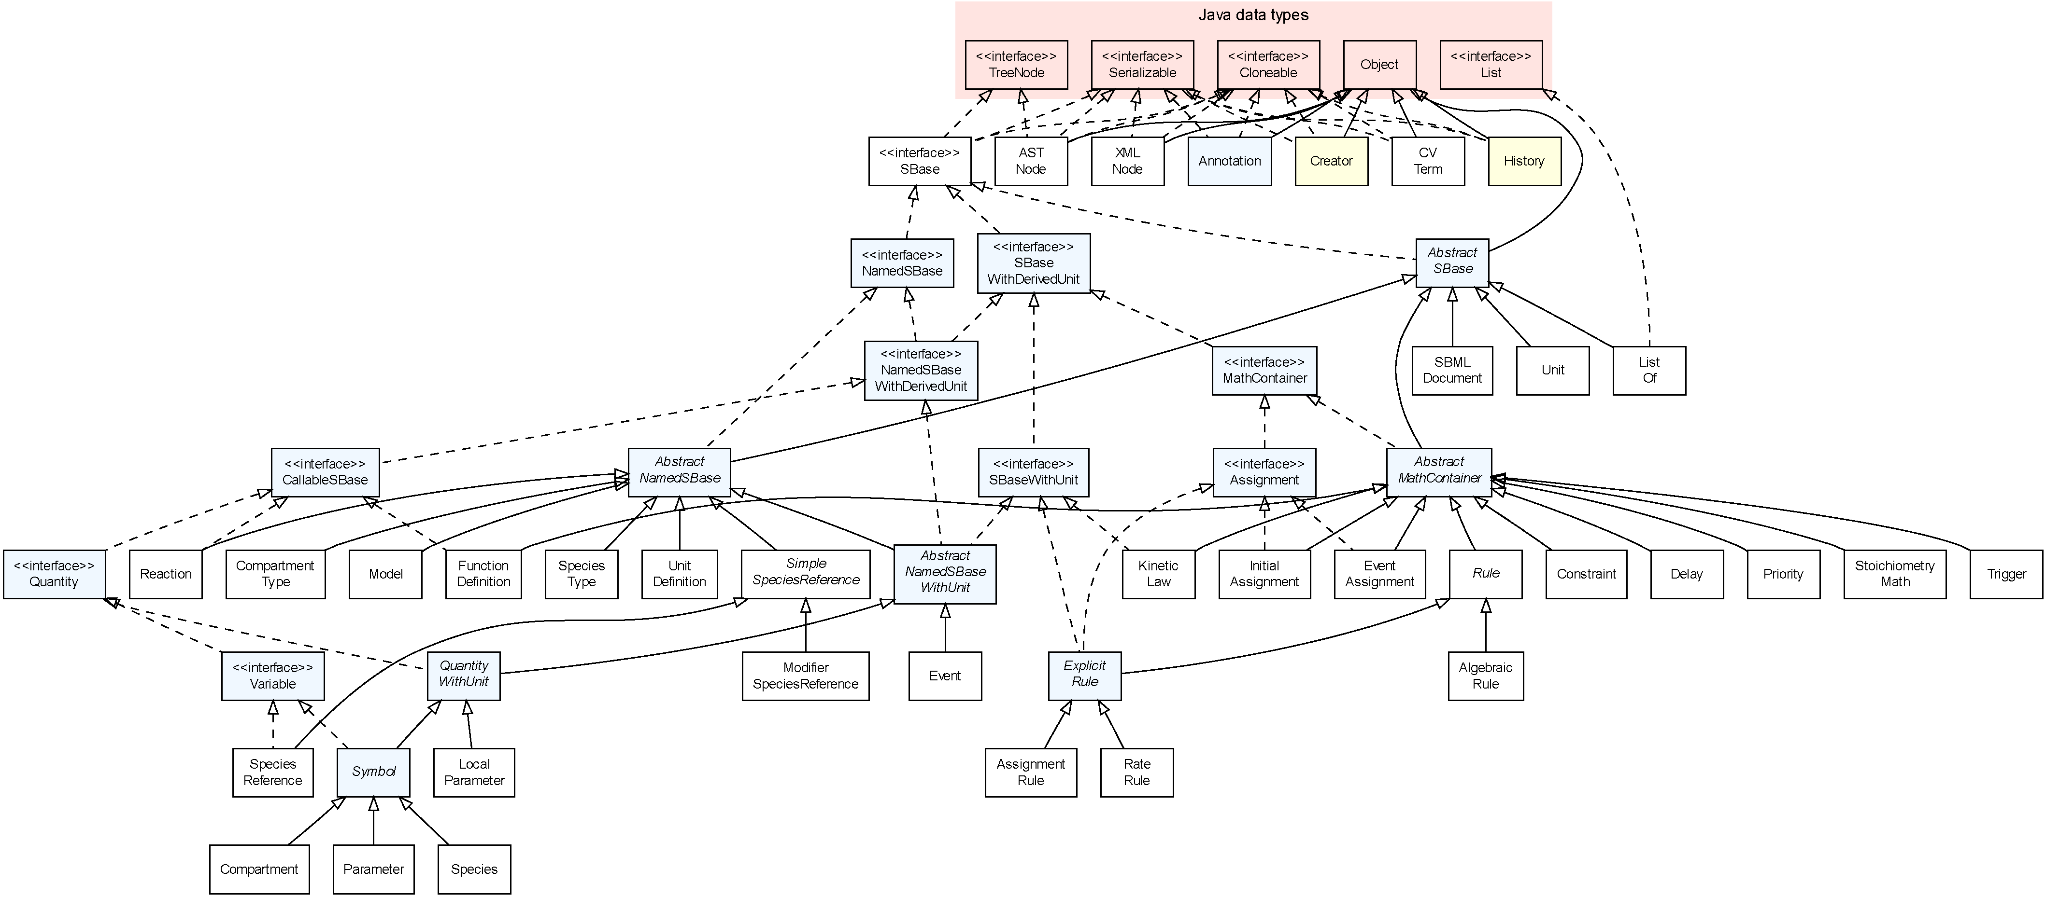
Type hierarchy

Slide 10
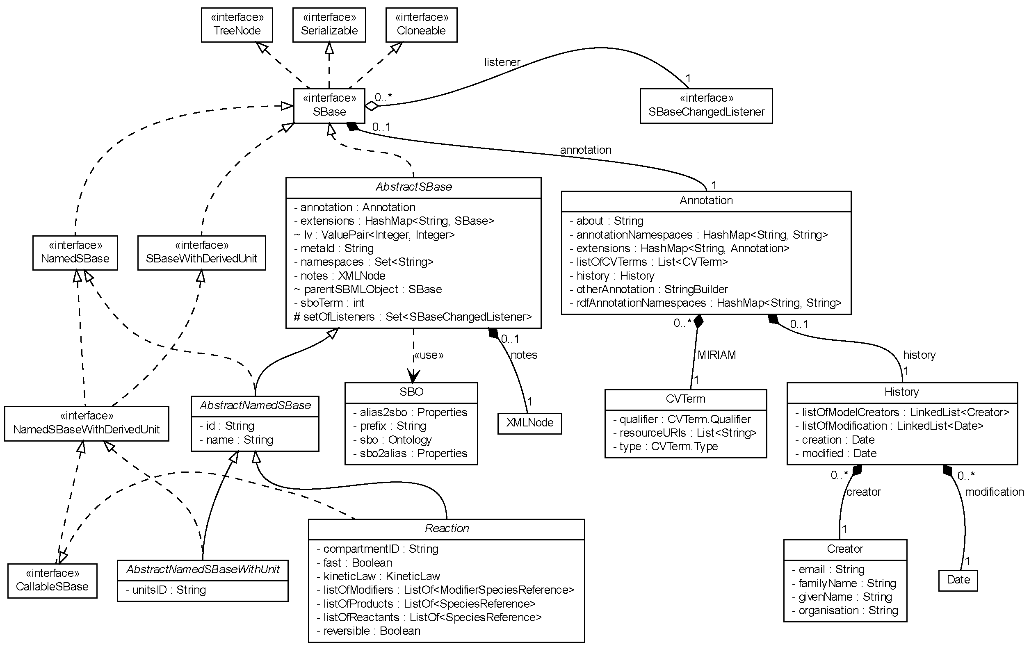
Closer look at the interface SBase

Slide 11
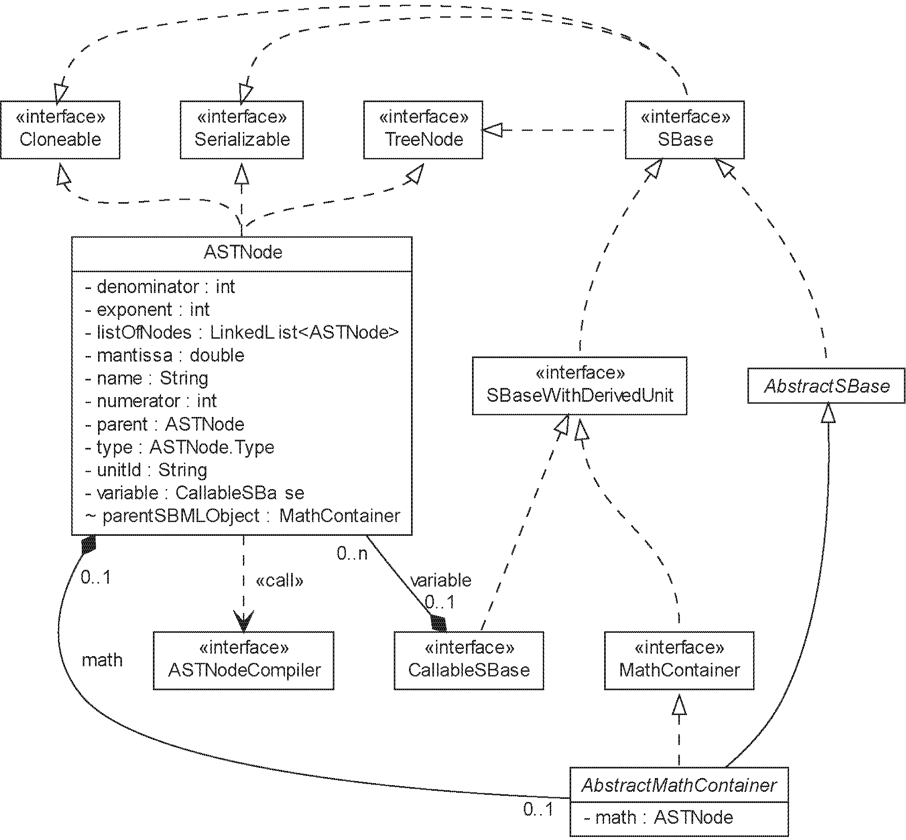
Representation of mathematical equations as ASTNode

Slide 12
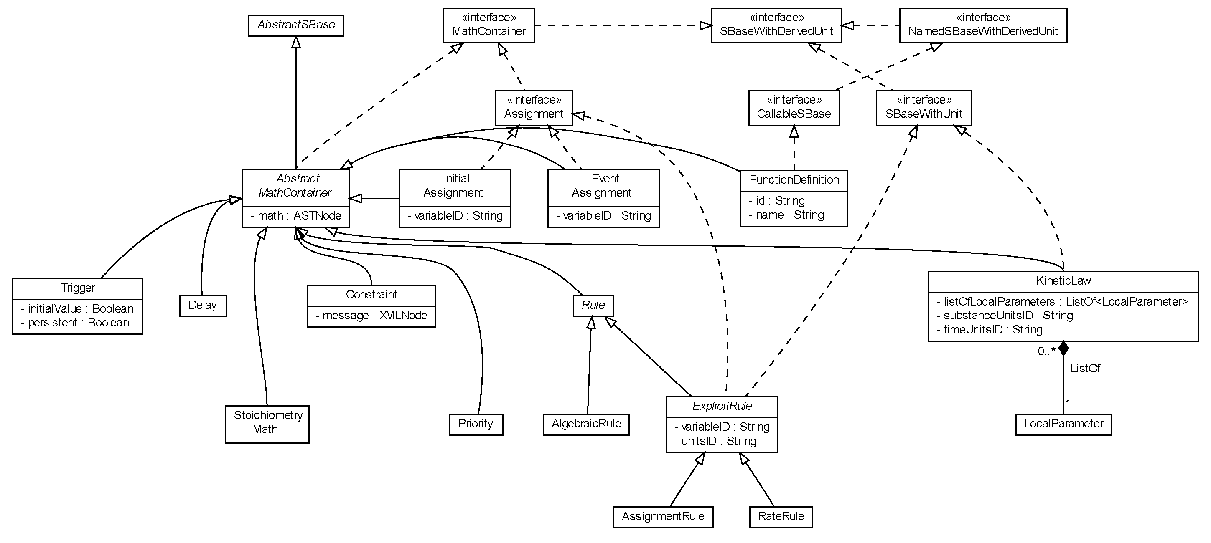
Closer look at the interface MathContainer

Slide 13
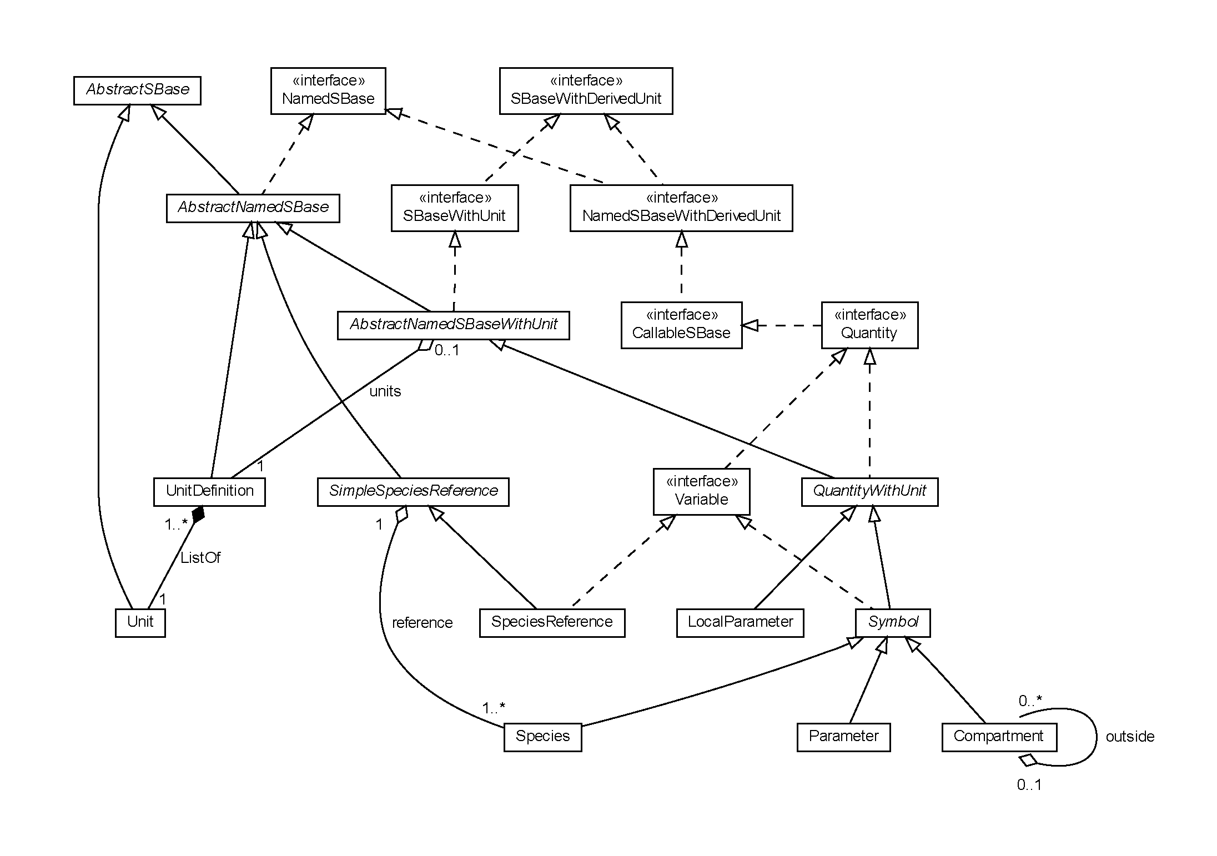
The relationship between instances of the interface Variable

Slide 14
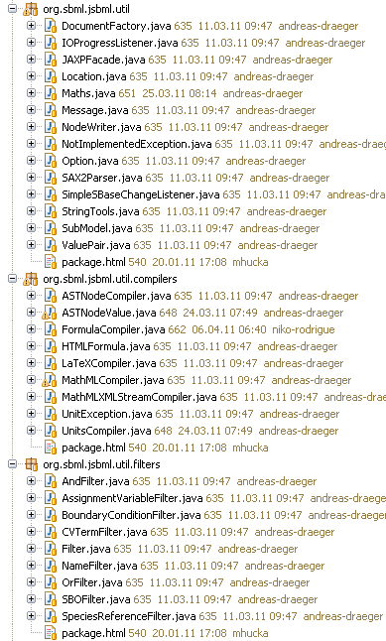
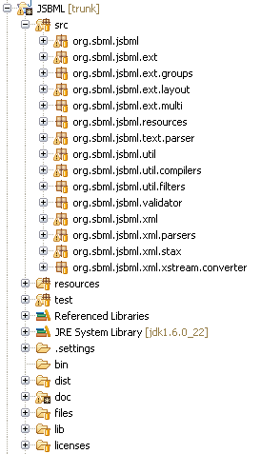
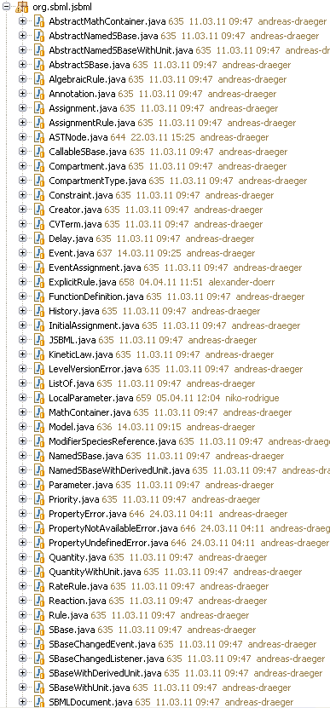
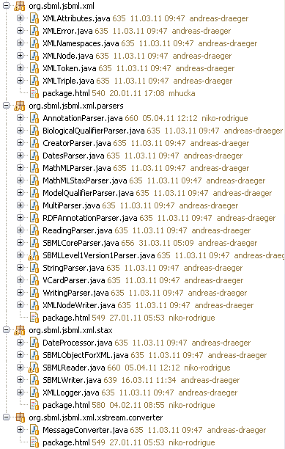
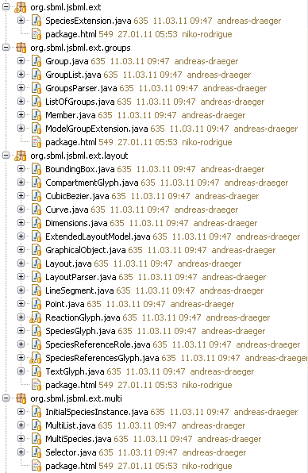
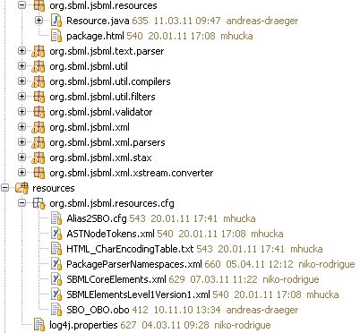
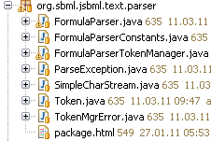

Package structure

Slide 15
Modules

Slide 16
Download of modules
LibSBML input/output:
svn co "https://jsbml.svn.sourceforge.net/svnroot/jsbml/modules/libSBMLio/"
libSBMLio
CellDesigner bridge:
svn co "https://jsbml.svn.sourceforge.net/svnroot/jsbml/modules/cellDesigner"
cellDesigner
LibSBML compatibility module for switching between libSBML and JSBML still under development

Slide 17
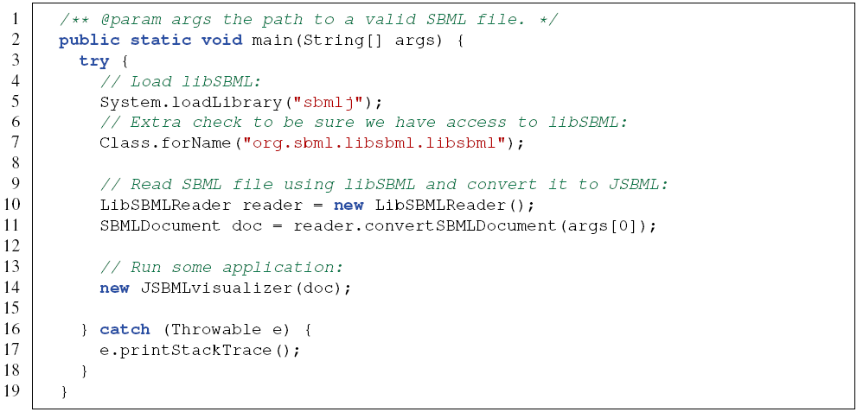
LibSBML module

Slide 18

CellDesigner module
Turning an existing application into a plugin for CellDesigner
Only implementation of two abstract classes required
Declares
Invokes
PluginAction
CellDesignerPlugin
Loads on start
Calls
CellDesigner

Slide 19
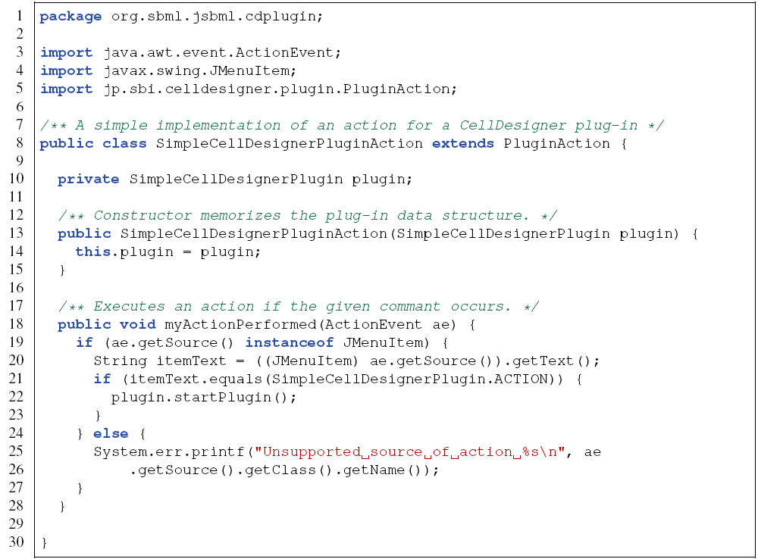
CellDesigner module: Example for a PluginAction

Slide 20
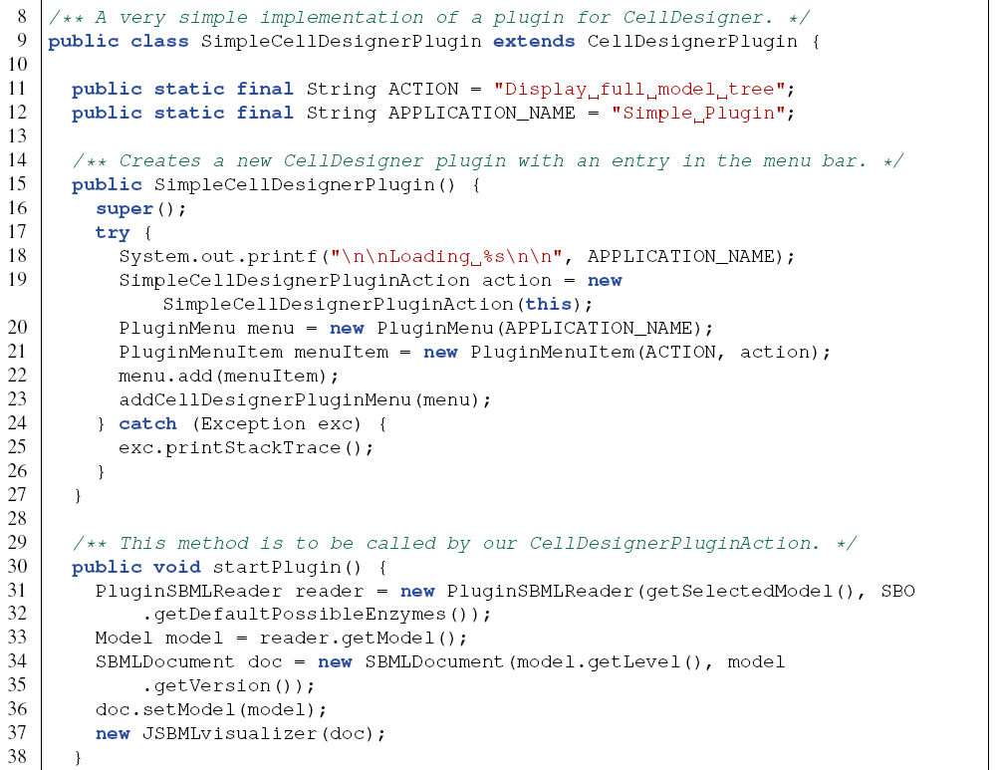
CellDesigner module: Example for a CellDesignerPlugin

Slide 21
Some more details

Slide 22
XML parsing
/jsbml-trunk/resources/org/sbml/jsbml/resources/cfg/PackageParserNamespaces.xml
/jsbml-trunk/resources/org/sbml/jsbml/resources/cfg/SBMLCoreElements.xml
Then each SBase has a readAttributes and writeAttributes methods that take care of reading and writing the attributes of the element.
The parsing is done in:
org.sbml.jsbml.xml.stax: main entry point of the parsing, using Stax.
org.sbml.jsbml.xml.parsers: parser independent of the underlying XML parsing library used.

Slide 23
How to contribute
Creating a patch:
Checkout the sources from sourceforge
svn co “https://jsbml.svn.sourceforge.net/svnroot/jsbml/trunk jsbml“ JSBML
Do your modifications, then create a patch file:
svn diff > jsbml-patch.txt
Attach it to a tracker item or send it through the development list.
Bug tracker: http://sourceforge.net/tracker/?group_id=279608&atid=1186776
Mailing lists:
jsbml-development@caltech.edu: public list with discussion about the development of JSBML and support for users.
jsbml-team@caltech.edu: private list for the JSBML team were anybody can send mails for support or bugs reports.

Slide 24
Thanks http://sbml.org/Software/JSBML
Publication under review:
Andreas Dräger¹, Nicolas Rodriguez², Marine Dumousseau², Alexander Dörr¹, Clemens Wrzodek¹, Nicolas Le Novère², Andreas Zell¹, and Michael Hucka³. JSBML: a flexible Java library for working with SBML. Submitted to Bioinformatics, March 2011.
All examples in this presentation will be made accessible on the web site.
¹Center for Bioinformatics at the University of Tuebingen (ZBIT), Germany
²European Bioinformatics Institute (EBI), Hinxton, United Kingdom
³California Institute of Technology, Pasadena, California, United States

